Slide 1
Animal Yoga
Every animal has a sacred gift for humans to learn. Animal poses can help us to connect with powerful aspects of the soul that we often repress in our busy lives. Before coming into an animal pose, it can be helpful to imagine what it feels like to be that animal. Try to envision where the animal lives, how its body moves, how it eats, and how it plays.
*Sanskrit names come from India. Bonus points to whomever can read the Sanskrit name!

Slide 2
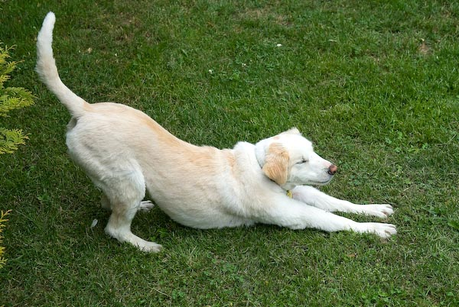
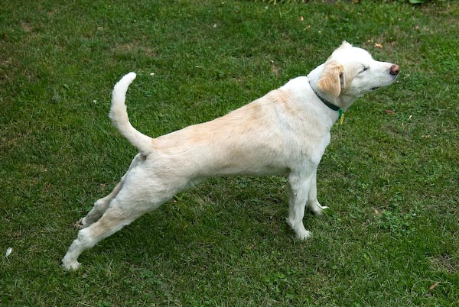
Dog
What do you think a dog yoga pose
looks like? Why?

Slide 3
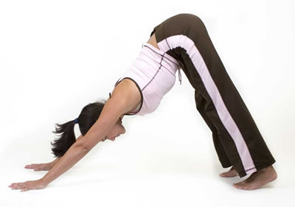
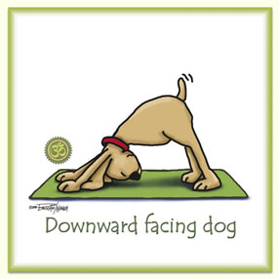
Downward Facing Dog – Adho Mukha Svanasana
Start laying down. Feet flat on the floor. Arms straight. Palms on the ground. Face downwards.

Slide 4
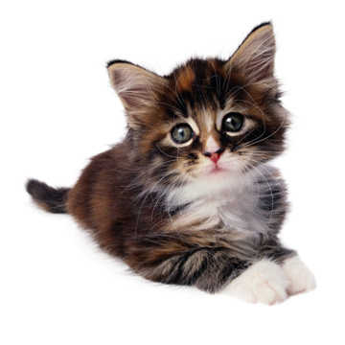
Cat
What do you think Cat Pose looks like? Why?

Slide 5
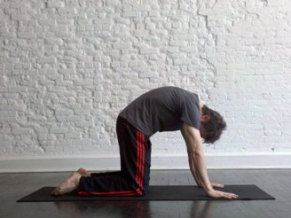
Cat Pose - Bidalasana
Shins flat on the floor. Palms pressed into the group. Back arched and head down.

Slide 6
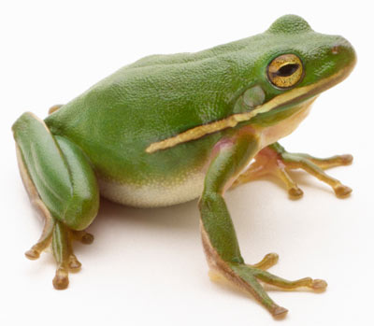
Frog
What do you think Frog Pose looks like? Why?

Slide 7
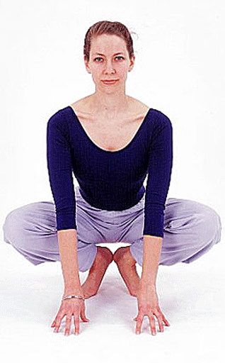
Frog Pose - Bhekasana
Crouch down. Place hands on ground.
Challenge: Pick hands up and balance!

Slide 8
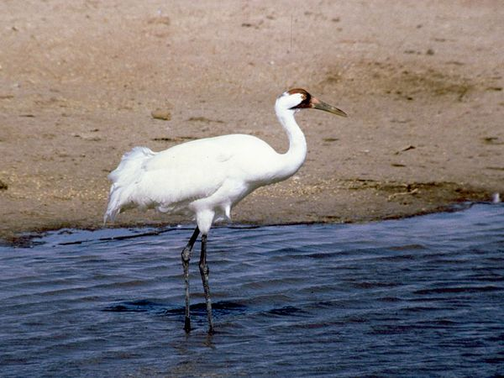
Crane
What do you think Crane Pose looks like? Why?

Slide 9
Crane Pose - Bakasana
Palms flat on floor. Balance on hands while picking legs up. Rest knees on shoulders.

Slide 10
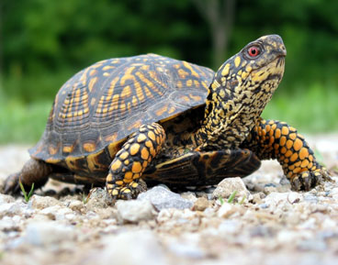
Turtle
What do you think Turtle Pose looks like? Why?

Slide 11
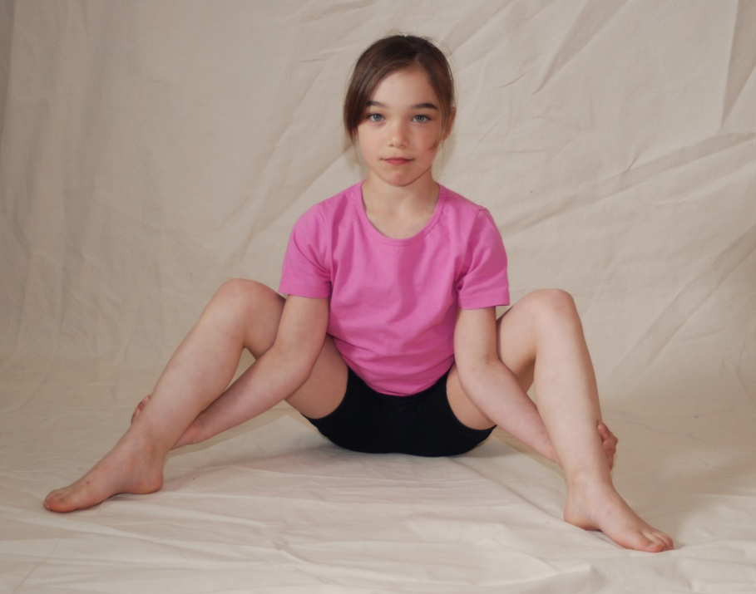
Turtle Pose - Kurmasana
Wrap your arms around your legs. Grab your ankles. Keeping legs straight, bend forward and lay your upper body against the floor.

Slide 12
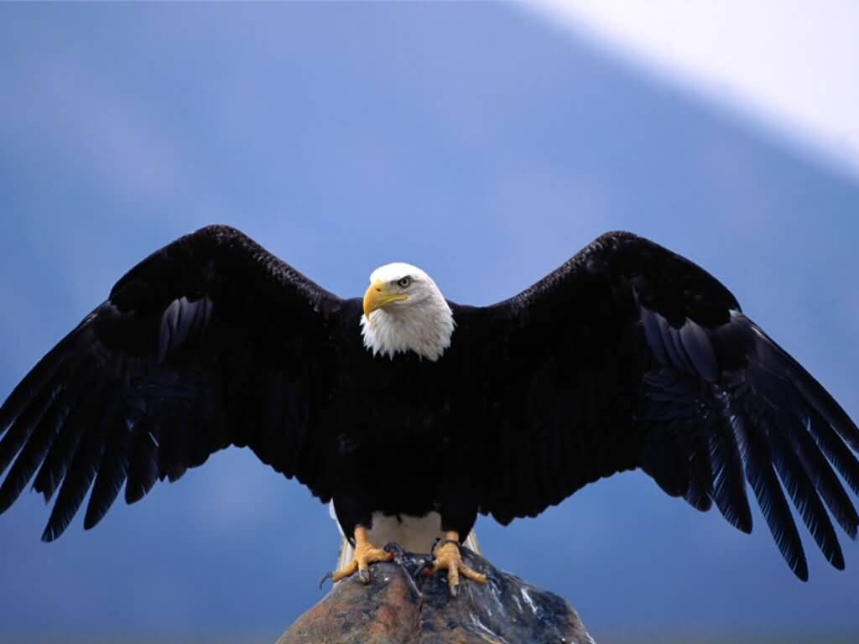
Eagle
What do you think Eagle Pose looks like? Why?

Slide 13
Eagle Pose - Garudasana
Cross your arms and legs. Balance on one foot. Hands together. Stare straight ahead.

Slide 14
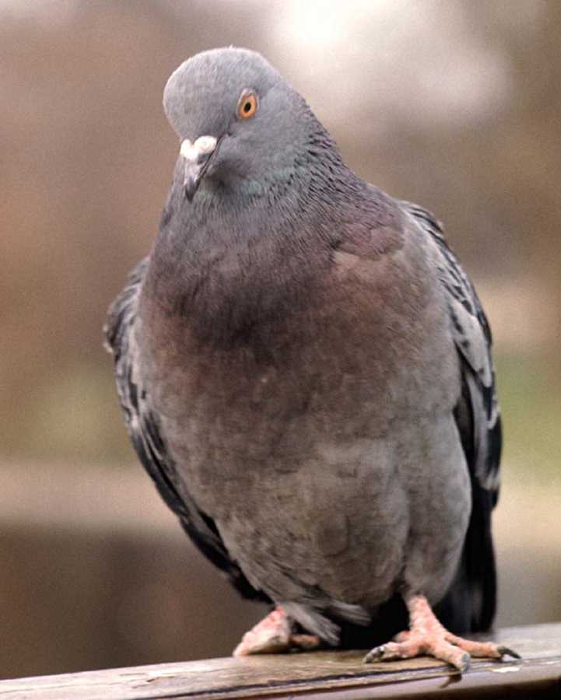
Pigeon
What do you think Pigeon Pose looks like? Why?

Slide 15
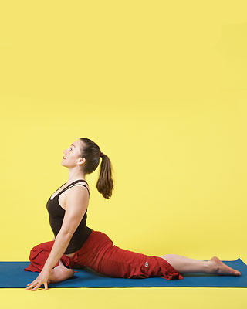
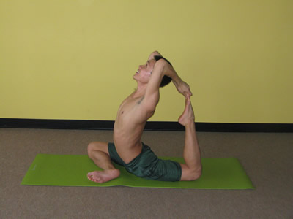
Pigeon Pose – Eka Pada Rajakapotasana
One leg flat behind you. Other leg bending in. Push your chest up and look up.
Challenge: Try to grab your foot!

Slide 16
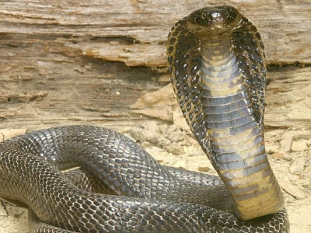
Cobra
What do you think Cobra Pose looks like? Why?

Slide 17
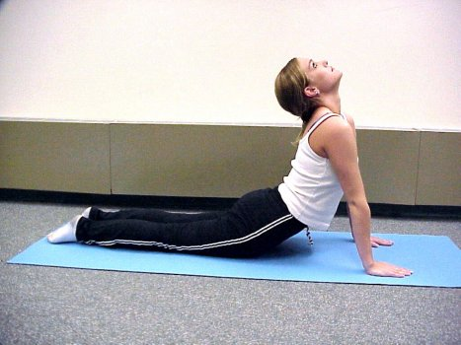
Cobra Pose - Bhujangasana
Lay flat on the floor. Push your upper body up with your arms. Belly off the floor. Head looking up high.

Slide 18
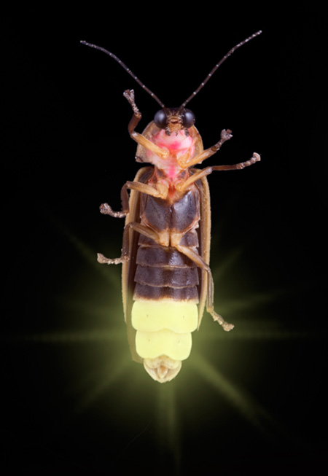
Firefly
What do you think Firefly Pose looks like? Why?

Slide 19
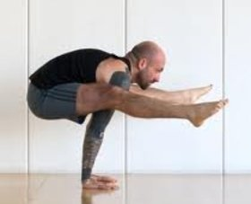
Firefly Pose – Tittibhasana
Start sitting down with legs out. Place hands on ground. Push yourself up. Try to rest legs on shoulders.

Slide 20
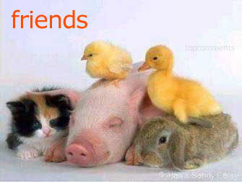
Create your own!
In your small groups, think of an animal we did not learn about. Create a new animal yoga move. Be careful! Be creative! ☺

