Slide 1
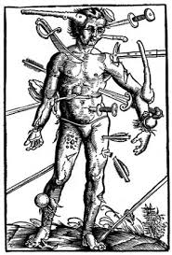
An Injury to the soft tissue
Wounds

Slide 2
Closed Wound
The skin surface has not been broken
Damage happens below the skin’s surface

Slide 3
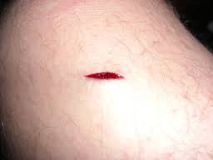
Open Wound
Skin’s surface is broken and blood may come through the tear in the skin
Most bleeding you encounter will not be serious
Wounds will cause the a blood vessel to tear, but the blood at the wound will soon clot and stop flowing

Slide 4
Open Wounds
Sometimes, however, the damaged blood vessel will be too large or the pressure too great for the blood to clot.
This can be life threatening
This can be the case for both open and closed wounds

Slide 5
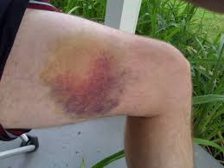
Closed Wound
Bruise – simplest closed wound where blood and other fluids seep into surrounding tissues, causing the area to swell and change colors

Slide 6
Closed wound care
I.C.E.
Ice
Periods of 20 minutes
Compression
Decreases bleeding beneath skin
Elevation
Do not elevate if it causes more pain

Slide 7
Signals of Internal bleeding
Tender, Swollen, bruised or hard area of the body, such as the abdomen
Rapid, weak pulse
Skin feels cool or moist or looks pale or bluish
Vomiting blood or coughing up blood
Excessive thirst
Becoming confused, faint, drowsy or unconscious

Slide 8
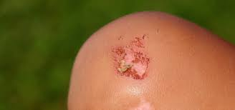
Abrasions
Most common type of open wound
Often cause by rubbing roughly against the skin
Don’t bleed very much
Sometimes called:
Scrape, rug burn, road rash, strawberry
Can be painful because the nerve endings are exposed

Slide 9
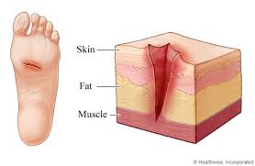
Laceration
A cut in the skin - commonly caused by a sharp object or when a blunt force splits the skin
Deep lacerations can cut the fat and muscle damaging both the nerves and blood vessels

Slide 10
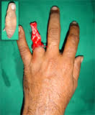
Avulsion
Injury which a portion of the skin and sometimes other soft tissue is partially or completely torn away
Bleeding is usually significant

Slide 11
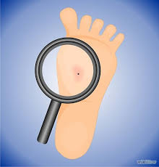
Puncture
Wounds usually cause by a pointed object – a gunshot wound is a puncture wound.
Usually not much bleeding unless blood vessel has been injured
If object remains in the wound it is called an “embedded object”

Slide 12
Care for open wounds
All open wounds need some type of covering to prevent infection
Dressings
Pads placed directly on the wound to absorb blood and other fluids
Most are porous to allow air in

Slide 13
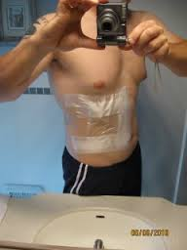
Occlusive dressing
Bandage or dressing that closes the wound and prevents it from being exposed to air
This helps prevent infection
Chest and abdominal wounds

Slide 14
Bandages
Material used to wrap or cover any part of the body
Used to:
hold dressings in place
to apply pressure to control bleeding
provide support
to prevent infection

Slide 15
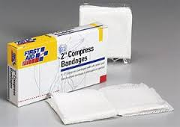
Types of bandages
Adhesive Compresses
Small nonstick gauze on adhesive tape
Minor wounds
Bandage Compresses
Thick gauze – tied in place
Help control severe bleeding
Roller Bandages
Made of gauze or gauze-like material

Slide 16
General Guidelines for roller bandages
Check for feeling, warmth and color or area
Secure the end of the bandage in place with a turn of the bandage
Do not cover the fingers or toes
Apply additional bandage if blood soaks through first bandage
Do not remove first bandage

Slide 17
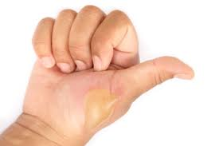
burns
Classified by their sources and depth:
Chemical
Electrical
Radiation
Superficial (1st degree)
Partial thickness (2nd degree)
Full thickness (3rd degree)

Slide 18
Critical Burns
Person has:
Trouble breathing
Burn covers more than one body part and a large surface
Suspected burns to their airway. (Mouth and nose may be signs of this)
Burns to the head, neck, hands, feet or genitals
Full thickness burn and is younger than 5 or older than60
A burn resulting from chemicals, explosions or electricity

Slide 19
Burn Care
Check scene for safety
Remove person from the source of the burn
Check for life-threatening conditions
Cool with large amounts of cold running water
Cover loosely with sterile dressing
Treat for possible shock

Slide 20
Do Not!!
Apply ice or ice water
Touch with anything other than clean covering
Remove clothing stuck to burn area
Try to clean a severe burn
Break blisters
Use any kind of ointment on a severe burn

Slide 21
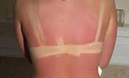
Degrees of Burn
1st Degree – Superficial
Involves top layer of skin – the skin is red, dry and usually painful
Healing time – about 1 week

Slide 22
Degrees of Burn
2nd Degree
Involves the top layer of skin – skin red, usually painful and has blisters
Healing time – 3 to 4 weeks

Slide 23
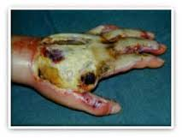
Degrees of Burn
3rd Degree
May destroy all layers of skin and some or all the underlying structures – fat, muscles, bones and nerves.
Can be extremely painful or not at all
Healing time – months to years

Slide 24
Chemical Burns
Remove any clothing that has chemicals on in
Flush with water for 20 minutes or until EMS arrives

Slide 25
Electrical Burn
Never go near a person unless power has been shut off
Be Prepared to start CPR
Care for shock and thermal burns

Slide 26
Wounds –
SPECIAL SITUATIONS

Slide 27
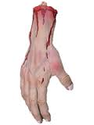
Severed Body Parts
Call 9-1-1
Wrap in sterile or any clean cloth
Put in plastic bag
Keep cold but don’t freeze

Slide 28
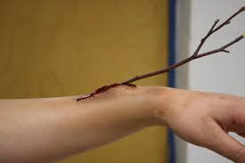
Embedded Objects
Do not remove it
Place several dressings around it to keep it from moving
If only a small splinter – remove with tweezers

Slide 29
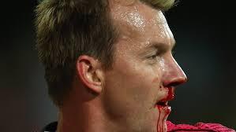
Nose Injuries
Have person sit with head tilted slightly forward
Pinch nostrils together for about 10 minutes
Ice to the bridge of the nose
Pressure just above the lip

Slide 30
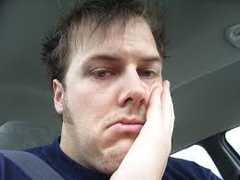
Mouth Injuries
Have head tilted forward to allow any blood to drain from the mouth
May cause breathing problems if blood or loose teeth block airway

Slide 31
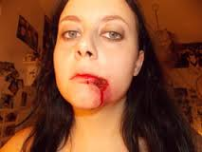
Lip injury
Place rolled gauze between the lip and gum

Slide 32
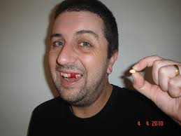
Tooth Injury
Have them bite down on something to maintain pressure
Save the tooth – place in milk if possible
Dentist within 30 minutes

Slide 33
Chest Injury
Leading cause of trauma deaths each year
Signs of serious chest injuries
Trouble breathing
Severe pain at site of injury
Flush, pale, ashen or bluish skin
Obvious deformity
Coughing up blood
Bruising at the site of a blunt injury
A “sucking” noise when the person breathes

Slide 34
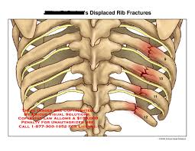
Rib Fractures
Rest in position that will make them more comfortable
Pillow of rolled towel make for a good way to immobilize the area

Slide 35
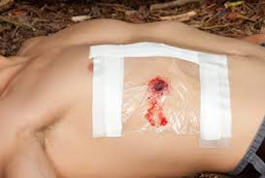
Puncture wounds to the chest
Considered a life-threatening injury
If injury penetrates the rib cage air can pass freely out of the chest cavity (Sucking Chest Wound)
https://www.youtube.com/watch?v=sfk6dqxMvNI

Slide 36
Sucking Chest Wound Care
Cover with a large occlusive dressing
Plastic wrap or plastic bag folded several times can be used
Tape into place – one side should remain loose

Slide 37
Abdominal Injury - Signs
Severe Pain
Bruising
External Bleeding
Nausea
Vomiting (can contain blood)
Weakness
Thirst
Pain, tenderness or tight feeling in the abdomen
Rigid Abdominal Muscles
Other signs of shock

Slide 38
Abdominal Injury - Care
Call 9-1-1
Position them on their back with knees up **
DO NOT apply direct pressure or push in any protruding organs back in
Remove clothing from around the wound
Apply moist, sterile dressing loosely over wound then cover with a plastic wrap (if available)

