Slide 1
TN State Standards K-5 Physical Education
Teaching to Meet Grade Level Outcomes
Christine hollifield – Christine.hollifield@tn.gov
TINA HALL - TINA.HALL@MTSU.EDU
Alysia Jenkins – Alysia.Jenkins@mtsu.edu

Slide 2
Contributing Authors
Tina Hall: University professor, 18 years K-8 physical educator
Alysia Jenkins: University instructor, 15 years K-5 physical educator
Elementary Physical Educators:
Terry Bellenfant
Ben Griffey
Susan Heiser
Martha Hyder
Victoria Rettman

Slide 3
Reviewers
Jamie Harvey, UTC professor
Bob Kerlin, K-5 physical educator
TAHPERD 2015 convention attendees
Statewide physical education teachers

Slide 4
What is the purpose of elementary physical education?
What is the curriculum of elementary physical education?
Why do we still ask these questions?

Slide 5
Elementary Physical Education
Is not: busy, happy, good
Is not: games and activities
Is not: my comfort zone
Is not: indoor recess
Is: teaching for learning
Is: teaching for skill acquisition
Is: instilling skills, knowledge & confidence for a physically active lifestyle (now & future)

Slide 6
TN Physical Education Standards
Based on research, motor development, developmental appropriateness and input from experienced teachers
Based on a two or three day per week program meeting 30 minutes.
Reduction or expansion will be necessary based on your program.
It is recommended that standards be revisited in a school year. Most standards will require more than one class period for student mastery.
While standards are grade-specific, some skills, when developmentally appropriate, may be introduced as exploratory tasks in an earlier grade.

Slide 7
Elementary Standards Focus
Based on the tenants of skill acquisition, enjoyment, & success
Success is measured by
Achieving the outcomes (Mastery) OR
Improving movement competency (student growth)
Focus is on mature fundamental movement patterns
Based on a developmentally appropriate progression from introduction to maturation of the skill
Individual, partner, and small-sided games/practice tasks

Slide 8
How much time do you have?
5 days per week of physical education = 180 days
3 days per week of physical education = 108 days
2 days per week of physical education = 72 days
1 day per week of physical education = 36 days

Slide 9
36, 72, or 108 days to teach children everything they should know & be able to do…
Locomotor skills Kicking
Balance Volley, underhand
Weight Transfer Volley, overhead
Underhand throw Striking, short implement
Overhand throw Striking, long implement
Catching Movement concepts
Dribbling with hands Fitness
Dribbling with feet Personal responsibility

Slide 10
Formatting
Grades K-5 are divided into five components: Motor Skills (MS) Movement Knowledge & Application (MKA) Fitness & Physical Activity (FPA) Personal & Social Responsibility (PSR) Values Physical Activity (VPA)
Each component is divided into subcomponents
MS → locomotor, rhythms, nonlocomotor, manipulatives
MKA → concepts, analysis & strategies
FPA → fitness knowledge, PA & knowledge
PSR → responsibility, accepting feedback, cooperation, procedures and rules, safety
VPA → appreciation, challenge

Slide 12
Standards

Slide 16
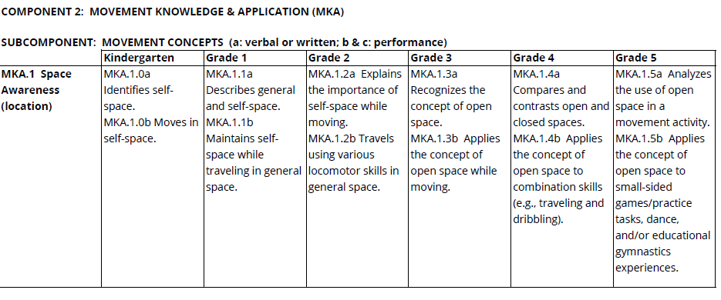

Slide 17
Supporting Documents
A glossary of terms
Suggested critical elements for the mature pattern of skills
Full K-12 standards:
http://www.tn.gov/assets/entities/sbe/attachments/7-22-16_III_F_Physical_Ed_Standards_Attachment.pdf

