Slide 1
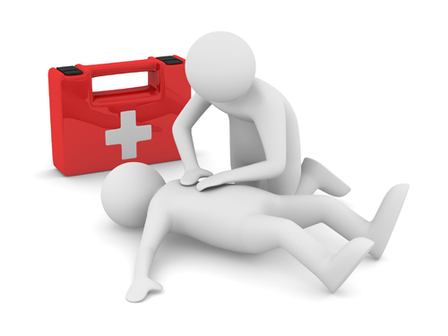
Let’s Create Lifesavers Together!
Angel Carter, BSN, RN
Project ADAM Middle TN Program Coordinator

Slide 2
To improve the sudden cardiac arrest survival rate beyond 10%, we must create cultures of prevention where youth live, learn and play

Slide 3
Sudden Cardiac Arrest: A Public Health Crisis
#1
#2
Nine out of Ten
356,000
7,000
Double or Triple
Black vs White
Male vs Female
69.5%
Notes:
AHA 2019 Heart and Stroke Statistics--#1 killer of our student athletes and the #2 medical cause of death among youth under age 25 ; 356,000 people, including 7000 children, per year experience an out-of-hospital SCA; 9 out of 10 die; immediate intervention can double or triple survival; the location of an OHCA in adults and children is most often in the home (69.5%--children broken down by age groups); The incidence of cardiac arrest was higher among blacks than among whites and among males than among females.

Slide 4
U.S. CPR Training Statistics
The median annual CPR training rate for U.S. counties was 2.39%.
Training rates were lower in rural areas, areas with high proportions of black or Hispanic residents, and counties with lower median household incomes.

Slide 5
Disparities exist for our students
African-American children who live in disadvantaged neighborhoods are approximately half as likely as white children in affluent areas to receive bystander CPR after an out-of-hospital cardiac arrest (OHCA), a new analysis finds.
Neighborhood risk factors include an African-American population greater than 80%, a high school graduation rate of less than 80%, unemployment above 10%, and a median annual income that is less than $50,000. With each increase in the number of risk factors, an African-American child’s likelihood of receiving bystander CPR declined appreciably, resulting in CPR for less than one-third of children in the most challenged communities.
Notes:
https://www.tctmd.com/news/race-wealth-and-neighborhood-predict-bystander-cpr-children

Slide 6
Disparities exist (continued)
Compared with white children, Hispanic children and children of other races/ethnicities were less likely to receive bystander CPR after an OHCA.
Neighborhoods with more high school age persons displayed the lowest survival. We discovered a significant disparity in OHCA survival within neighborhoods of low-income, black-predominance, and low-education. Reduced survival was seen in neighborhoods with larger populations of high school students
As expected, the lowest rates of CPR training occurred in neighborhoods that were rural, low-income, and minority-predominant. Altogether, this is consistent with lower survival rates in rural, low-income, and minority-predominant neighborhoods, most likely due to lower incidence and poor performance-quality of bystander CPR, which is likely worsened by reduced CPR training.
Notes:
https://www.tctmd.com/news/race-wealth-and-neighborhood-predict-bystander-cpr-children; https://www.ncbi.nlm.nih.gov/pmc/articles/PMC4917693/;

Slide 7
“It’s especially tragic if children are dying of cardiac arrest because of their zip code.”

Slide 8
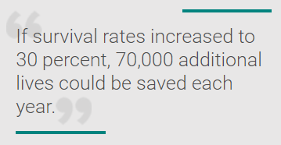
What we know…
The chances of survival from sudden cardiac arrest decrease by 10 percent each minute after onset, which is why it is so important for bystanders to act quickly.
Calling 911, starting CPR, and using the nearest AED can mean the difference between life and death for victims of sudden cardiac arrest

Slide 9
2017 Tennessee Code Title 49 - Education Chapter 6 - Elementary and Secondary Education Part 12 - Junior and Senior High Schools -- Curriculum § 49-6-1208. Cardiopulmonary resuscitation (CPR) program for junior or senior high schools curriculum.
Key Points
All students should participate in this introduction at least once during their attendance in junior or senior high school.
It is not the intention of this section to require full certification in CPR. It is the intention of the section that students will learn the techniques and practice the psychomotor skills associated with performing CPR.
The program of instruction on CPR shall include instruction on the use of an automatic external defibrillator (AED) and location of any AED in the school, if the school has an AED or AEDs. If the school has an AED, the school shall conduct a CPR and AED drill so that the students are aware of the steps that must be taken if an event should occur that requires the use of an AED.

Slide 10
What can we do?
Increased training opportunities for students and families
Meet them where they are—church, youth rec leagues, etc.
A strong focus on Hands Only CPR simplifies training and time required
The population category of high school students should be a strong target for future CPR trainings
Consider starting in middle school— “slightly older age bracket of 12 to 14 year olds, significant proficiency with CPR skills was demonstrated 4 weeks after training”– “In another study, 13 to 14 year olds performed chest compressions on the level of adults”
We can hopefully close the gap by targeting whole high school populations of students!
Notes:
https://www.ncbi.nlm.nih.gov/pmc/articles/PMC4917693/

Slide 11
Increased Training Opportunities
Students—athletic team drills letting the students participate, invite parents to observe, provide brief huddle afterwards (video here)
If involved in youth rec leagues, offer several FREE CPR and AED training sessions for parents and coaches
If involved in a church, help facilitate CPR and AED trainings there
If involved in neighborhood programs (ie, Boys Clubs, neighborhood carnivals or events, swimming pools, etc) offer FREE Hands Only CPR and AED trainings
Think of ways to enlist student support-HOSA, Health Science Academy projects, flash CPR events at ½ time of HS games, CPR booth at school Health Fairs, etc.

Slide 12
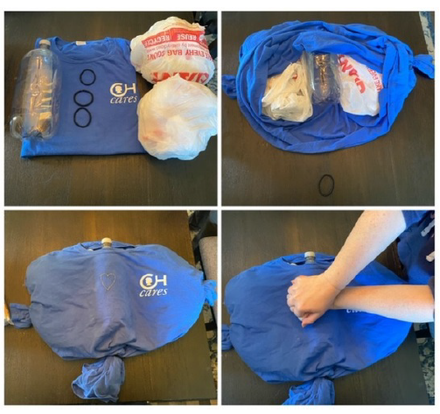
Strong Focus on Hands Only CPR with AED training
Saves time, which is money for most people
No fee required for certification cards
Can be covered in a class period
Many YouTube videos about AEDs can facilitate this training—(PA video here)
Can make DIY manikins if lack of equipment is issue

Slide 13
Involving Students in AED drills
All school gatherings (show video here)
Conduct AED drills in classrooms after preparing students
Conduct AED drills in hallway and invite nearby classes to quietly attend and observe with debriefing afterwards
Conduct AED drills in PE class and have students sit in bleachers
Anyone already doing this?

Slide 14
What about students as emergency responders?
Advantages—
They have firsthand knowledge of physical structure of building
Often have more social clout with their peers than teachers
When they have ownership in response, they develop a sense of pride and community
They are modeling leadership for their peers
Roles could include AED retrieval, crowd control, EMS direction, documentation
Anyone already doing this?

Slide 16
Low income, rural and ethnically diverse neighborhoods have lowest rate of bystander CPR
Median annual CPR rate for U.S. counties is 2.39%
Let’s challenge each other to be part of the change…creating our future generation of lifesavers instead of helpless bystanders
Ultimate goal, be part of the movement of doubling or tripling the current 10% survival rate in the U.S.

Slide 17
Watch ETCH video to close it up!

Slide 18
Contact Project ADAM for support
Middle Tennessee
Angel.carter@vumc.org
West Tennessee
rmiller@etch.com
East Tennessee
hopefully coming soon

