Slide 1
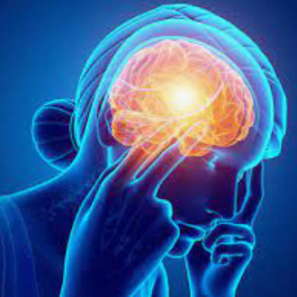
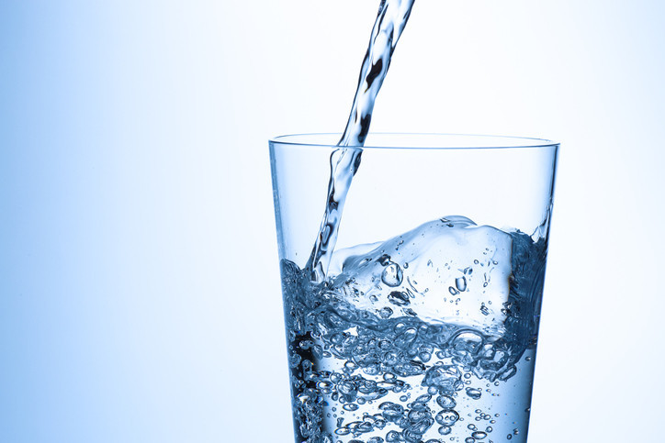
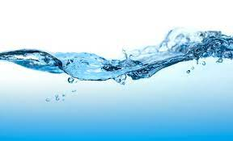
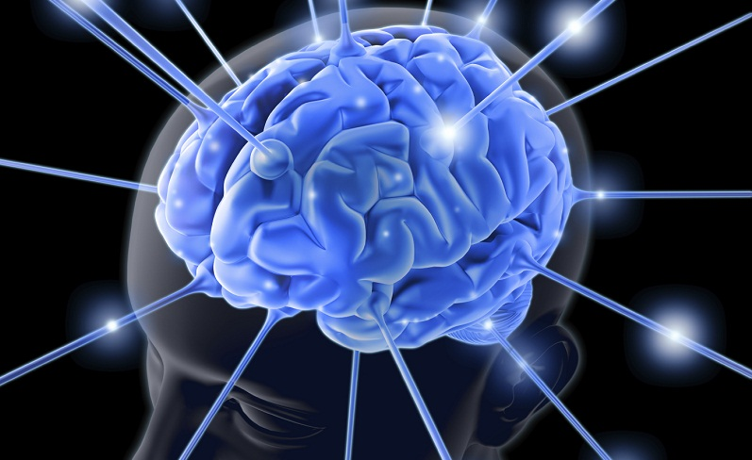
Why staying hydrated is important
Makayla Bullock

Slide 2
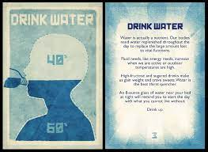
1 Flush toxins and prevent illness
Even though your kidneys naturally filter out the waste in your body, they need to have water to be able to do so.
Water reduces inflammation, prevents joint disorders, and improves cartilage health.

Slide 3
2 Improve skin complexion
Skin cells are made up of water, and if the skin does not receive hydration, it can become dry, tight, flaky, and a higher chance of wrinkles.

Slide 4
3 Increase energy levels
After any type of exercise, it is important to rehydrate to replace loss of fluids.
Staying hydrated before and after exercise can also reduce fatigue, and improve endurance.
With a healthy amount of hydration, exercise can improve energy levels.

Slide 5
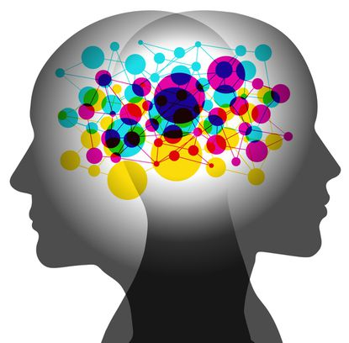
4 Boost cognitive functioning
A study conducted by psychologists at the university of Westminster and the University of East London found that drinking just 300ml of water can boost attention 25%.
People who drink more water perform better and faster over those who do not drink as much.
Dehydration can also lead to a short attention span, loss of memory functions, and irritability.

Slide 6
5 Improve mood
Dehydration is known for causing headaches and can result in having a negative effect on mood.
A simple glass of water can rehydrate your body and cause a more energetic mind and mood.

