Slide 1
Stay Fit & Active with Healthy Food | Eating Fit
Healthy Food

Slide 2
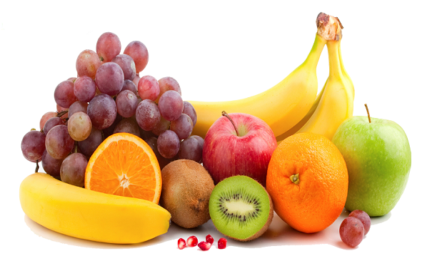
Introduction
A healthy diet is the backbone of a healthy life, it is all about eating food which has low calorie and has a high nutritional content. The body process will run smoothly to facilitate the proper functioning of the body parts.
Include loads of fresh fruits, vegetables, whole grains, and lean protein to stay healthy and to lose weight. A healthy diet rich in nutrients, vitamins, and proteins is sure to boost up the energy level.
It is very significant to get in touch with the dietitian and get a healthy diet chart. The final diet chart is prepared with keeping in mind all the vital parameter of your body so that the body gets the right food and have good health.

Slide 3
Interesting, right?
This is just a sneak preview of the full presentation. We hope you like it! To see the rest of it, just click here to view it in full on PowerShow.com. Then, if you’d like, you can also log in to PowerShow.com to download the entire presentation for free.

