Slide 1
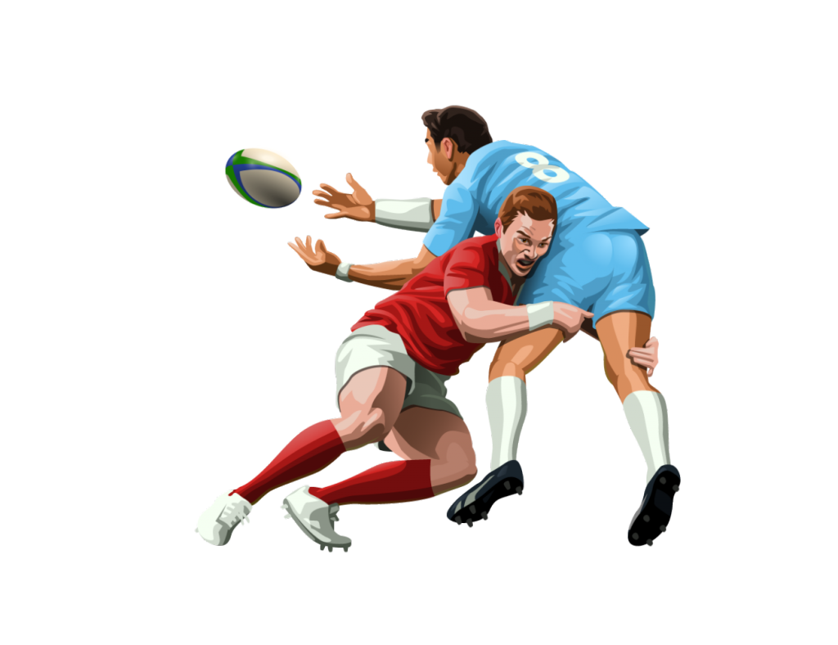
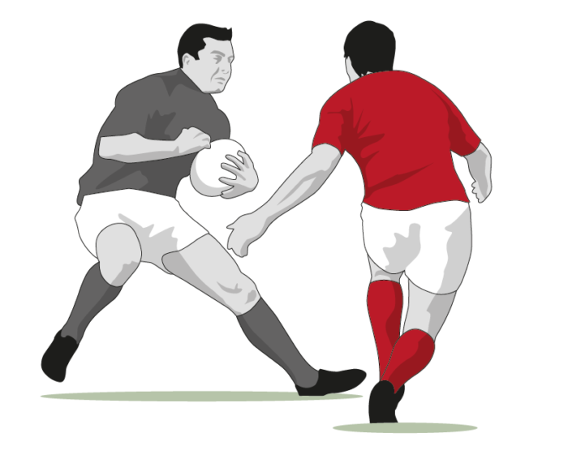
Rugby Resources Handbook The A – Z of Rugby
Teaching Points and points to consider when delivering Rugby Union in schools
@LouisMcPE

Slide 2
A - Accuracy
One of the crucial components of a team’s success in rugby is accurate passing
However accuracy is also crucial when kicking and tackling.
Be progressive –slowly build up movement with the ball, starting with walking rugby and possession games
Angles of pas are always changing with players in different positions.
Player of Note: Danny Cipriani
Key Teaching Points:
Soft hands
Composure
Static/moving

Slide 3
B - Ball Familiarisation
Prior Knowledge
Be progressive
Teaching Points
Use activation drills to allow pupils to become familiar with the shape and feel of the ball.
A Rugby ball is like no other, allow pupils time to explore its movement pattern.
Don’t implement strict rules from the get go
Control of the ball, following on from accuracy, reward consistent play, if at first someone knocks the ball on and the other team receives the ball, play on, use the moment to bring in the knock on rule.
Focus on short passing at first.

Slide 4
C - Continuity
Players maintaining/gaining possession of the ball.
Support players being in a position to help maintain possession of the ball.
Ball carriers keeping and making the ball available.
Decision making about where to attack next.

Slide 5
D - Delivery
‘Game Zones’ – Conditioned games that implement the skills practiced or lesson objectives
Skill Zones’ - Skill specific but engaging – If you co/team teach use the other teacher to deliver this at the same time as the game zone.

Slide 6
E – Evasion
Rugby is not a contact game. It is an evasion game.
Footwork and evasion skills are the “fine arts” – ways to run with the ball and beat players with skill, pace and panache
Allow your students to be creative in their evasion techniques
Three Key Areas:
avoid tackles
how you slip through defences
how you move opposition
Not everyone is the next Jonathon Joseph, however they can still be used to create space and create gaps.
Player of Note: Damian McKenzie

Slide 7
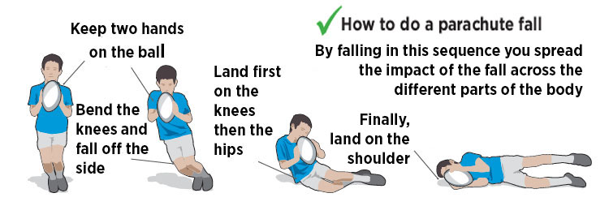
F – Falling Technique

Slide 8
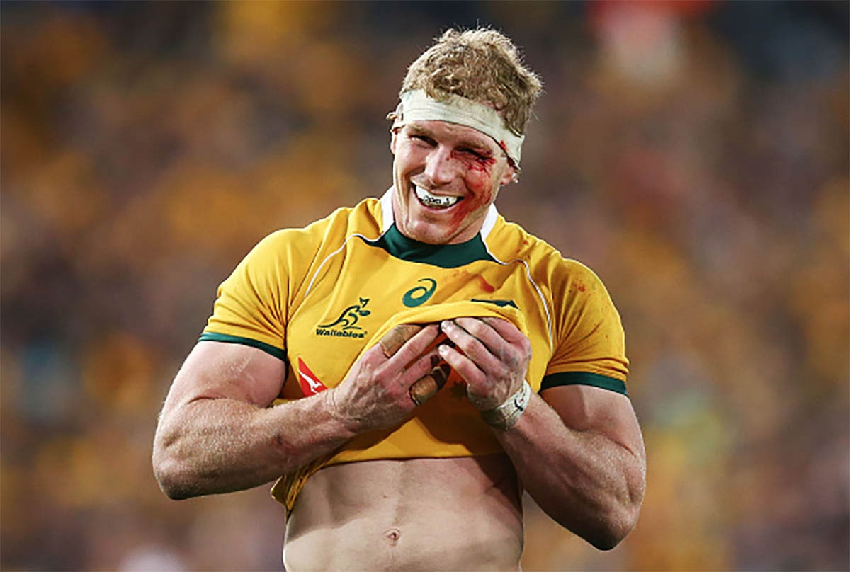
G – Grit
Be strong in body and mind
In a game situation every player must be "strong" on the ball and secure in contact. Your players must get into the mindset that they will never give away possession
Player of Note: David Pocock
Rugby is a hard game
In a game situation every player must be "strong" on the ball and secure in contact. Your players must get into the mindset that they will never give away possession

Slide 9
H – Handling
The safest pass
The ball carrier passes back to a supporting player whilst they are still on their feet. (The "pocket pass".)
Player of Note: Brian O’Driscoll
The least safe pass
The ball carrier falls over with the tackler and offloads the ball just before or whilst going to ground.

Slide 10
I - Inclusive
Rugby is inclusive and welcomes diversity at all levels.
World Rugby – “a sport for all, true to its values. We are a game for all shapes and sizes, genders, ages and abilities”
Differentiation is a key aspect when delivering any sport. However, rugby can bring a range of barriers to full participation and engagement.
Areas to consider | Potential Fix
Confidence | Move to confidence-based groups
Physical Impairment | Coaches, Referees, Performance analysts
Behaviour/Challenging students | Give control, use as referee, respect
Ability | Use superpowers

Slide 11
J - Judgement
Don’t overcomplicate things:
Laws
Foul Play
Well-executed basics can make the difference between finishing chances and missed opportunities.
The referee is the sole judge of fact and of law during a match.
The referee keeps the time. However, the match organiser may appoint a time-keeper who will signify the end of each half.
The referee keeps the score.
Anything a player does which is contrary to the letter and spirit of the Laws of the Game, including obstruction, unfair play, dangerous play and misconduct. The referee must sanction appropriately for foul play.
Player of note: Owen Farrell

Slide 12
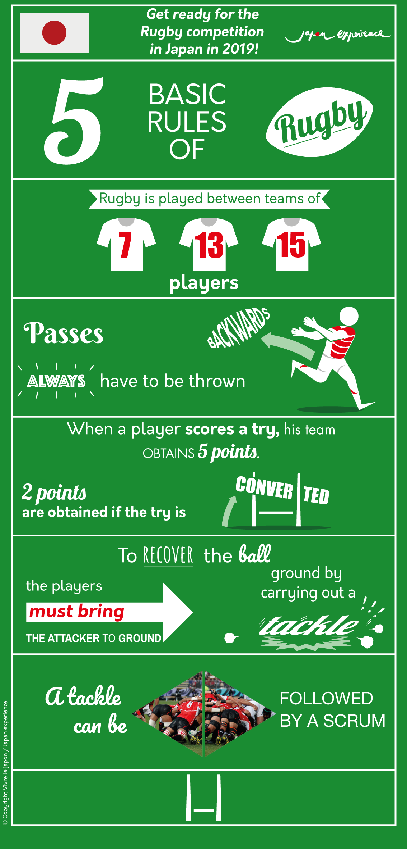
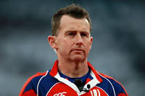
K - Knowledge
The team is split into two groups known as forwards and backs. There are 8 forwards (positions include Hooker, Prop, Second Row, Flanker and Number Eight) and 7 backs (positions include Scrum Half, Fly Half, Inside Centre, Outside Centre, Wingers and a Full Back).
Referee of note: Nigel Owens
The game must have one referee and two touch judges.

Slide 13
L - Leadership
Communication
effective communication isn’t just about one person talking: listening is key. Leaders need to listen to their teams, allow them to influence decisions, and encourage them to become part of the process.
Leading by example
A good captain will show, not tell.
Player of note: Richie McCaw
Learning and Unlearning
All pupils should learn from the past and their own experiences, but they should be open to new ideas. Learn from the team around you and be willing to change your mindset.
Passion and Pride
It may be as simple as “get the ball to the backs”. Success depends on everyone in the team understanding what the goal is, and how they play a part in the result. By setting clear expectations – what is a win, what is a failure, who’s responsible for what, what’s in scope – you will ensure the team works together in the same direction.

Slide 14
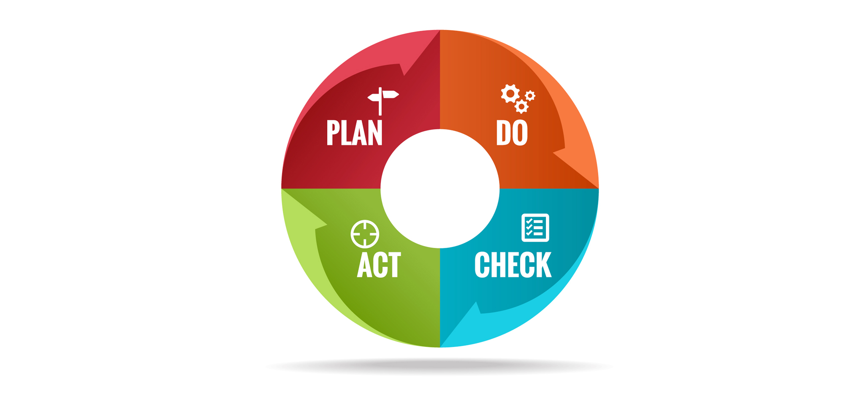
M – Management
The kick off – have a plan and be calm
Set the rhythm and move at your pace
Patience
Focus on what is going to happen in the first few plays. The first lineout, first backs move. Players can then move quickly into position in the helter-skelter of the first moments of the game.
Set the rhythm of the game by the way the team approaches the restarts. Slow things down by moving slowly to a set scrum or lineout, but then change the tempo later in the game by being in position before the opposition arrive, shouting the systems or calls to make the other team hurry up.
Winning teams are often patient teams. They have confidence in their plan and their ability to carry out the plan

Slide 15
N - Nuisance
The contest for possession of the ball is one of Rugby’s key features. These contests occur throughout the Game and in a number of different forms:
• in contact
• in general play
Player of note: Tom Curry
• when play is restarted at scrums, lineouts and kick offs.
Examples:
A team forced to kick for touch because of its inability to maintain the play, is denied the throw-in to the lineout.
Similarly, the team knocking the ball on or passing the ball forward is denied the throw-in at the subsequent scrum.

Slide 16
O – Offence
Open Play
Creativity
Offload
Attacking players must remain behind the ball whilst active or run the risk of being called offside. Players not interfering with play can be in front of ball but must get back behind the ball before then again interfering with play.
The best attack is one that the opposition struggles to read.
Be creative
Be confident
You need a weapon to unleash in those 1-on-1 scenarios. The side-step offers that with devastating efficiency – with no better example coming from Wales legend Shane Williams.
Avoiding the breakdown is a valuable facet of the game that is often ignored.
exploit space and ensure continuity and pace in play. Keep the ball alive as long as possible, and avoid the potential pitfalls of the breakdown.
Team of note: Japan 2019 World Cup

Slide 17
P - Protection
The most important piece of equipment is the mouthguard (gumshield). The RFU strongly recommend that mouthguards are worn for any contact rugby activity.
Boots are also of paramount importance to provide stability and firm contact with the ground

Slide 18
Q – Quality
Top quality possession: The ball carrier passes the ball before or out of the contact.
The measure of the quality of possession is how easy it is to "go forward" from it.
Poor quality possession: The ball carrier goes to ground with the ball (and a ruck is formed)

Slide 19
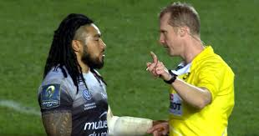
R - Respect
“Rugby is a hooligans game played by Gentlemen”
Players
Respect is at the heart of rugby.
Coaches
Referees
It is crucial that respect is rewarded. Having rewards for the most respectful player or most sportsmanlike performance is great to encourage this type of behaviour on and off the field.
Referee of note: Wayne Barnes

Slide 20
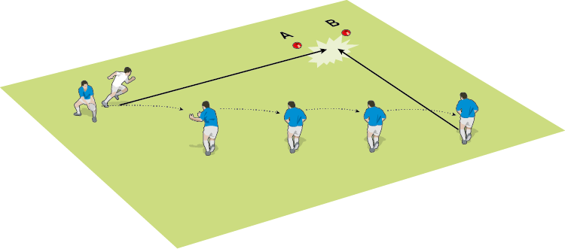
S - Support
Look after the ball: The ball carrier must keep the ball away from the opposition.
Stay on your feet: A player can only compete for the ball when they are on their feet. So your ball carriers must fight to stay on their feet to maintain possession.
Player of note: Antoine Dupont
They should only go to ground as a last resort and then only when they have enough support. Consequently, support players must be quick to support!

Slide 21
T - Tackling
Eyes on Thighs
Ring of Steel
Cheek to Cheek
Squeeze the knees
Player of note: Michael Hooper
When you tackle an opponent, you cannot make contact above the shoulders. This is for safety reasons.
The referee will instantly give a penalty
if he sees a high tackle, and a few stronger words may follow if the challenge is deemed dangerous.
Expect a yellow card and a spell in the sin-bin or a red card and instant dismissal for more serious offences.

Slide 22
U - Unconscious
Concussion awareness should be a key factor when delivering any form of contact sport and is often overlooked when delivering schoolboy rugby.
This does not mean look up bad concussions and show these to your class. Focus on tackle technique and head positioning, using poor head positioning as teaching point. Reiterate this as often as possible using freeze frames.
Below is a link for Age Grade Rugby – this will help you regarding what you want to achieve at each year group:
https://www.englandrugby.com//dxdam/fa/fa1dbfe2-9a2b-4171-9ee8-259313647fc5/AG%20Flyer%202019.pdf

Slide 23
V - Vision
Person with the most useful information. You have the ability to make the best decisions.
There are so many players, so much movement, so many options, so much space.
Have vision, show the way. You detect gaps, over-defended areas and under-defended areas. – aids evasion, offence and defence.
.
Player of note: Beauden Barrett

Slide 24
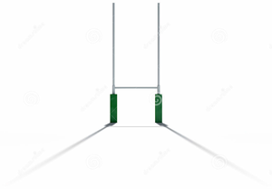
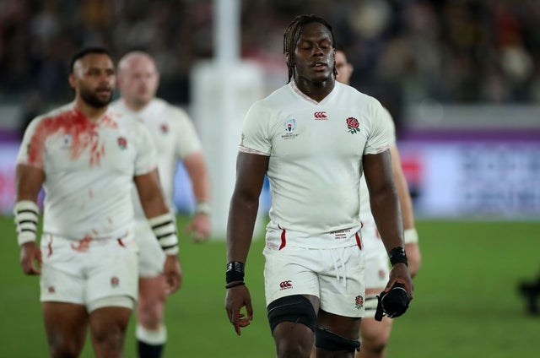
W – Winning
It is important that we teach pupils winning isn’t everything.
Learn from defeat
Improvise, adapt,
Overcome
Win humbly, lose gracefully.

Slide 25
X – Rugby X
A new five-a-side rugby format captured a new audience when it debuted at the O2 Arena in London.
This is great for small sided games, developing a plethora of skills and characteristics.
Can be used as full contact or touch rugby on a half size pitch.
Games at 10 minutes long.
Drawn matches are settled by a ‘one on one’ involving one defender on 5m line and one attacker 30m from goal with a ball. The attacker has 10 seconds to score. (This is great fun as an end of lesson game).
https://www.rugbyx.com/
https://youtu.be/1DQE9zrj1AE

Slide 26
Y – Yellow Card
If a player is shown a yellow card, they have to leave the pitch and spend the next 10 minutes in the sin-bin, giving the opposition 10 minutes to make use of their one-man advantage
A yellow card is presented for a variety of offences including persistent infringements, high tackles or dangerous play, foul play or a professional foul.

Slide 27
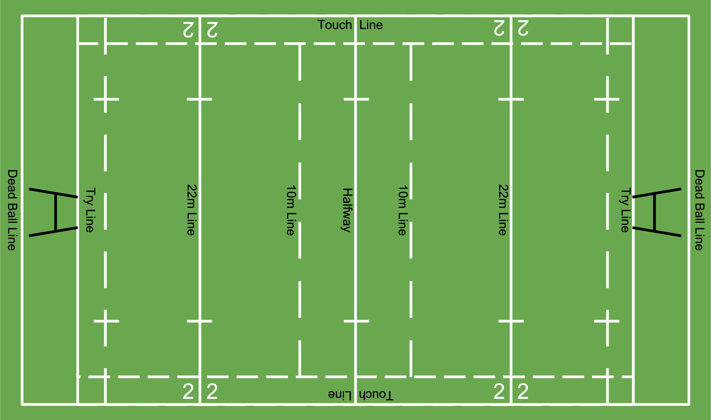
Z - Zonal Play
Knowing where and when to kick/run and pass is a key aspect when applying pressure to the opposition.
Some key laws:
22-metre drop-out. This is one of the methods used to restart play when the ball has gone over a team's dead ball line. ... Once the ball has been touched down, a player from the defending team can advance to the 22m line and restart play with a drop kick
Mark:
Calling a mark is a great way of relieving the pressure in defence when the opposition are on the attack inside the 22-metre line.
A player can only make the mark when they catch a high ball inside their own 22-metre or in-goal area.
As they catch the ball they shout "MARK".
If they catch the ball cleanly, the referee will give that player a free-kick on the spot where they caught the ball.

Slide 28
Useful Links for Further Support:
General guide
https://www.englandrugby.com/participation/playing/player-welfare-rugby-safe/essential-guides-and-resources
Concussion:
https://www.englandrugby.com/participation/playing/headcase
Protection:
https://www.englandrugby.com/participation/playing/player-welfare-rugby-safe/essential-guides-and-resources
Laws:
https://rugbyready.worldrugby.org/?section=1
Drills:
https://www.youtube.com/watch?v=XeEy9weR99o&list=PLz3WzYi2nLwziXbukUWHti7GkqBGPiAdT

