Slide 1
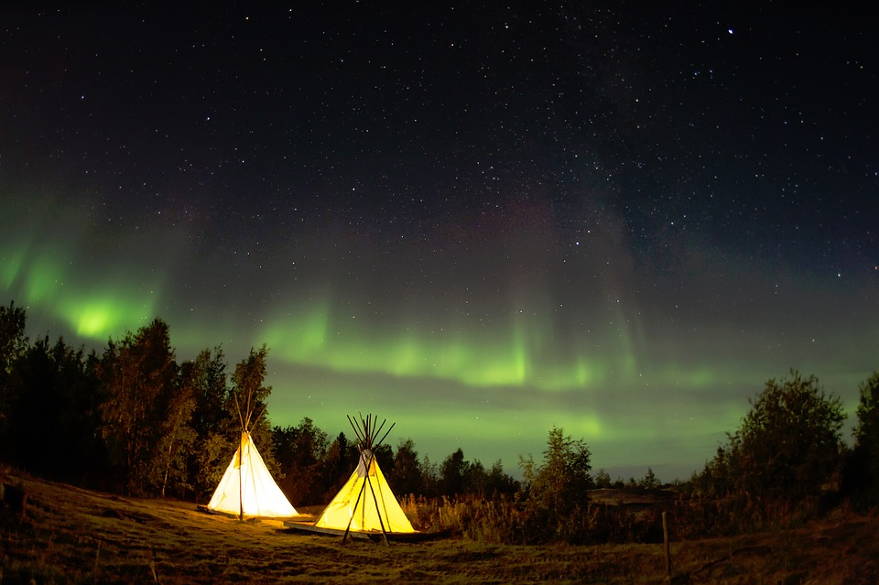
The Great Outdoors!
April 26-30, 2021

Slide 2
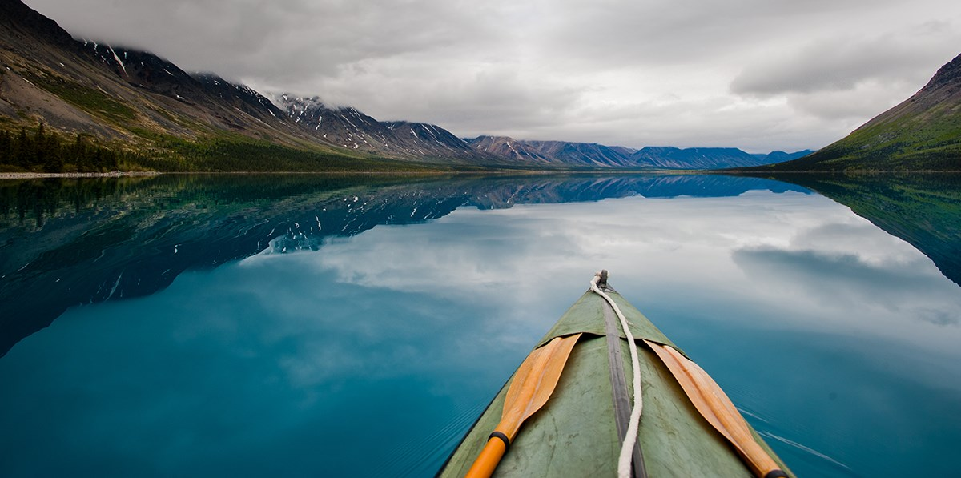
Learning Targets
I can work cooperatively with my small group.
I can correctly identify safe practices for various outdoor activities.
Notes:
Grades: K-4
Standards: FPA.2 Physical Activity
VPA.1 Appreciation
PSR.1 Personal Responsibility
PSR.3 Working with Others
PSR.5 Safety

Slide 3
Small Group Jobs
Leader - Reminds you where to go
Reader - Reads reflection questions
Cleaner - Makes sure your station is tidy before you leave
Reporter - Reports problems you need me to address
Notes:
Grades: K-4
Standards: FPA.2 Physical Activity
VPA.1 Appreciation
PSR.1 Personal Responsibility
PSR.3 Working with Others
PSR.5 Safety

Slide 4
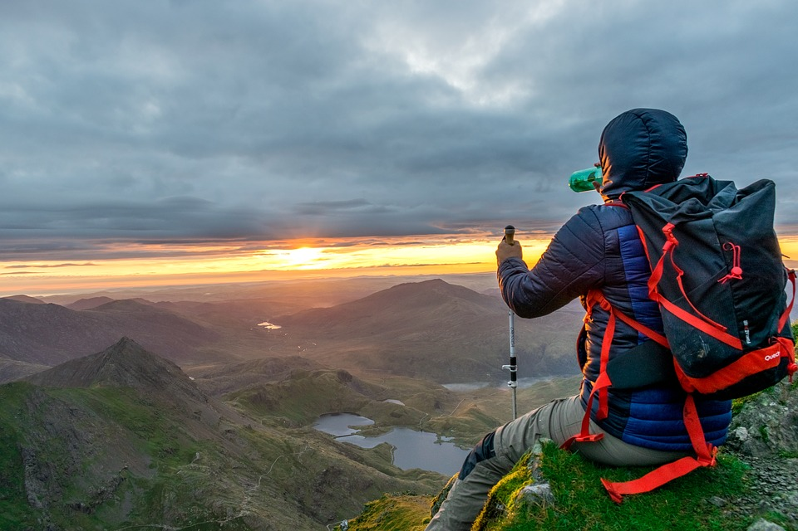
Land Safety Questions
How can you tell if a snake is venomous?
When hiking on a trail, what are some important safety rules to follow?

Slide 5
Land Safety Questions
How can you tell is a snake is venomous? The shape of its head: triangle=venomous; circular=non-venomous
When hiking on a trail, what are some important safety rules to follow? Always carry a whistle; bring a rain jacket; bring plenty of water to drink; wear bright colored clothing; wear appropriate shoes; always hike with a buddy

Slide 6
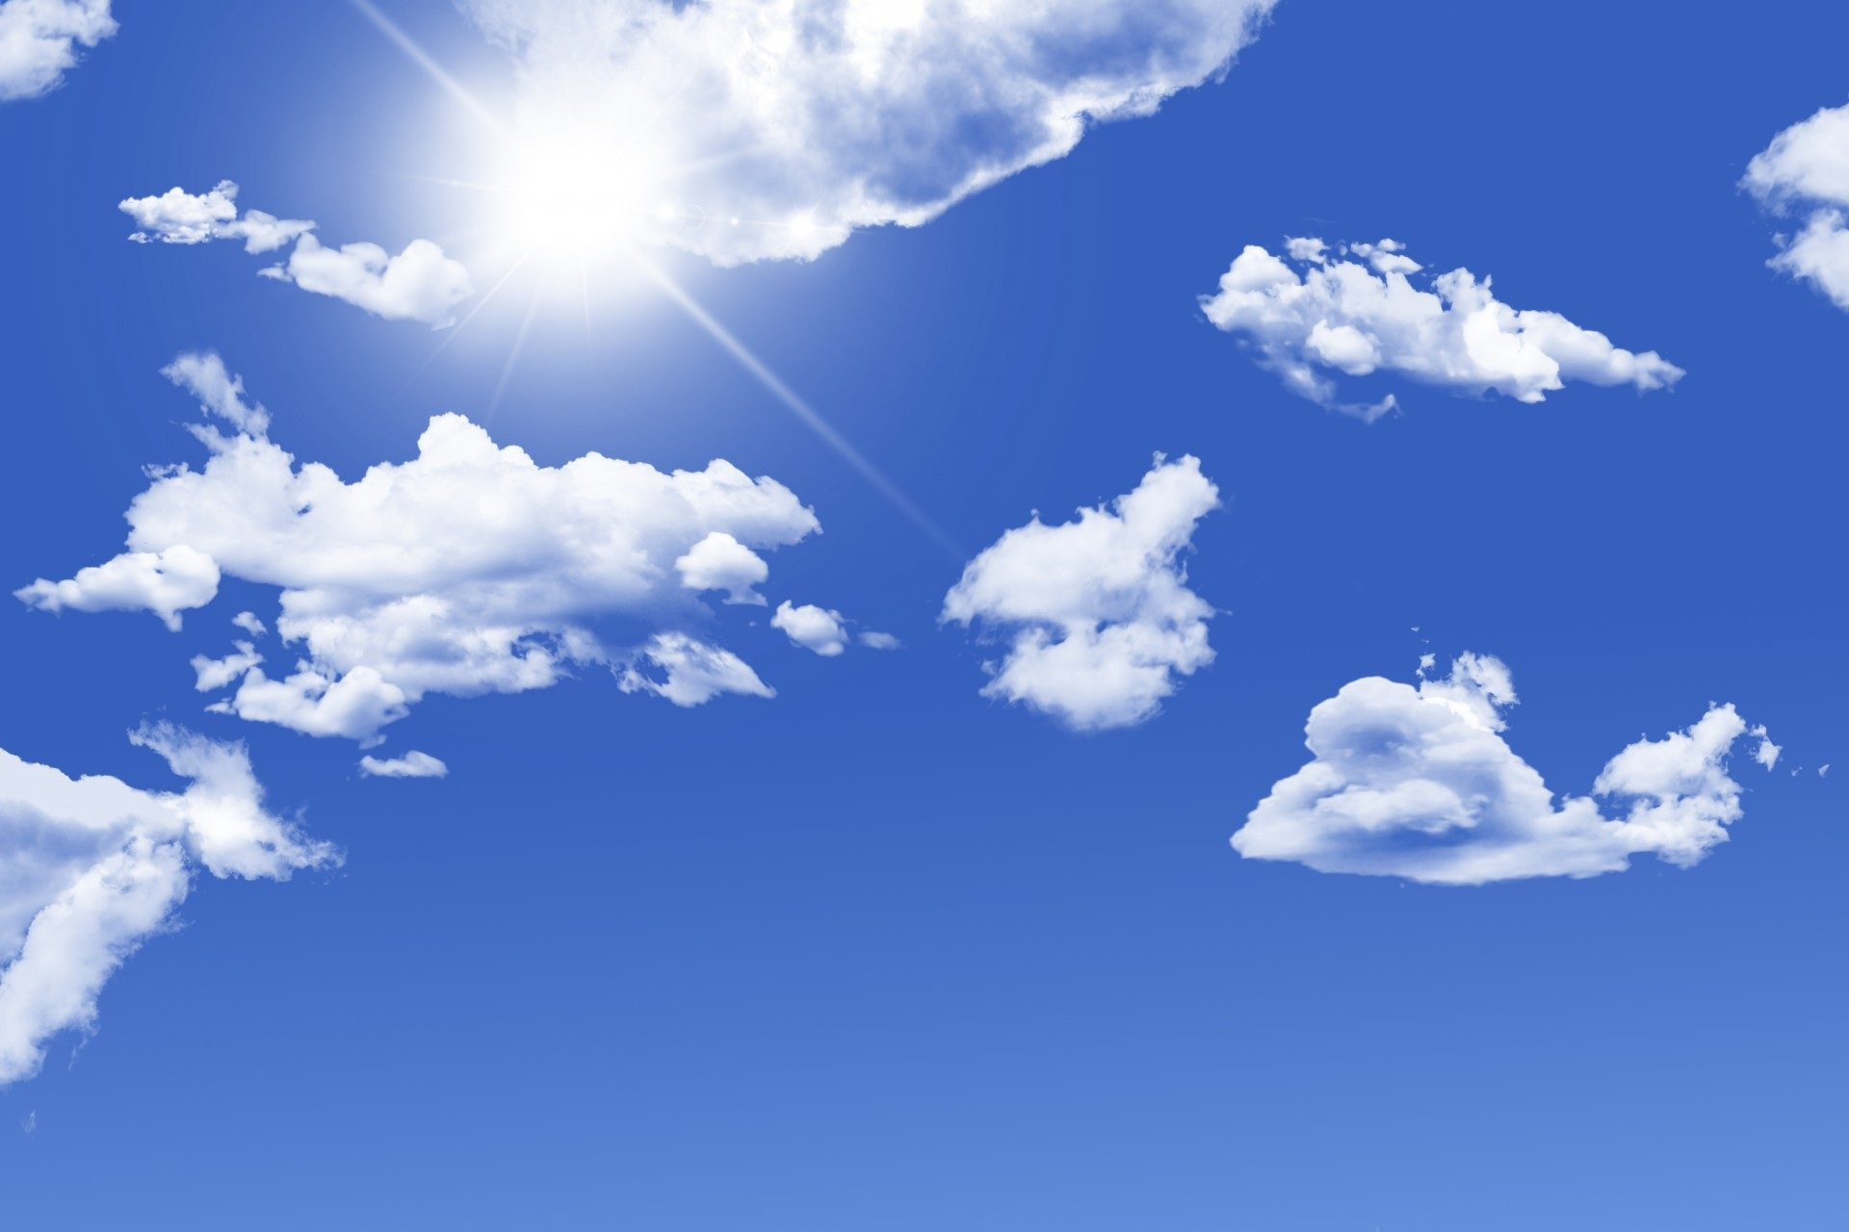
Sun Safety Questions
What does UV stand for?
Is it possible for you to get a sunburn on a cloudy day?
Name at least 3 ways to stay safe in the sun.

Slide 7
Sun Safety Questions
What does UV stand for? Ultraviolet
Is it possible for you to get a sunburn on a cloudy day? Yes; because the Ultraviolet Rays can pass through the clouds.
Name at least 3 ways to stay safe in the sun. Wear sunscreen; find some shade; wear protective clothing; avoid staying in the sun for too long; stay hydrated (drink lots of water)

Slide 8
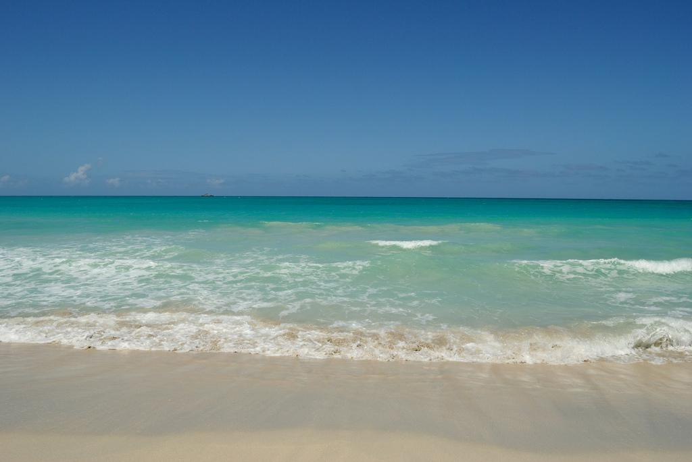
Water Safety Questions
All children under what age must wear a lifejacket when on a moving boat in Tennessee?
What are some ways to stay safe in and around the water?

Slide 9
Water Safety Questions
All children under what age must wear a lifejacket when on a moving boat in Tennessee? 12 years old
What are some ways to stay safe in and around the water? Never swim alone; don’t dive in shallow water; wear a lifejacket if you are at a lake or on a boat; don’t run around a pool; never enter someone’s backyard pool or hot tub without permission; get out of the water if you see lightning; take a break when you feel tired; follow lifeguards directions

Slide 10
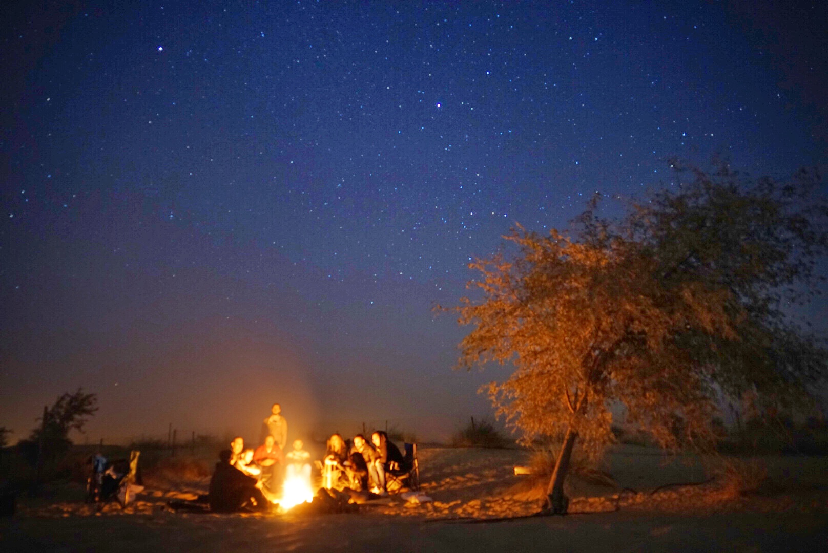
Camping and State Parks Questions
What are some ways to stay safe at a campsite?
Can you name at least one state park in West TN? Middle TN? East TN?

Slide 11
Camping and State Parks Questions
What are some ways to stay safe at a campsite? Always put out the fire before you leave; don’t leave food out that would tempt the animals; only camp in designated areas; always clean up your campsite before you leave
Can you name at least one state park in West TN? Meeman Shelby-Forest State Park Middle TN? Radnor Lake State Park East TN? Norris Dam State Park

Slide 12
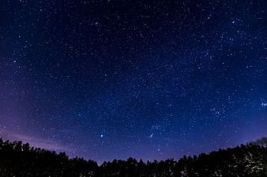
Additional Questions
Can you name at least one constellation that was NOT shown in the stargazing tent?
Can you name at least one fact you learned about caves in Tennessee?
How do you score points in cornhole?
What does the word “equine” mean? (Hint: Equestrian)
What was your favorite station? Why was it your favorite?

Slide 13
Stations
Campground 1 (smaller tent & fake s’mores)
Campground 2 (larger tent & grilling/picnic gear)
Canoeing / lazy river
Stargazing tent
Fishing
Caves
Swimming and water safety
Nature Walk / TN Map
Corn Hole
Equestrian Center

