Slide 1
ORIENTEERING

Slide 2
THINGS TO LEARN ABOUT
BENEFITS
SYMBOLS
COMPASS
MAPS
COLors
SPORT
ORIENTEERING

Slide 3
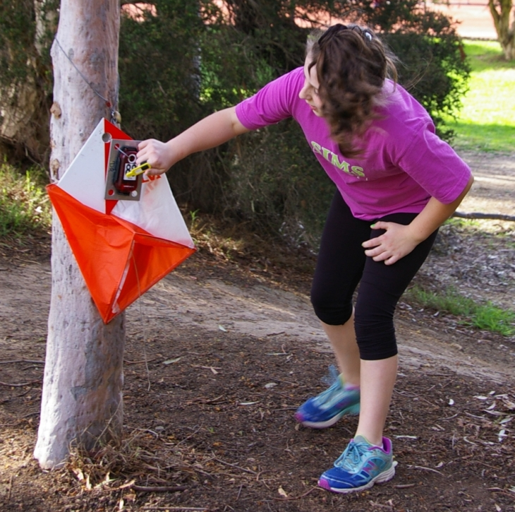
BENEFITS
Builds self-confidence
Provides mental challenges
Provides physical challenges
Mind
Body
Spirit

Slide 4
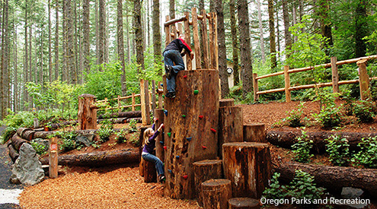
Body
Much higher levels of fitness
Stronger bones
Improved eyesight
Better sleep
A longer life span and healthier adult life
Notes:
Being outside can benefit the body by increasing fitness levels and developing healthy and active bodies. This is “an important strategy in helping the one in three American kids who are obese get fit.” Spending time outside also increases vitamin D levels that help protect children from future bone problems, heart disease, diabetes, and other health issues.(⁴NWF, 2018)
“In the last 20 years, the prevalence of obesity among young children aged 6 to 11 has more than doubled to 17 percent and more than tripled to 17.6 percent for adolescents aged 12-19.17 The odds of being obese are even higher in marginalized neighborhoods with few or no parks. Risks associated with overweight and obesity include high blood pressure, diabetes, high cholesterol, asthma, sleep apnea, joint pain, and fatty liver disease—and most alarmingly, shortened life expectancy” (⁴ NWF, 2018)
According to the National wildlife federation and an article by the Washington Post youth that have more “green time” than “screen time” benefits their body by:
Much higher levels of fitness→ they are participating in organized sports, hiking, breathing fresh air, and much more.
Stronger bones→ Exposure to natural light helps prevent vitamin D deficiency, making outdoorsy children less vulnerable to bone problems, cardiovascular disease, diabetes and other health issues.
Improved eyesight→ Time spent outdoors can help combat increasing diagnosis of nearsightedness
Better sleep→ Exposure to natural light, and lots of physical activity, help reset a child’s natural sleep rhythms.
A longer life span and healthier adult life (O’Mara, 2018)
→ Active kids are more likely to grow into active adults

Slide 5
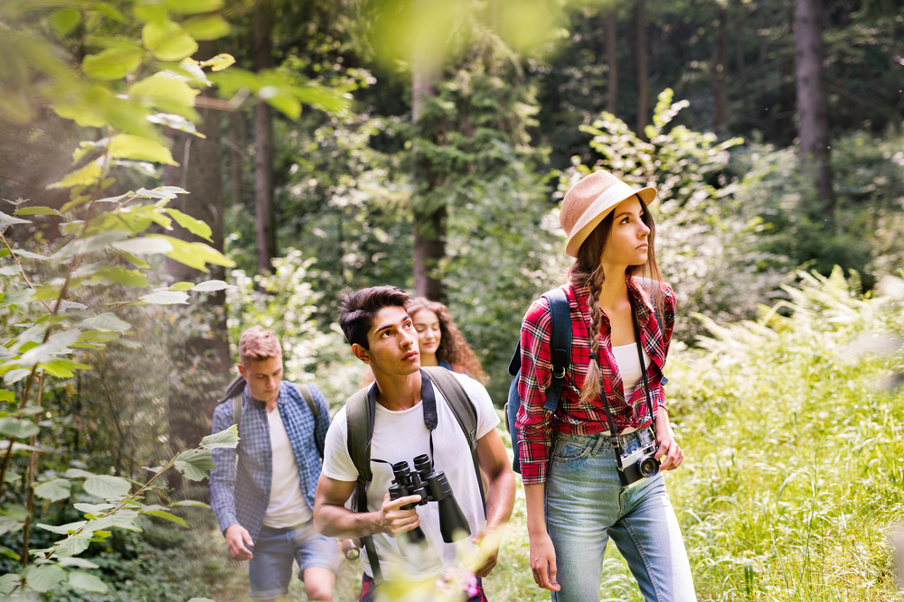
Mind
Better performance in school
Less depression and hyperactivity.
Stress levels fall
“Green time” lengthens attention spans
Notes:
Being outside can benefit the body by increasing fitness levels and developing healthy and active bodies. This is “an important strategy in helping the one in three American kids who are obese get fit.” Spending time outside also increases vitamin D levels that help protect children from future bone problems, heart disease, diabetes, and other health issues.(⁴NWF, 2018)
“In the last 20 years, the prevalence of obesity among young children aged 6 to 11 has more than doubled to 17 percent and more than tripled to 17.6 percent for adolescents aged 12-19.17 The odds of being obese are even higher in marginalized neighborhoods with few or no parks. Risks associated with overweight and obesity include high blood pressure, diabetes, high cholesterol, asthma, sleep apnea, joint pain, and fatty liver disease—and most alarmingly, shortened life expectancy” (⁴ NWF, 2018)
According to the National wildlife federation and an article by the Washington Post youth that have more “green time” than “screen time” benefits their body by:
Much higher levels of fitness→ they are participating in organized sports, hiking, breathing fresh air, and much more.
Stronger bones→ Exposure to natural light helps prevent vitamin D deficiency, making outdoorsy children less vulnerable to bone problems, cardiovascular disease, diabetes and other health issues.
Improved eyesight→ Time spent outdoors can help combat increasing diagnosis of nearsightedness
Better sleep→ Exposure to natural light, and lots of physical activity, help reset a child’s natural sleep rhythms.
A longer life span and healthier adult life (O’Mara, 2018)
→ Active kids are more likely to grow into active adults

Slide 6
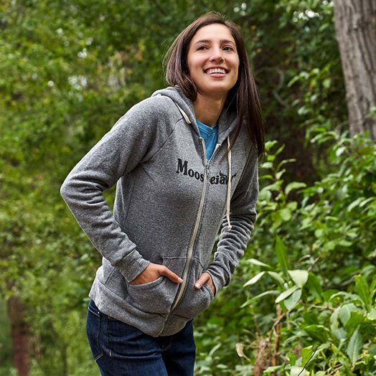
Spirit
More creativity
More friends
Improve social interactions
Nature also makes human beings behave more human—it makes you nicer

Slide 7
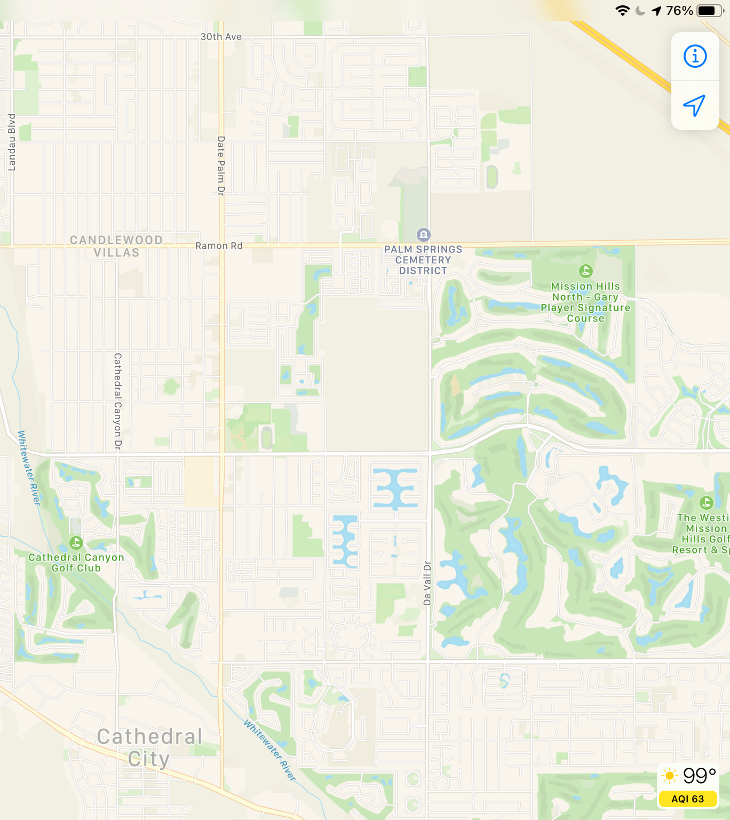
MAPS
TYPES OF MAPS
ANALOGUE MAPS are most common in the form of paper maps, nautical charts and signs in all of its forms. However, the generation of today use DIGITAL MAPS more and more through the “smartphone” or tablet.
AnalogUE
Digital

Slide 8
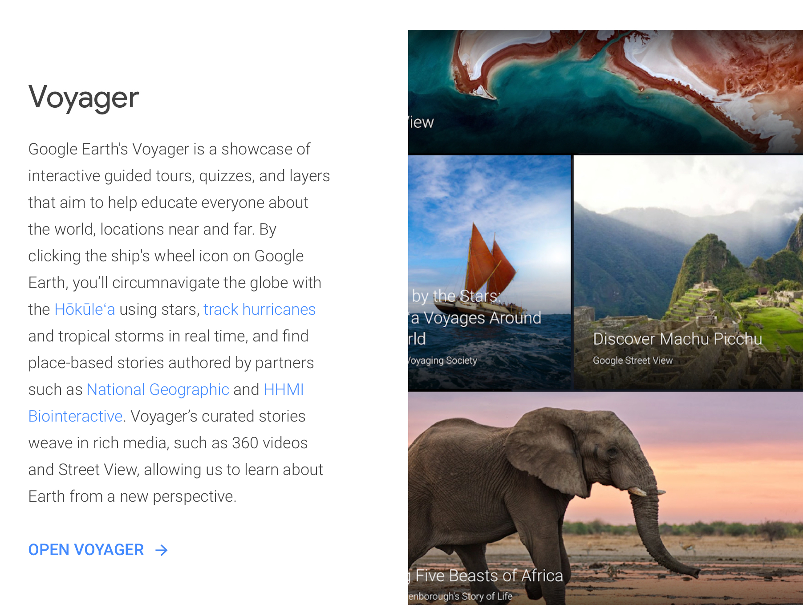
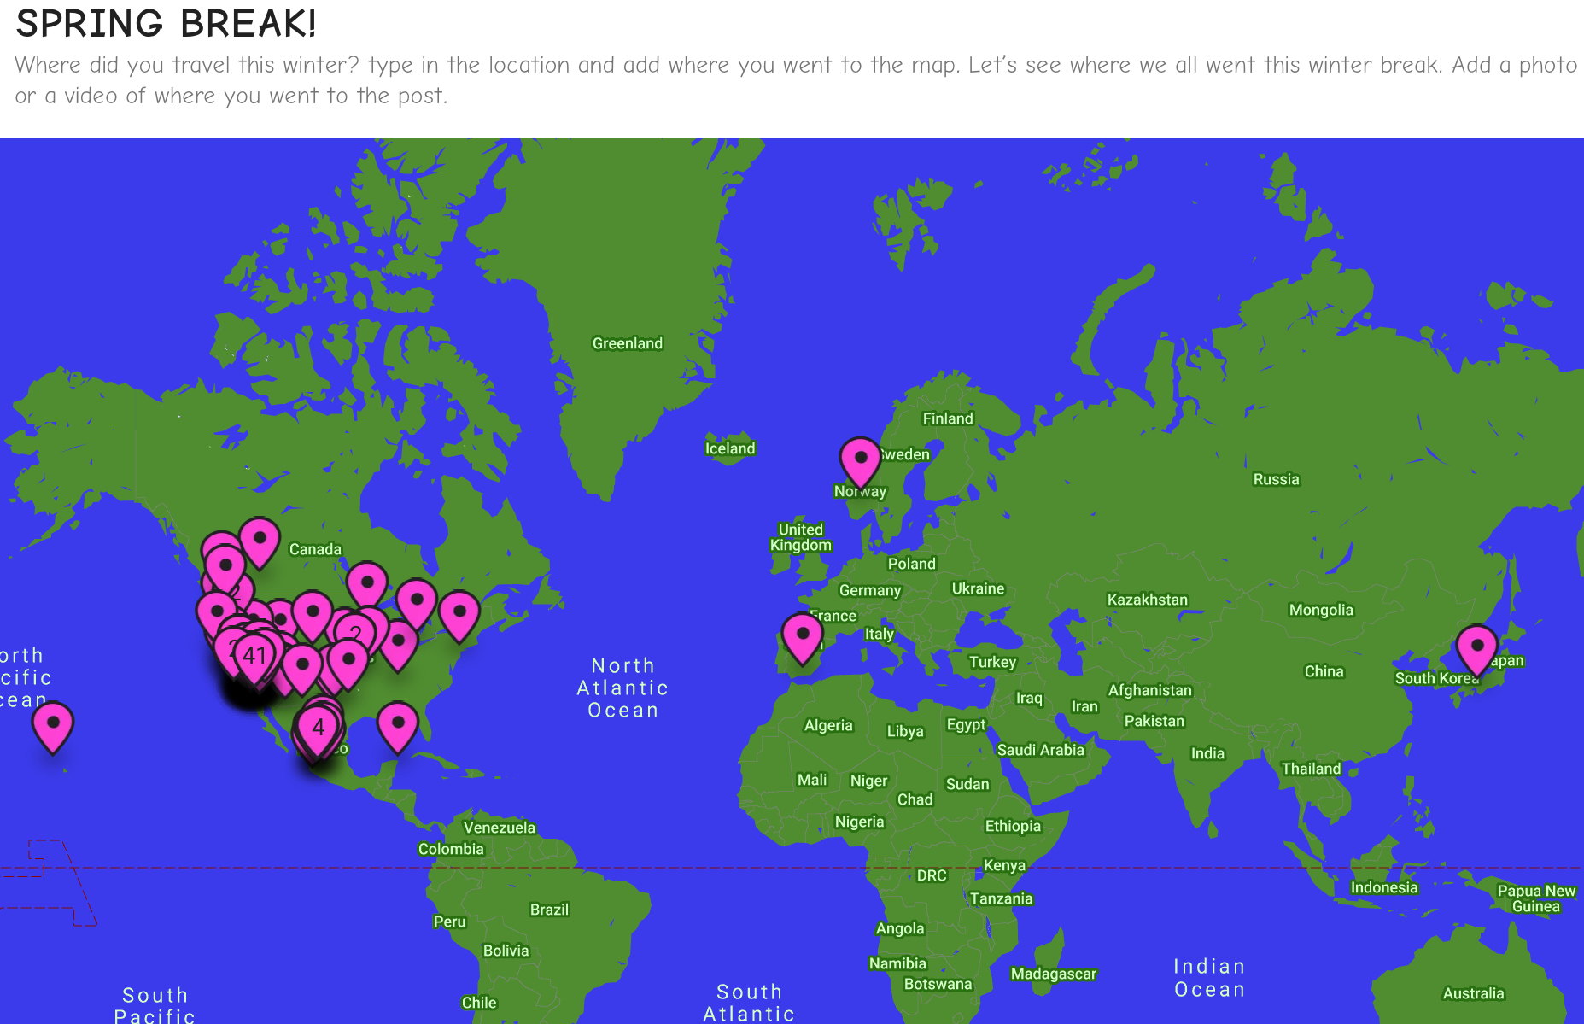
MAP Activities

Slide 9
MAP DIAGRAM
Use the next 2 slides to view the school campus. One map is a digital map. One map is an analogue map.once you have viewed the maps try and locate your classrooms on each map. Use and “X” to indicate where each class is.

Slide 10
Map your schedule. Create a text box and put an “X” on each location you have a class.

Slide 11
Map your schedule. Create a text box and put an “X” on each location you have a class.
200 WING

Slide 12
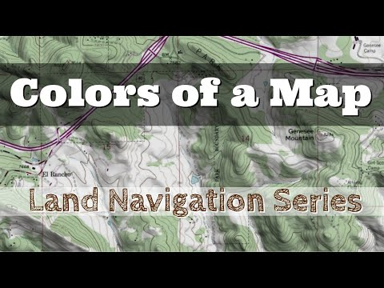
COLORS on a map
LAND FORMS
Use the line feature in the toolbar and draw a line from the color to the correct box that identifies what color it represents on a map
WATER FEATURES
ROCK FEATURES
VEGETATION
MANMADE FEATURES
OVER PRINTING FEATURES

Slide 13
COLORS on a map
Blue covers lakes, ponds, rivers, water channels, marshes, and wells etc.
Yellow colour shows open areas.
Green means a forest of low visibility with reduced running speed, being graded from slow running, through difficult running, to impassable.
Purple and red are specified so that a course can be overprinted on the map. It includes symbols for the start, control points, control numbers, lines between control points, and finish.
Black indicate man-made features that include roads, tracks, paths, power lines, stone walls, fences, buildings, etc.
Black covers cliffs, boulders, boulder fields, and boulder clusters etc.
Brown indicates landforms by using contour lines.

Slide 14
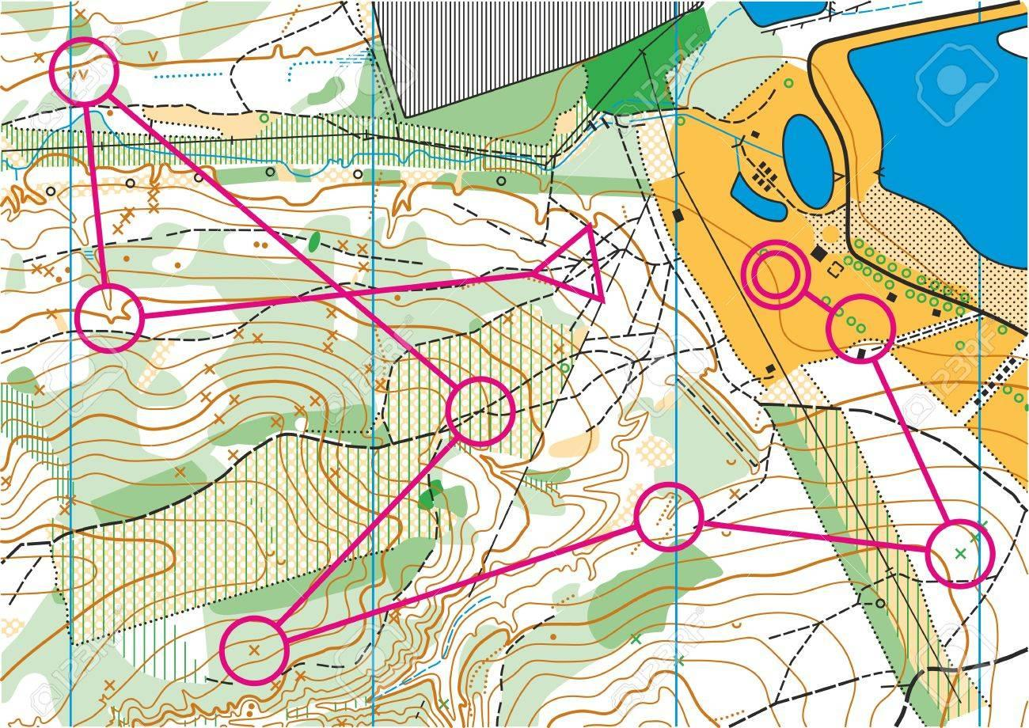

Slide 15
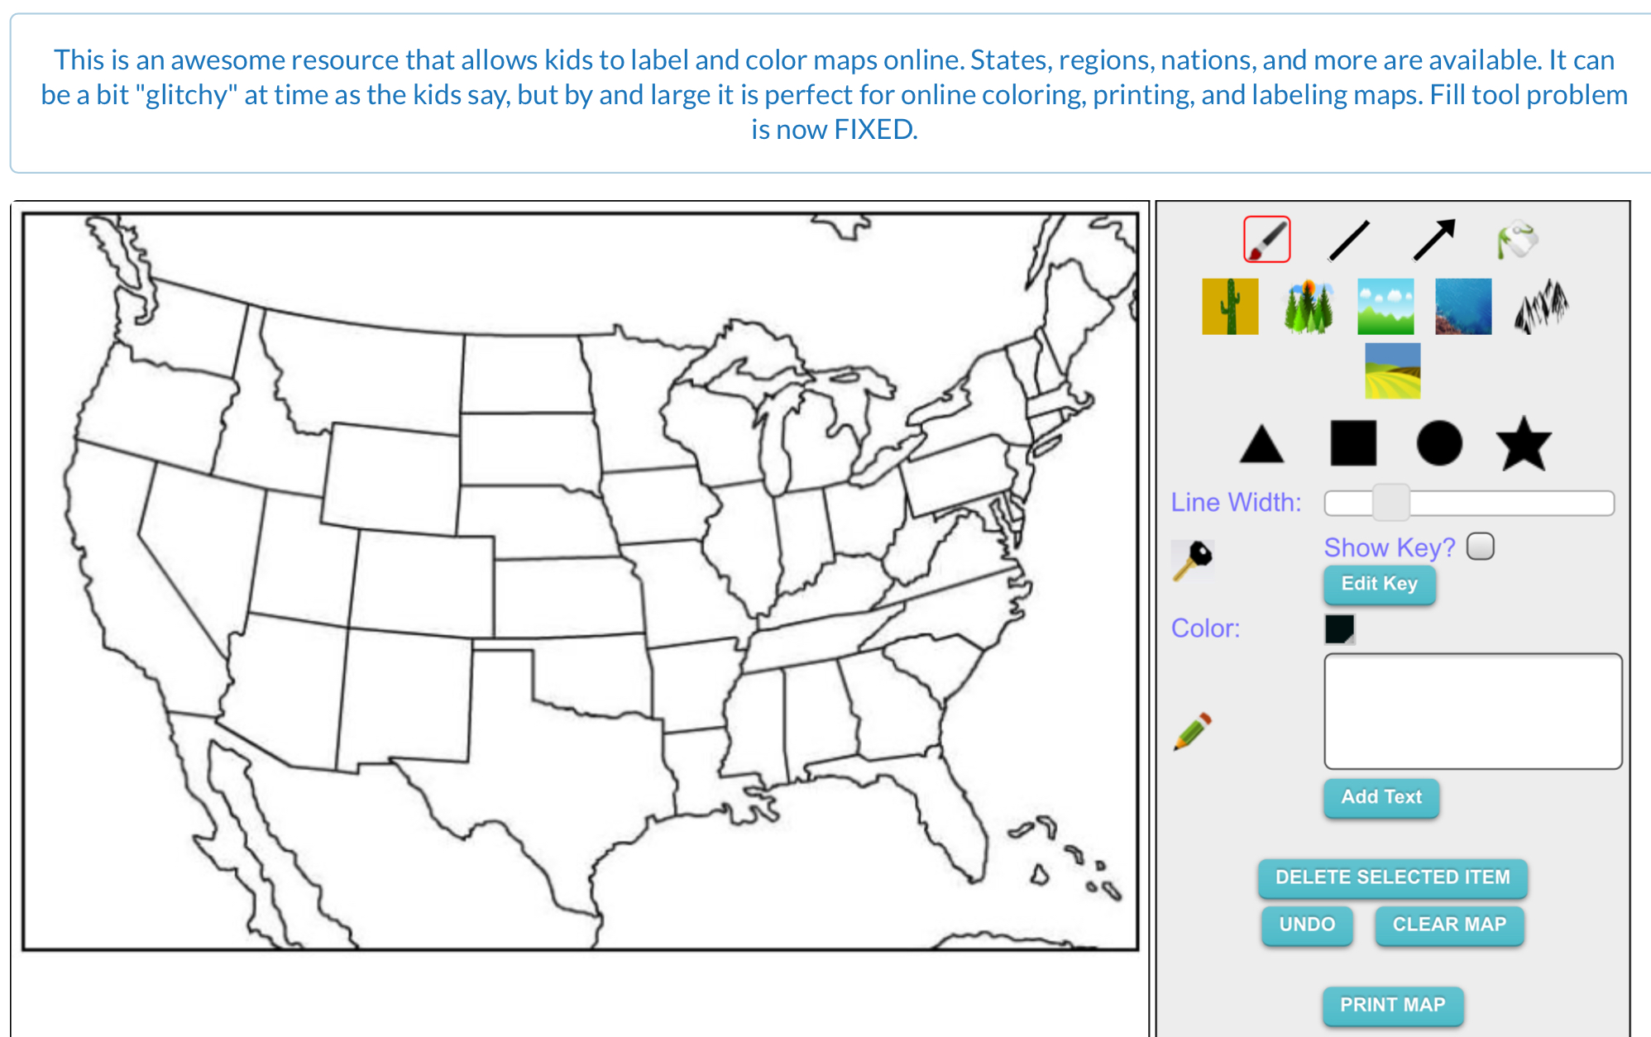
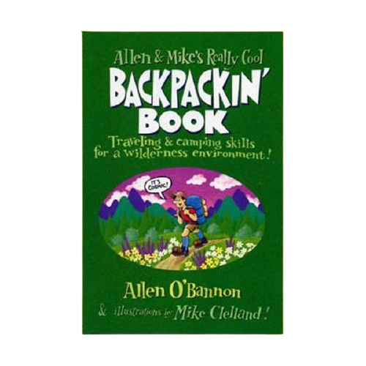
Colors on a map Activities
Mountains — use brown and green
Lakes and Rivers — blue
Oceans — shade along coastlines (see below) with blue
Deserts — light brown, can shade with yellow and/or orange
Forests, or vegetation areas — green
Divider lines between regions — a bright color, drawn with a fine line.
Roads, routes or highways — dark colors such as Black, brown or red
https://mapofthemonth.com/site/hands-on-maps/
https://mrnussbaum.com/maptivation-online-map-making

Slide 16
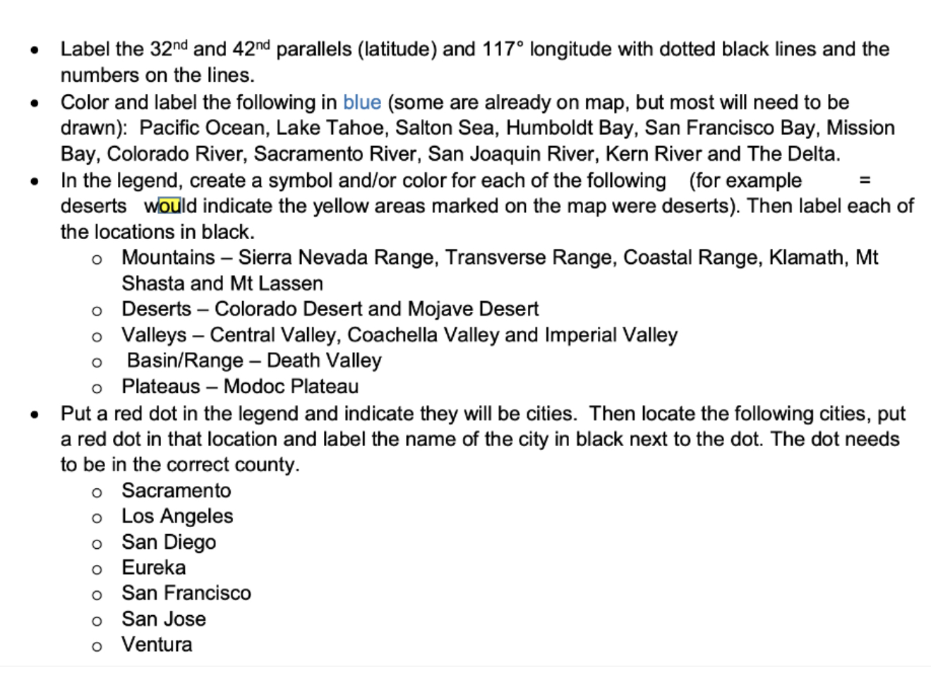
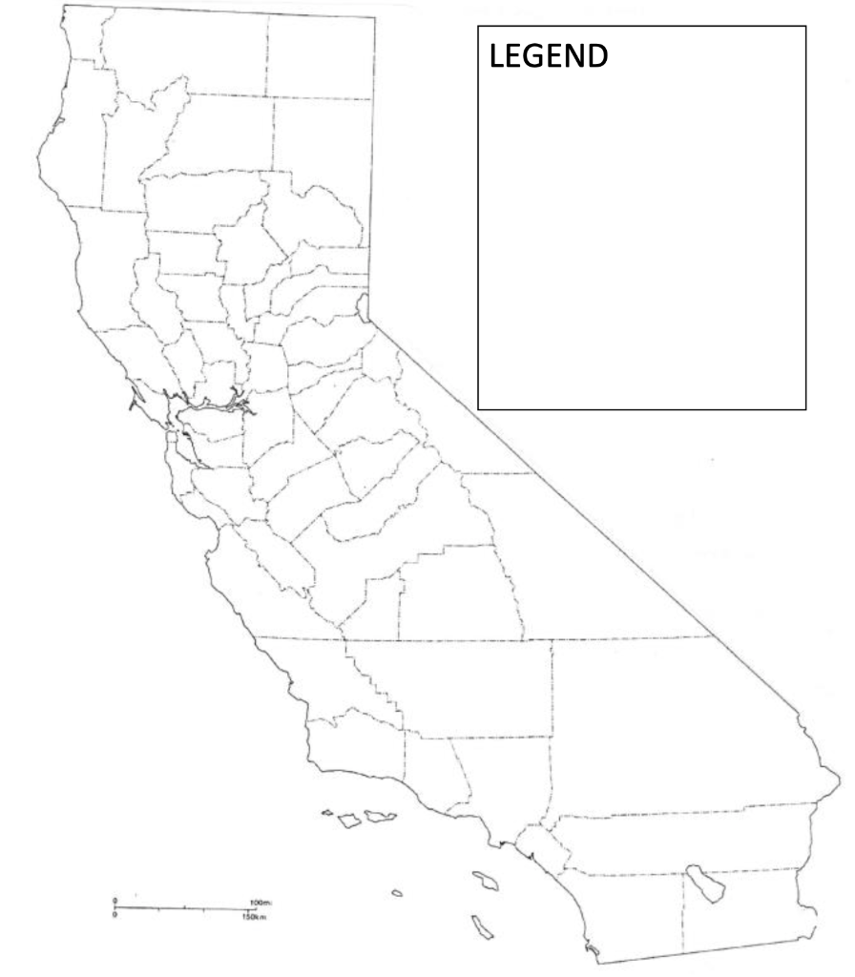
Color DIAGRAM

Slide 17
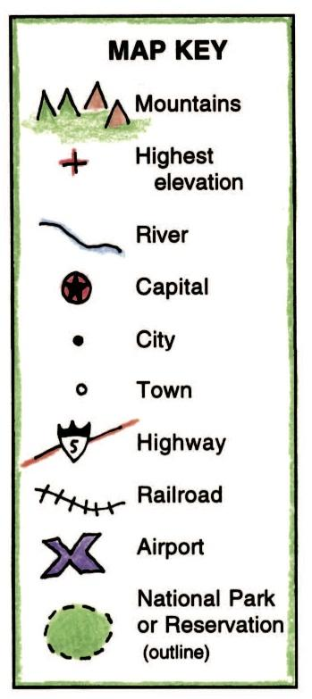
Symbols on a map
Symbols are small pictures that stand for different features on a map. A symbol is often drawn to look like what it represents. For example, a triangular shape is often used to denote a mountain. A desert is often shown by a group of dots that might look a little bit like sand. A forest could have little shapes that look like trees. A railroad can be shown as a line with bars drawn across it, like a train’s track.
All the symbols for a map are often grouped together in a MAP KEY for reference. Sometimes the MAP KEY is a box shape where the symbols are arranged. Sometimes the symbols are just displayed in a more freeform manner, without a box around them.

Slide 18
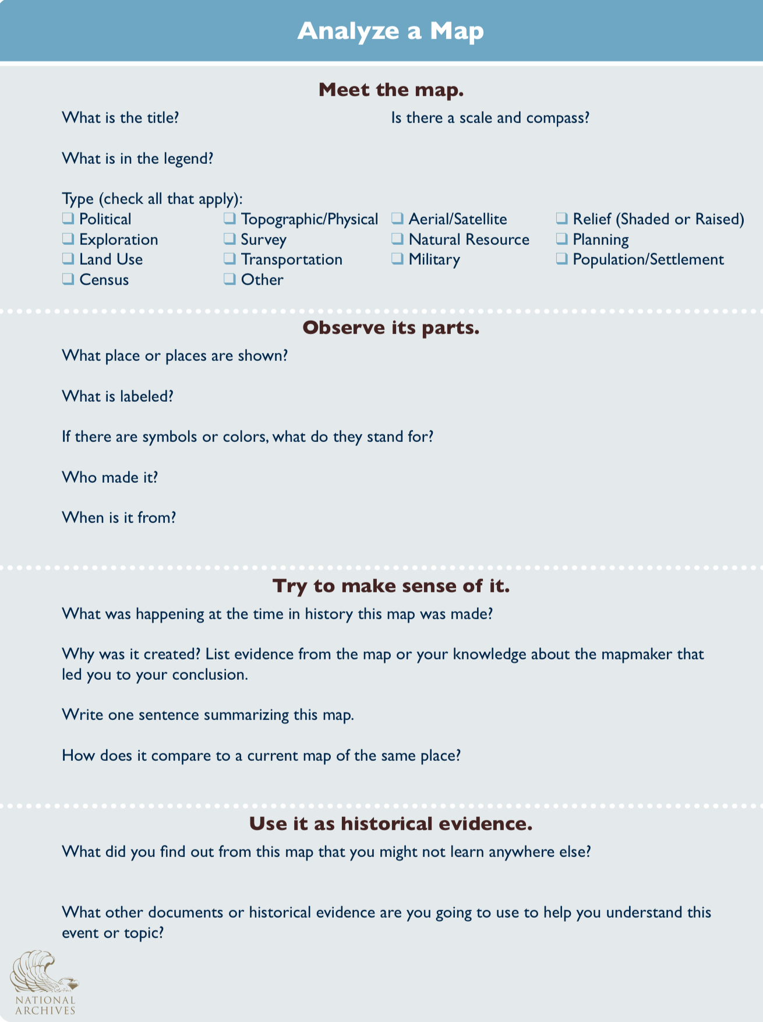
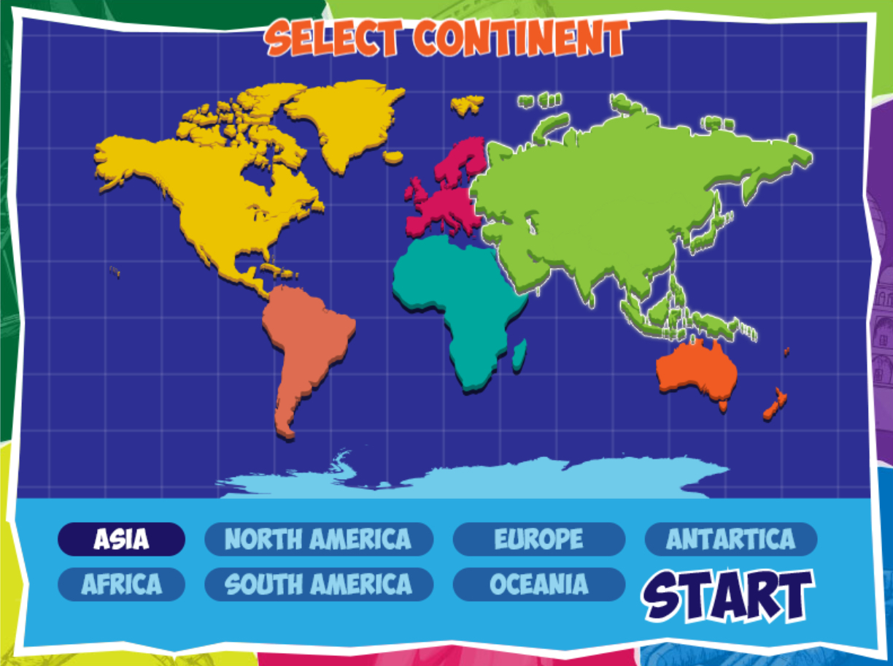
Symbols on a map Activities

Slide 19
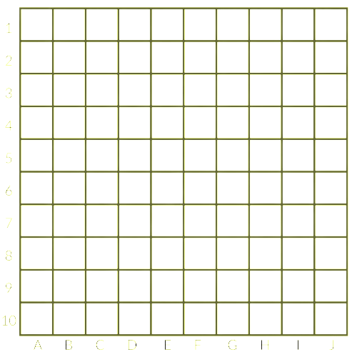
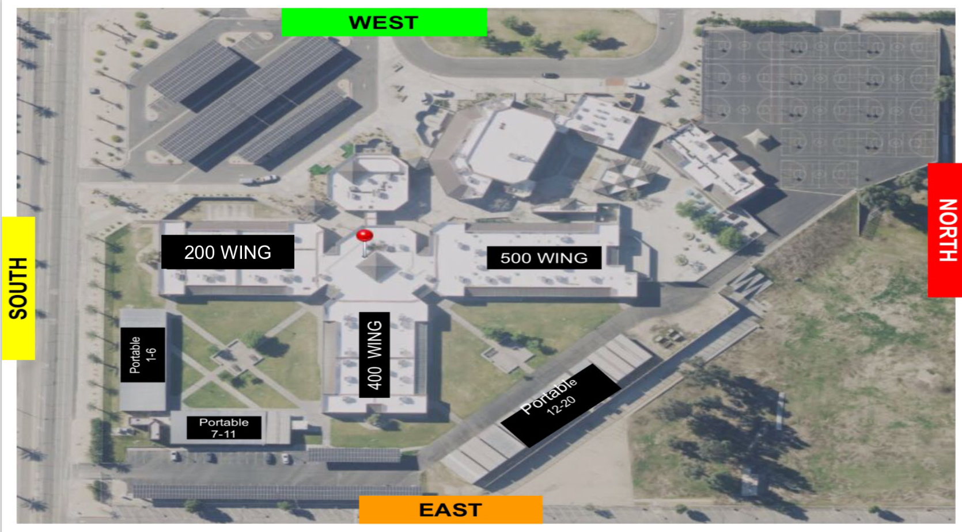
Symbols on a map DIAGRAM
Use the image here to create a treasure map of JWMS. Write coordinates to help someone locate the treasure. Create a key map to help find the treasure.
COORDINATES TO LOCATE THE TREASURE

Slide 20
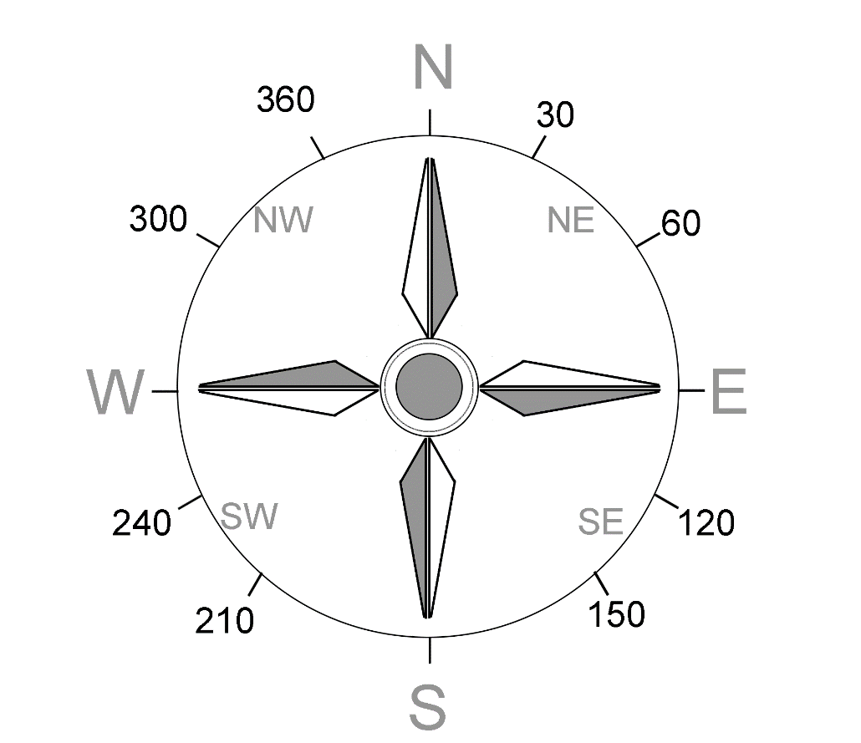
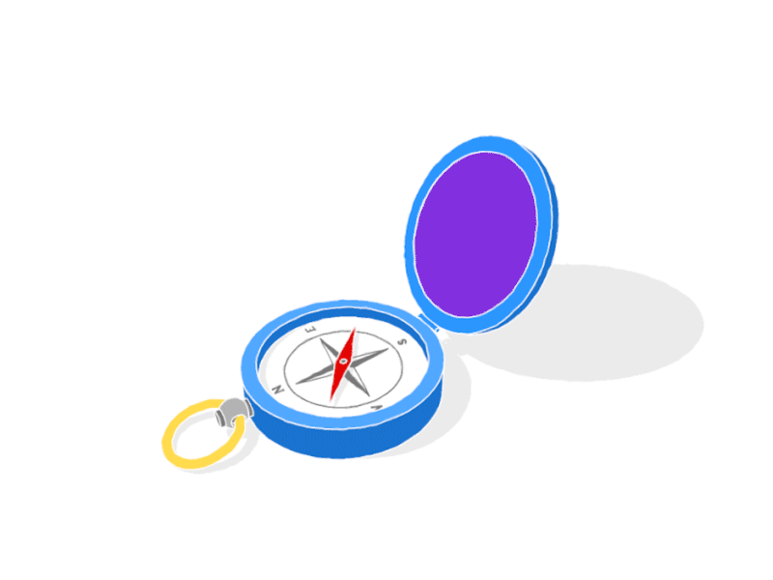
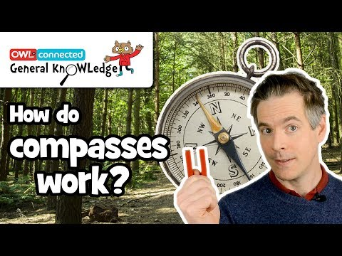
COMPASS
CARDINAL DIRECTIONS
NORTH
NORTH WEST
SOUTH
NORTH EAST
EAST
SOUTH WEST
WEST
SOUTH EAST

Slide 21
COMPASS
Orient your map
Place your compass on the map with the direction of travel arrow pointing toward the top of the map.
Rotate the bezel so that N (north) is lined up with the direction of travel arrow.
Slide the baseplate until one of its straight edges aligns with either the left or right edge of your map. (The direction of travel arrow should still be pointing toward the top of the map.)
Then, while holding both map and compass steady, rotate your body until the end of the magnetic needle is within the outline of the orienting arrow.

Slide 22
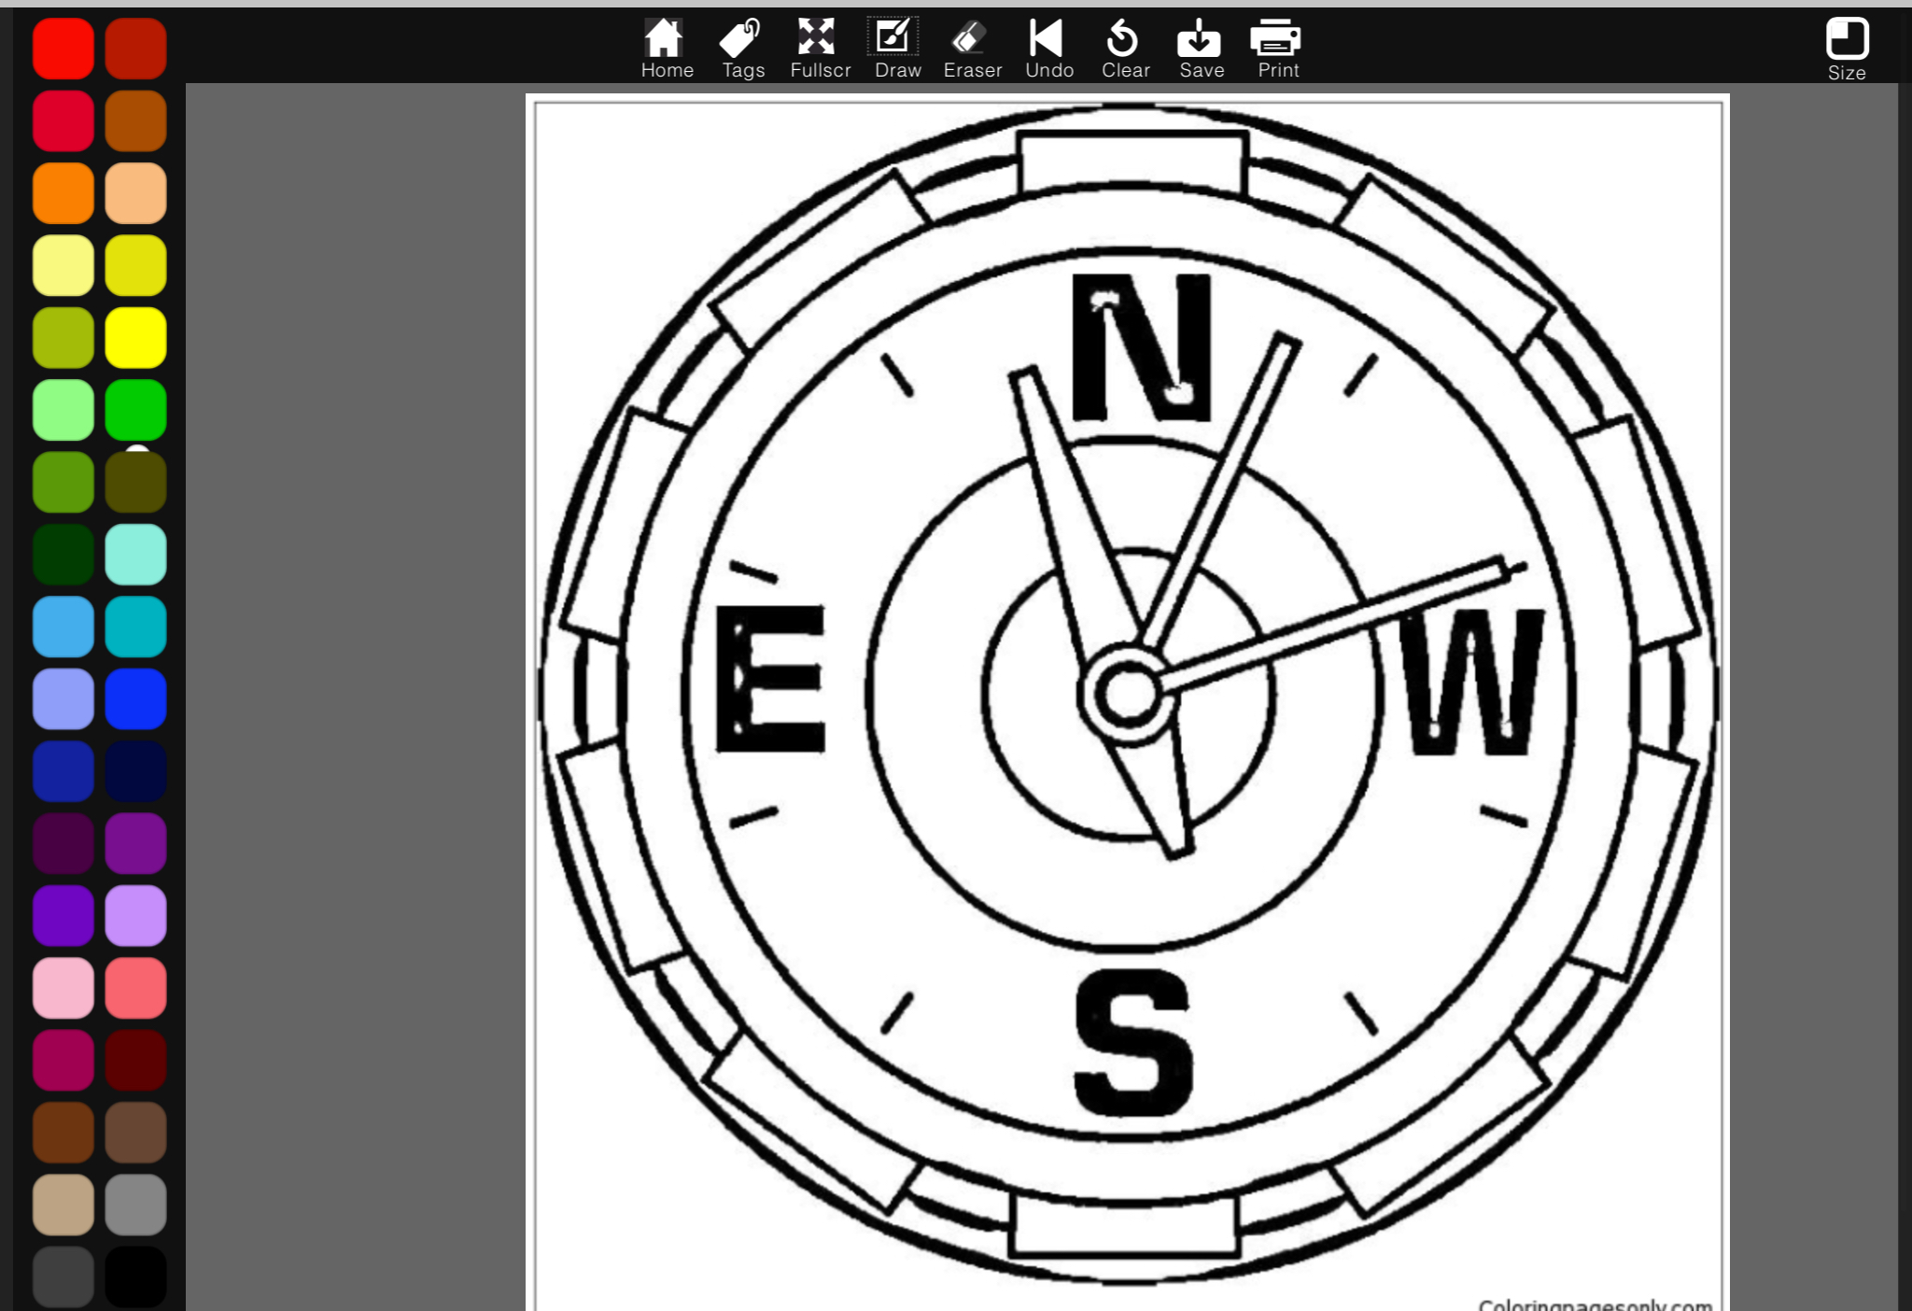
Compass Activities
DIRECTION ACTIVITY

Slide 23
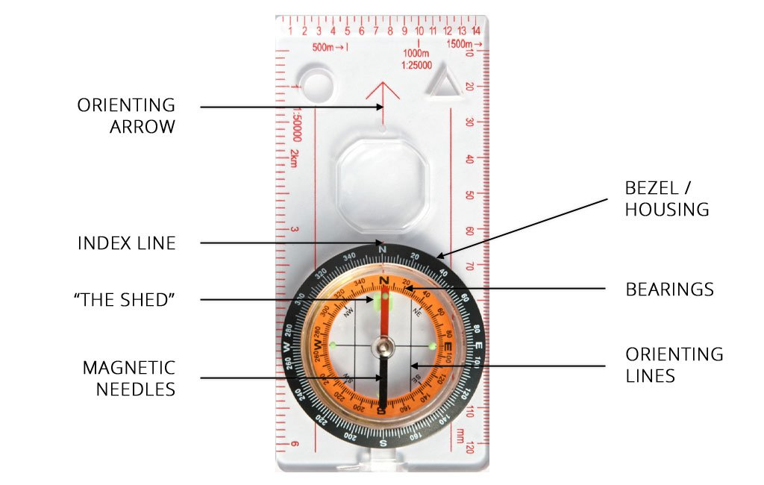
Compass DIAGRAM
Parts of a baseplate compass
Label the diagram with the correct terms. Use the word boxes below to fill in the correct terms.
BEZEL/
HOUSING
BEARINGS
INDEX LINE
MAGNETIC NEEDLES
ORIENTING ARROW
ORIENTING LINES
“RED IN THE SHED”

Slide 24
BEARING measurements
Set your compass on the map so that the straight side of the baseplate lines up between your current position (1a) and the map location for a destination like a campsite (1b).
Make sure the direction of travel arrow is pointing in the general direction of that campsite (in other words, it's not upside down).
Now rotate the bezel until the orienting lines on the compass are aligned with the north-south grid lines and/or the left and right edges of your map. (Be sure the north marker on the bezel is pointing north on the map, not south.)
Look at the index line to read the bearing you’ve just captured.
Hold the compass with the direction of travel arrow pointing away from you.
Rotate your body until the magnetized needle is inside the orienting arrow. The direction of travel arrow is now facing the bearing you captured and you can follow it to your destination.
https://youtu.be/0cF0ovA3FtY
Start at 3:25

Slide 25
BEARING measurements in the field
Start by finding a landmark that you can also identify on your map.
Hold your compass flat with the direction of travel arrow pointing away from you and directly at the landmark.
Now rotate the bezel until the magnetized needle is inside the orienting arrow.
Look at the index line to read the bearing you’ve just captured.
Lay your compass on the map and align one corner of the straight edge with the landmark.
Making sure that the direction of travel arrow remains pointed in the general direction of the landmark (6a), rotate the entire baseplate until the orienting lines are running north/south (6b) and the north marker on the bezel is pointing to north on the map (6c).
Now you can draw a line on the map along the straight edge of your compass (7a). The point where that line from the landmark crosses your trail is your location (7b).

Slide 26
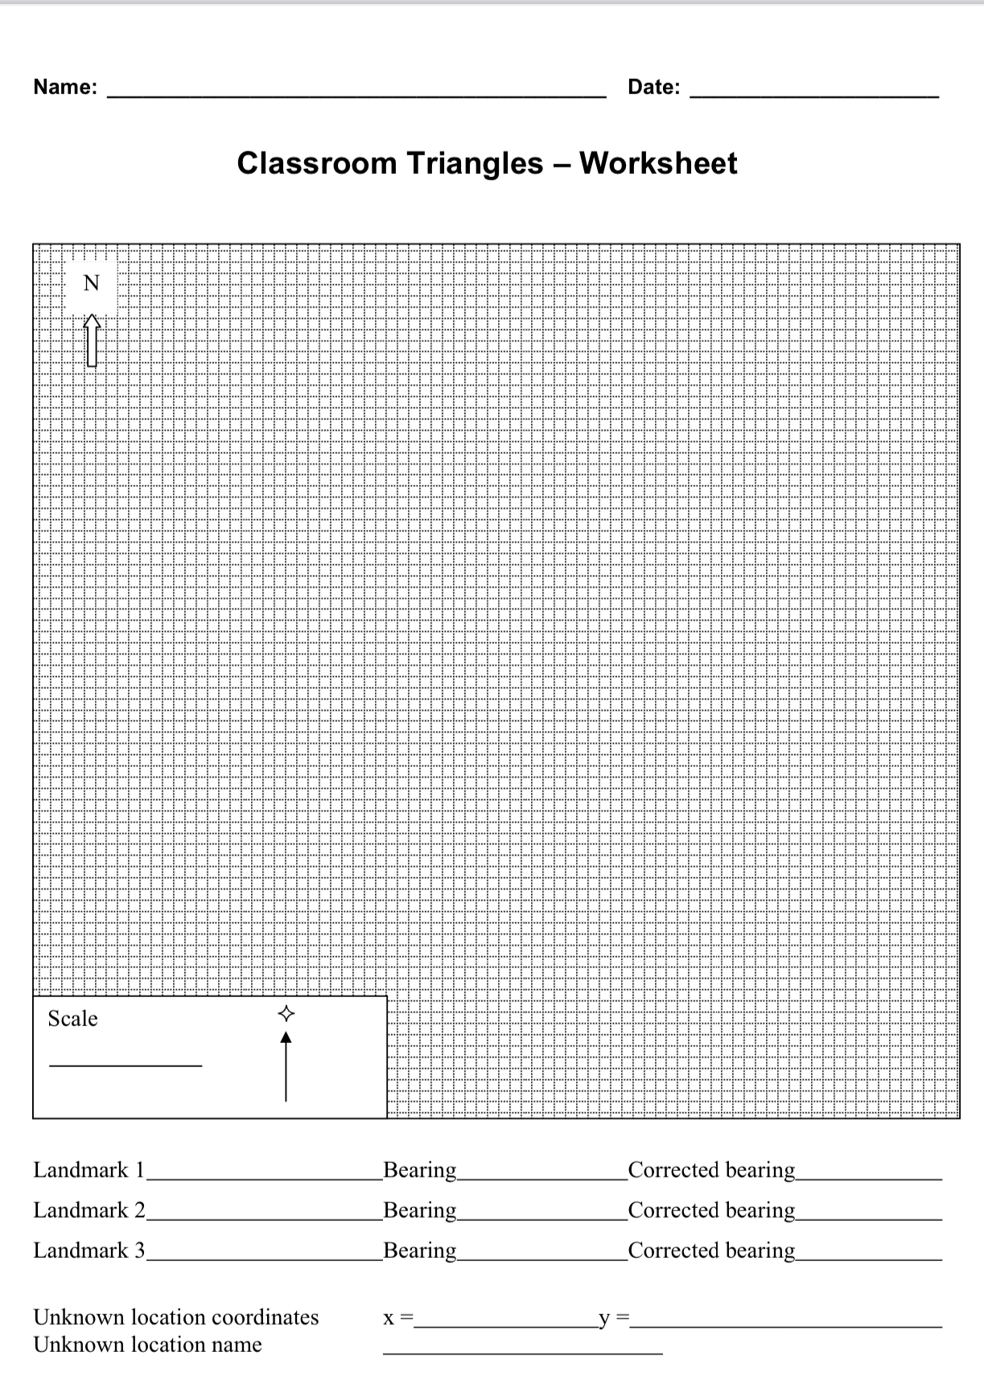
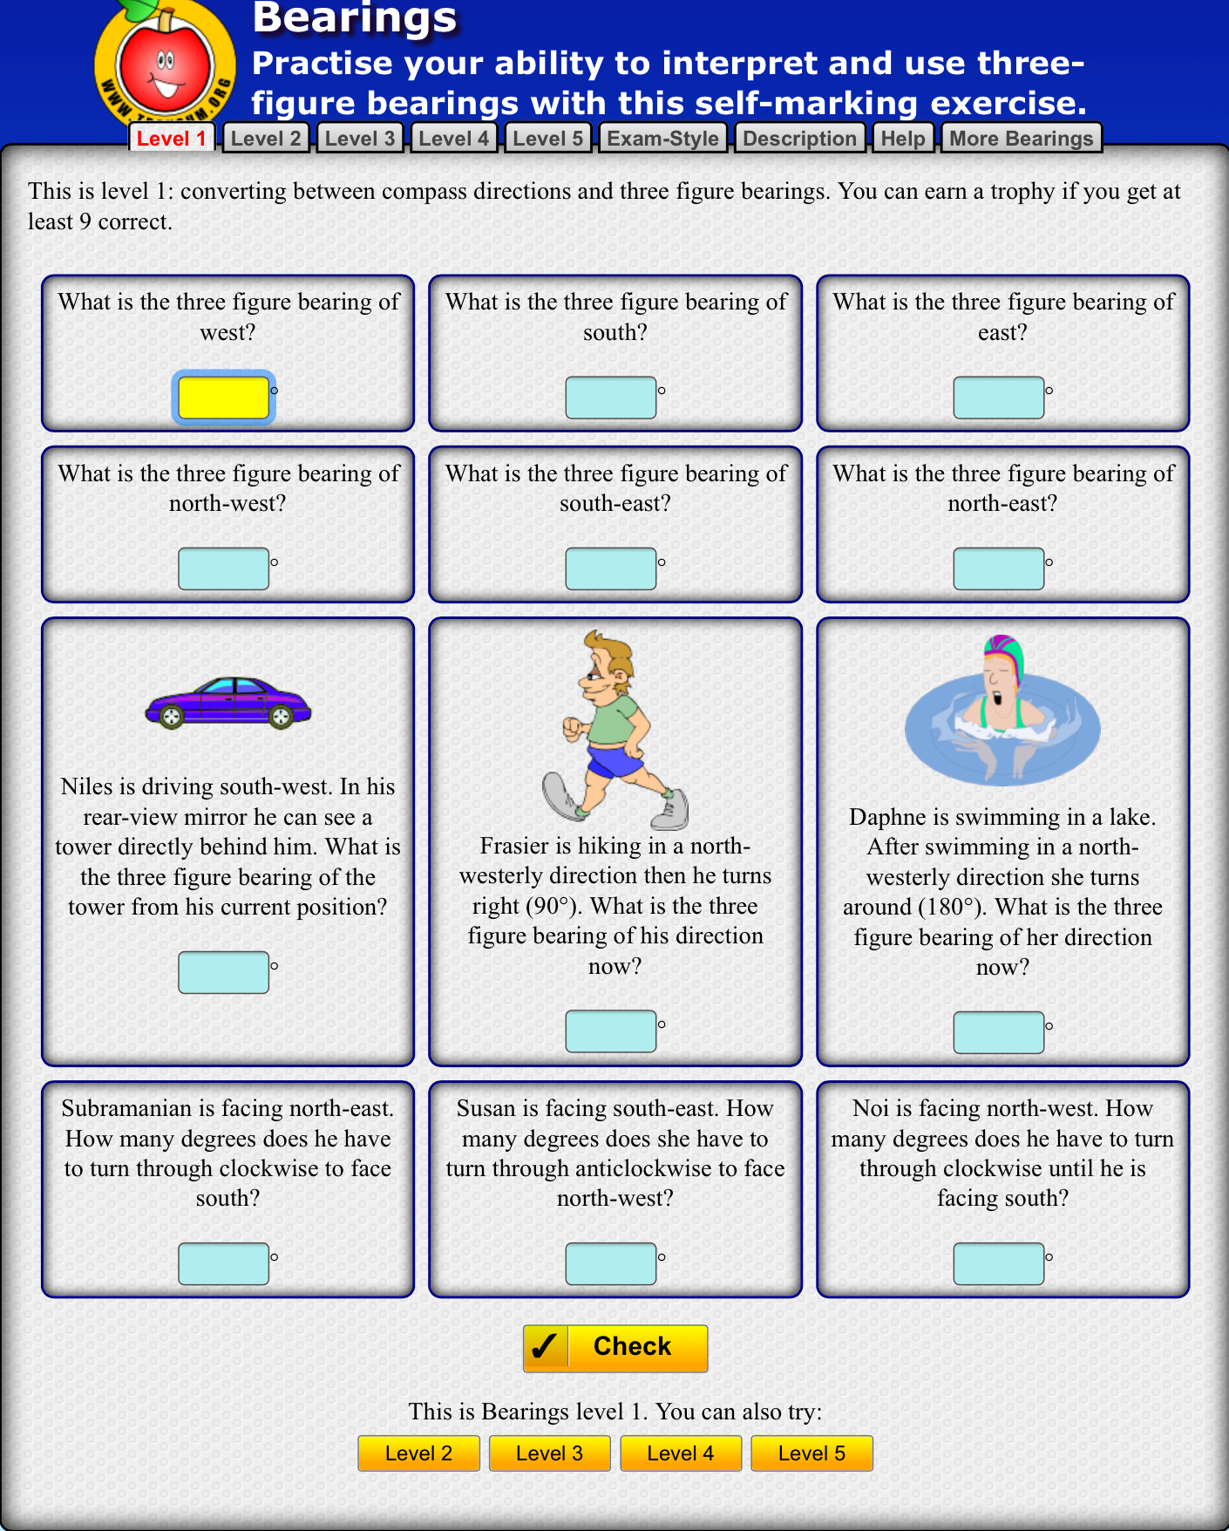
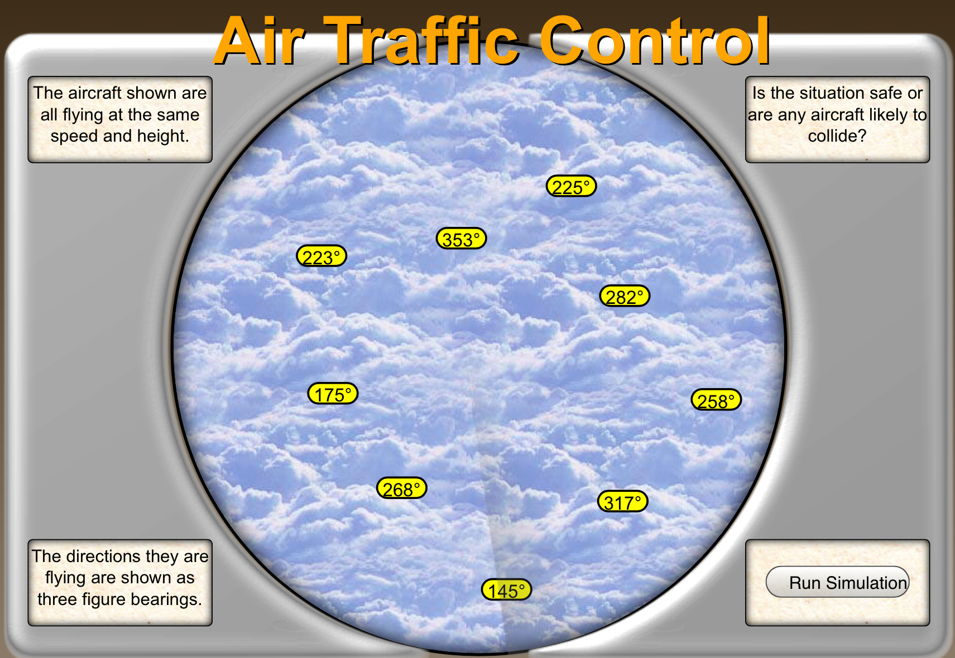
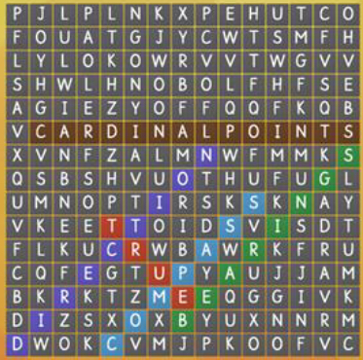
BEARING ActivitIES

Slide 27
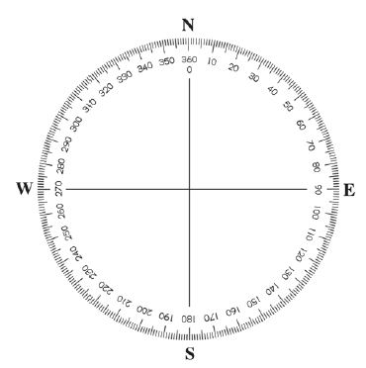
BEARING DIAGRAM
USING THE COMPASS IDENTIFY THE CARDINAL COORDINATES WITH a BEARING MEASUREMENT
NORTH | 360 or 0
SOUTH
EAST
WEST
NORTHWEST
NORTHEAST
SOUTHEAST
SOUTHWEST

Slide 28
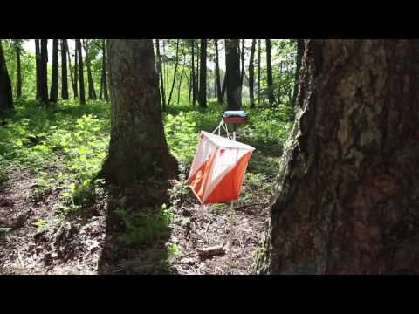
SPORT ORIENTEERING
“Orienteering is a competitive international sport that combines racing with navigation. It is a timed race in which individual participants use a specially created, highly detailed map to select routes and navigate through diverse and often unfamiliar terrain and visit control points in sequence. Courses also can be enjoyed as a walk in the woods, with difficulty levels from beginner to expert offered at most events”.

Slide 29
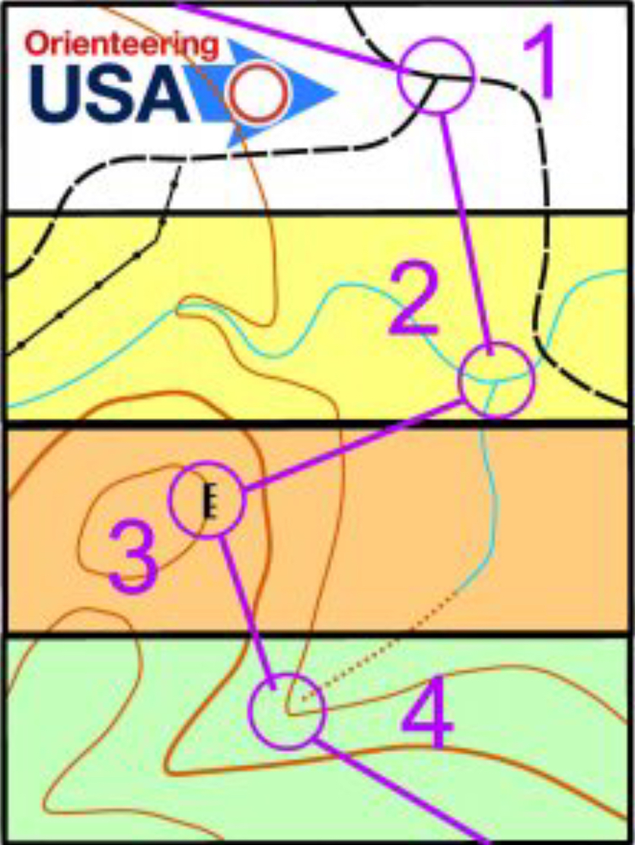
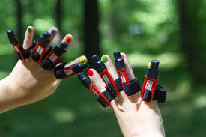
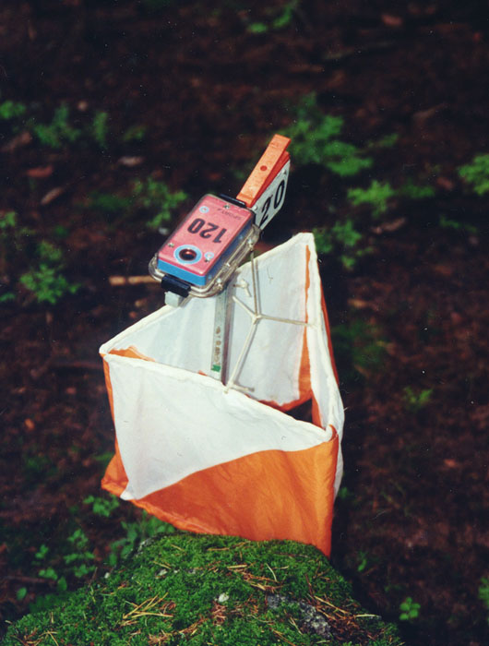
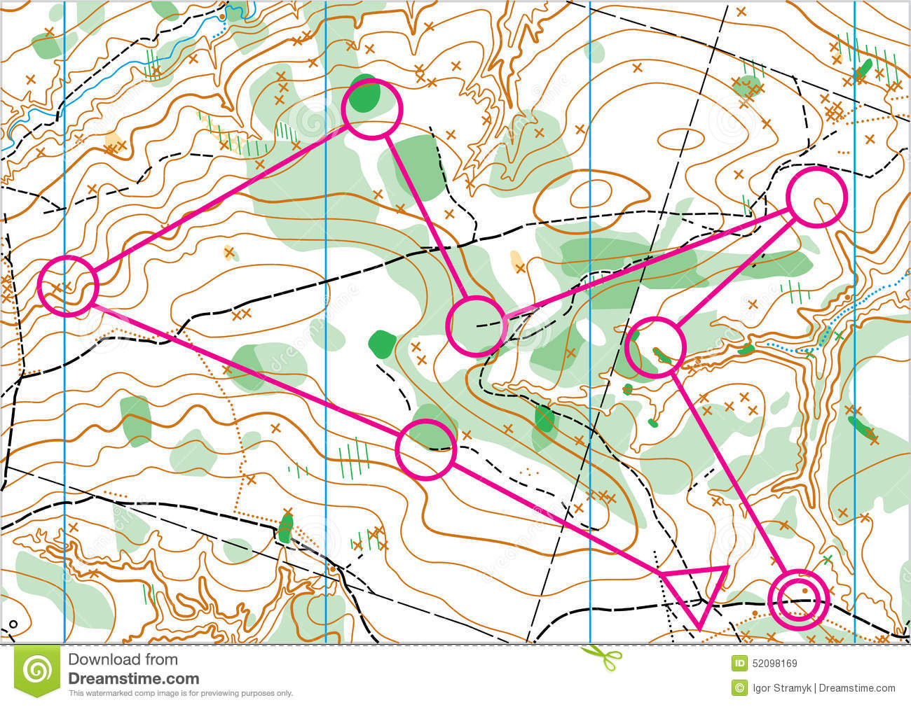
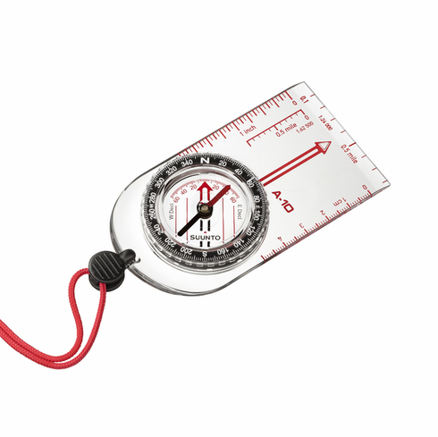
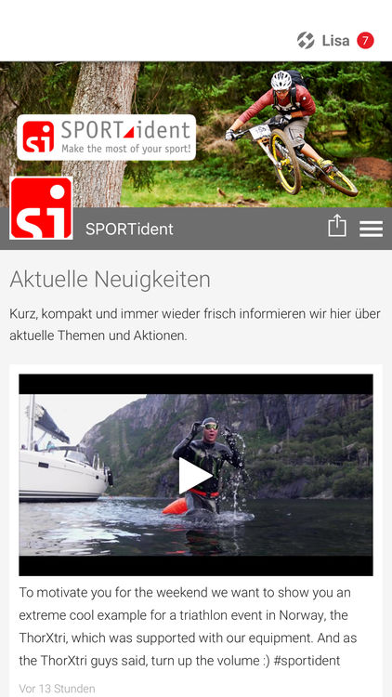
SPORT ORIENTEERING ActivitIES
EQUIPMENT
SI CARD
MAP
COMPASS
SI STATION
&
CONTROL FLAG
Smart Device APPS

Slide 30
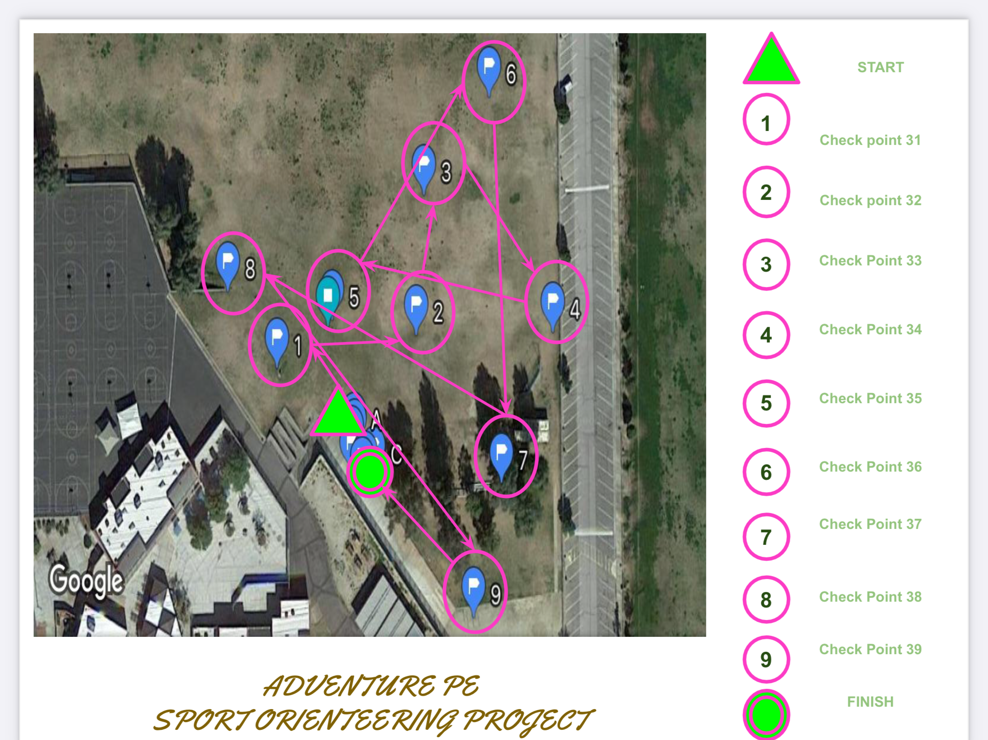
Sport orienteering DIAGRAM
Design a course on your campus and teach student how to use the sport orienteering equipment and navigate the course. You can also challenge them and have them locate their points with waypoints on a compass.

Slide 31
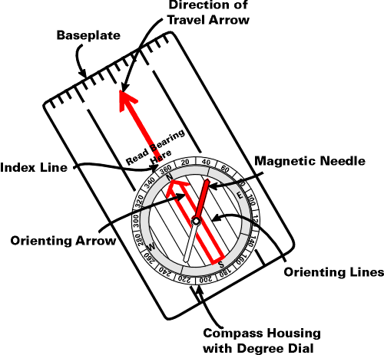

Slide 32
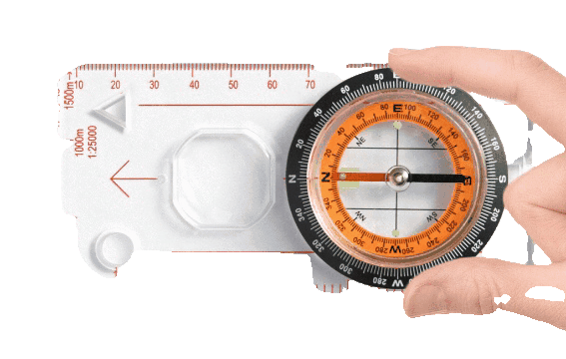
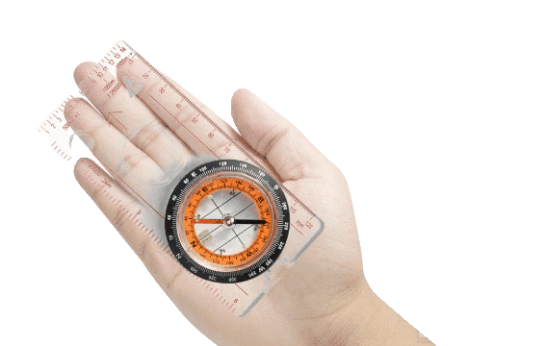
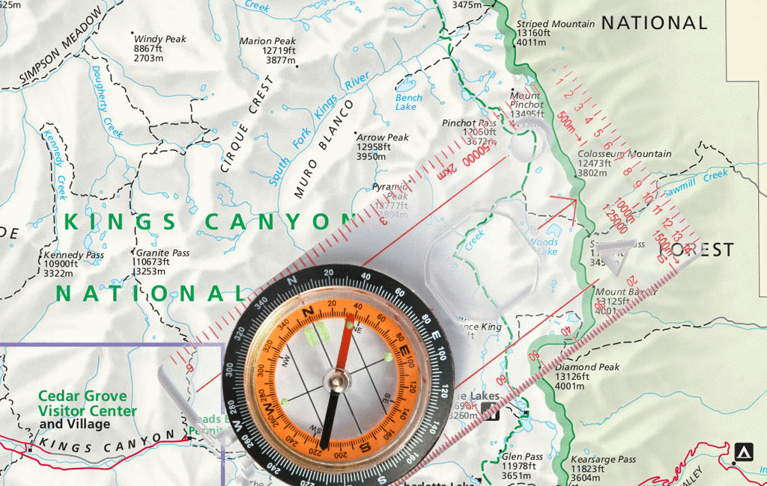

Slide 34
ORIENTEERING

