Slide 1


Empowering Kids (and families) to be Healthy and Smart from the Inside Out!
Notes:
OrganWise has been on a mission for over 2 decades to be the global solution for childhood obesity.

Slide 2


Sesame Street Meets Healthy Learning
=
ABCs and 1,2,3 Nutrition and Exercise
Notes:
OrganWise does this through great story telling that empowers children to believe in themselves, practice self-reliance and make healthy choices.

Slide 3
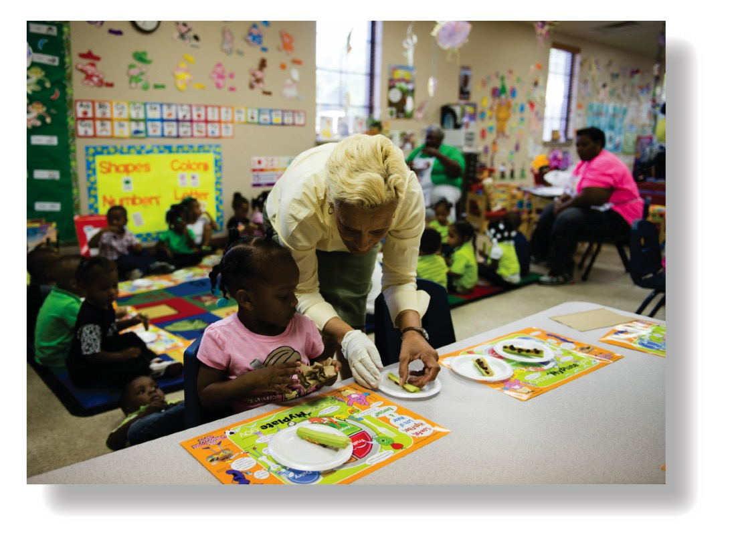
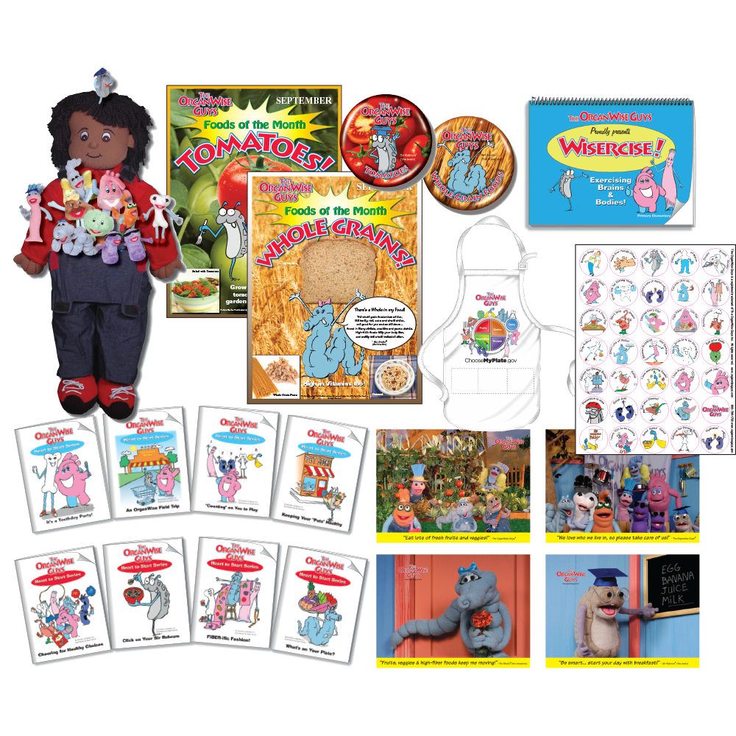

Evidence-based Early Childhood and Elementary Programming
Notes:
Do we want to mention the research here?
Research conducted on our Early Childhood curriculum was presented at an American Heart Association conference that demonstrated one-of-a-kind results never seen in this age group before.

Slide 4

Notes:
Two of the most popular items for teachers and students alike are OrganWise Gal and OrganWise Guy. Each kit comes with one of each.
By housing the organs inside a child-friendly doll, students can imagine their precious organs living inside them and thus really make the connection that their behavior choices have an impact on their OrganWise Guys.
It’s always amazing to learn the multitude of ways that teachers have found to utilize these dolls such as having them “tell their story” for a creative storytelling lesson or performing “surgery” as part of an anatomy lesson!

Slide 5
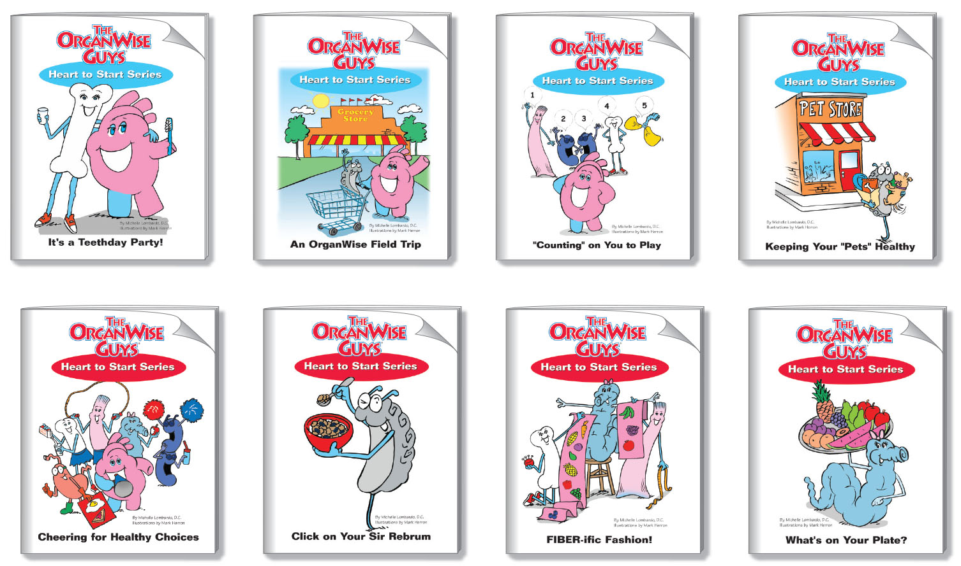
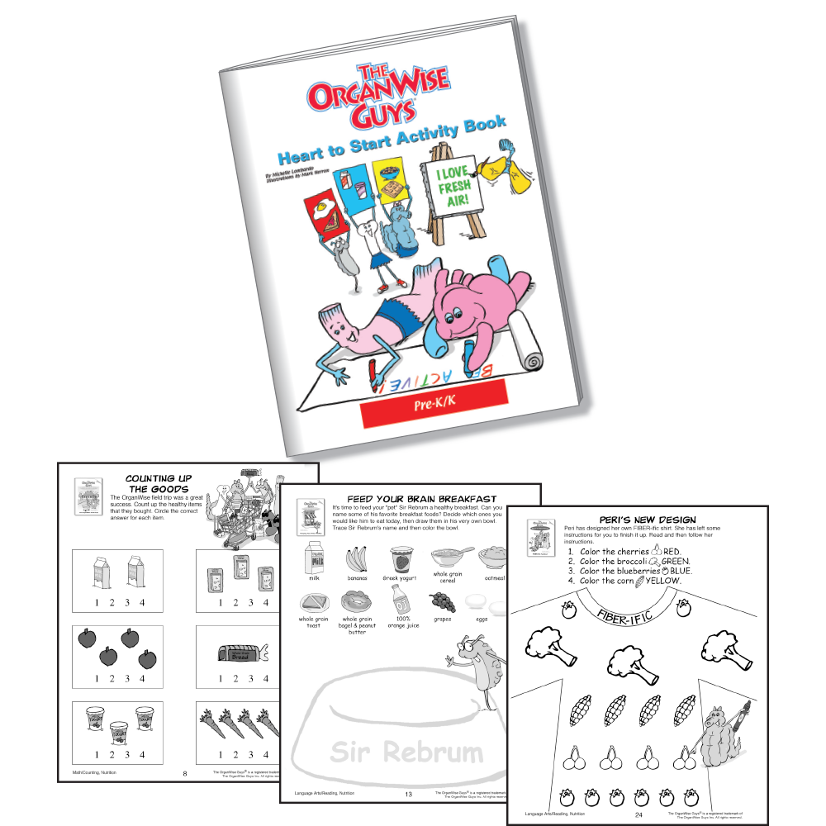
PreK-K Curriculum (English/Spanish)
Notes:
Two of the most popular items for teachers and students alike are OrganWise Gal and OrganWise Guy. Each kit comes with one of each.
By housing the organs inside a child-friendly doll, students can imagine their precious organs living inside them and thus really make the connection that their behavior choices have an impact on their OrganWise Guys.
It’s always amazing to learn the multitude of ways that teachers have found to utilize these dolls such as having them “tell their story” for a creative storytelling lesson or performing “surgery” as part of an anatomy lesson!

Slide 6
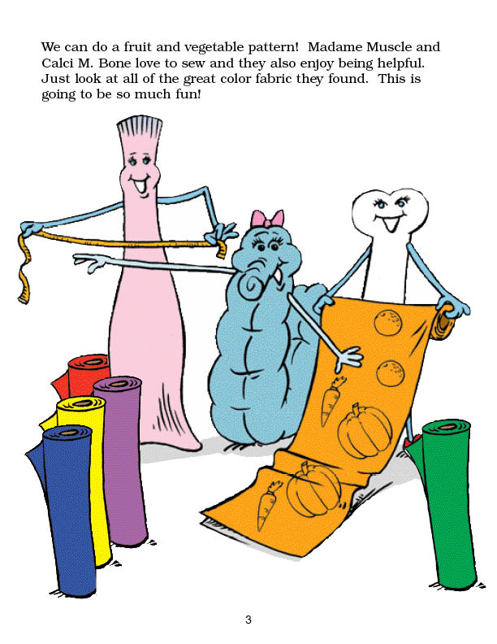

Notes:
To look the part, she asks her good friends, Calci M. Bone and Madame Muscle, to help her design and sew a new outfit. They use bolts of bright, colorful fabric to cut out fruits and vegetables for her dress, so children can learn and practice color site words while being exposed to the beautiful array of nature’s produce.

Slide 7
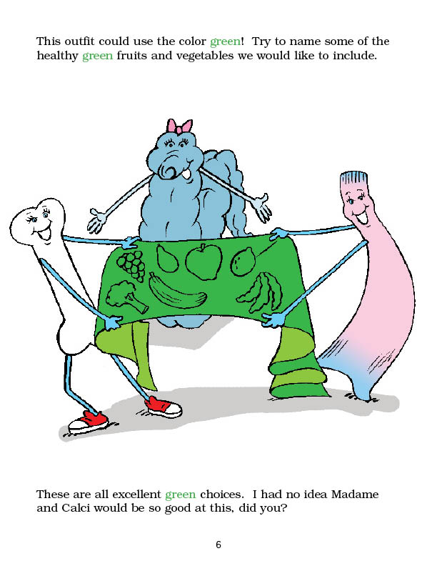
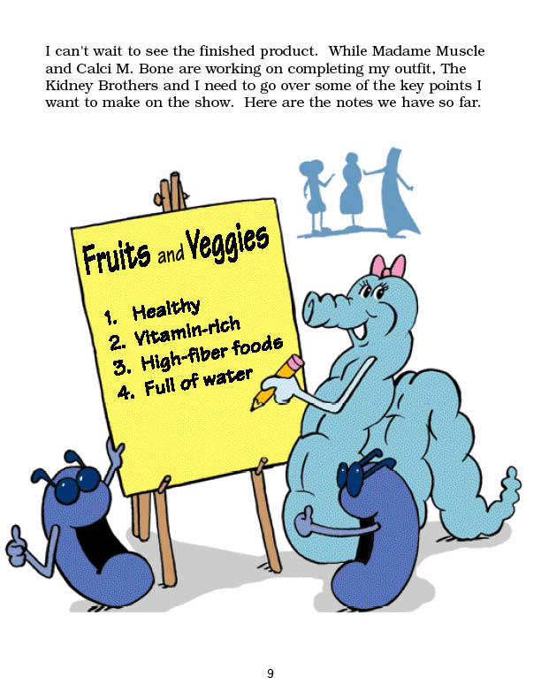
Notes:
They learn that it’s important to organize your ‘talking points’ – while they are learning the healthy messages!

Slide 8
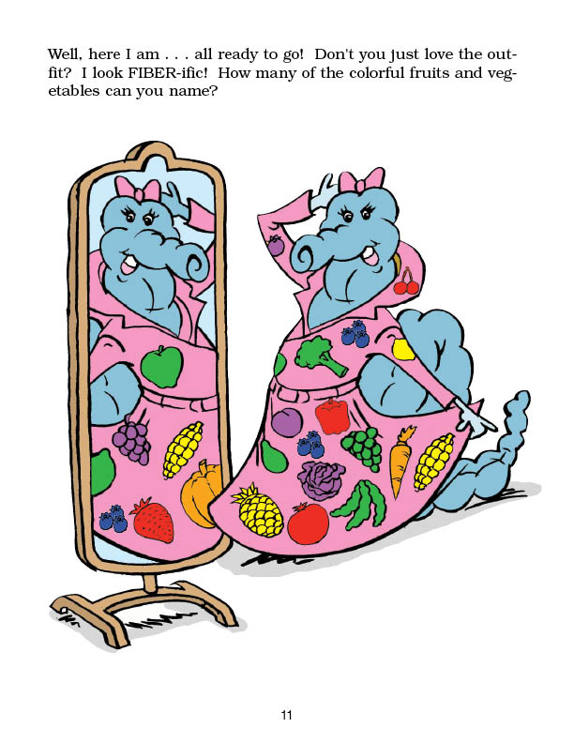
Notes:
Doesn’t she look beautiful!

Slide 9
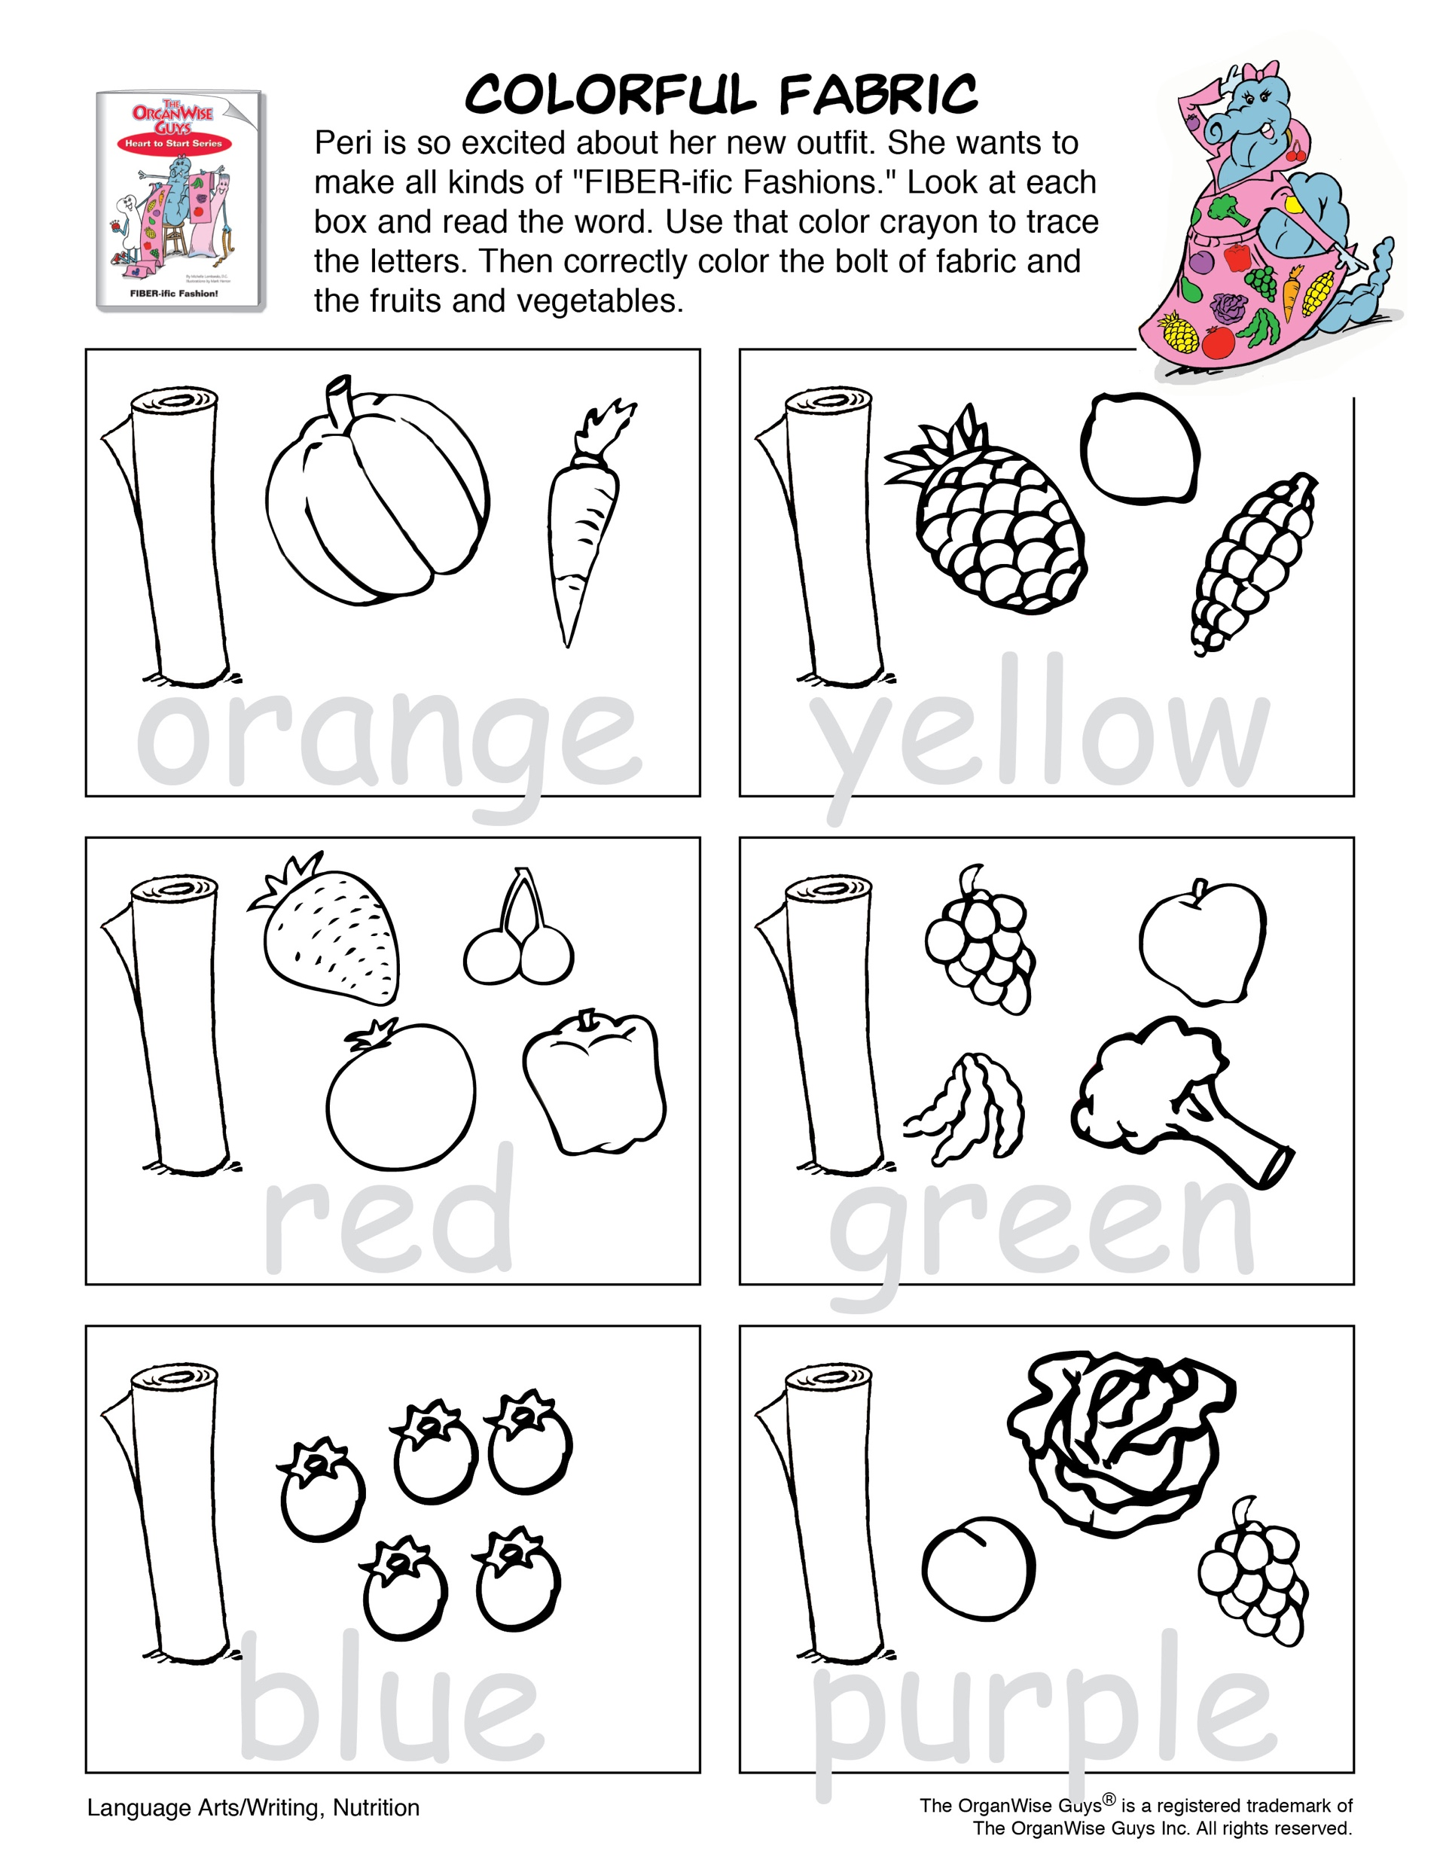
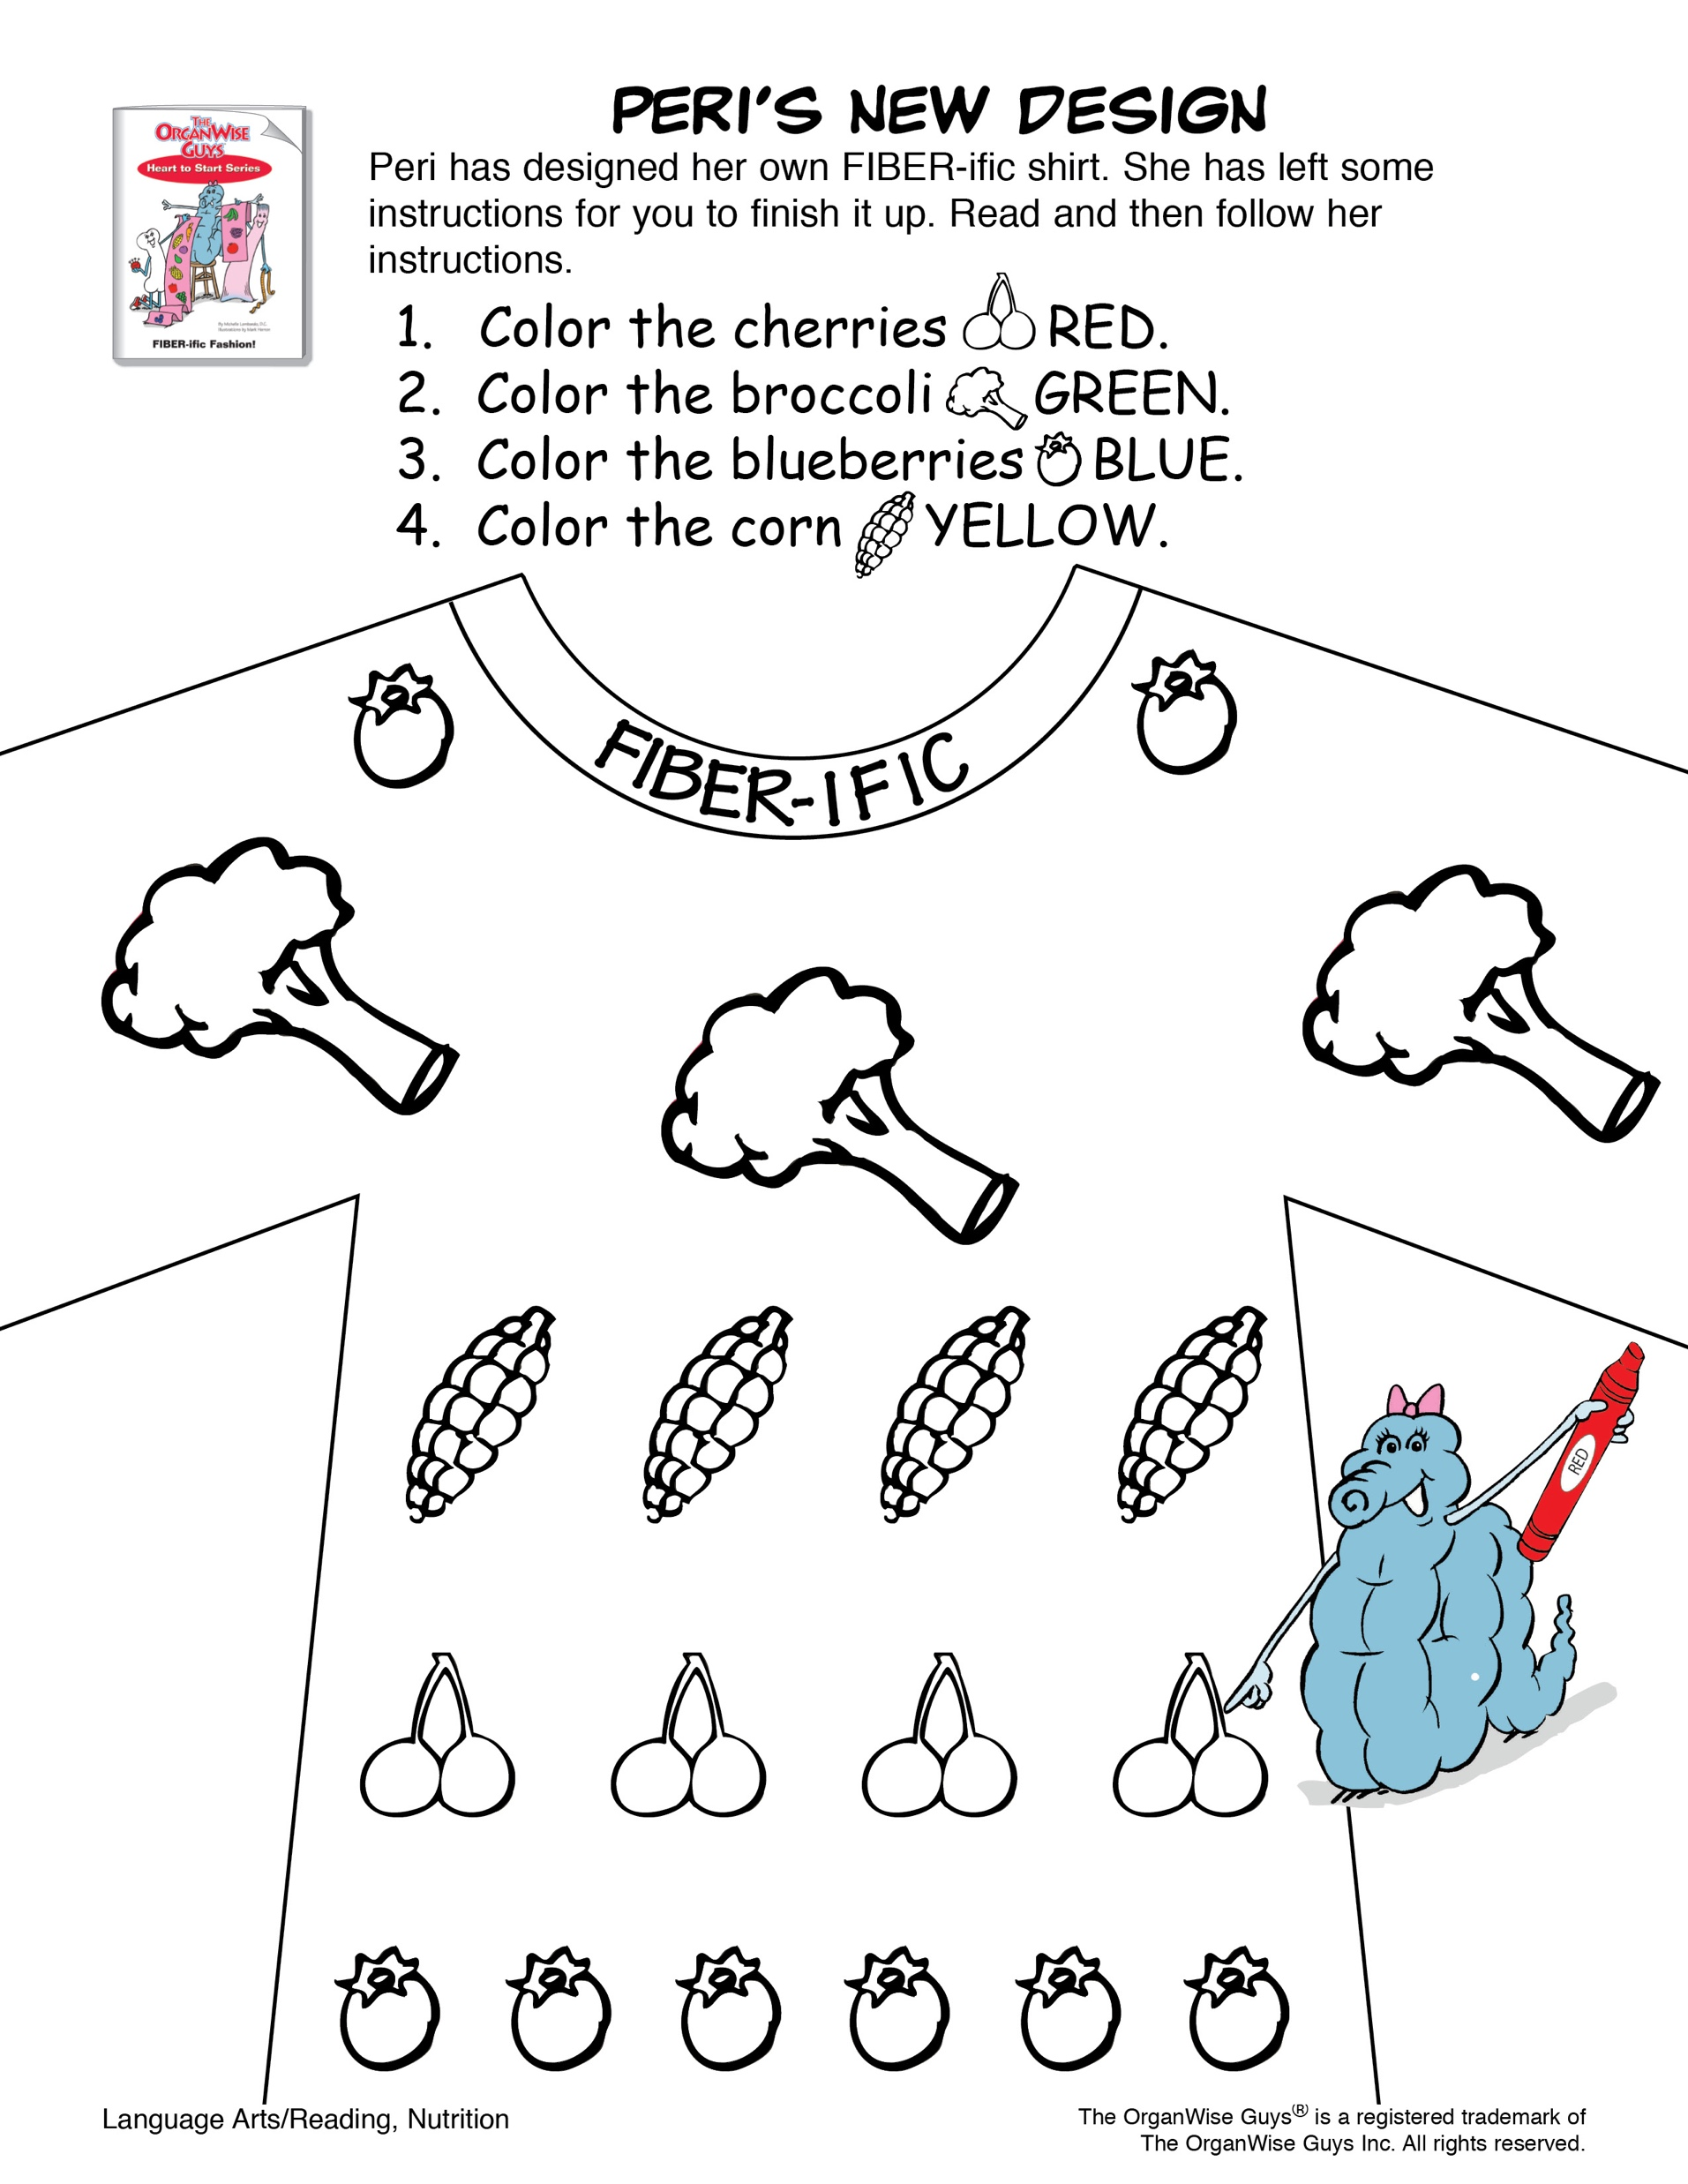

Slide 10

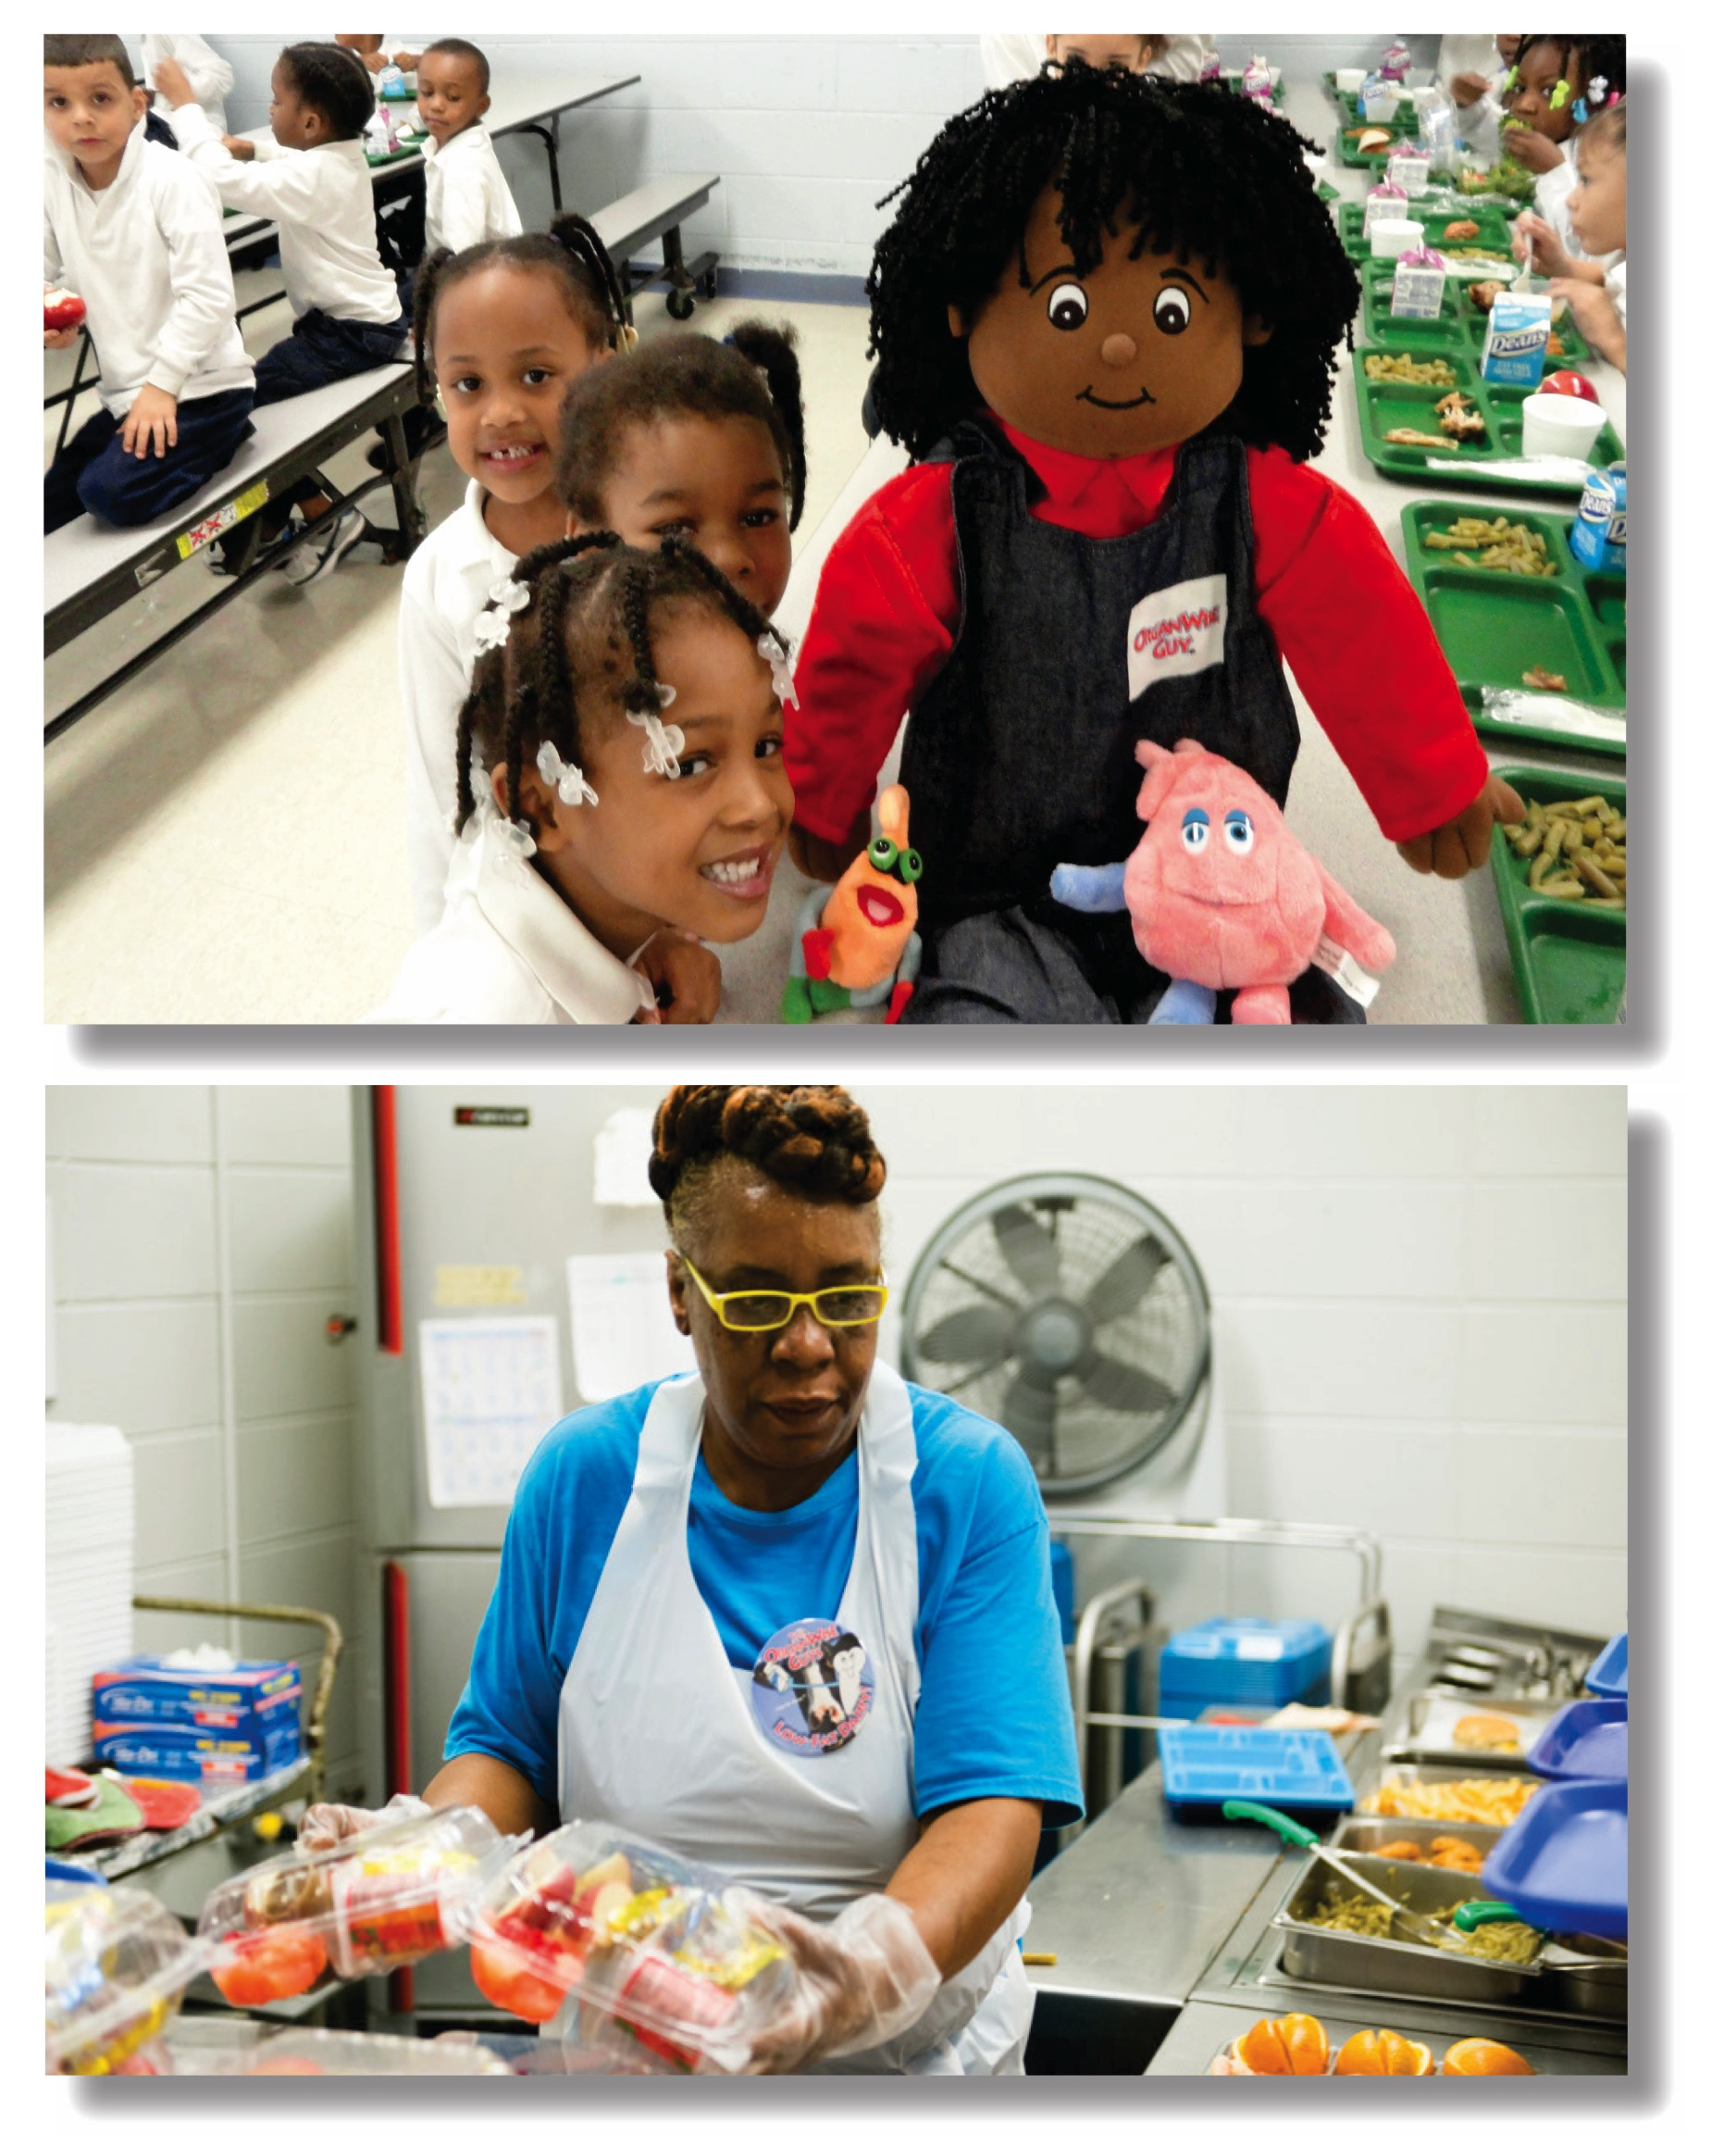
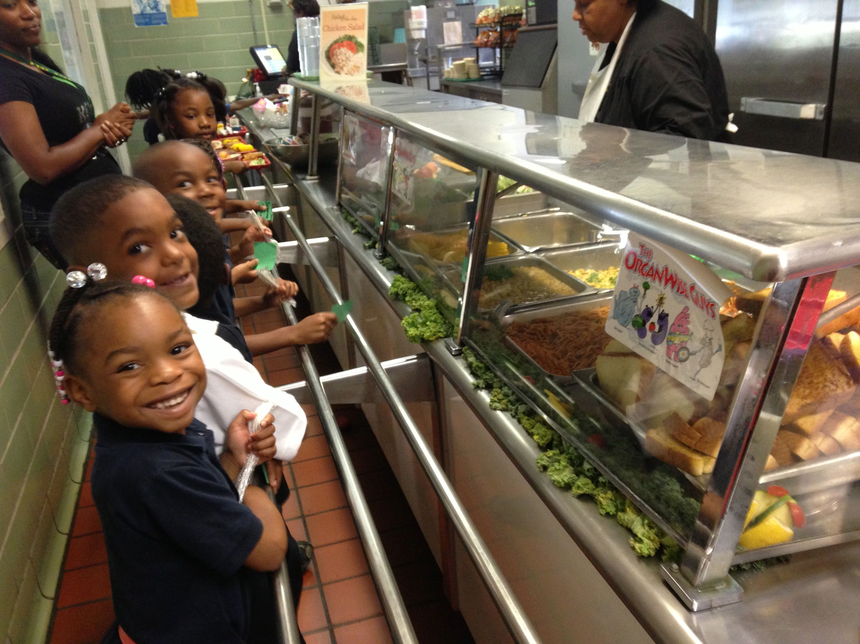
Notes:
Foods of the Month extends the fun learning from the classroom into the cafeteria for all day immersion in healthy living.
Two different nutrient-rich foods are highlighted each month in an engaging manner to encourage kids to start incorporating them into their meals and snacks.
These healthy messages reach the home as well with monthly newsletters designed for parents.

Slide 11
OWG Foods of the Month Club Calendar
September | Whole Grains | Tomatoes
October | Apples | Winter Squash
November | Lean Meats | Sweet Potatoes
December | Citrus | Root Vegetables
January | Cruciferous Vegetables | Legumes
February | Good Fats | Reduced Fat Dairy
March | Stems | Fish
April | Nuts | Fresh Beans
May | Eggs | Spinach
June | Berries | Peppers
July | Tropical Fruits | Corn
August | Stone Fruits | Summer Squash
Notes:
The FoM calendar was created during a 4.5 year study, and via consultation with the editor of Organic Gardening (magazine). The goal is to promote nutrient-dense foods in classroom lessons, materials sent home, and other community-wide nutrition education activities as well as to encourage foodservice personnel to menu FoM items the first, last, and at least 1 day each week of the month in which they are profiled as a “role-modeling” opportunity.

Slide 12
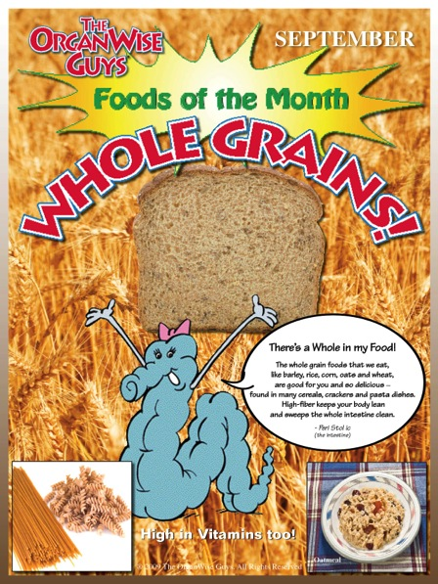
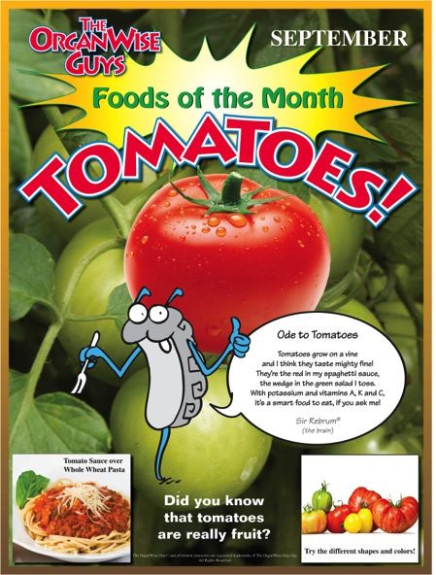
Monthly Posters
Notes:
Each month, the food service personnel will hang the posters of the two highlighted foods in strategic locations in the cafeteria where students can read the silly, yet educational poems and see pictures of the yummy dishes into which these nutrient-dense foods can be transformed. (FoM comes with two sets of these monthly posters.)
Ideally, these posters should be laminated for durability.

Slide 13
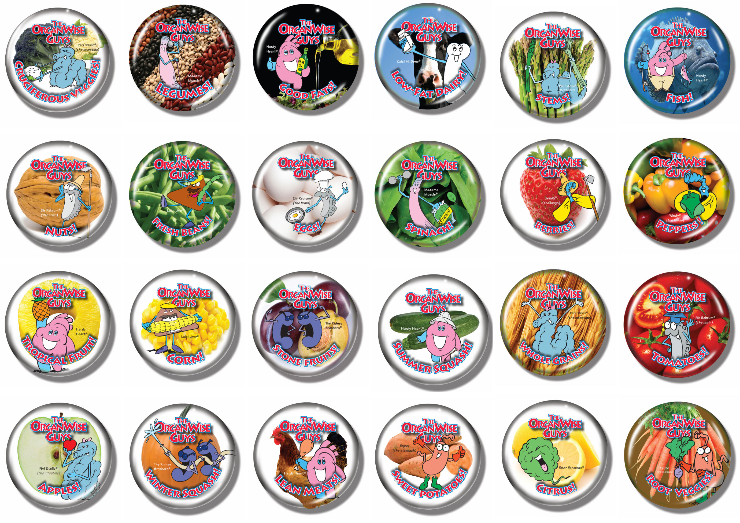
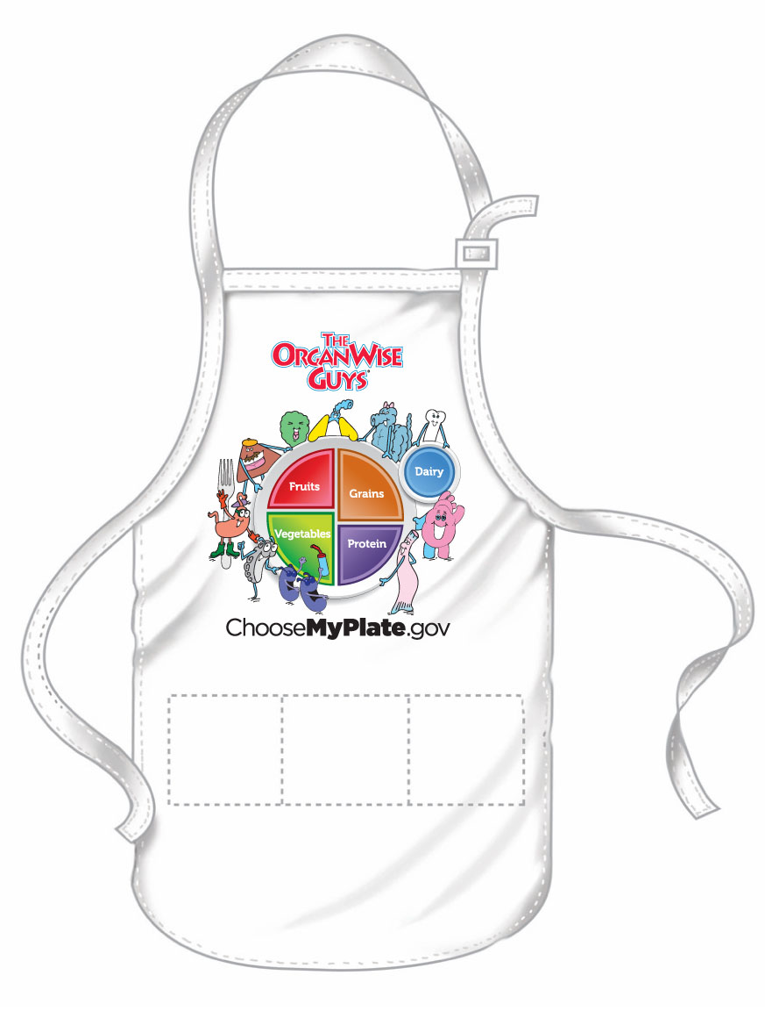
Buttons/Aprons for Child Nutrition Professionals
Notes:
These friendly buttons worn by the food service personnel are reminders of the FoMs as children are making their way down the lunch line.
The buttons do not have months on them so they can be worn all year long on days that any nutrient dense food is served (For example, the whole grain and tomatoes buttons could be worn on a day that pizza made with a whole grain crust is served.)
Suggestion: Keep buttons in a basket or some handy place so they’re easily accessible.

Slide 14
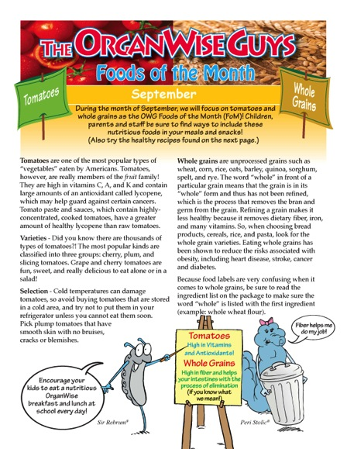
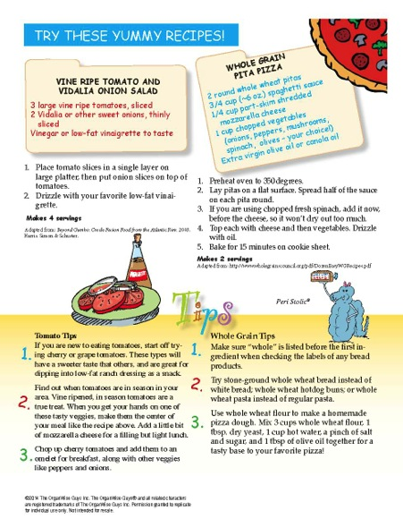
Family Newsletters
Notes:
Also available on the website are monthly newsletters that can be customized with your logo. These friendly, concise newsletters provide fun, nutrient-dense food education as well as recipes and tips. What a great way to communicate to the parents and the community about all the great work you are doing to help nourish and educate their children!
These newsletters are available in both English and Spanish.
Also, there is a space on page two at the bottom if your school would like to add their information before distributing them.
The OrganWise Guys Inc. also allows for a “FoM Club” school to put these on their school website for an even more cost-effective mode of distribution.

Slide 15
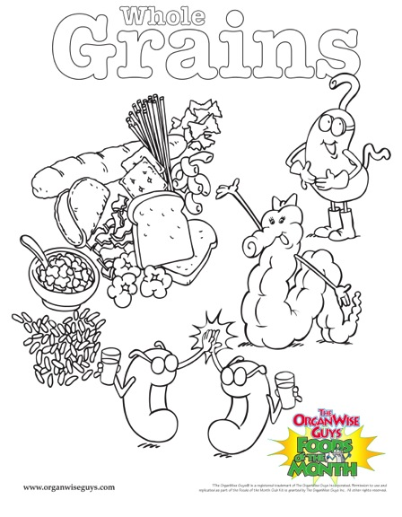
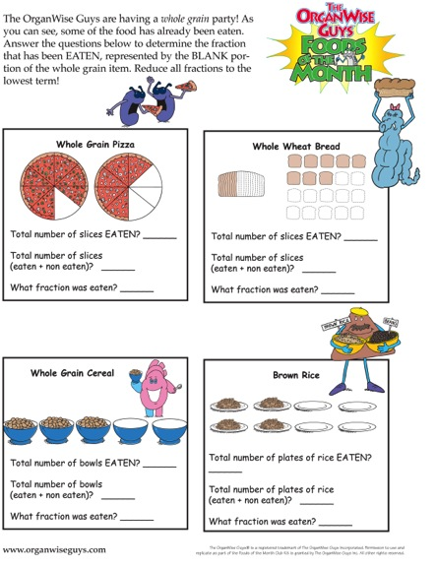
Activity/Coloring Sheets
Notes:
A great way to reinforce the healthy messages and remind students to choose these healthy foods at school and home is to print off activity sheets from the website. These sheets can be done in the classroom, afterschool or at home.

Slide 16
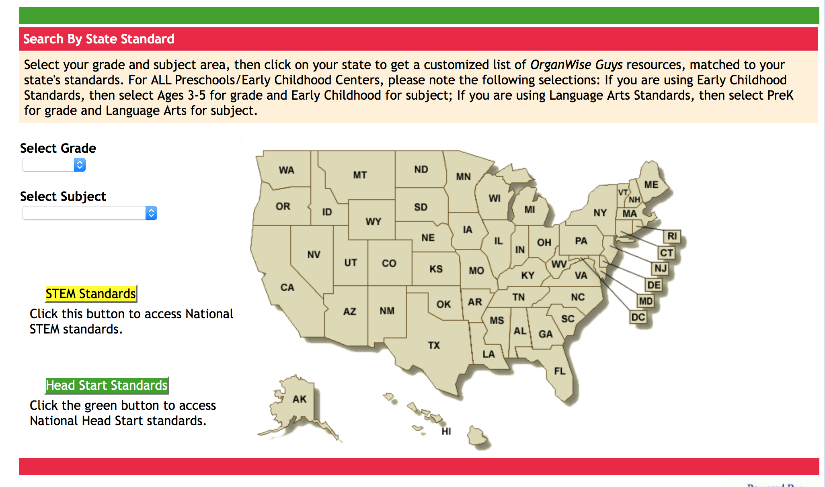
Linked to standards in all 50 states!

Slide 17
Statistically-Significant Health AND Academic Outcomes!
Results published in:
Journal of the Academy of Nutrition and Dietetics
Journal of American Public Health
Journal of Healthcare for the Poor and Underserved
Notes:
Our partners turn to us because we are the only study published in scientific journals showing these types of results on a large-scale school program. OWG is not just a fun program (although it is!) – we have a scientifically-backed proven model to help kids improve their healthy status and become better students by making smart choices that are good for their OrganWise Guys.

Slide 18
The Gold Standard: Reducing BMI Percentiles in Children
Change in BMI Percentiles
With OrganWise Program
Fall to Spring* (school year)
Change in BMI Percentile
Published in the Journal of the American Dietetic Association
(Journal of the Academy of Nutrition and Dietetics)
*p=.007
Hollar D, Messiah SE, Lopez-Mitnik G, Almon M, Hollar TL, Agatston AS. Effect of a school-based obesity prevention intervention
on weight and blood pressure in 6-13 year olds. Journal of the American Dietetic Association, 2010;110 (2), 261-267.
Notes:
In terms of health marker relevance, reducing BMI percentiles is the benchmark of success.
The Journal of the American Dietetic Association is the premier source for the practice and science of food, nutrition, and dietetics. The monthly, peer-reviewed journal presents original articles prepared by scholars and practitioners and is the most widely read professional publication in the field

Slide 19
Lowers Blood Pressure in Children
Fall Yr 1 Spring Yr 1 Fall Yr 2 Spring Yr 2
Published in the Journal of the American Dietetic Association
(Journal of the Academy of Nutrition and Dietetics)
Hollar D, Messiah SE, Lopez-Mitnik G, Almon M, Hollar TL, Agatston AS. Effect of a school-based obesity prevention intervention
on weight and blood pressure in 6-13 year olds. Journal of the American Dietetic Association, 2010;110 (2), 261-267.
Notes:
Similar to the significantly greater improvements in BMI percentile just shown, the intervention/program children began the study with higher diastolic blood pressures than controls/non-program children. However, by the end of the 2-year period, intervention/program children improved their diastolic blood pressures, with girls doing so to a statistically significant extent. Boys had significant improvements as well.
Note how the intervention/program children also experienced far less of an increase during summertime, which is typically a time where weight and blood pressure increases, as compared to control children. These results also were published in the Journal of the American Dietetic Association.

Slide 20
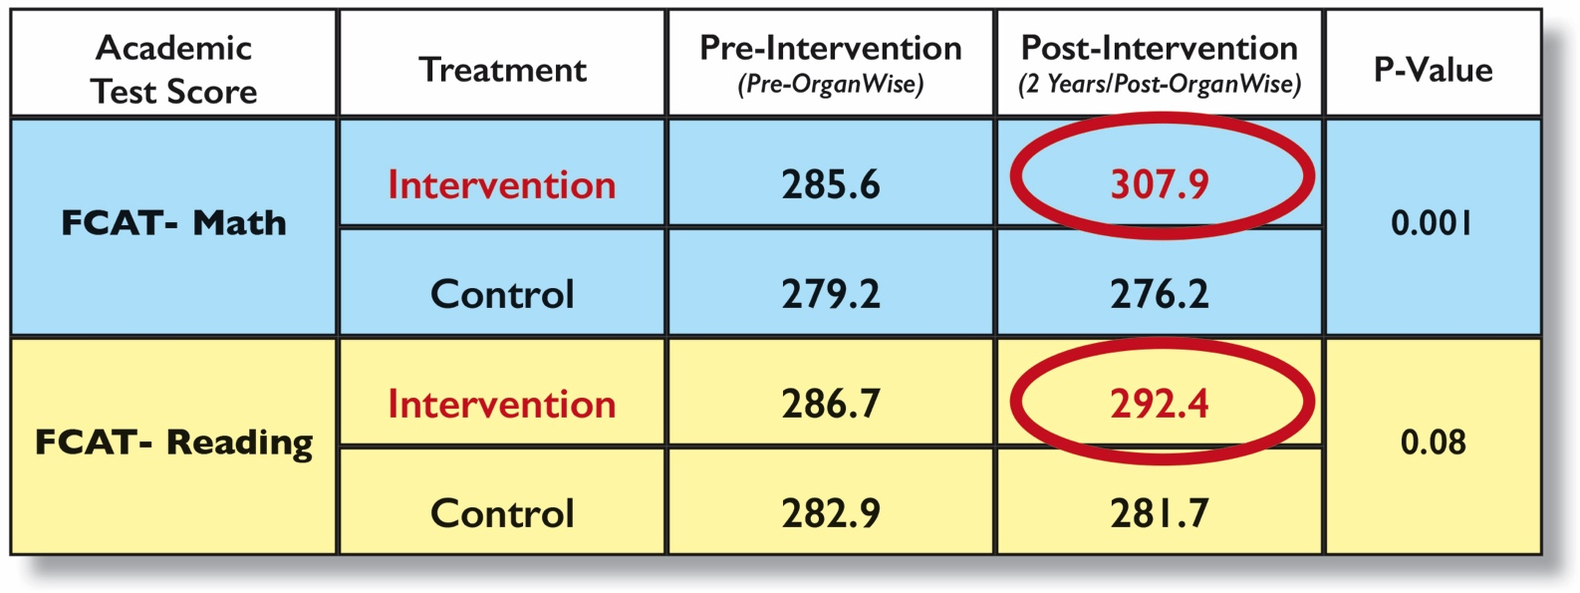
Improves Math and Reading Scores
No other program has achieved these results!
Published in the American Journal of Public Health
Hollar D, Messiah SE, Lopez-Mitnik G, Almon M, Hollar TL, Agatston AS. Effect of an elementary school-based obesity prevention
Intervention on weight and academic performance among low income children. American Journal of Public Health. 2010;100: 646-653.
Notes:
Notes for reference: Baseline data (2003-2004) reporting the math and reading scores of intervention and control children showed no statistically significant differences between the groups with respect to the average test scores.
However, as the study commenced, the intervention children began out- performing the control children, to a statistically significant extent. These are the only data in all of the published literature that show school-based obesity prevention interventions improve BOTH health and academic achievement of children.
The American Journal of Public Health (AJPH) is dedicated to the publication of original work in research, research methods, and program evaluation in the field of public health. The mission of the AJPH is to advance public health research, policy, practice, and education. Each month, national and international public health professionals turn to AJPH for the most current, authoritative, in-depth information in the field.

Slide 21


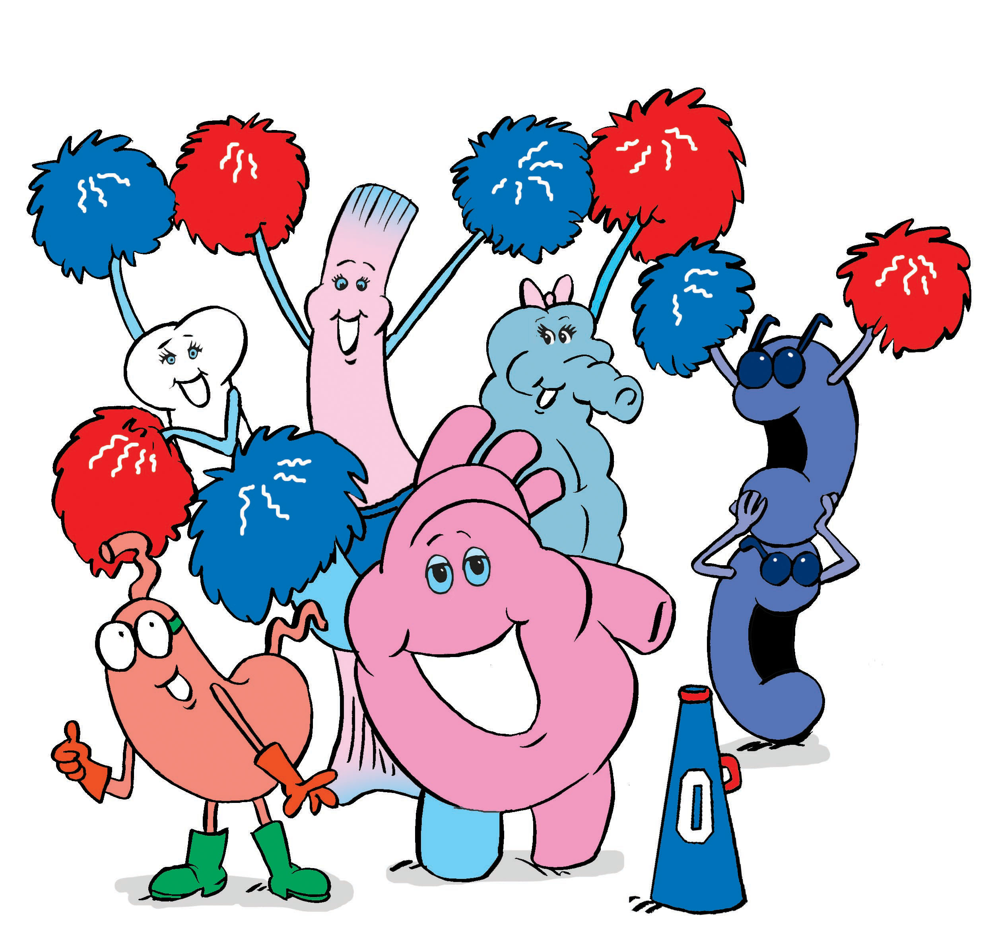
The following program was added September 2019
As a Research-Tested Program
Notes:
The Supplemental Nutrition Assistance Program (SNAP-Ed) Toolkit highlights successfully evaluated nutrition and healthy living programs conducted in low-income populations.

Slide 22

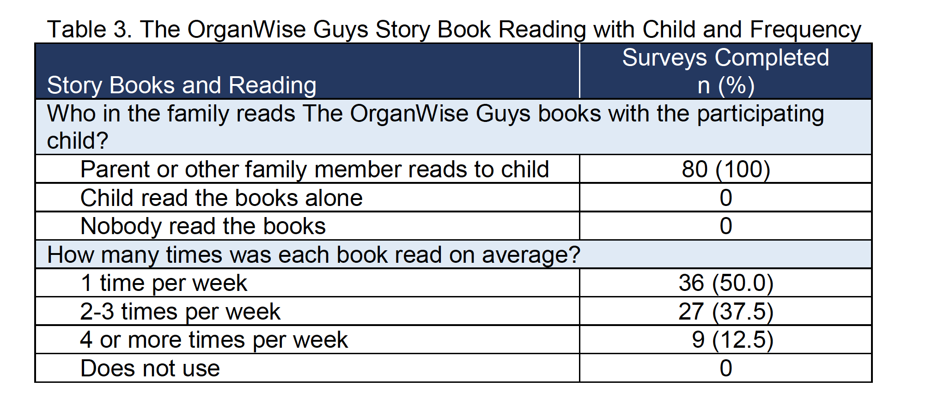

Slide 23
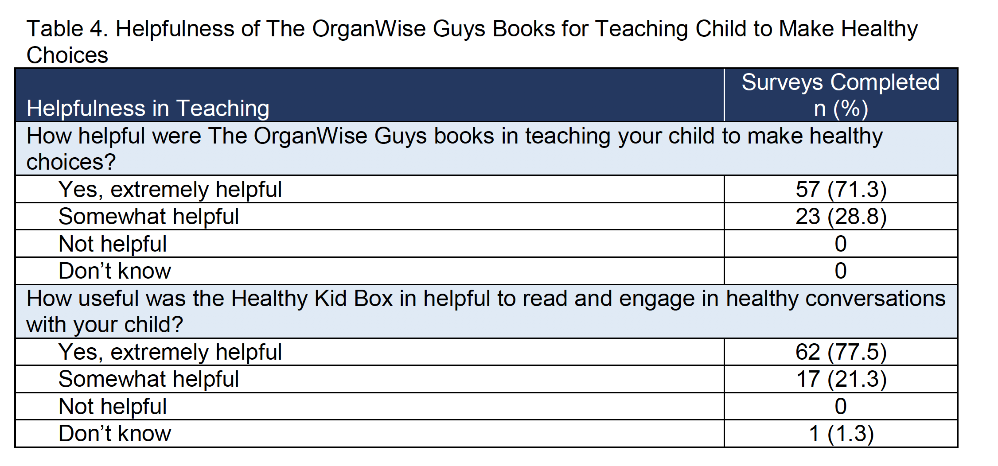

Slide 24
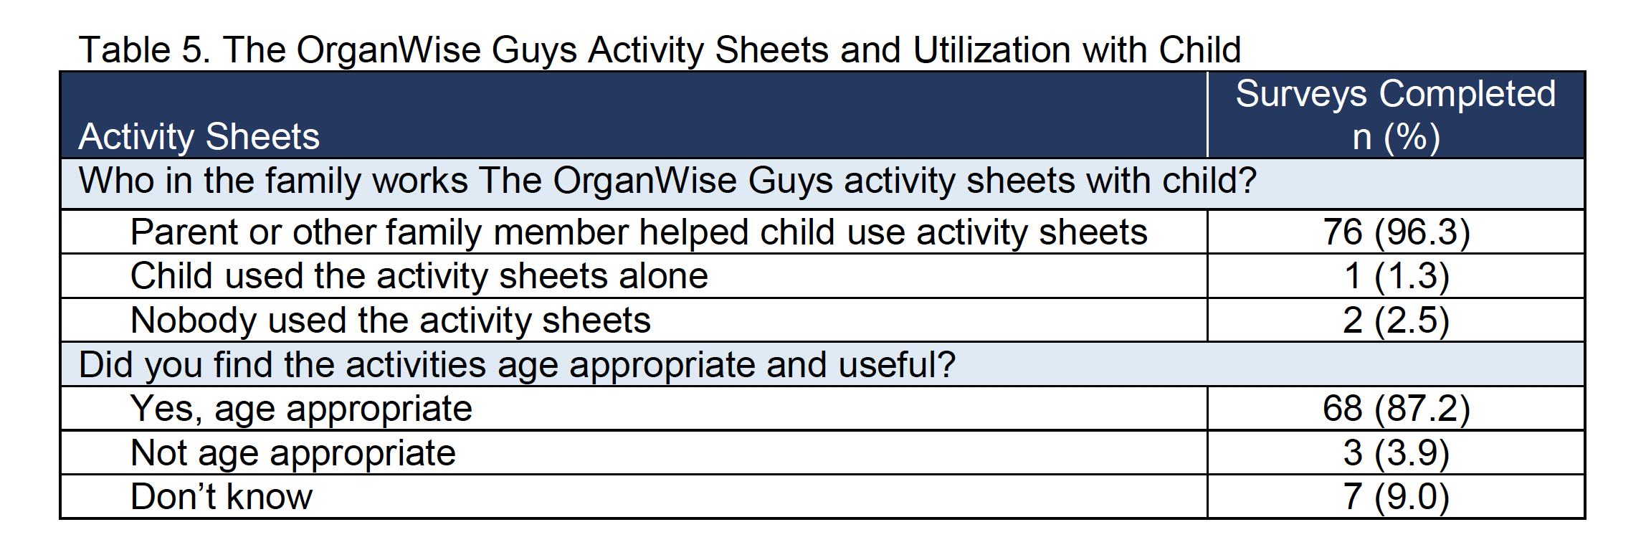

Slide 25
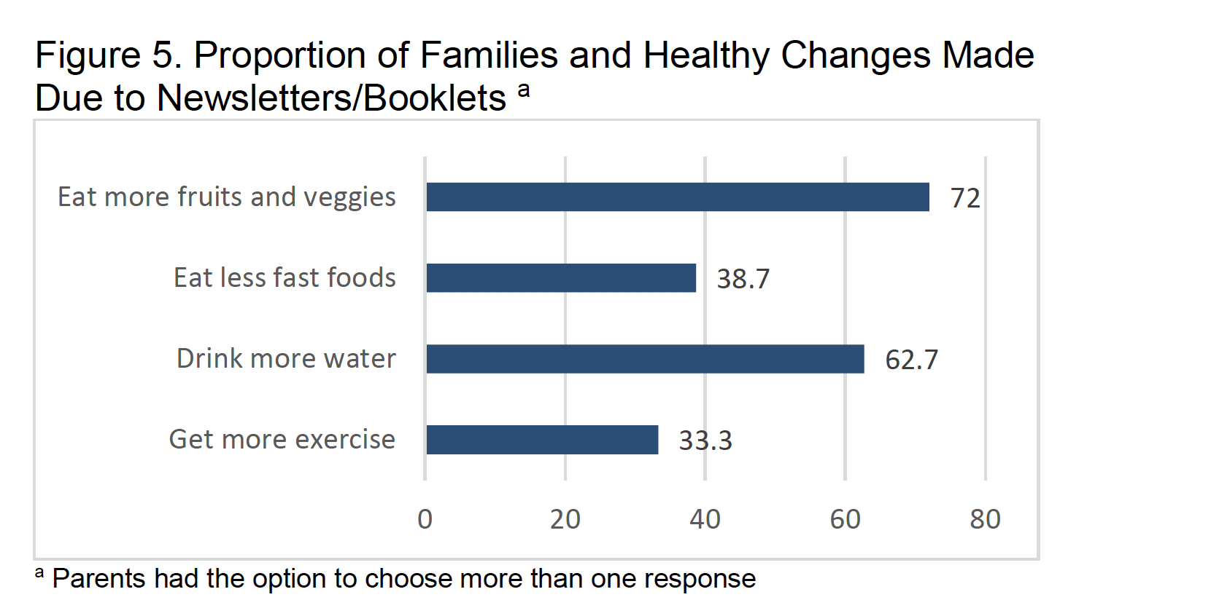

Slide 26
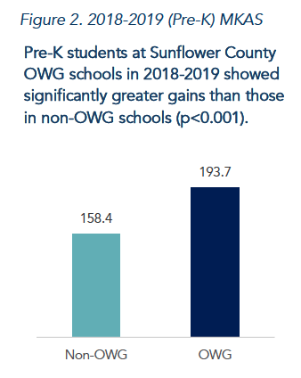
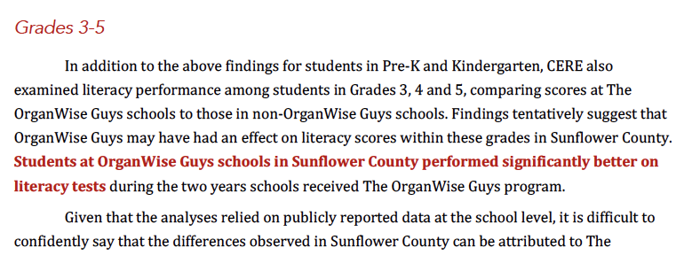

Slide 27
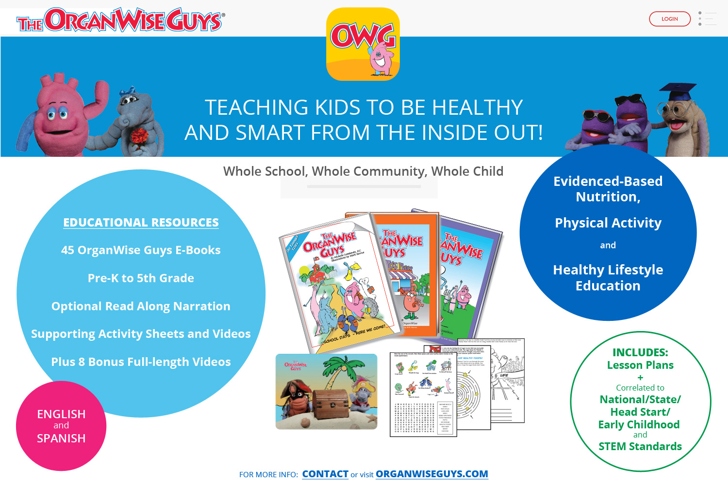

Slide 28
