Slide 1
Tactical Approach to Invasion Games
Matt Pomeroy
Twitter - @Physed_Pomeroy
Email - Pomeroym@merton.k12.wi.us
http://pomeroyshpe.weebly.com/

Slide 2
Becoming Comfortable TGfU
My 6th year using the TGfU Model / Have combined with a
game centered approach as well

Slide 3
Why Did I Start Using TGfU?

Slide 4
Disconnect
Low levels of engagement / interest / low levels of activity

Slide 5
Twitter
I saw what other educators were doing in regards to TGfU and how they were incorporating it!

Slide 6
My Journey
Started with units I was comfortable with (invasion games)
Worked towards other units (net / wall)
Finally tried (striking / fielding & target)

Slide 7
Traditional
We have always done it this way
Sills in isolation (strategies might be forgotten about)
Some smaller sized game play
Final large games

Slide 8
TGfU Is
Game, Skill Focus or Practice Task, Then Game
Skill Focus or Practice Task is also in a mini game with modified rules to focus on the skill
Practice Task could also be a strategy or tactic to develop
Highly active (kinesthetically and mentally)
Give students a chance to practice skills and strategies in a game and this helps them make better decisions

Slide 9
TGfU Is
Builds Students Competence (skills and strategies)
With Higher Levels of Competence, Students Develop Confidence in the Play
With Confidence, Students are Motivated to Play
When Students are Motivated, then they Participate

Slide 10
What is TGfU?
Classification of Formal Games (Hopper, Butler & Storey, 2009, p. 15)
•Target: archery, bocce, bowling, golf
•Striking: baseball, cricket, rounders, Danish longball
•Net/Wall: badminton, squash, volleyball, pickleball
•Invasion / Territorial: hockey, football (all kinds!), water polo, ultimate frisbee, basketball

Slide 11
Standard #1 - GLOs
Throws a mature pattern for distance or power-appropriate to the activity during small-sided game play. (S1.M2.8)
Catches using an implement in a dynamic environment or modified game play. (S1.M3.8)
Catches using an implement in a dynamic environment or modified game play. (S1.M3.8)
Passes and receives with an implement in combination with locomotor patterns of running and change or direction, speed and/or level with competency in invasion games such as lacrosse or hockey (floor, field, ice). (S1.M4.8)
Throws a lead pass to a moving partner off a dribble or pass. (S1.M5.8)
Executes the following offensive skills during small-sided game play: pivot, give & go, and fakes. (S1.M7.8)
Foot-dribbles or dribbles with an implement with control, changing speed and direction during small-sided game play. (S1.M9.8)

Slide 12
Standard #2 GLOs
Opens and closes space during small-sided game play by combining locomotor movements with movement concepts. (S2.M1.8)
Executes at least 3 of the following offensive tactics to create open space: moves to create open space on and off the ball; uses a variety of passes, fakes and pathways; give & go. (S2.M2.8)
Creates open space by staying spread on offense, cutting and passing quickly, and using fakes off the ball. (S2.M3.8)
Reduces open space on defense by staying on the goal side of the offensive player and reducing the distance to him/ her (third-party perspective). (S2.M4.8)
Reduces open space by not allowing the catch (denial) and anticipating the speed of the object or person for the purpose of interception or deflection. (S2.M5.8)
Transitions from offense to defense or defense to offense by recovering quickly, communicating with teammates and capitalizing on an advantage. (S2.M6.8)

Slide 13
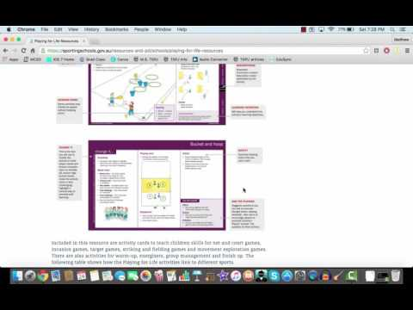
Sporting for Schools - TGfU Acivities - Playing For Life

Slide 14
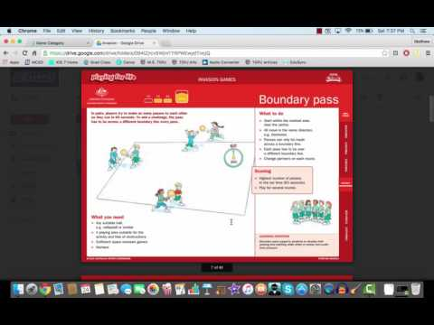
Invasion - Activities from Sporting Schools

Slide 15
Soccer
Middle - High School Example
Notes:
Test notes

Slide 16
INVASION GAMES
Dribble & Chase
Focus
What are we learning while participating?
Dribble and chase is a great introductory activity to teach students how to dribble and maintain possession on the object. This activity really challenges the student that is dribbling and help them improve their dribbling technique while playing a game at a very high level. This activity also begins to layer in defensive tactics. The defender has a major advantage in these early stages of the unit and it helps build their competence in defending the ball and taking it away. Partners will challenge someone at their ability level and that will help both of their skills improve, while having fun!
Notes:
Test notes

Slide 17
INVASION GAMES
Passing & Moving
Focus
What are we learning while participating?
One or Two Touch Passes
What can I use for more control?
Passing with Inside / Outside of the Foot
How can I successfully get the ball to my teammate?
Receiving and Controlling the ball
How can I control to ball off a pass?
Passing to a Moving Target
Where do I move to get open?
Moving to Open Space
Notes:
Test notes

Slide 18
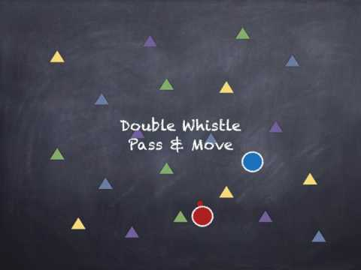
Invasion Games
Passing, Moving, & 1v1
Focus
What are we learning while participating?
Everything in the first drill
Now adding the complexity of playing 1v1 when the teacher asks for it.
Chaging speeds, direction, and making moves to get past a defender
Defender is working on the ball on defense and keeping themselves between the ball and the goal.
Notes:
Test notes

Slide 19
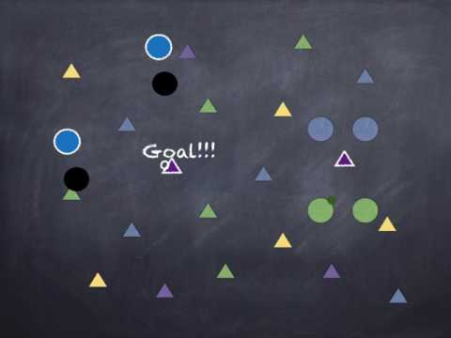
Invasion Games
2 V 2
TACTICAL LEARNING
How can two offensive players work together to score?
How can two defenders work together to stop them from scoring?
Consider setting up this activity 2v1 where the offensive players could not dribble. What will the focus be then?
SUGGESTED QUESTIONS:
HOW CAN WE EFFECTIVELY COMMUNICATE?
WHERE SHOULD YOU GO TO GET THE BALL?
WHAT HAPPENS WHEN YOU GO FROM ON THE BALL TO OFF THE BALL?
HOW DO I KEEP THE PLAYERS IN FRONT OF ME WHEN THEY HAVE THE BALL?
Notes:
Test notes

Slide 20
Day #2
Will start with 2v2 to a cone goal
for the instant activity

Slide 21
Invasion Games
3 v 1 Passing & Defending
TACTICAL LEARNING
How can one defensive player stop 3 offensive players from making their passes.
Consider setting up your activity to challenge the offense to see how many passes they can catch before the ball is stolen.
SUGGESTED QUESTIONS:
WHEN DO YOU PASS THE BALL?
HOW DO I PASS THE BALL?
WHERE DO I PASS THE BALL?
HOW DO I USE 2 TOUCHES?
WHERE DO I MOVE TO?
WHEN DO I MOVE TO PLAY ON THE BALL DEFENSE?
WHEN DO I MOVE TO PLAY OFF THE BALL DEFENSE?
Notes:
Test notes

Slide 22
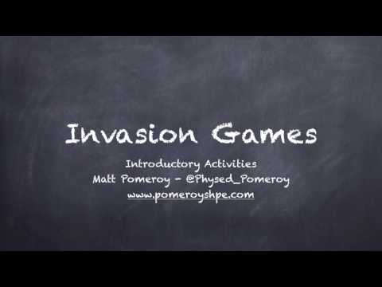
Invasion Games
3 v 1 To a Cone Goal
TACTICAL LEARNING
How can one defensive player stop 3 offensive players from making their passes.
Consider setting up your activity to challenge the offense to see how many passes they can catch before the ball is stolen.
SUGGESTED QUESTIONS:
WHEN DO YOU PASS THE BALL?
HOW DO I PASS THE BALL?
WHERE DO I PASS THE BALL?
WHEN SHOULD WE SHOOT THE BALL?
WHERE DO I MOVE TO?
WHEN DO I MOVE TO PLAY ON THE BALL DEFENSE?
WHEN DO I MOVE TO PLAY OFF THE BALL DEFENSE?
Notes:
Test notes

Slide 23
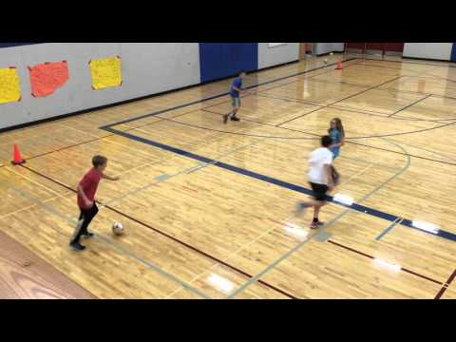
Invasion Games
2 V 2 Endball
TACTICAL LEARNING
How can we use our skills and strategies to attack and defend modified goals?
Consider setting up this activity using different rules. Try no dribbling, no defending the passer, or 3 passes before a score
SUGGESTED QUESTIONS:
HOW CAN WE FIND OPEN SPACE ON OFFENSE?
HOW CAN WE STOP SOMEONE FROM FINDING OPEN SPACE?
WHAT PASSES ARE MOST EFFECTIVE?
HOW CAN I MAKE IT HARDER FROM THE PASSER?
HOW DO WE ATTACK AND DEFEND A BIG GOAL?
Notes:
Test notes

Slide 24
Invasion Games
2 V 2 W/ 2 Cone Goals
TACTICAL LEARNING
HOW DO YOU STRUCTURE YOUR OFFENSE / DEFENSE TO ATTACK / DEFEND 1 SMALL GOAL?
Consider setting up your game in a small space / large space or even using more goals to create more space.
SUGGESTED QUESTIONS:
HOW CAN YOU ATTACK A SMALLER GOAL?
HOW CAN YOU CREATE ENOUGH SPACE AROUND THE CONE TO SCORE?
WHEN SHOULD YOU PASS?
WHEN SHOULD YOU DRIBBLE
WHEN COULD YOU HELP ON DEFENSE?
Notes:
Test notes

Slide 25
Day #3
Start with 2 vs 2 with 2 Cone Goals
for an instant activity

Slide 26
Invasion Games
4 V 4 W/ Goalies & Goals
TACTICAL LEARNING
HOW DO YOU STRUCTURE YOUR OFFENSE / DEFENSE TO ATTACK / DEFEND YOUR GOAL?
HOW CAN YOU COMMUNICATE AS A TEAM?
SUGGESTED QUESTIONS:
HOW CAN YOU ATTACK A SMALLER GOAL?
HOW CAN YOU CREATE ENOUGH SPACE AROUND THE GOAL TO SCORE?
WHEN SHOULD YOU PASS?
WHEN SHOULD YOU DRIBBLE?
WHEN COULD / SHOULD YOU HELP ON DEFENSE?
Notes:
Test notes

Slide 27
Invasion Games
2 V 1 W/ A Goalie
TACTICAL LEARNING
HOW CAN YOU ATTACK THE GOAL AS A TEAM?
WHO DO YOU GUARD ON DEFENSE AND WHEN DO YOU CHOOSE TO ATTACK?
SUGGESTED QUESTIONS:
HOW CAN YOU ATTACK QUICKLY?
HOW CAN YOU UTILIZE MORE PLAYERS ON OFFENSE?
HOW CAN YOU MOVE IN FRONT OF THE GOAL?
WHO SHOULD YOU DEFEND?
WHEN SHOULD YOU DEFEND THEM?
HOW CAN YOU ANTICIPATE WHAT IS HAPPENING NEXT?
Notes:
Test notes

Slide 28
Invasion Games
4 V 4 W/ Goalies & Cones
TACTICAL LEARNING
HOW DO YOU STRUCTURE YOUR OFFENSIVE / DEFENSIVE SUCCESS?
SUGGESTED QUESTIONS:
HOW CAN YOU ATTACK A SMALLER GOAL?
HOW CAN YOU CREATE ENOUGH SPACE AROUND THE GOAL TO SCORE?
WHEN SHOULD YOU PASS?
WHEN SHOULD YOU DRIBBLE?
WHEN COULD / SHOULD YOU HELP ON DEFENSE?
Notes:
Test notes

Slide 29
Day #4
Start with 3 v 3 w/ 2 Cone Goals

Slide 30
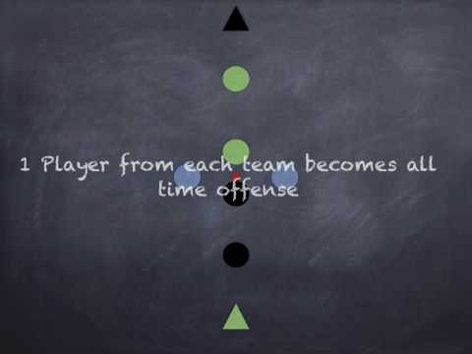
Invasion Games
4 V 2 Overload
TACTICAL LEARNING
Creating Open Space and Attacking The Goal
Making Decisions on Defense About who is the Biggest Scoring Threat
SUGGESTED QUESTIONS:
HOW CAN YOU ATTACK QUICKLY?
HOW CAN YOU UTILIZE MORE PLAYERS ON OFFENSE?
HOW CAN YOU MOVE IN FRONT OF THE GOAL?
WHO SHOULD YOU DEFEND?
HOW CAN YOU EFFECTIVELY TRANSITION FROM OFFENSE TO DEFENSE AND VISA VERSA?
Notes:
Test notes

Slide 31
Day #4
Finish with Larger Teams

Slide 32
Options for more Skill / Strategy Development for younger students

Slide 33
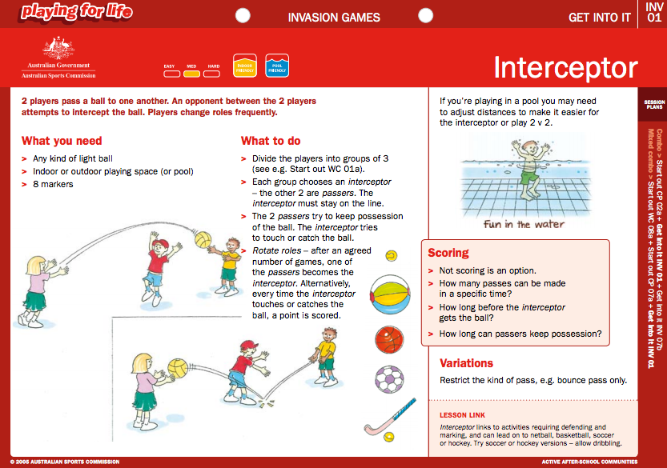
Invasion Games - Activities - Australian Sport

Slide 34
Invasion Games - Activities - Australian Sport

Slide 35
Invasion Games
3 V 3 Endball
TACTICAL LEARNING
How can we use our skills and strategies to attack and defend modified goals?
Consider setting up this activity using different rules. Try no dribbling, no defending the passer, or 3 passes before a score
SUGGESTED QUESTIONS:
HOW CAN WE FIND OPEN SPACE ON OFFENSE?
HOW CAN WE STOP SOMEONE FROM FINDING OPEN SPACE?
WHAT PASSES ARE MOST EFFECTIVE?
HOW CAN I MAKE IT HARDER FROM THE PASSER?
HOW DO WE ATTACK AND DEFEND A BIG GOAL?
Notes:
Test notes

Slide 36
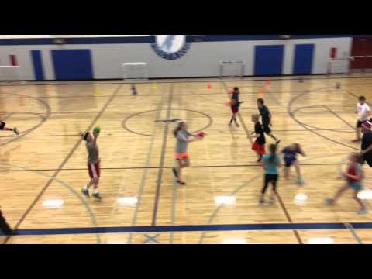
3 V 3 Endball - Handball
Notes:
Test notes

Slide 37
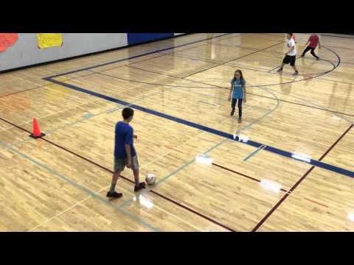
Invasion Games
3 V 3 W/ Cone Goals
TACTICAL LEARNING
HOW DO YOU STRUCTURE YOUR OFFENSE / DEFENSE TO ATTACK / DEFEND 1 SMALL GOAL?
Consider setting up your game on a larger / smaller court. Maybe you use 1, 2 or 3 cone goals to score on.
SUGGESTED QUESTIONS:
HOW CAN YOU ATTACK A SMALLER GOAL?
HOW CAN YOU CREATE ENOUGH SPACE AROUND THE CONE TO SCORE?
WHEN SHOULD YOU PASS?
WHEN SHOULD YOU DRIBBLE
WHEN COULD YOU HELP ON DEFENSE?
Notes:
Test notes

Slide 38
Invasion Games - Activities - Australian Sport

Slide 39
Invasion Games - Activities - Australian Sport

Slide 40
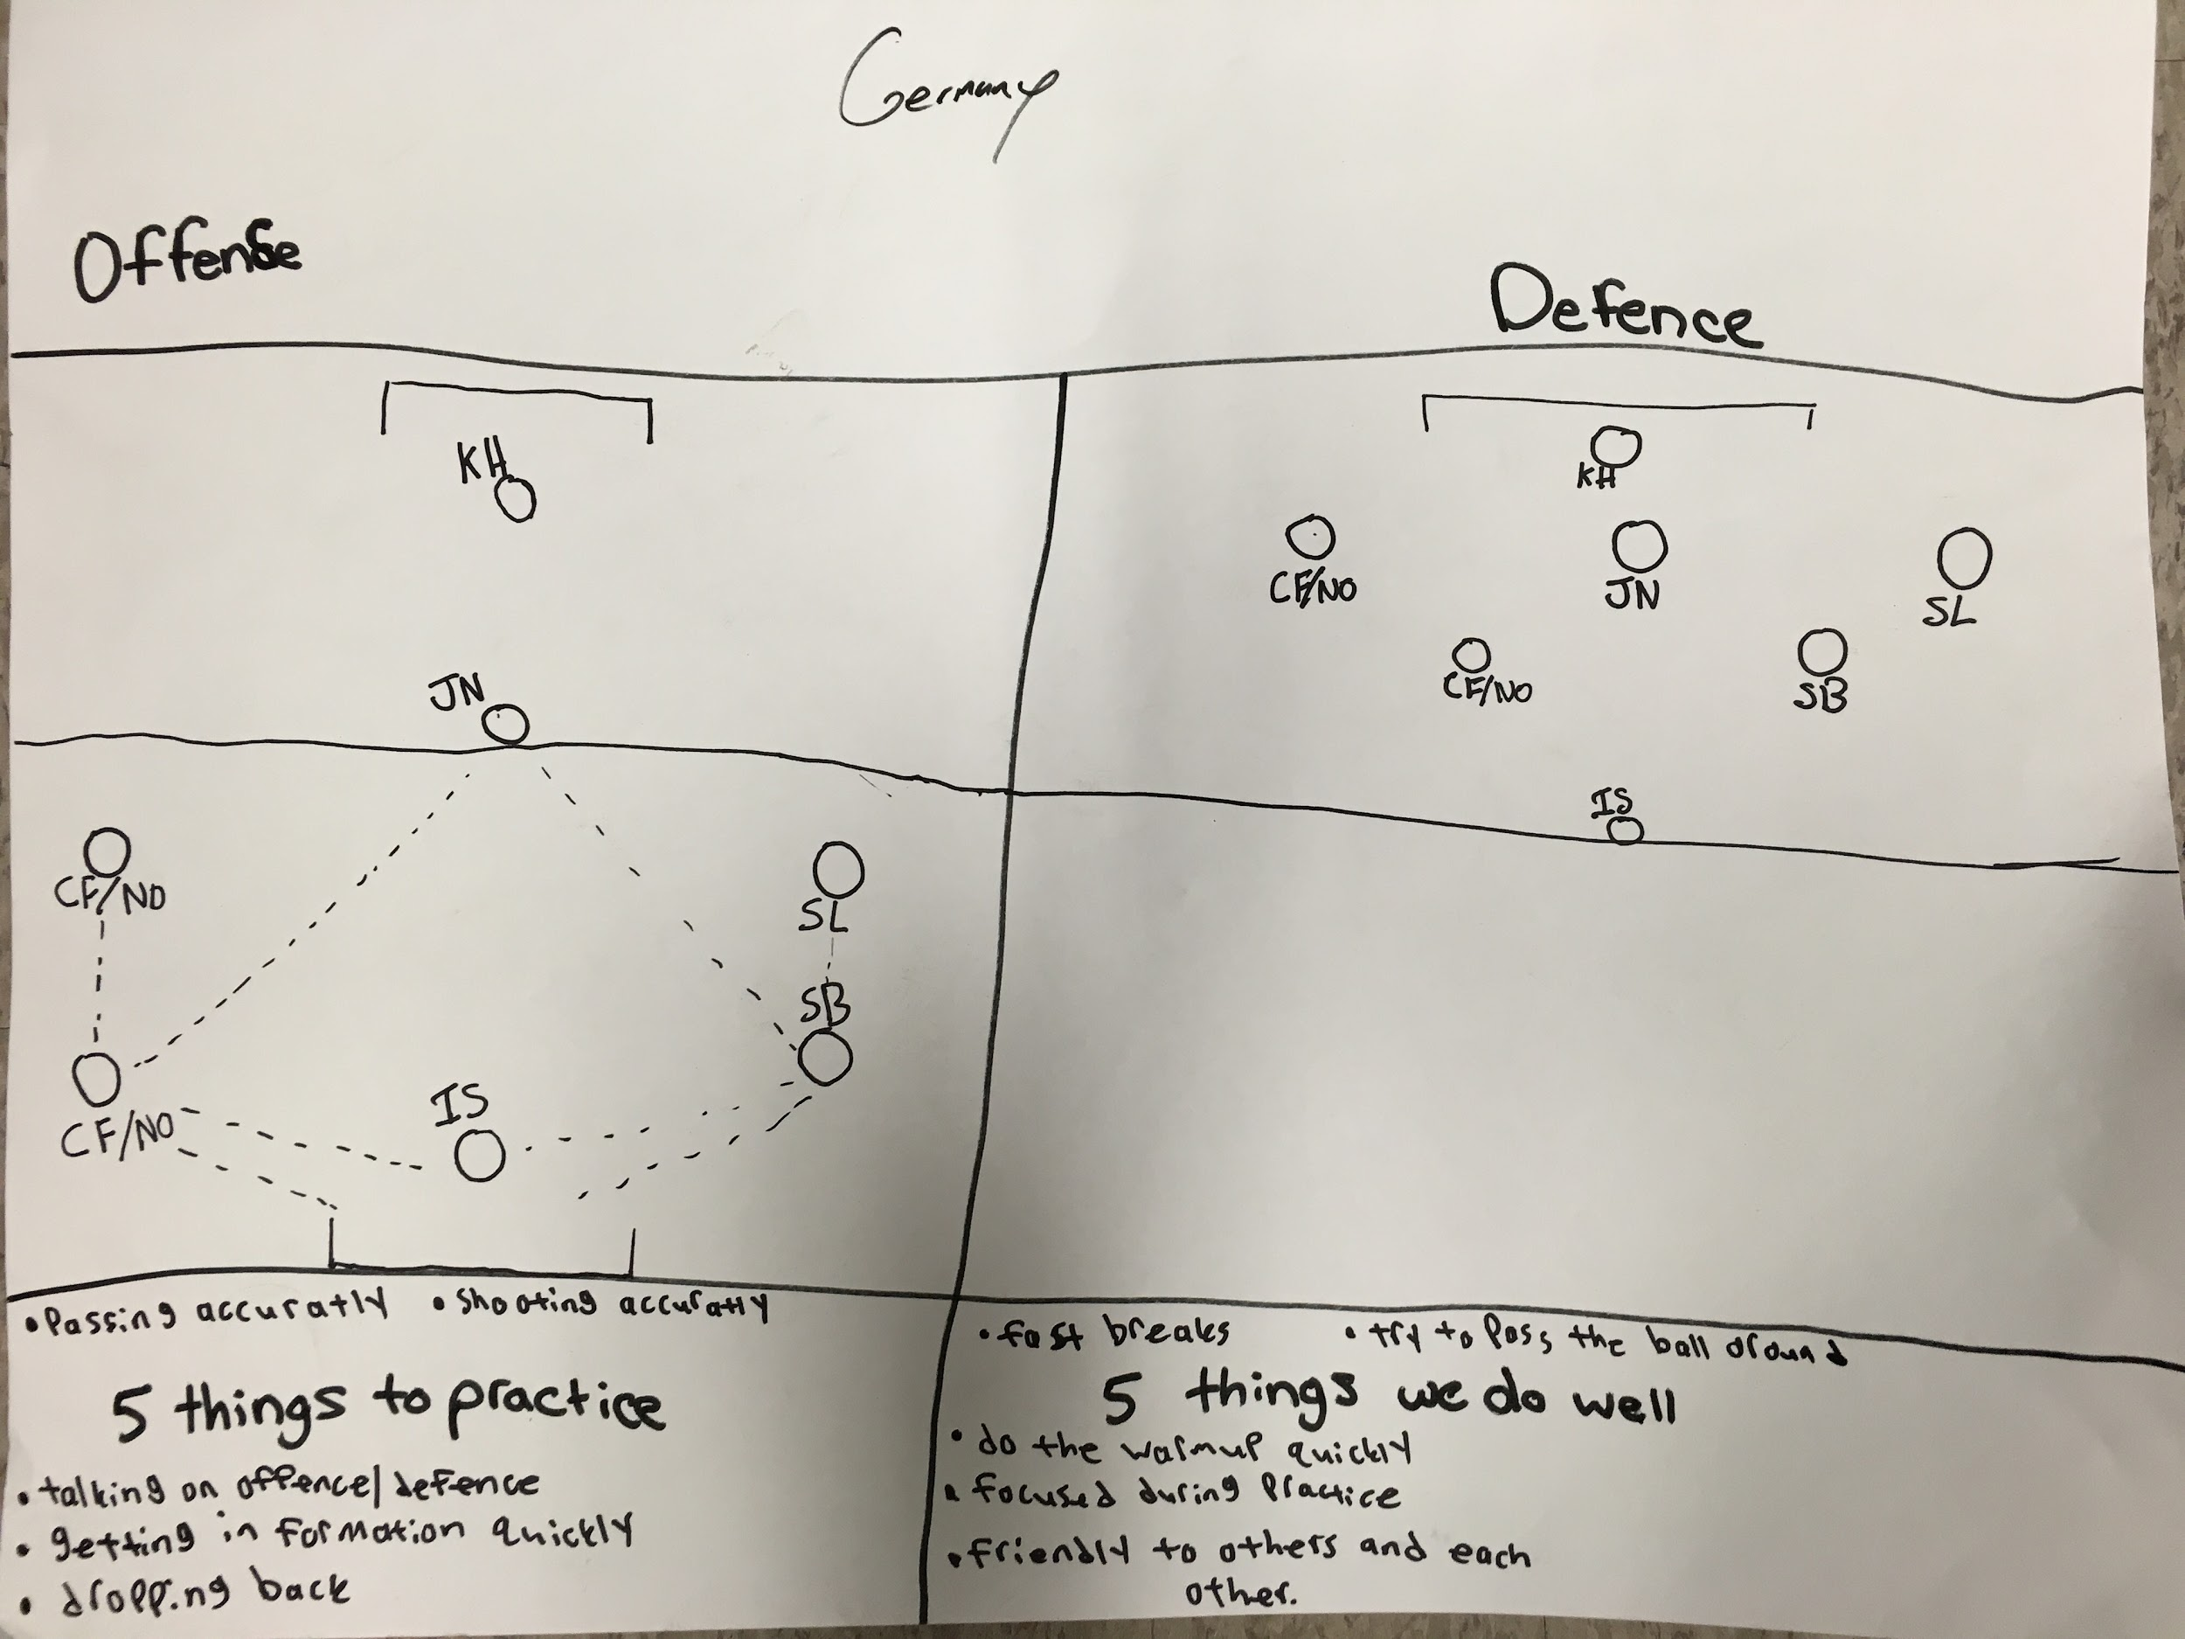
ASSESSMENT
KNOWLEDGE
TASK
Working as a team you will discuss a gameplan for the soccer season. This will include offensive and defensive gameplans, positioning, and tactics. Also list 5 specific skills / gameplay strategies that your team still need to work on. Students also listed 5 things that they really do well as a team. I used this as a rainy day assessment so the teams could sit down for longer periods and plan as a team. It was a beneficial experience for everyone, because each person got to talk, discuss, and plan for the rest of the soccer sport education season.
Notes:
Test notes

Slide 41
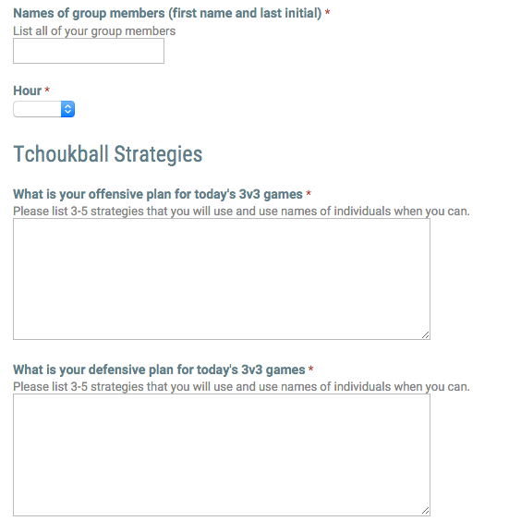
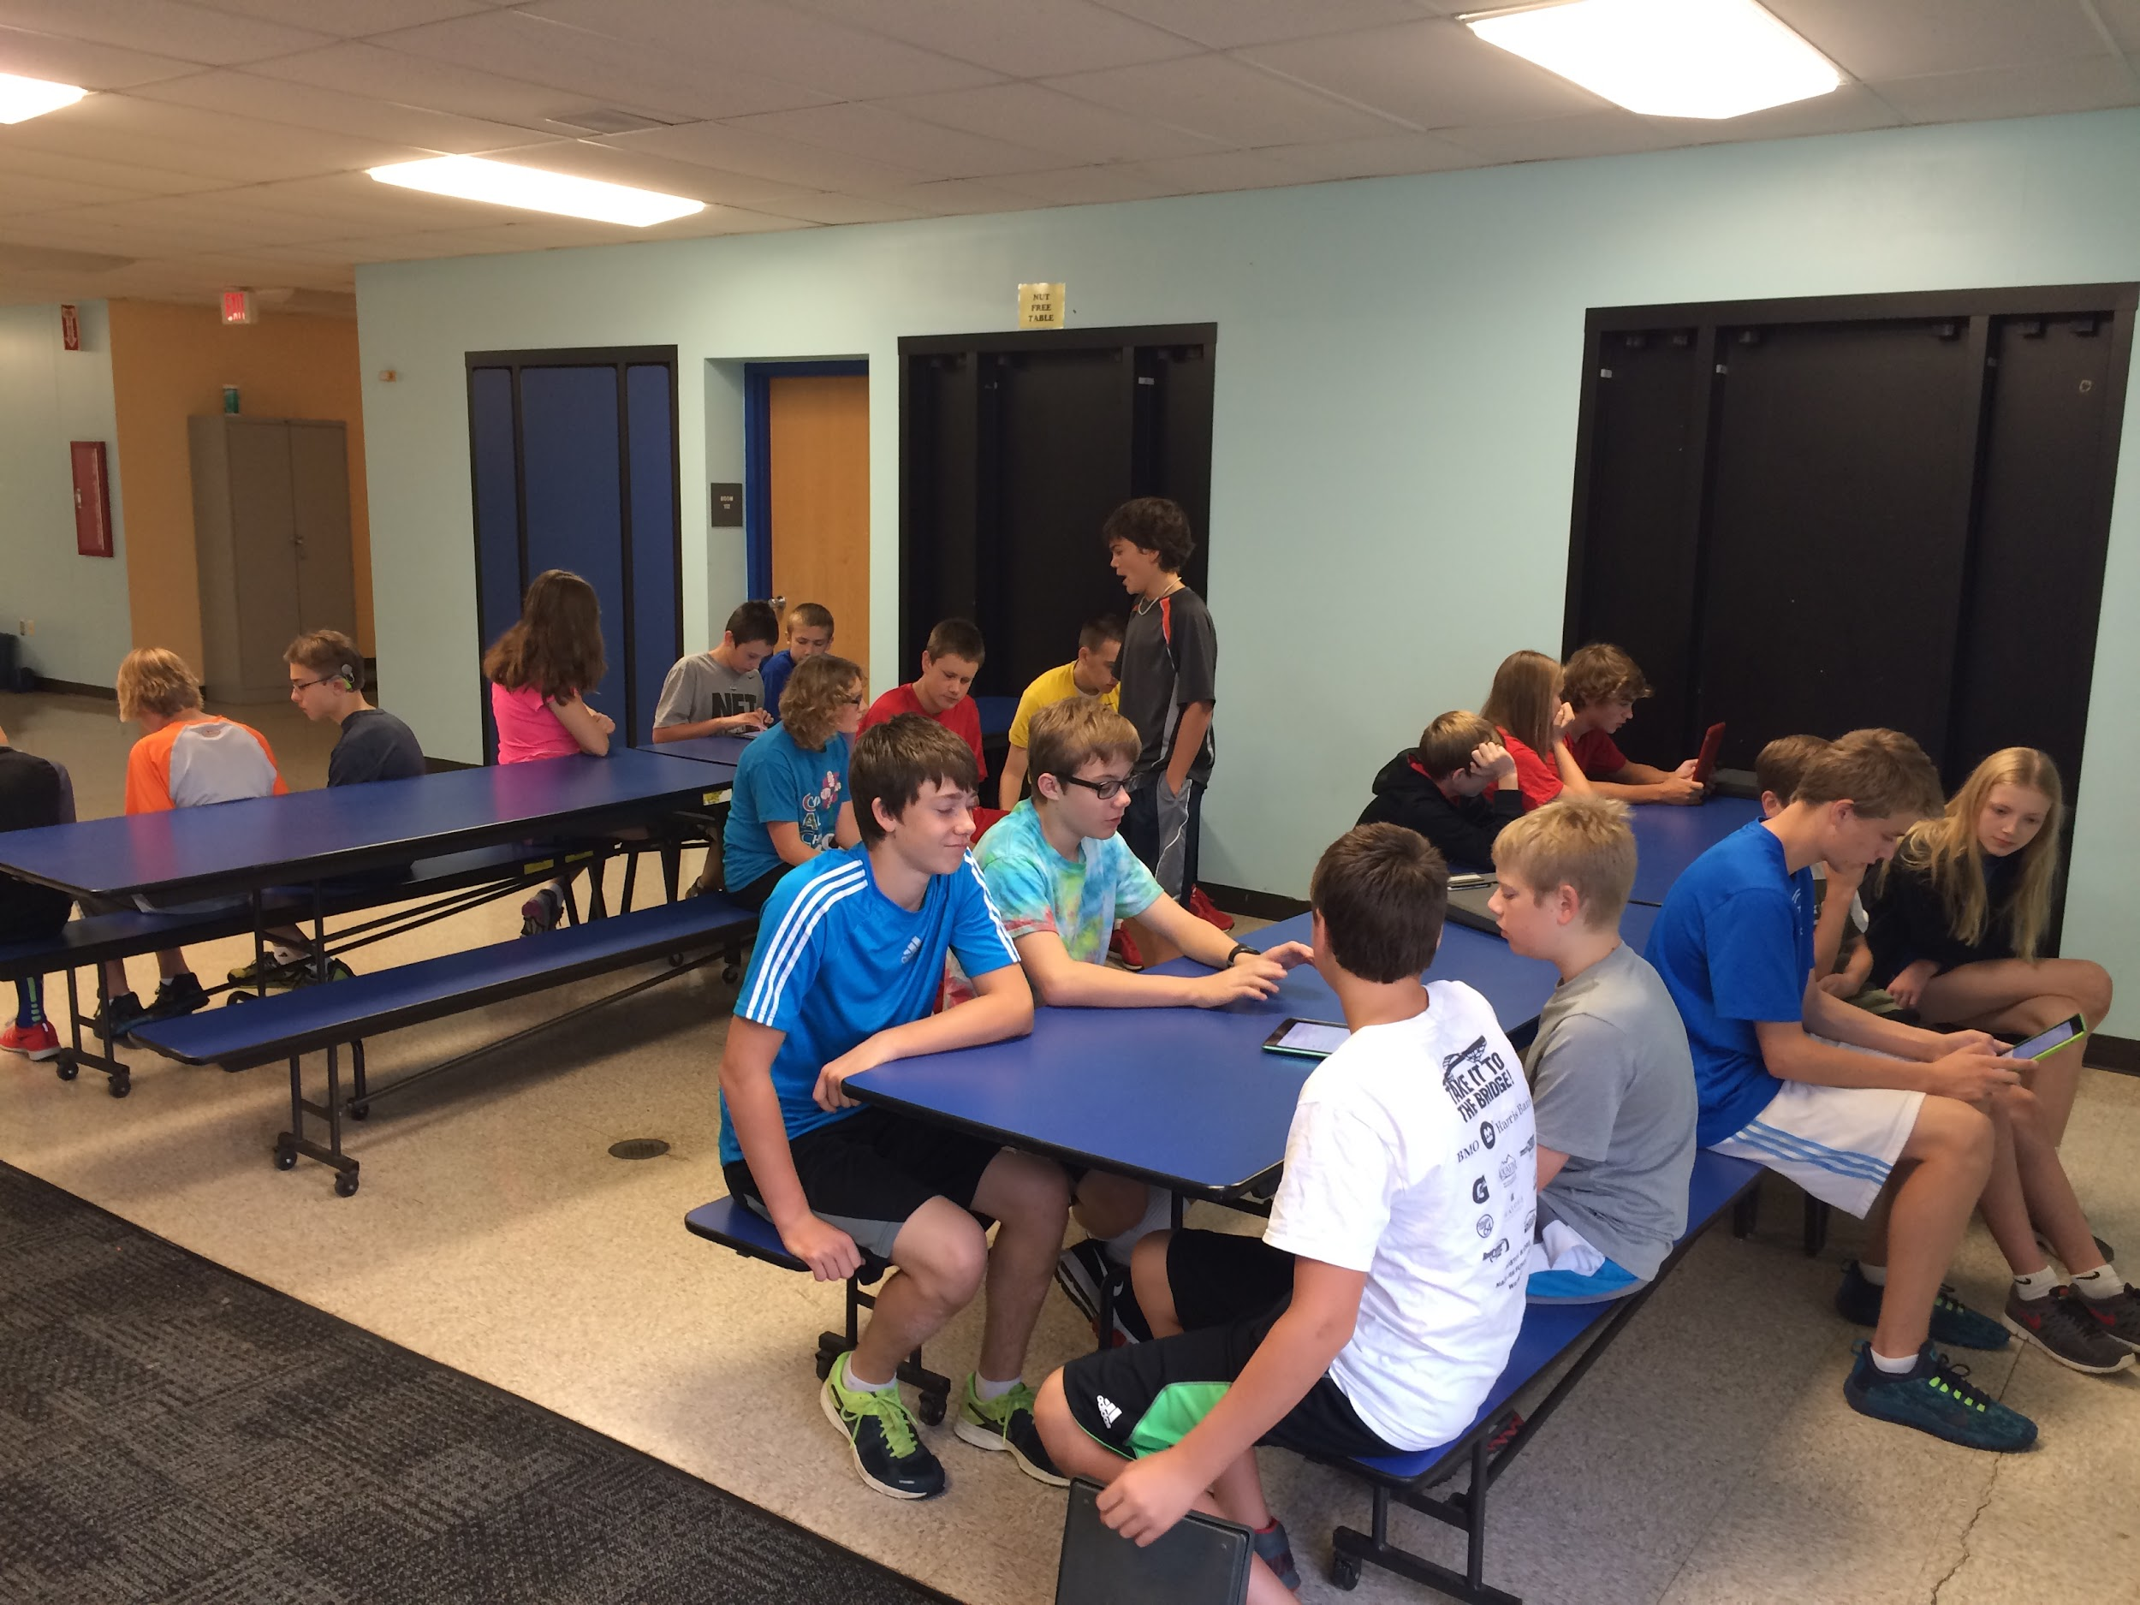
ASSESSMENT
KNOWLEDGE
TASK
Working as a team you will discuss a gameplan for today’s tchoukball games. Teams were to discuss 3-5 different offensive and defensive strategies that they could implement for today’s games. This was highly effective, because it gave the class a chance to discuss what individuals strengths and weaknesses were. It let them plan specifically for each players strengths and weaknesses. This team discussion was vital to get everyone on their team involved in the game and participating so their team could be more successful!
Notes:
Test notes

Slide 42
ASSESSMENT
PERFORMANCE
TASK/S and TOP TIER OF RUBRIC
In Game play Situations you:
Consistently demonstrate a range of the above skills in a fluent, controlled and powerful manner. You results were usually accurate.
You could apply these skills in a range of game play situations.
Consistently demonstrated a range of complex Game sense strategies/tactics that we worked on in class with fluency and good timing.
You could apply these strategies in a range of game play situations.
Consistently and quickly read the game play well and responded effectively
Students are assessed on their game play work in their activity and their ability to cross over skills and modify game play based on games being played. They have established their questions of inquiry and this has also led to skill and game sense conversations about complexity and how we can add to our repertoire of performance skills/strategies.
Notes:
Test notes

Slide 43
Net / Wall Games: General
As the name of this category implies, a net and/or wall is necessary for this type of activity. Net/Wall games consist of two opposing teams or individuals. They can be divided by a net, or may share the same playing field. The object of the game is to transfer an object into the opponent's court within the boundaries so that they are unable to return it. Net/Wall games vary according to their court type/size and whether the ball is allowed to bounce or not prior to its return (Webb, Pearson & Forrest, n.d.).
Net games can be divided into two categories: with a racquet or without. Badminton, tennis, and table tennis are examples of net games which involve the use of a racquet. Volleyball is an example of net game that does not. Squash, Gaelic handball, and racquet ball are all examples of wall games (Thorpe, Bunker & Almond, 1986). Walley-ball is an example of a Net/Wall game without a racquet. It is a sport in which you play volleyball in a squash court and the walls are considered in play (Koleric, R).
Tactical goals in Net/Wall games have a degree of complexity involved. For example, delivering consistency is a 1-Low level of complexity while setting up for an attack in a sport such as volleyball is a 3-Medium level of complexity (PlaySport). It is important to remember than when teaching a high-level skill such as an attack in Volleyball that you work up to this skill last; using previous, less complex skills (such as bumping).

Slide 44
Net / Wall Games: Skills
Net Wall games develop many skills that are transferable later on in students athletic careers. Many of these games develop spatial awareness and court positioning. Having good spatial awareness and court positioning requires students to work on their running, stopping, and ability to change directions (Griffin & Butler, 2005).
The ability to quickly stop and change direction is a vital key for gaining and control the court. These types of skills can be transferred over to more advanced games such as volleyball, handball, racquetball, and squash (PlaySport, No Date).
Spatial awareness in particular can also be transferred outside of the specific category of Net/Wall games. Spatial awareness is a very important skill and basic component of a great number of games. The true understanding and execution of good spatial awareness can further connect the similarities between a wide variety of games for students.
Other skills, such as use of trajectory, depth and angles of attack, are also fine tuned by participating in net wall games. For example, students learn how to hit the ball with a specific force, how to put spin on the ball, attack from all angles and heights which makes it difficult for their opponents to return shots (Griffin & Butler, 2005).
These types of skills can be transferred over to games such as tennis, table tennis, and badminton (PlaySport, n.d.). With the addition of added spatial awareness by getting better with Net/Wall games the lateral mobility of individuals will definitely be improved (Koleric, R).

Slide 45
Net / Wall Games: Strategies
All net and wall games involve the same basic strategies. The fundamental intention of most Net/Wall games is to send an object to your opponent(s) with the goal of the opponent(s) being unable to return the object to you/your team (Butler et. al., 2003. p. 41).
The goal should be to keep an opponent moving within the boundaries of the court while attempting to hold the best position for oneself mid court (Mitchell, 2003). This means, being an effective player requires one to use the entire court and place shots in the open spaces, away from the opponent, while at the same time anticipating where the opponent will return the object. Novice players may assume that by using more force they are making it harder for their opponent to return a shot. However, in most cases placement is more important than the speed or power of a shot (Mitchell, 2003).
Along with shot placement comes shot timing, or the length of time a shot takes to reach its intended space on the court (Mitchell, 2003). Effective players use different kinds of shots in various offensive and defensive situations to change the amount of time their opponent has to react to them (Mitchell, 2003). By being conscious of shot placement, force and timing one can quickly become adept at all types of net/wall sports.

Slide 46
Net / Wall: Strategies - Defense
Rading the Ball - A players sould always be watching the ball or play and anticipating beforehand what will happen. This could involve observing that a ball has been hit hard and moving backwards to compensate or even that a player has moved close to the net to make a drop shot. This is a cognitive element and is crucial to success.
Anticipatory Movements - A player in the base position should be ready to react to the lay as soon as possible. To help maximize reaction time, a quick split step should be performed just as a player begins their movement. This will give them an extra split second to make a play.
Forward, Backwards, and Lateral movement - During a game, moving your feet is always a key factor in not only getting into position to cover your defensive end. This ultimately requires a quick run.
Support - This is a defensive movement involving moving to support a team mate. This means putting yourself in a position to read where the ball may go when your teammate makes a play on the ball.
Defensive Movements - A player should always be reading the play and tryig to gain a tactical advantage using knowledge gained from observation. This can help you make quicker decisions. This could involve charging thenet when a drop shot is made, or falling back to center after a shot to cover defensively if needed.

Slide 47
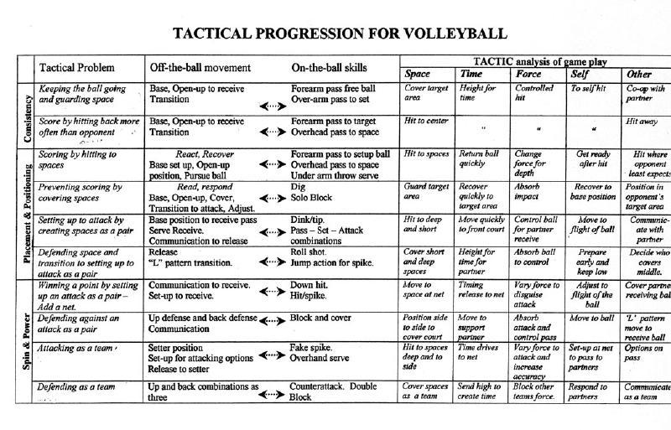
Net / Wall Games - Tactical Progression

Slide 48
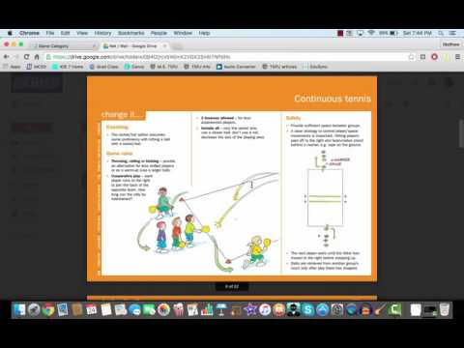
Net / Wall- Activities from Sporting Schools

Slide 49
Net / Wall Activities
Created by Dr. Hopper

Slide 50
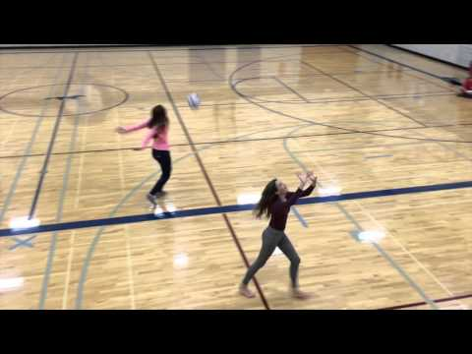
Net / Wall Games
Bounce Game
To position yourself a move to the ball
Rules
Start with the ball in your hands standing in the base position.
Bounce the ball so you can move your feet quickly and get in position to catch it.
Move some bounces farther away and some higher.
Levels / Layers of the Activity
#1 - Bounce the ball and then use a forearm pass
#2 - Forearm pass and then catch the ball before it bounces.
Notes:
Test notes

Slide 51
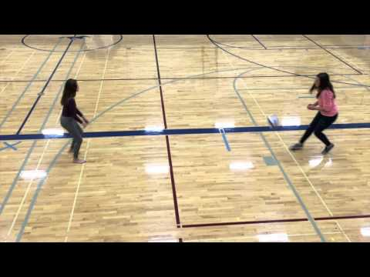
Net / Wall Games
Line Game
To send the ball into the opponent's court and elude them
Rules
Player must bounce the ball on their side of the line and into their opponent’s court.
Opponent must move to catch the ball and quickly bounce the ball back.
A point is earned when one player eludes their opponent or when a player uses incorrect bounce technique.
Levels / Layers of the Activity
#1 - Make middle line longer - How can I take advantage of the wider court to gain a point?
#2 - forearm pass instead of catching the ball - Where can I pass the ball so my opponent can’t catch it?
#3 Use a smaller ball - How can I be ready to move to get to the ball the fastest?
Notes:
Test notes

Slide 52
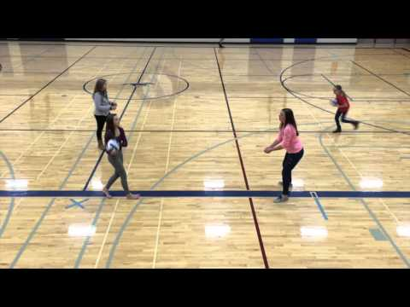
Net / Wall Games
Seated Pass Practice
Create a platform for forearm pass
Rules
In pairs, one student tosses the ball to the passer extending a flat platform
Pass starts sitting, then kneeling on one knee then standing
Passer must send arched pass back to partner 5-10x
Levels / Layers of the Activity
#1 - Both partners pass the ball - How much force do I need to get the ball to my partner?
#2 - Make passes longer - How does where my shoulders are facing affect where the ball goes?
#3 - Have students count number of successful passes to target - Does trying to go faster make the ball harder to control? Is speed better than accuracy when passing?
Notes:
Test notes

Slide 53
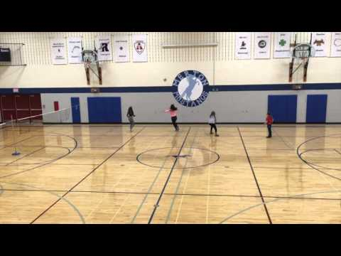
Net / Wall Games
Wall Game
To win game by scoring on your opponent
Rules
Students must toss the ball at the wall
Points are scored if the ball cannot be caught by the opponent or if the ball goes out of bounds
Students have 1 bounce after the ball comes off the wall to catch it.
Levels / Layers of the Activity
#1 - Play for cooperation (How many tosses off the wall can you catch in a row as a team)- Where to throw the ball so partner can catch it
#2 - Play for competition (Who will be the first to elude your partner)- Where to throw so partner can’t catch it?
Notes:
Test notes

Slide 54
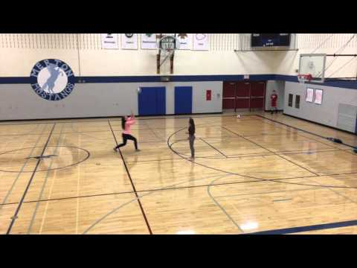
Net / Wall Games
Overhead Pass Target Drill
Develop accuracy with overhead pass
Rules
In pairs one student tosses the ball to the passer
Passer overhead passes the ball
Points scored when ball lands in the hoop
Levels / Layers of the Activity
#1 - Play for cooperation - Proper overhead pass technique, go for height
#2 - How many points can you get in 30 seconds - Pass technique and stress accuracy
#3 - Feeder tries to make receiver move - How do you anticipate the ball movement? What happens if you don’t get back to base?
Notes:
Test notes

Slide 55
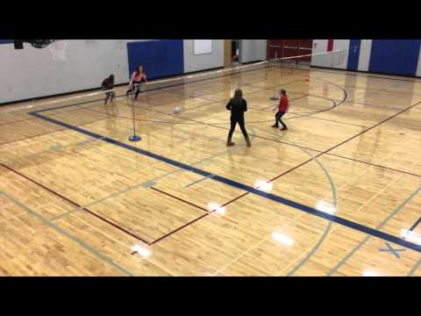
Net / Wall Games
Fuukahara Game - Move vertically and laterally inside court boundaries and covering space to create tactical advantages
Rules
Ball must be rolled under the net
Players can only touch the ball once before a teammate touches the ball.
Teams get up to 3 hits to get the ball across the midline
Ball must be hit along the ground
No “Blocking”
Levels / Layers of the Activity
How do you attack the net with 3 hits?
What advantages do you get when using more space on offense?
How do you position yourself on defense?
Notes:
Test notes

Slide 56
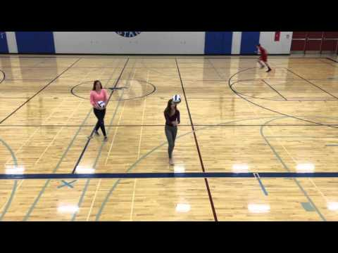
Net / Wall Games
Self Rally
Keep a forearm pass going consistently
Rules
Students forearm pass the ball up in the air to themselves with control.
Students must stay in the 5x5 boundary and may catch the ball to maintain control
If the ball rolls out of the circle then they should start counting over again.
Levels / Layers of the Activity
#1 - Decrease the square so you have less space to move around - How do you hit the ball to maintain control?
#2 - Have students hit low, then high controlled passes - How does hitting the ball harder affect control?
#3 - Jog and pass to self - How does movement affect ball control?
Notes:
Test notes

Slide 57
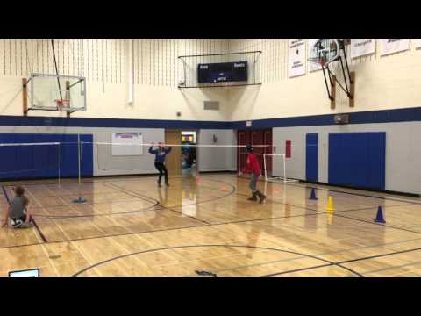
Net / Wall Games
Pass, Set, Over the Net
Passer to pass the ball and land on target
Rules
One partner stands at 3M line on the opposite side of the net with the ball to toss.
Passer must run to and from the baseline to the 3M line to pass back the tossed ball
Passer must aim to hit as many passes as they can to a set target
Levels / Layers of the Activity
#1 - count number of successful passes to target - consistent height and good contact over the net
#2 - Use a set in place of the pass - good technique and consistency to the target
#3 - Make the target smaller - Evident accuracy to the target.
Notes:
Test notes

Slide 58
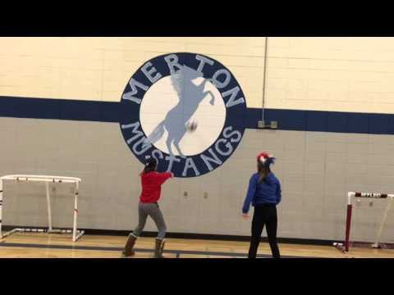
Net / Wall Games
Wall Set - Pair Set
Accurate setting
Rules
Stand at the wall and set the ball against it with short small sets.
Count how many sets consecutively
Move to executing short sets with a partner
Levels / Layers of the Activity
#1 - Students set high and then low against the wall
#2 - Set over the net with a partner
#3 - Add competitive element by seeing how many the team can get in a row.
Notes:
Test notes

Slide 59
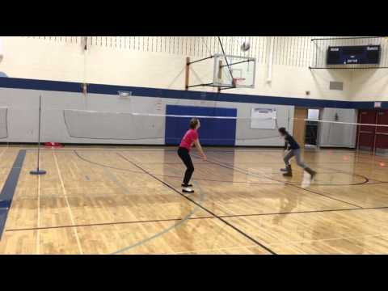
Net / Wall Games
2 vs Themselves
Make three sets with a partner and send the ball over the net
Rules
Set the ball three times between two partners on one side of the net
Send the 3rd set over the net and both players run under the net to get it.
Let the ball bounce once and continue the 3 set and over
Levels / Layers of the Activity
#1 - Get to the ball before it bounces on the other side
#2 - Alternate passing and setting
#3 - Create scoring based on number of rallies
Notes:
Test notes

Slide 60
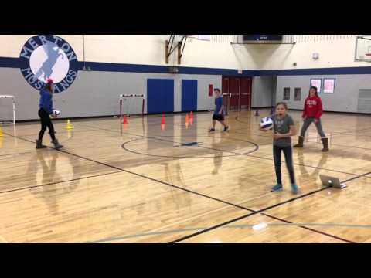
Net / Wall Games
Square Pass and Switch
Accurate passes
Rules
2 Pairs join together to make square
Players with backs to the net have balls and make a high toss to the player opposite of them
Opposite player pases the ball back and switches with adjacent passer to pass with new tosser
Levels / Layers of the Activity
#1 - Set the ball rather than pass it
#2 - Controlled passes to the target with good height
#3 - Have all players pass and switch - How do you get to your spot quickly? How can you give your partner more time to get to the ball?
Notes:
Test notes

Slide 61
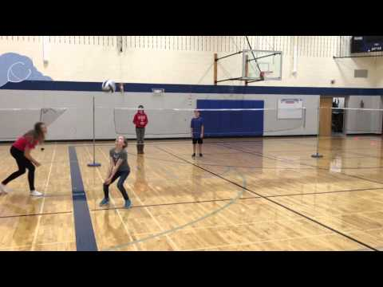
Net / Wall Games
2v2 Mini Court Game
Incorporating passing and tactical skills into a game like situation
Rules
Forearm passing only initially
Throw ball for serve
Points scored when ball touches floor or goes out of bounds
Levels / Layers of the Activity
#1 - Forearm passes only (maybe even play 1 bounce rule) - Face partner when passing, call for the ball.
#2 - Add in overhead pass - Attack where opponents are not, and continue to communicate.
#3 - Require 3 touches on each possession - Communication is big and so are tactical considerations (attack where they are not and anticipate the ball).
Notes:
Test notes

Slide 62
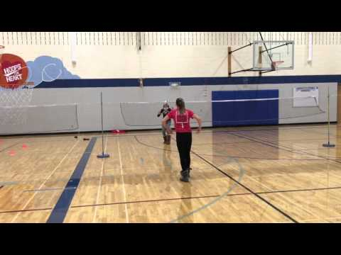
Net / Wall Games
1v1 Mini Court Game
Send the ball into your opponent’s court and make them move to return it.
Rules
1st player stands in their court with the ball and serves it over the line to their partner
The two players have a one-touch rally, trying to elude their partner
A player gains a point if the ball lands in their opponent's court or they hit the ball out of bounds
Levels / Layers of the Activity
#1 - 3-touch 1v1 - Best way to keep ball under control? What if it’s low? What if it’s high?
#2 - Increase play area - Where and how to stand to easily return the ball?
#3 - Create game with first to 10
Notes:
Test notes

Slide 63
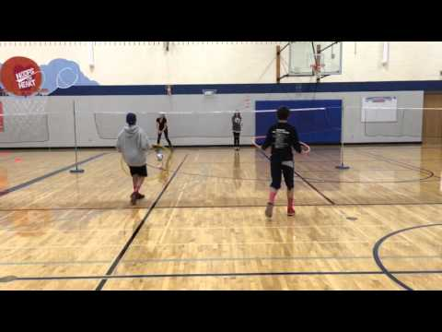
Net / Wall Games
Hoop Target Game
Serving for accuracy
Rules
The server stands on one side of the net at mid-court
They try to serve the ball over the net and have it land on the target
Partner retrieves the ball and sends it back under the net to the server
Levels / Layers of the Activity
#1 - Step back with successful serve (at target) and forward if not - How much force is needed to put ball for or short?
#2 - Add more targets, alternate targets - How does where you face effect where the ball goes?
#3 - After bounce on target, retriever passes it back and rally begins - Goes into a 1v1 mini court game. After the serve, how do you get ready to rally?
Notes:
Test notes

Slide 64
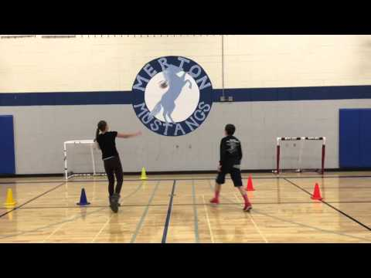
Net / Wall Games
Serve Wall Ball
Serving and Receiving
Rules
One person starts with a ball, 3 M from the wall and underhand serves the ball at the wall.
Second partner must move to catch the ball and serve again.
Partners try to keep a serve and catch rally going against the wall.
Levels / Layers of the Activity
#1 - Pass the ball to self rather than catch it - How can I be ready to catch the ball?
#2 - Try to elude your partner - Where do I aim so my opponent can’t catch the ball?
#3 - Larger play area - How can I move to compensate for the larger area of play?
Notes:
Test notes

Slide 65
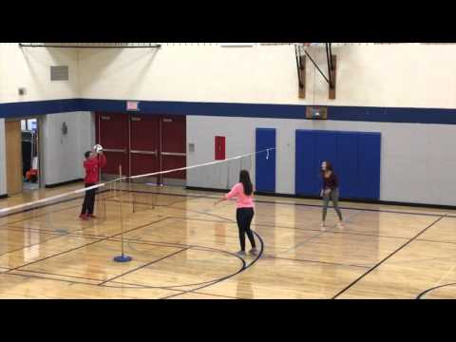
Net / Wall Games
3 Person Passing Drill
To improve passing proficiency
Rules
Feeder throws ball above eye level
Receiver receives ball, passes to partner who passes it back to the feeder
Points scored when either ball is returned to feeder (receiver’s point) or ball isn’t returned to feeder (feeder’s point).
Levels / Layers of the Activity
#1 - Play for cooperation - Turn to face where you want to the ball to go before ball gets to you.
#2 - Play for competition - Communication with partner. Throw ball where receivers are not
#3 - All 3 partners use forearm pass - Face person you are passing to. Use communication skills.
Notes:
Test notes

Slide 66
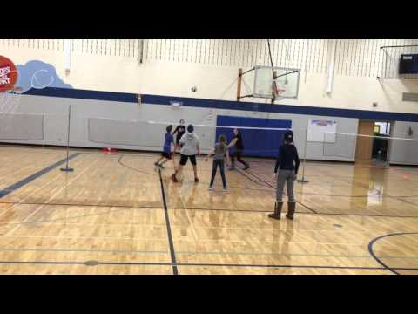
Net / Wall Games
3v3 Small Court Game
Practice skills and tactics in a small sided game situation
Rules
1st layer stand in their court with the ball and serves it over the line to the receiving team.
The two teams have a one-touch ralley trying to elude the other team.
A team gains a point if the ball lands in their opponent's court or they hit the ball out of bounds.
Levels / Layers of the Activity
#1 - 3 touch 3v3
#2 - Increase play area
#3 - Create game with first to 10
Notes:
Test notes

Slide 67
Net Wall Games - Activities - Australian Sport

Slide 68
Net Wall Games - Activities - Australian Sport

Slide 69
Net Wall Games - Activities - Australian Sport

Slide 70
Net Wall Games - Activities - Australian Sport

Slide 71
Striking Games: General
The main concept behind striking/fielding games is that when you are on offense you are striking an object (example: batting in baseball), and when you are on defense you are fielding an object (example: throwing the ball in cricket).
Players can only score on offense by hitting a specified object into open area, and then advancing to designated areas(PlaySport [PS], no date).
Players on defense will attempt to stop the offense from scoring by catching the object while it is in the air before it hits the ground or by retrieving the object and bringing it to the specified area before the offensive player gets there (PS, no date).
Tracking, player will have to predict the path of the object in play (whether it be a baseball,cricket ball. ect) in attempt to hinder the progress of their opponents.
One of the most common striking/fielding games is baseball. Other variations include games such as cricket, slow-pitch, 3 pitch, soccer baseball, tennis baseball, rounders, lob ball, and many others.
Striking/fielding games are an excellent way to teach fundamental skills such as catching, throwing, running and striking(Butler et.al., 2003. pg. 29)

Slide 72
Striking Games: Skills
There are three types of skills involved in striking/fielding games: Locomotor, non-locomotor, and manipulative skills (Guest Editorial, no date).
Locomotor skills involve players being able to run, slide, jump, and leap.
Non-locomotor skills involve stretching, bending, and reaching for an object.
Manipulative Skills involve players being able to send an object (both by throwing and by striking it), receive (catch) an object, and retain (and run with) an object.
These skills can also transfer over to invasion games such as basketball, where athletes must be able to pass the ball to their teammates who must catch it.

Slide 73
Striking Games: Strategies
OFFENSE
When on offense, the striker should attempt to place the selected object in areas where defenders cannot reach, in order to maximize the difficulty of getting the striker out and increasing the amount of points the offensive team can score. This may involve the striker using a variety of different shots such as a bunt, a high arcing shot, a line drive, or slap and run shot.
The objective of every offensive player should be to hit the object out of the playing field if outside, or to a designated area if inside (examples include: home runs in baseball, and 6 points in cricket).
Also it may be beneficial for an offensive player to sacrifice their own opportunity to advance one of their teammates. For example bunting in baseball to advance a teammate who is already on base.

Slide 74
Striking Games: Strategies
DEFENSE
When on defense, players should always be in the ready position and try to anticipate where the object will be going so they can react quickly in order to make a play. In sports like Baseball smart players can strategically plan their throws in order to achieve double or triple plays.
Fielders should cover the playing area evenly as individuals and as a cohesive unit (PlaySport [PS], No Date).
The defensive player in charge of delivering the object to the striker should vary the method of delivery making it more difficult for the striker to contact the object (PS, No Date).
Also it may be in the defenses best interest to "skip" certain offensive players that are dangerous offensively. for example; intentionally walking a batter in baseball.(Koleric,R).

Slide 75
Striking Games: Tactics
Tactical goals in Striking and Fielding games have a degree of complexity involved. For example, covering space in a game is a 3-Medium level of complexity while stopping a run in baseball is a 5-High level of complexity (PlaySport).

Slide 76
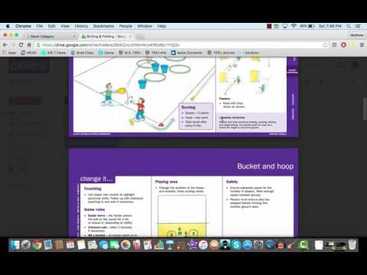
Striking & Fielding - Activities from Sporting Schools

Slide 77
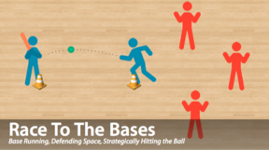
Striking Games: Activities - ThePhysicalEducator.com

Slide 78
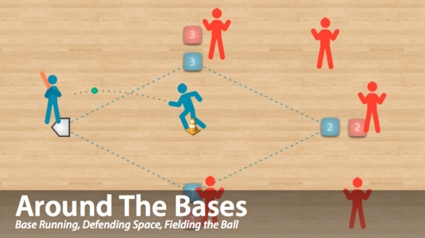
Striking Games: Activities - ThePhysicalEducator.com

Slide 79
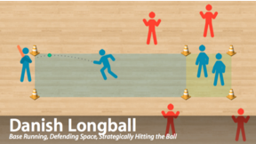
Striking Games: Activities - ThePhysicalEducator.com

Slide 80
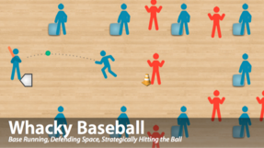
Striking Games: Activities - ThePhysicalEducator.com

Slide 81
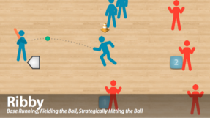
Striking Games: Activities - ThePhysicalEducator.com

Slide 82
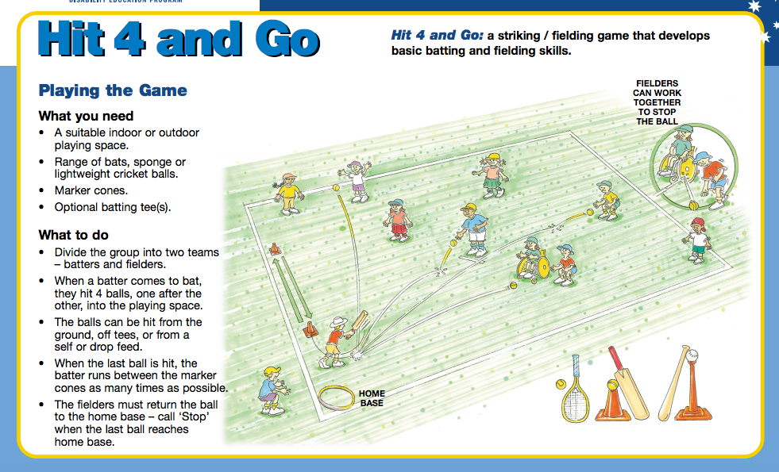
Striking Games: Activities - Australian Sport

Slide 83
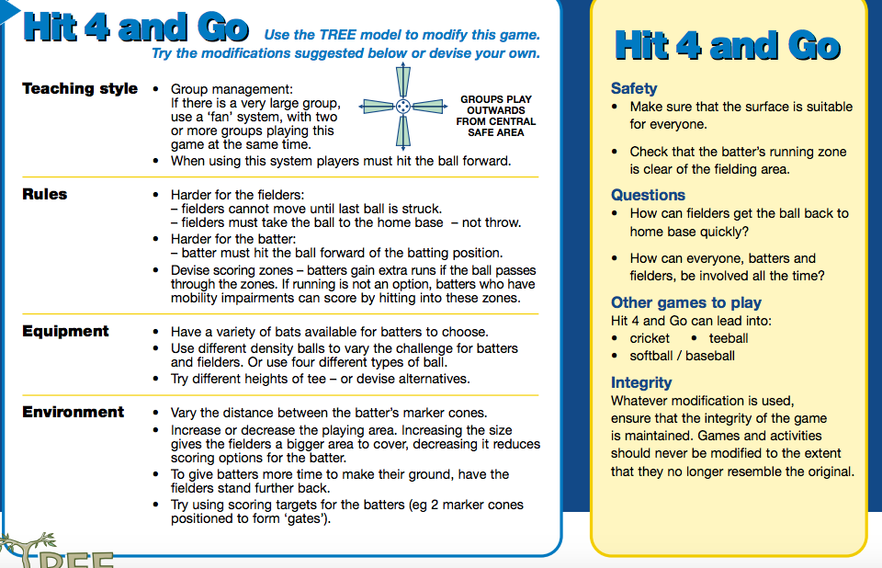
Striking Games: Activities - Australian Sport

Slide 84
Striking Games: Activities - Australian Sport

Slide 85
Striking Games: Activities - Australian Sport

Slide 86
Striking Games: Activities - Australian Sport

Slide 87
Striking Games: Activities - Australian Sport

Slide 88
Target Games: General
In target games, a player either throws, slides, or strikes an object with the goal of having the object land closest too or in a designated target. Griffin et al. (2006, p. 21) Target games can be in the form of either a team sport or an individual sport and sub-categorized into being either unopposed (e.g. golf, archery, ten pin bowling) or opposed (e.g. lawn bowling, curling, shuffleboard).
The same source also explained that with opposed target games players can prevent their opposition from scoring by knocking or blocking their opponent's ball or rock to an unfavorable position in relation to the designated target. This means that when participating in an unopposed target game, a player focuses solely on their execution in an attempt to be as close to the target as possible, whereas in opposed target games, the player has to be aware of their opponent's execution as well as some offensive and defensive strategies. Modified versions of target games should consider the students physical, cognitive, and social states of development in order to be successful (Araújo., D, Button, C., Chow, J,I., Davids, K., Renshaw, I., & Shutleworth, R., 2007).

Slide 89
Target Games: Skills
Transferable skills are skills that can be acquired in one game and utilized in other games as well. In order for these skills to be transferable, the games must be similar to each other. Games can be grouped into categories or divisions so that students can identify common features such as tactics, rules, and skills more easily (PlaySport, n.d.).
Transferable skills that are common to target games are:
Players must be able to demonstrate hand-eye, foot-eye accuracy
Players aim and shoot/throw/roll/etc. for a goal target
Players utilize the synchronization of numerous body parts when releasing the object used in the game
Both gross and fine motor skills are used to alter the flight/path of the released object

Slide 90
Target Games: Strategies
It is commonly believed that the goal of any target game is to get a "bulls eye" by hitting the middle of a given target, however there is much more strategy to target games then one might believe. If the target game being played is unopposed, it is likely that only offensive strategies will be used. However, if the target game being played is opposed, then it is more likely that both offensive and defensive strategies will be used (Griffin et al., 2006, p. 21). The following are some common offensive and defensive strategies (www.playsport.net/en/Transferable-Skills.cfm).
Offensive strategies - Aim and accuracy are the main focus. The goal is to have the final location of the object be as close to the designated target as possible. This is achieved by controlling the object's speed and trajectory. You must plan your path to the target. For example, throwing a bulls-eye in darts.
Defensive strategies - There are several strategies that can be implemented within target games. Blocking your opponent's path to the target is a very common strategy. Using your ability to control aim and accuracy, have your object rest in an area that blocks a path and decreases your opponent's chances of having their object be closer to the target than yours. For example, setting up a guard in curling so that your opponent cannot take out your rock.

Slide 91
Target Games: Tactics
Tactical aspects of Target games such as the aim and accuracy and the protection of the target come with a degree of complexity. For example, aim and accuracy is a 1-Low level of complexity while the protection of a target is a 4-High level complexity (PlaySport).

Slide 92
Target Games - Activities from Sporting Schools

Slide 93
Target Games: Activities
Activity 1: Target roll
In pairs. Place a target 5 metres away e.g. a witches hat, between the pairs. Practice
rolling at the target. Begin with a large ball and then introduce a small ball.
Questions;
What is the best way to make sure the target is hit? Discuss the best technique when
rolling a ball towards the target.

Slide 94
Target Games: Activities
Activity 2: Multiple target roll
In groups of 4 or 5. Place a number of lines (you can use ropes) with different point
values. The closest line your ball is to your score. Let each student have 3 turns.
Questions:
How hard should you roll the ball?
What techniques are required to aim the ball?

Slide 95
Target Games: Activities
Activity 3: Frisbee throw
In pairs throwing a frisbee to land in a hoop. How many throws is required to land in
the hoop?
Questions:
How hard do you need to throw the frisbee?
If it is going to left or right of the target how do you correct it?

Slide 96
Target Games: Activities
Activity 4: Frisbee golf
Set up a mini golf course of 5 holes using hoops as the hole. Students can play the
game in pairs.
Questions:
How do we determine whose turn?
Use questions from above.
The extensions from here are numerous for the introduction of bowling, golf and other target games.

Slide 97
Section #5
Resources and Links
From Mel Hamada

Slide 98
Resources
PHE Canada’s Move, Think, Learn Series
Free PDF resources for 9 different sport using a TGfU approach
http://www.phecanada.ca/resources/move-think-learn
Teaching Games for Understanding: Theory, Research and Practice. Linda Griffin & Joy Butler
TGfU…Simply Good Pedagogy: Understanding a Complex Challenge. Tim Hopper, Joy Butler & Brian Storey (Eds)
Teaching Games for Understanding in Physical Education and Sport. Joy Butler, Linda Griffin, Ben Lombardo & Richard Nastasi (Eds)

Slide 99
Resources
Dr. Tim Hopper’s website (University of Victoria)
http://web.uvic.ca/~thopper/
TGFU Posters created by Ardis Hufnagel & Naomi Hartl
https://drive.google.com/file/d/0B4uMP9WUchJjUEJ3Z1I3dEx6VUk/view?usp=sharing
TGfU Teacher Resource by Naomi Hartl
https://docs.google.com/document/d/1yVLFe4bs5-_jTbpGbFCyRcv6mjCrmwupv0ZRBGQp0Ic/edit

Slide 100
RESOURCES/ FURTHER READING
INQUIRY/CONCEPT BASED LEARNING RESOURCES
Research:
How would Socrates teach Soccer? A constructivist approach. Joy Butler, Journal of Physical Education, Recreation & Dance 1997
Books:
Essential Questions: Opening Doors to Students Understanding. Jay McTighe & Grant Wiggins
Understanding by Design. Grant Wiggins & Jay McTighe
Embedded Formative Assessment. Dylan William
Learning together Through inquiry. Kath Short
Asking the right questions:A guide to critical thinking. Neil Browne
Other:
file://localhost/Users/mark.williams/Desktop/Inquiry%20/Creating%20Essential%20Questions.html
Notes:
Test notes

Slide 101
RESOURCES/ FURTHER READING
TGfU RESOURCES
Developing Game Sense Through Tactical Learning: Ray Breed, Michael Spittle
Book: Play with Purpose: Game Sense to Sport Literacy (3rd Edition) by Shane Pill
Book: Teaching Sport Concepts & Skills 3rd Edition : A Tactical Games Approach by Mitchell/Oslin/Griffin
TGfU Website - conference dates, videos and more
iOS and Android app: TGfU Games PE By Nicholas Stratigopoulos
NZ sport (7 min video) - explanation of how TGfU is used in various codes of sport in NZ and why
iOS app: PE Activities by Apps for Academics (Mel Hamada)
Teaching Strategies in Games Teaching: Tactic-to-skill assessment in net/wall games
Net Games Rubric via Glenn Young & Surrey School District
Spatial Awareness Rubric
Ophea - TGfU Activity Support Package - from www.ophea.net Canada (.pdf 100 pages, lots activities for ES students
TGfU Invasion Games - Performance Analysis Framework
TGfU Teacher Presentation - great work, ideas, explanations and resources by Naomi Hartl
Nick Hill Coaching - blog with excellent resources
http://www.playsport.net/ - an online activity-based resource
Tim Hopper is a great resource. Professor of Physical Education at UVIC. He has been working with TGfU for years and his sites are a great source of university student work, research and resources.
http://web.uvic.ca/~thopper/ - Homepage
http://web.uvic.ca/~thopper/tactic/index.htm - TGfU specific
Google Slide Presentation for all #Physed to add to about TGfU with activities and more from Doug Gleddie
Notes:
Test notes

Slide 102
RESOURCES/ FURTHER READING
Tim Hopper @thopper33 Blog/Website - PE lecturer, author of many books and more
Shane Pill @Pilly66 - PE lecturer, author of many books, articles and more on Game Sense
@KellyAnnParry Her Blog/website
Mel Hamada @mjhamada
Mark Williams @williams10mark
Miss Naomi Hartl @MissHartl - part of the PhysEdagogy team and Spark team in the USA
@JoeyFeith - ThePhysicalEducator (video examples too!)
Nathan Horne @PENathan iPhys-Ed.com
Dr Ash Casey @DrAshCasey - PE lecturer and works on the PEPRN blog and now podcast with lots of academic ideas and research into PE teaching and learning
Adam Metcalf @MrMetcalfPE - practicing PE teacher and advocate of TGfU in the classroom
Simon Mills - UNIS Hanoi (simonmills@unishanoi.org) - excellent PE teacher/coach - has worked as a top tier coach’s coach for many years.
Alex Thomas @alex76thomas - PE teacher and fantastic inquiry teacher, currently at YIS
Dr Jenny Clarke and Richard Light - have a TGfU workshop (contact Richard.light@canterbury.ac.nz)
@Imsporticus - UK Head PE teacher and writes an excellent resource: blog Drowning In the Shallow
Mark Williams @williams10mark
@Vgoodyear - Dr Vicky Goodyear has an amazing VLOG series - check her TGfU one here
@nerdyphyseder - Michael Ha - practicing PE teacher and mentor in Game Sense / TGfU
@doug_gleddie - Doug Gleddie is an ES PE teacher and has great resources and ideas on quality PE programs.
@deandudley - Dean Dudley a PE lecturer in Australia
@drstephenharvey - Dr Stephen Harvey - lecturer and writer from the USA. His blog with examples of work and articles published on Questions and TgfU is here
INQUIRY/CONCEPT BASED LEARNING PEOPLE/TWITTER HANDLE
Notes:
Test notes

Slide 103
RESOURCES/ FURTHER READING
OTHER RESOURCES
PRESENTATION - design of layout and presentation advice from Jolan Martinez (at Yokohama International School) martinezj@yis.ac.jp
Gif maker from - https://www.giflike.com/create
YouTube videos U8 Soccer Jimmy Fallon High School Musical (Disney) Greatest Haka of all time? (World Rugby) June2015
At YIS we work as a PE Dept, but the Unit Statement given in Example 2 - High School is attributed to Alex Thomas.
The Student example is given by permission of her parent at YIS.
Thank you to the Physedagogy Team for the opportunity to share at the PhysedSummit 3.0
Visible Thinking Routines - great resources for Inquiry in your classroom
Austrialian Sport Govenment - Great Activity Cards that I shared
Sporting for Schools - Great activity cards
Notes:
Test notes

Slide 104
RESOURCES/ FURTHER READING
TGfU RESEARCH
¨Teaching Games for Understanding: What does it look like and how does it influence student skill acquisition and game performance?¨ by Tim Hopper, University of Victoria & Darren Kruisselbrink, Acadia University.
“Inﬂuence of a hybrid Sport Education—Teaching Games for Understanding unit on one teacher and his students” by Peter A. Hastie and Matthew D. Curtner-Smith, Auburn University & University of Alabama, USA.
“The Role of Nonlinear Pedagogy in Physical Education” by Chow, J. Y., K. Davids, C. Button, R. Shuttleworth, I. Renshaw, and D. Araujo.
“Teaching Games for Understanding: the difﬁculties and challenges experienced by participation cricket coaches” by Simon John Roberts
“Mentoring in TGfU teaching: Mutual engagement of pre-service teachers, cooperating teachers and university supervisors” by Lijuan Wang, Shanghai University of Sports, China; Amy Ha, The Chinese University of Hong Kong, Hong Kong.
“Four Rs for tactical awareness: Applying game performance assessment in net/wall games” by Tim Hopper
Harvey, S., & Light, R. L. (2015a). Questioning for learning in game-based approaches to teaching and coaching. Asia-Pacific Journal of Health, Sport and Physical Education, 6(2), 1–16. Retrieved from http://dx.doi.org/10.1080/18377122.2015.1051268
Notes:
Test notes

