Slide 1
Sport Education
https://goo.gl/SwGkZT
Matt Pomeroy
@Physed_Pomeroy
pomeroym@merton.k12.wi.us
http://pomeroyspe.weebly.com/

Slide 2

Sport Education
A student led unit

Slide 3
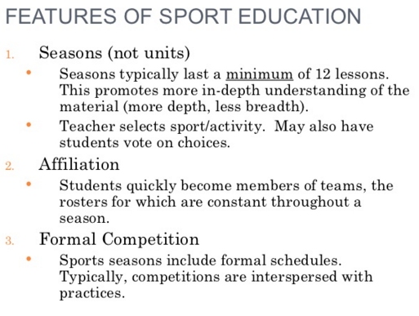
Sport Education - Features
A student led unit

Slide 4

Sport Education - Features
A student led unit

Slide 5
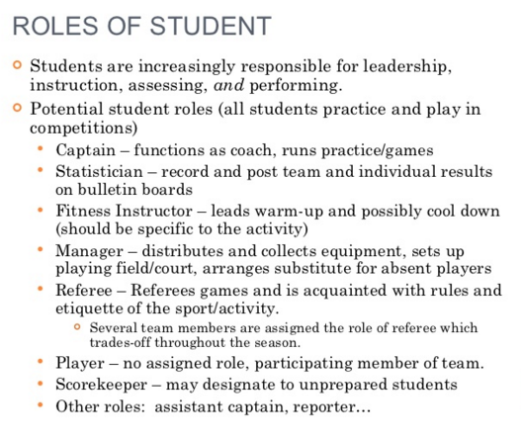
Sport Education - Roles
A student led unit

Slide 6
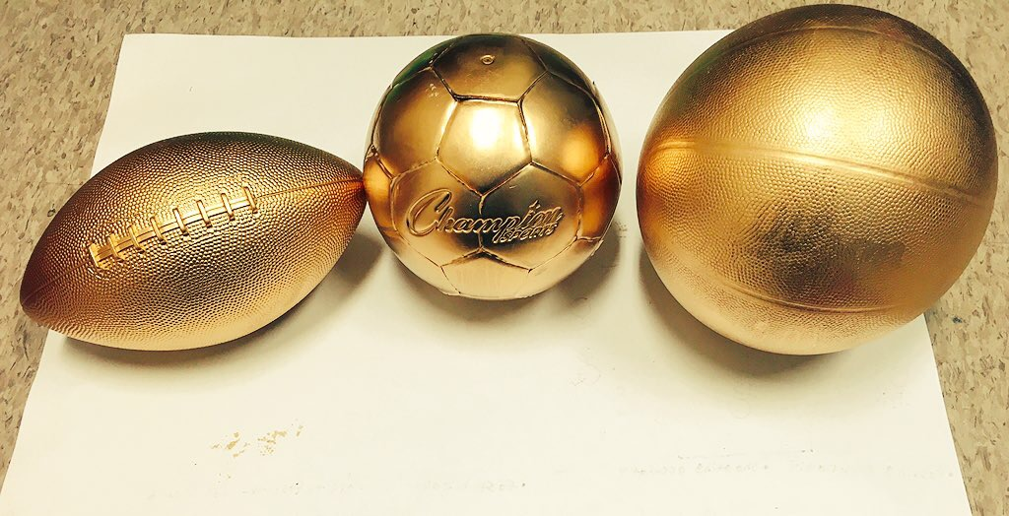

Slide 7

Flag Football
A student led flag football unit

Slide 8

Mustang Bowl

Slide 9
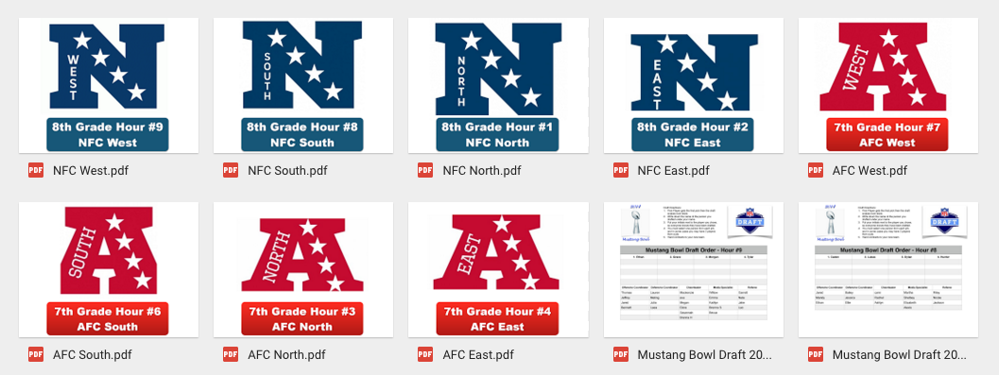
The NFL was a perfect fit

Slide 10
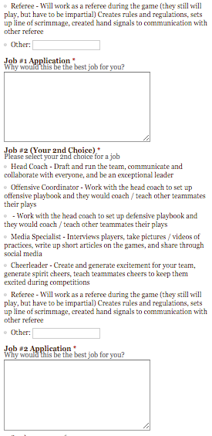

Job Applications & Signed Contracts

Slide 11
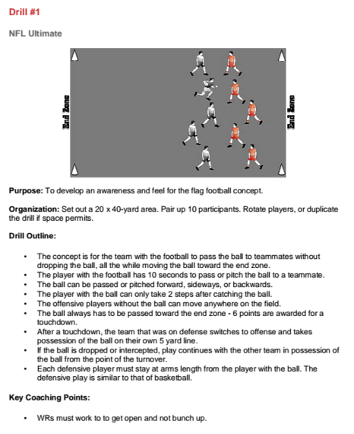
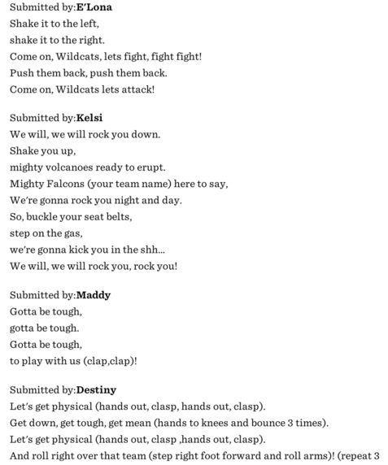
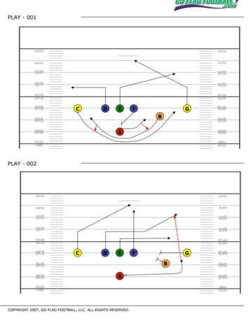
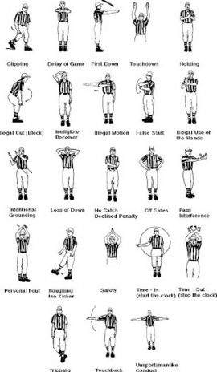
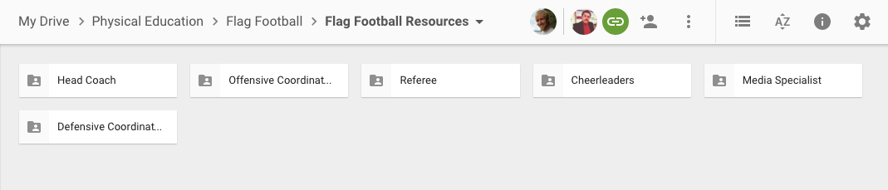
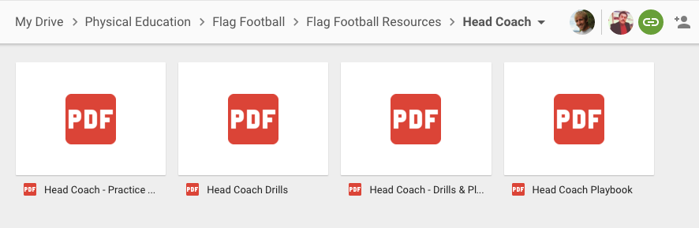
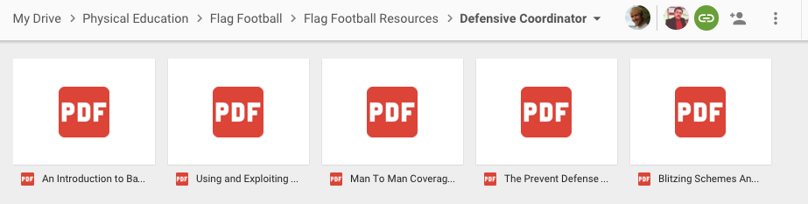
Resources for Job Success

Slide 12
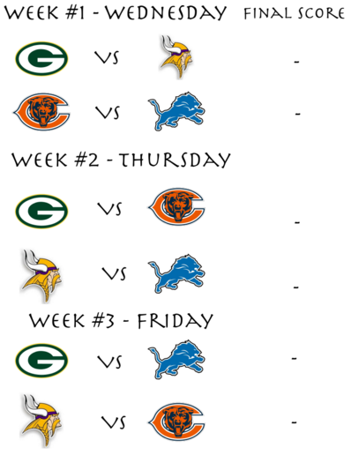
Season Schedule & Postseason

Slide 13
Super Bowl Video

Slide 14
#OSHAPE18
Lets being our football championships!!

Slide 15
Are you ready for some football!!

Slide 16
Let’s Build
The Construction of a Sport Education Season

Slide 17
What Sport or Type of Season?
Tradition or Non-Traditional?

Slide 18
What Grade Levels will be Participating?
Elementary, Middle, or High School

Slide 19
What Grade Level Outcomes will be Assessed?
List 3-4 that you could assess

Slide 20
What Will Your Roles Be?
Will Your Roles Switch Throughout The Season?
Will Your Roles Stay The Same Everyday?

Slide 21
How Will Roles Be Selected?
By You
Decide as a Team
Sign up Before the Season

Slide 22
What Resources Will You Make Available for Each Role?
Online
Folder
Posted on the Walls?

Slide 23
What will your Culminating Event Look Like?
School Wide, In Each Class, or Anything in Between?

Slide 24
How Long Will Your Season Last?
5, 7, 9 or more lessons?

Slide 25
What Will Your Preseason Look Like?
General Block Plan - 3 Lessons

Slide 26
What Will Your Season Look Like?
Short Practice + Games
or Game, Practice, Game

Slide 27
Will Everyone Play at Once?
4 teams 1 field - 2 Teams Practice / Job Duties
4 Teams / 2 Fields - All Play
Bigger Class? What Will you Do?

Slide 28
What Will Your Postseason Look LIke?
Tournament Brackets
Before School / After School
Recess
Weekend
During Class

Slide 29
How Will You Pick The Teams?
You
Head Coaches
League Officials
Draft & Blind Draw

Slide 30
What Teams Will You Use?
Professional
College
Made Up
Countries

Slide 31
Will you Have a Trophy or Prize?
What will that be?

Slide 32
How can you Post Results & Build Excitement?
Posters
Announcements
A Website
Etc

Slide 33
CrossFit Sport Ed Season
A student led unit

Slide 34
What is CrossFit?
The ability to do real work movements of any type (cardio, strength, power, etc) for any specified amount of time (short, middle, or long durations).
This definition of fitness encompasses all types of fitness: cardiovascular and respiratory endurance, stamina, strength, flexibility, power, speed, coordination, agility, balance, and accuracy.
CrossFit athletes achieve this fitness through high intensity workouts that combine elements of cardiovascular conditioning, body-weight skills, and weightlifting. These workouts very constantly, so there is little repetition of specific workouts.
CrossFit Kids is a developmentally appropriate version of the adult verson of CrossFit. The workouts are scaled down to levels that youths can perform safely, while still maintaining the high intensity that define CrossFit.

Slide 35
Why is CrossFit a Good Fit for Physed?
High Intensity functional fitness.
The workouts are short (typically 5-20 minutes) but challenging.
CrossFit workouts can make fitness attainable within the typical PE course.
CrossFit is an open-source program, so every resource a teacher could ever need is provided for free on www.crossfit.com
Equipment and space needs are simple and you can make it work with what you already have available and even works great in small spaces.
You can easily modify if you have little to no equipment by using bodyweight exercises.

Slide 36
CrossFit as Sport Education?
Pre-Season - Course Orientation, Fitness Pre-Assessment, and making of teams.
In-Season - Practicing as teams and working out as individuals on different skills (air squats, shoulder press, medicine ball clean, etc) and participating in a WOD (workout of the day).
Post-Season - One day or multiple days of of team competitions and or one day or multiple days of an individual competition

Slide 37
CrossFit as Sport Education?
Teams - 4-6 students of various fitness levels with equitability across the teams. A fitness assessment (health related and skill related) should be held before the unit to determine baseline fitness levels.
Scoring - Point awards must be balanced so the competitive aspect of the WOD is maintained, while providing opportunities for all students and teams regardless of skill and fitness levels. Points for competition place, WOD completion, performing team roles, sportsmanship. With this setup, competition matters, but so does cooperation, fun, and fitness for all.
Culminating Event - Celebratory event such as a final tournament, or competition to crown a champion for teams or individuals. This could be a CrossFit Games Competition or in an Adventure Race Format. It could also be offered for parents and students. News stories, video coverage, and even nutritious food / snacks could be integrated into the event.

Slide 38
CrossFit Daily Lesson
Role Check - Students check what their role of the day is. You can have coach, equipment manager, trainer, official, and record keeper.
Warm-Up - Dynamic warm-up exercises that have been taught through teacher-led instruction at the beginning of the season.
Teacher-Led Instruction - Detailed instruction and guided practice on the fundamental skills (air squat, front squat, overhead squat, shoulder press, push press, push jerk, the deadlift, and the medicine ball clean).
Team Practice - Work on the skill of the day (task cards may help with this portion of the day)
Workout of the Day - Raleigh CrossFit Archives, More Archives,
Cool-Down

Slide 39
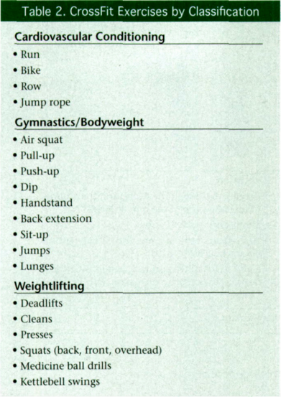
CrossFit Exercises by Classification

Slide 40
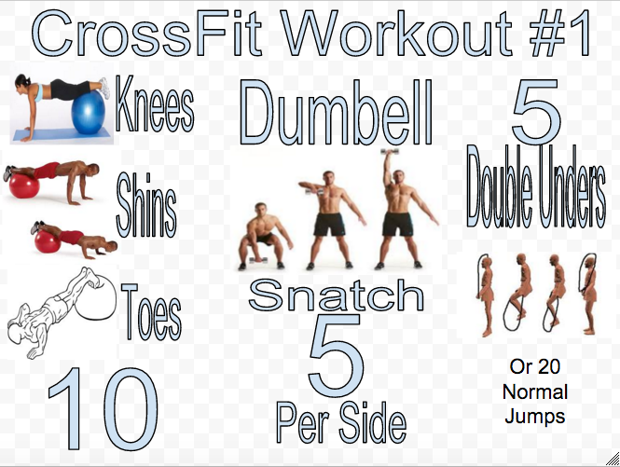
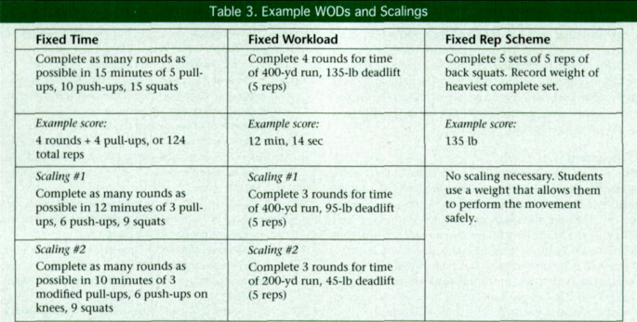
CrossFit WOD and Scaling

Slide 41
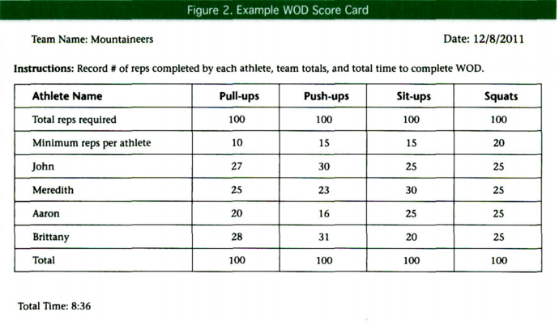
CrossFit WOD Score Card

Slide 42
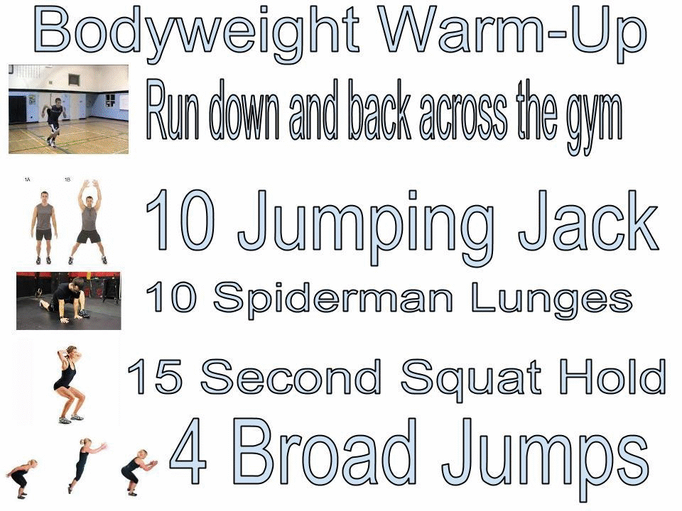
Example - Workouts of the Day

Slide 43


CrossFit Action

Slide 44
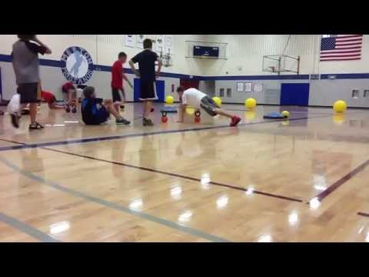
CrossFit Action

Slide 45
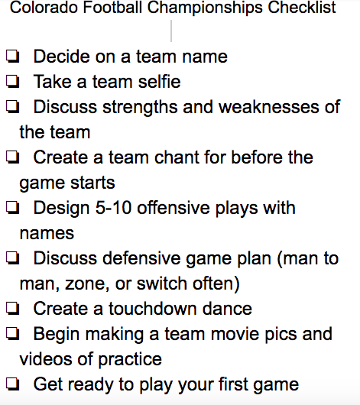

Slide 46
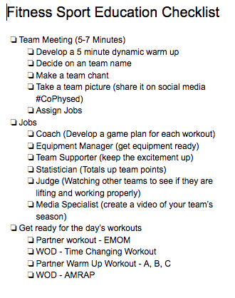

Slide 47

Let the Vail Bowl Begin

Slide 48

World Cup Soccer
A student led sport education unit

Slide 49

World Cup - Provocation

Slide 50
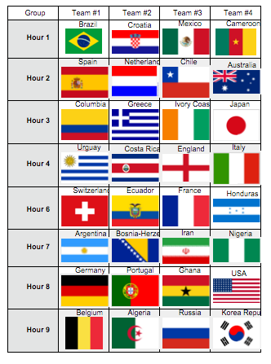
Inspired by 2014 Men’s World Cup

Slide 51
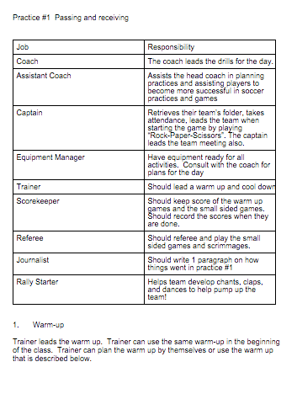
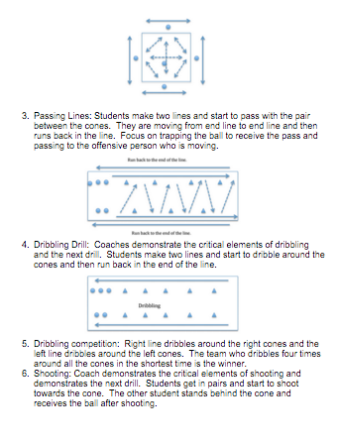
New Jobs & New Approach

Slide 52
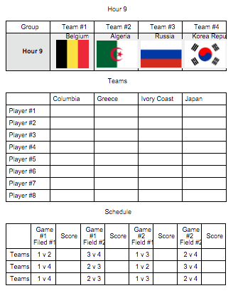
Schedule & Postseason
Round robin tournament during class.
Single elimination round of 8 at recess.
7th vs. 7th
8th vs. 8th
until…..
The World Cup Final 7th vs 8th

Slide 53
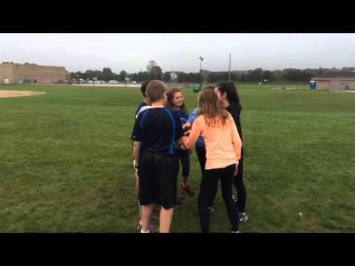
World Cup Soccer 2015 @ Merton Intermediate

Slide 54

Basketball Sport Ed Season
A student led unit

Slide 55



NBA or College

Slide 56

Golf - Read More Here

Slide 57

Olympic Gymnastics

Slide 58

Volleyball

Slide 59

Badminton

