Slide 1
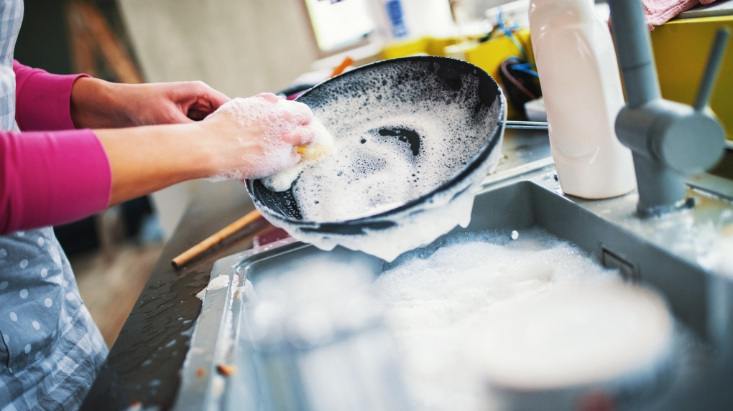
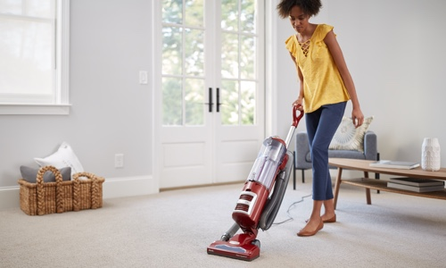
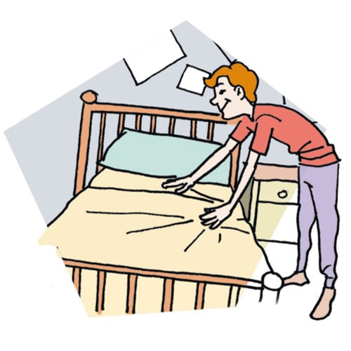
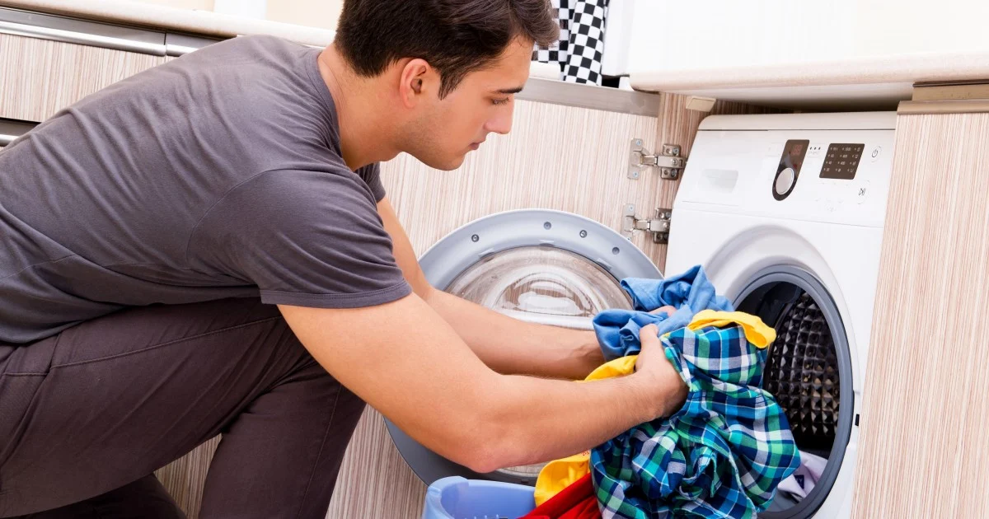
Do you have any chores that you do at home?
Yes or No?
If yes, what kind of chores do you do?

Slide 2
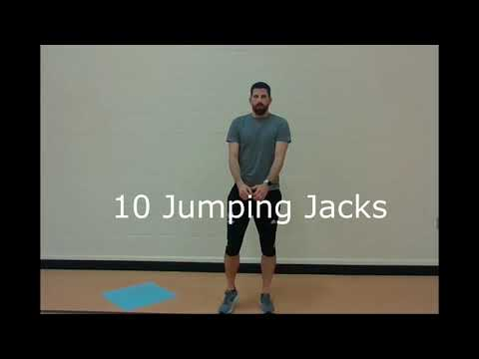
Warm-Up
Round 1:
10 jumping jacks
5 push-ups
10 lunges
5 sit-ups
10 punches
Round 2:
10 jumping jacks
5 push-ups
10 lunges
5 sit-ups
10 punches

Slide 3
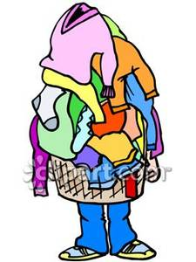
Water Break
Today we will be pretending to do some laundry as we practice our components of fitness

Slide 4
Laundry Day
With
Mr. Long
Here’s what you need:
10 items:
Some examples: stuffed animals, paper balls, socks, toilet paper rolls, shirts, towels, etc.
Also, if you have a box, laundry basket, or anything to put these in.

Slide 5
Muscular Endurance and Strength: 1st Round

Slide 6
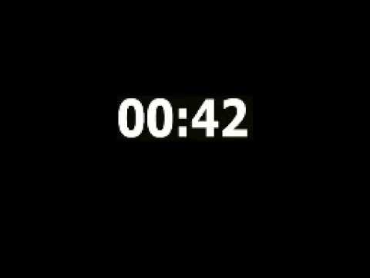
Ready?
PLAY!

Slide 7
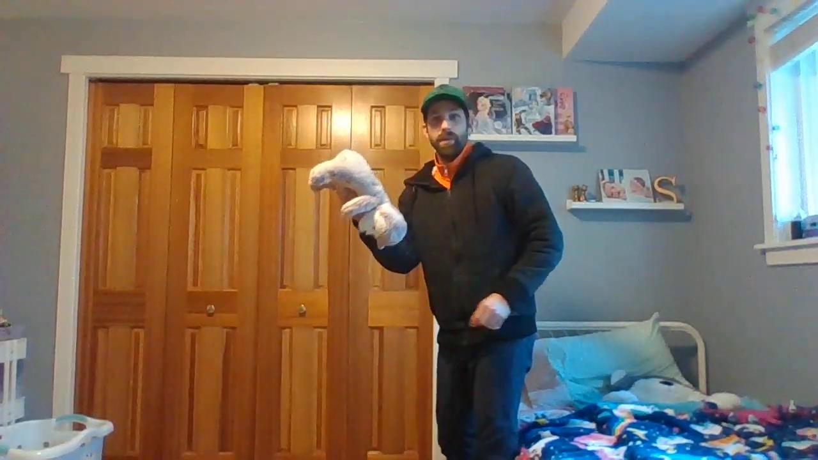
Flexibility with Arms and Underhand Toss

Slide 8
Ready?
PLAY!

Slide 9
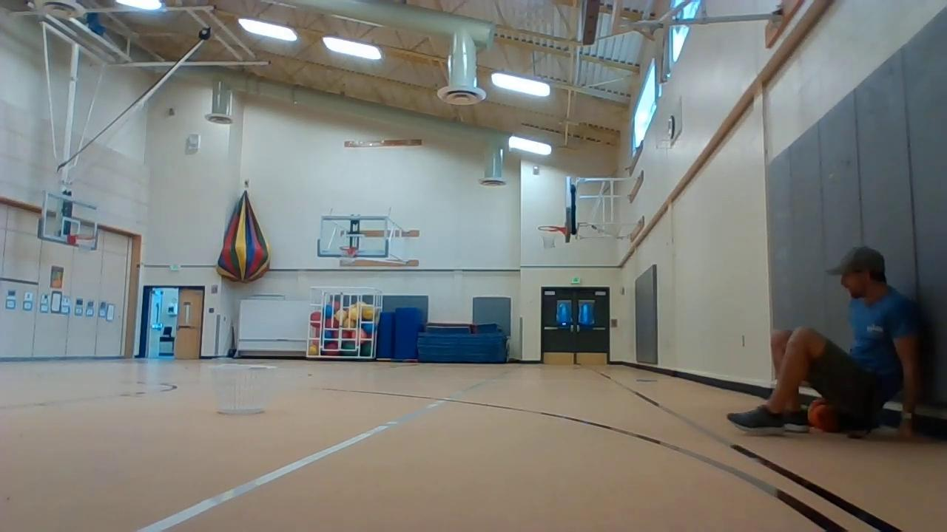
Muscular Endurance Crab Walk Style

Slide 10
Ready?
PLAY!

Slide 11
Flexibility with Legs

Slide 12
Ready?
PLAY!

Slide 13
Muscular Endurance and Strength: Round 2

Slide 14
Ready?
PLAY!

Slide 15
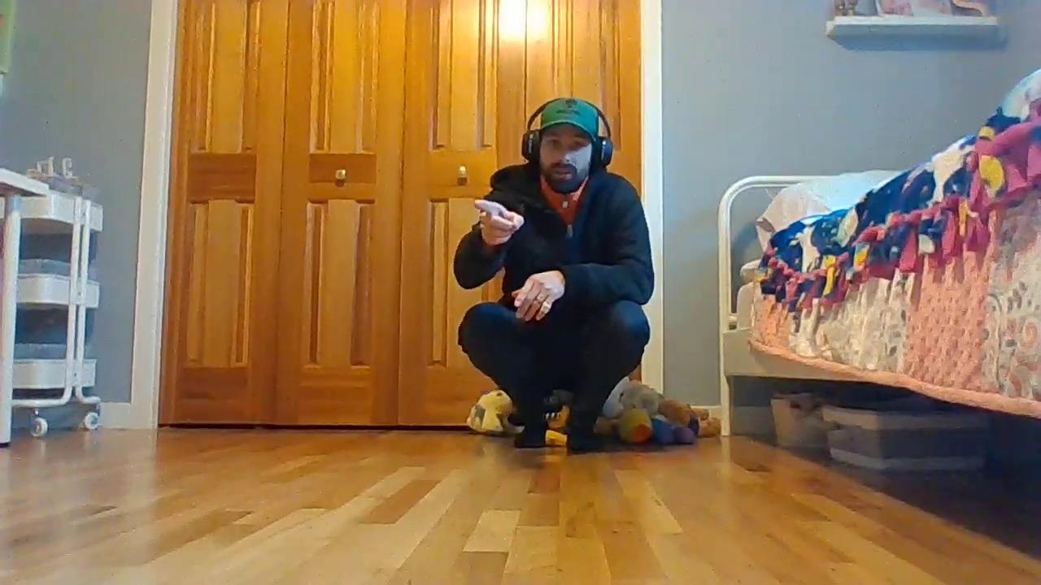
Cardio Endurance and Muscular Endurance: Rabbit Style

Slide 16
Ready?
PLAY!

Slide 17
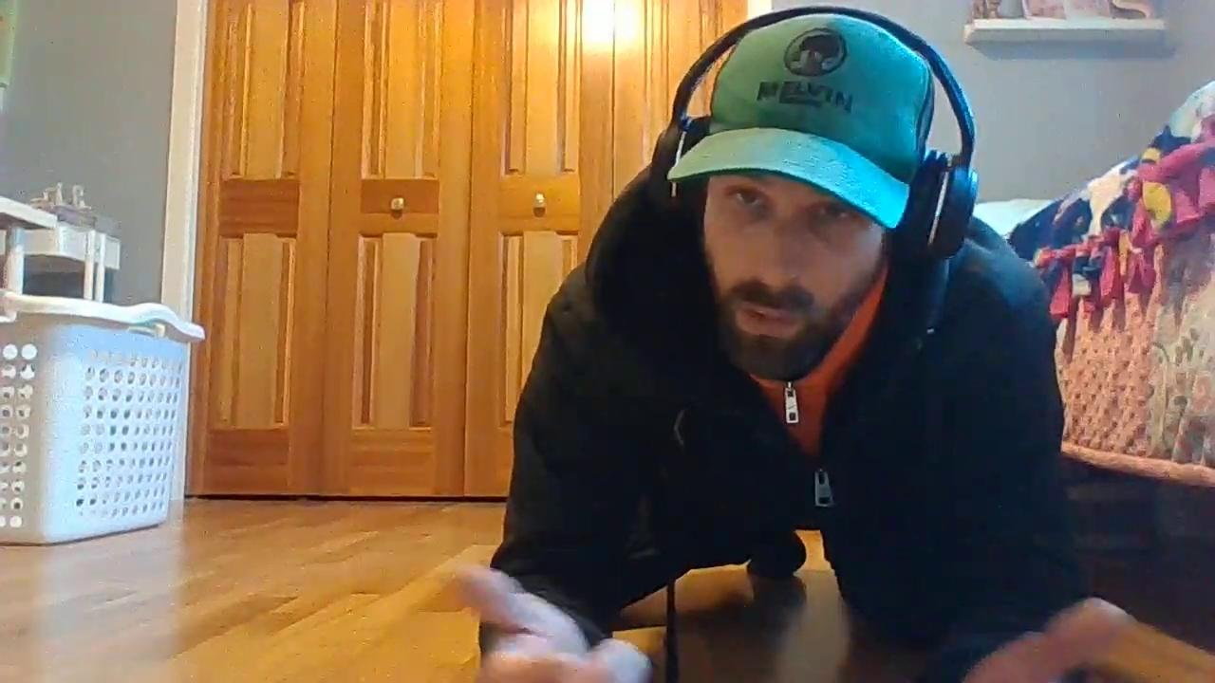
Muscular Endurance: Squats with Underhand Toss

Slide 18
Ready?
PLAY!

Slide 19
Muscular Endurance and Strength: Round 3

Slide 20
Ready?
PLAY!

Slide 21
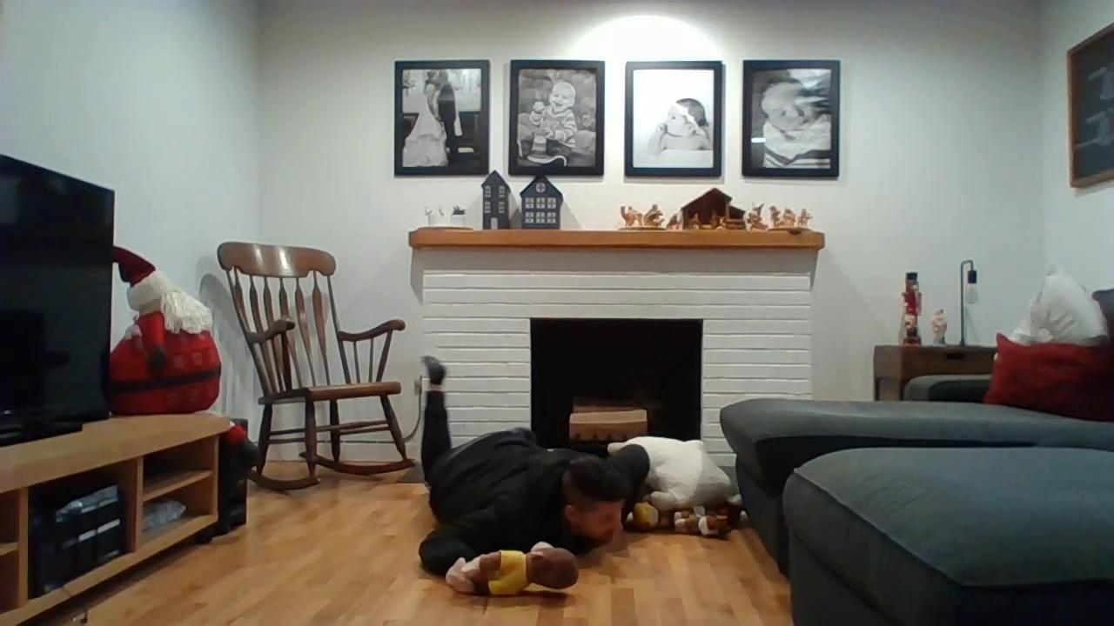
Muscular Endurance: Lizard or Snake Crawl/Slither

Slide 22
Ready?
PLAY!

Slide 23
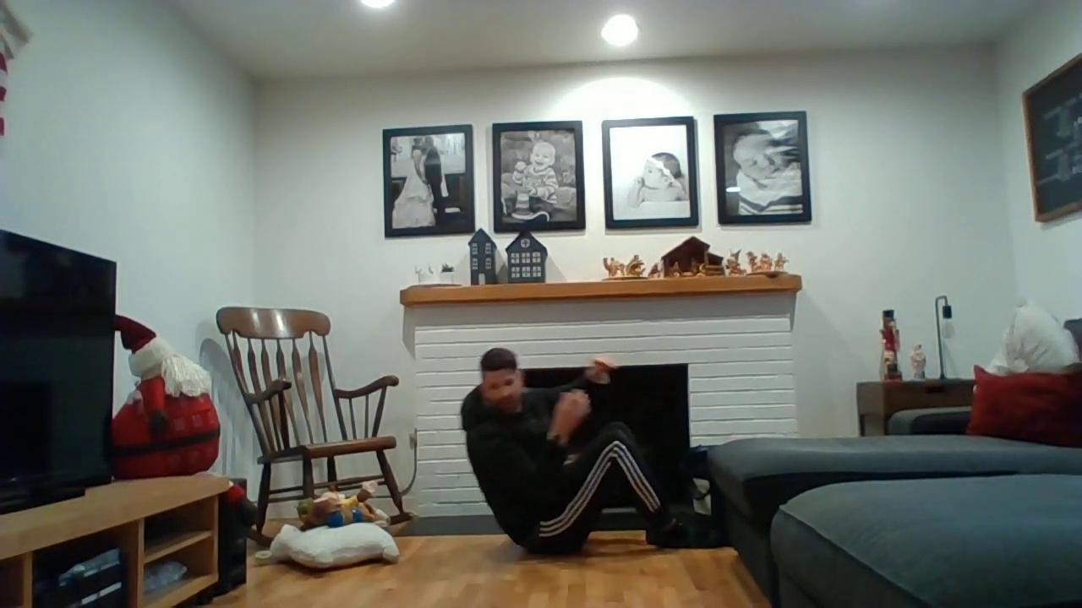
Muscular Endurance: Sit-up Slam Dunk

Slide 24
Ready?
PLAY!

Slide 25
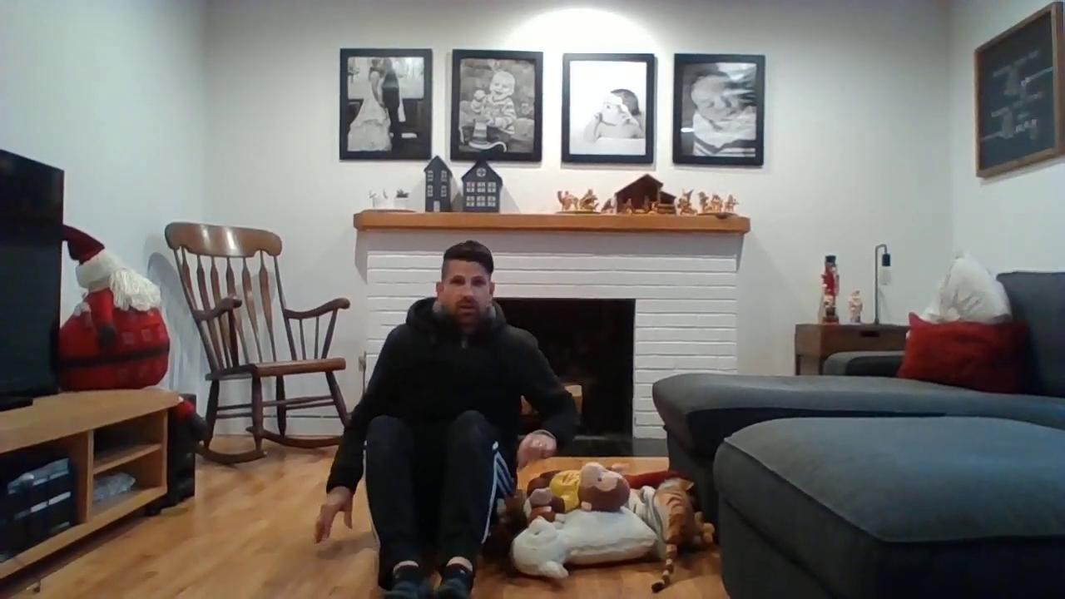
Muscular Endurance: Ab Twist

Slide 26
Ready?
PLAY!

Slide 27
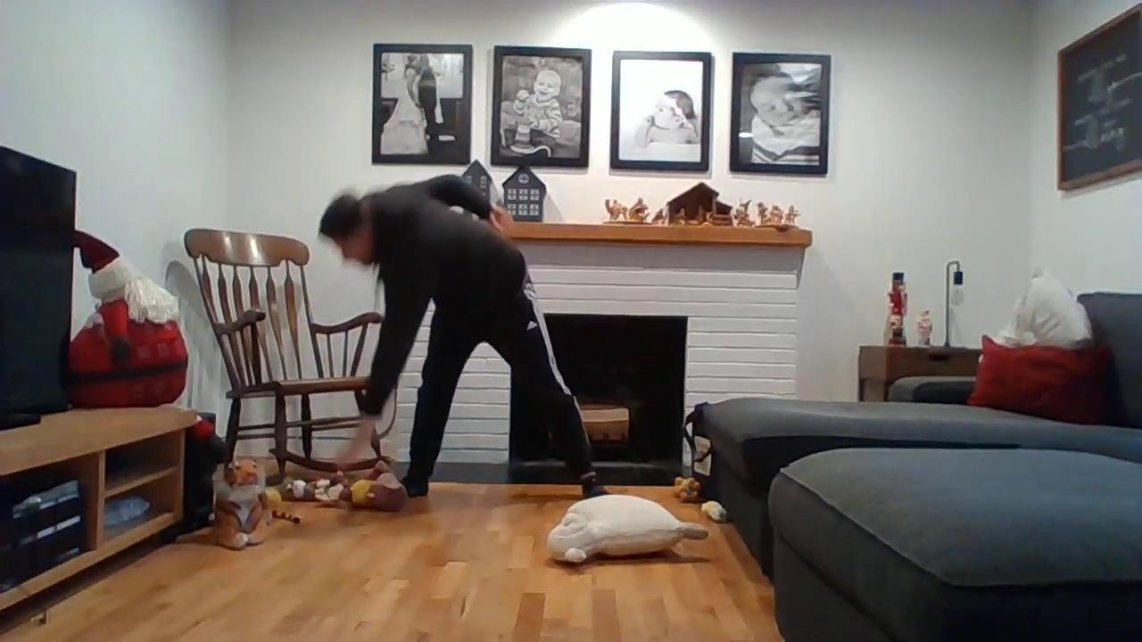
Flexibility: Windmill Mayhem

Slide 28
Ready?
PLAY!

Slide 29
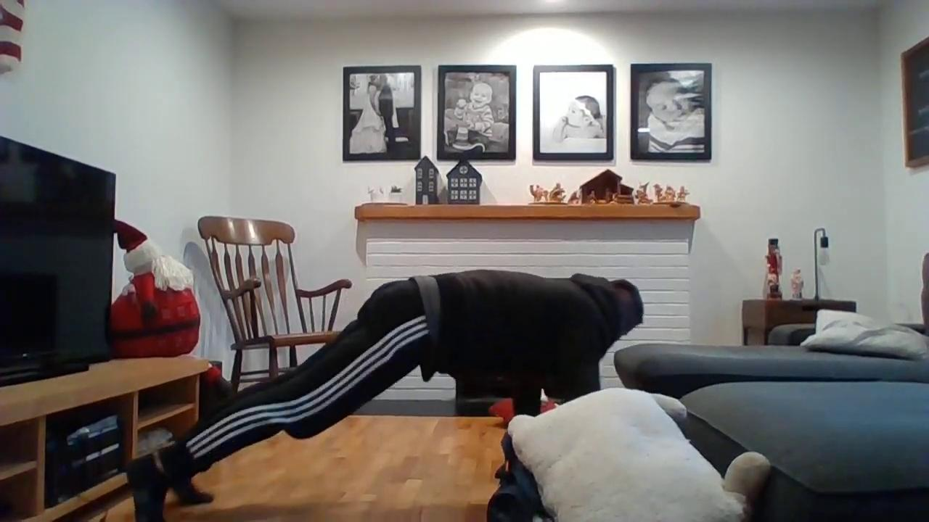
Muscular Endurance: Walk the Plank

Slide 30
Ready?
PLAY!

Slide 31
Cardio Endurance: Jump Rope Laundry Basketball

Slide 32
Ready?
PLAY!

