Slide 1
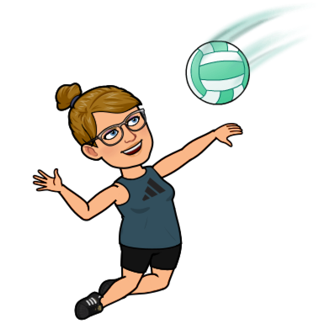
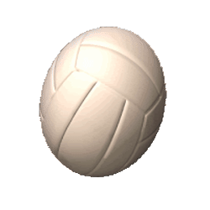
VOLLEYBALL

Slide 2
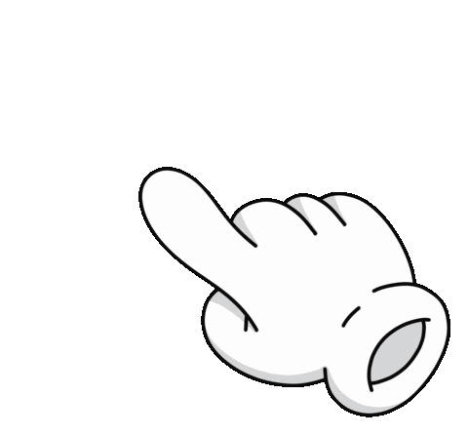
What will you learN?
SERVING
PASSING
PoSITIONS
SETTING
ROTATION

Slide 3
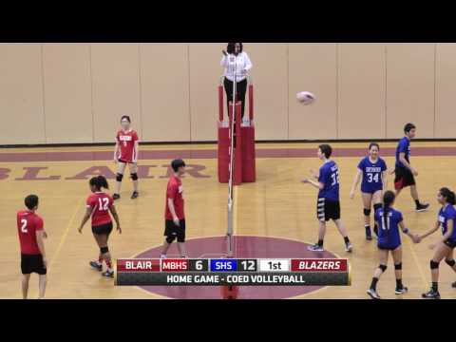

Slide 4
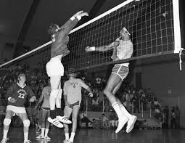
HISTORY of the game
1895
Fun facts
HOLYOKE mA
Year founded
WHERE
WILLIAM G MoRGAN
MINIONETTE
WHO CREATED IT
Original name

Slide 5
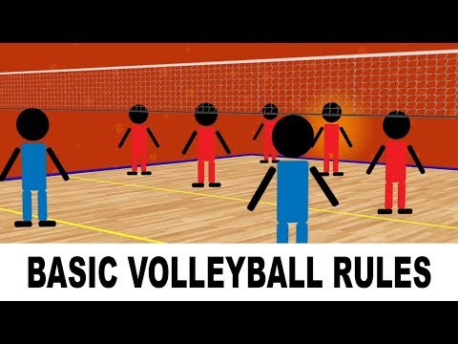
Rules of the game
Volleyball is a sport that can be played indoors or out, on multiple surfaces.
Players can compete in men’s, women’s, or co-ed at levels from casual leagues to professional tours.
Players will need to learn to begin movements from an athletic “ready” position, and will enjoy a fast paced game as well as a strenuous aerobic workout.
The skills you will need to learn are: Passing (bump and set), Serving (underhand or overhand), and Rotating (playing positions on the court).
6
SERVE
sideout
ROTATE
Clockwise
How many players on a team?
How do you start each volley?
What do you call it when a team makes a mistake?
What do you call it when a team switches servers?
What direction does a team rotate?

Slide 6
Volleyball Olympics
SUMMER 1964
Tokyo
Year introduced
WHERE
SUMMER 1984
Atlanta GA
Year introduced
WHERE

Slide 7
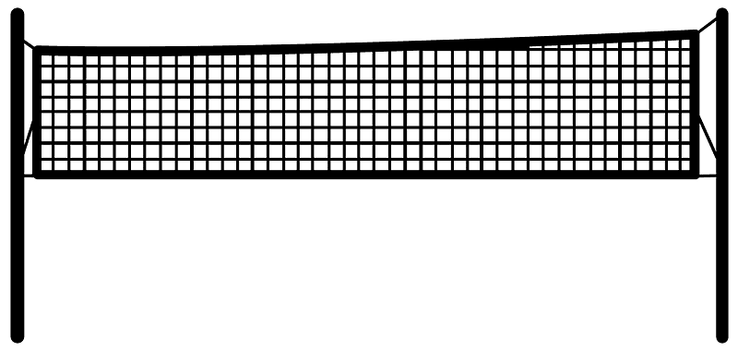
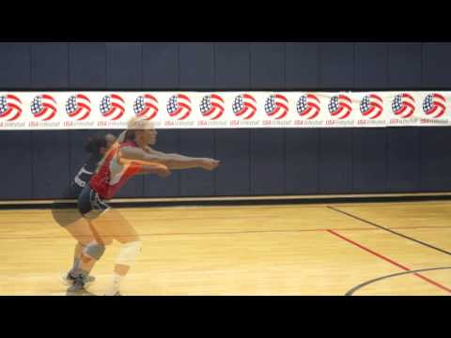
PASSING
READY POSITION
Place feet shoulder width apart with toes pointed straight ahead.
Place 1 foot forward and bend your knees and get low.
Stretch arms out in front; lock elbows straight. Place one hand on top of the other. Place thumbs side-by-side and point slightly down.
Create flat platform with forearms.
EXECUTION
Position yourself in front of the incoming ball so you can step into pass.
Watch as ball contacts your forearms.
As ball makes contact, straighten knees, shrug shoulders, and move arms up slightly to pass.

Slide 8
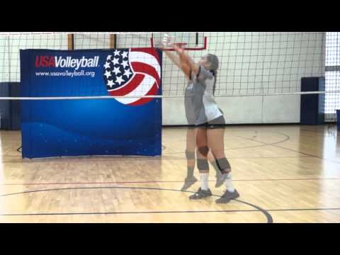
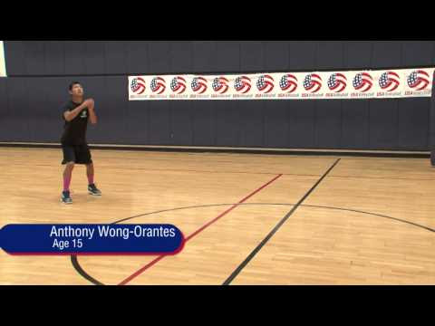
SETTING
READY POSITION
Point your toes straight ahead and feet shoulder width apart. Place 1 foot slightly forward, bend your knees, and get low.
Square your shoulders to the target.
Raise arms overhead; bend elbows out to sides to create a large diamond.
Make hands in the shape of the ball and point thumbs toward eyes.
EXECUTION
Position yourself under the incoming ball so you can step forward and into the pass.
Watch ball contact finger pads.
Extend your knees, elbows, and wrists toward your target.
Allow hands to “give” (spring back) on contact.

Slide 9
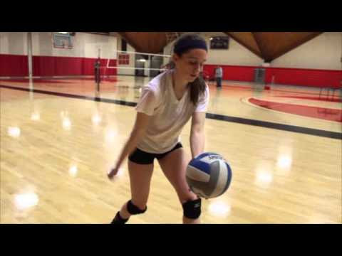
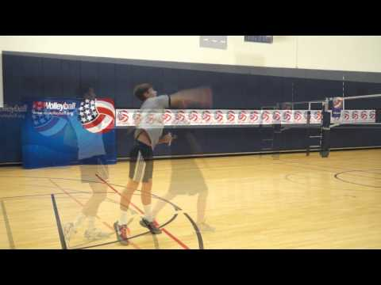
Serving
READY POSITION
Hold the ball at hip height in your non-dominant hand.
Point your toes straight ahead with the lead foot being on the same side as the hand holding the ball.
With your dominant hand in an open fist, swing your hand back and low behind your hip.
EXECUTION
Step forward with the lead foot while swinging your dominant hand toward the ball.
Be sure to hold the ball low and watch the ball contact the lower pad of your palm of your striking hand.
Follow through with the striking hand in the direction of your target.

Slide 10
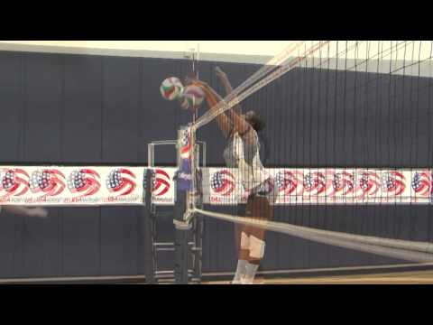
BLOCKING
READY POSITION
Stand at a comfortable distance off the net. You should be standing with enough leverage to push off and move sideways if you need to.
Place your arms up in front of you. You want your arms up ready to react to the other teams offense.
EXECUTION
start by jumping laterally off of one foot. To move to the left, take a big step (or jump) to your left foot.
Follow with your right foot, land, and jump straight up.
You want to jump lined up in front of where the hitter will be contacting the ball.
You want to make sure you are balanced before you jump.

Slide 11
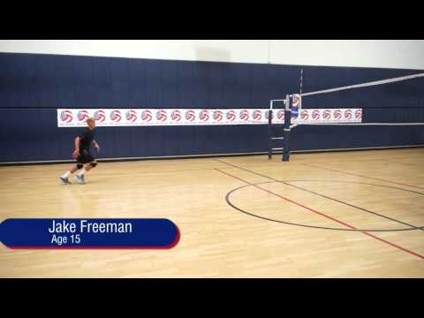
Hitting
EXECUTION
APPROACH
The purpose of the approach is to position your body in the air ready to hit.
TAKE-OFF
Develop volleyball skills to quickly get off the ground using both legs to jump. The shorter the ground contact time is on the last two steps of the approach the more elastic energy you can utilize for exploding high.
MID-AIR CONTACT
You want to get positioned with your arm stretched upward about six inches behind the ball, then contact the ball at your highest point in the jump.
LANDING
Cushion your landing by landing on the balls of your feet with your knees bent.

Slide 12
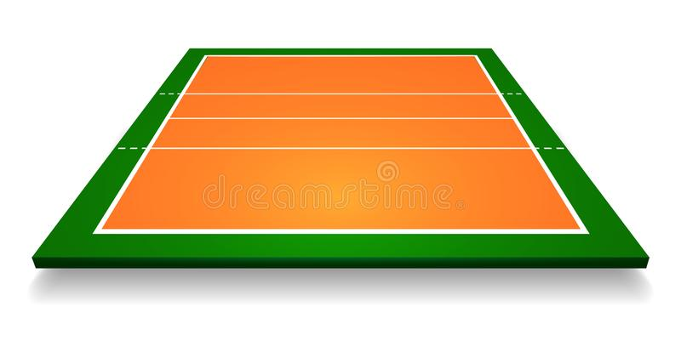
Setter – Runs the team's offense. Tries to make second contact with the ball and set it high in the air for the attackers to get a good, strong hit. Line up on the right front or right back of court.
Libero – Specialized defensive player whose job is to return spikes and serves. Subs in for anyone in the back row and must remain in the back row without rotating like the rest of the players.
4
3
5
Middle blocker (middle hitter) – Primary blocker and decoy hitter. Plays in the middle, front row.
Power
hitter/
blocker
Middle blocker/
hitter
outside hitter/
blocker
Outside hitter (power hitter) – Most dependable hitters on the team that receive more sets than other players. Line up on left side of the court on the front and back row,
4
2
1
Opposite hitter (offside hitter) – Defensive blocker and backup setter. Plays on the right side of the net on the front row.
Backrow P hitter
libero
setter
POSITIONS

Slide 13
When the serving team loses a point, the opposing team will get the next serve. This is known as a sideout.
Following a sideout, the new serving team will rotate positions to a new server to start the next point. The team who lost the point causing the sideout will not rotate until they get the serve back from the new serving team.
There is no rotation on either side of the net when the serving team scores a point. The serving team will remain in position as long as they continue to score points.
4
5
6
3
2
1
ROTATION

Slide 14
Each team will have six players positioned on their side of the court.
Play begins when the serving team serves the ball to the opponent starting a “rally” for that point.
A point is awarded to the team who keeps the ball in play by returning the ball over the net in 3 hits or less.
After conclusion of the previous point, play continues with another serve performed by the team who won the previous point.
Left
FRONT
MIDDLE FRONT
Right
FRONT
Left
Back
MIDDLE
Back
Right
Back
SERVER
Court names

Slide 15
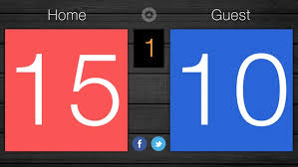
Scoring
Scoring is done through “rally scoring”, where a point is scored on every serve. Points are scored by forcing the opposing team to commit an error.
The active server is responsible for calling the score before each serve. The score should be called with the serving teams points first, followed by the opponents points. Example: 7 serving 15 or 7-15 service
The first team to reach 25 points is the winner, as long as they have won by 2 or more points. If the score is 25 - 24. Play will continue until a team has a 2 point advantage.
Example: 28 - 26

Slide 16
When an error occurs, a point is awarded to
the opposing team.
SIDEOUTS include:
Double hit - A player is not allowed two consecutive hits or two hits in a row.
Touching the net or crossing the centerline
Serving the ball into the net or out of bounds
A ball that hits the net and goes over is considered playable not an error
Hitting the ball out of bounds
A ball that touches the line or part of the line is considered in bounds

