Slide 1
The Ins and Outs of Food Allergy in Pediatrics
25th Annual Three Rivers NAPNAP Winter Symposium
Kim Woodward, MSN, APRN, CPNP-PC
Pediatric Allergy, Immunology, & Pulmonary Medicine
February 5, 2021

Slide 2
Objectives
Overview of FA: background, prevalence, definitions
IgE mediated
Allergens
Diagnosis, treatment, prevention
Non IgE mediated
Mixed
What’s new in the world of FA

Slide 3

Public perception
¼ households in US have dietary modifications in place due to perceived food reaction
Parents are quick to label any reaction an “allergy”
Notes:
Not all allergy – but also intolerance or personal preference

Slide 4
AAAAI* definition of food allergy
“Adverse health effect arising from a specific immune response that occurs reproducibly on exposure to a given food.’’
  Not limited to IgE-mediated reactions
  Describes the induction of clinical signs and symptoms
  This contrasts with sensitization, which indicates the presence of IgE antibodies to a food, often in the absence of clinical symptomatology.
*American Academy of Allergy Asthma & Immunology
Notes:
The American Academy of Allergy, Asthma & Immunology
One can have sensitization to a food but be able to tolerate it upon ingestion without symptoms.

Slide 5
Notes:
We won’t discuss the non-immune mediated or “intolerance” reactions today, but you should consider these when hearing families who present with concerns for adverse food reactions.

Slide 6
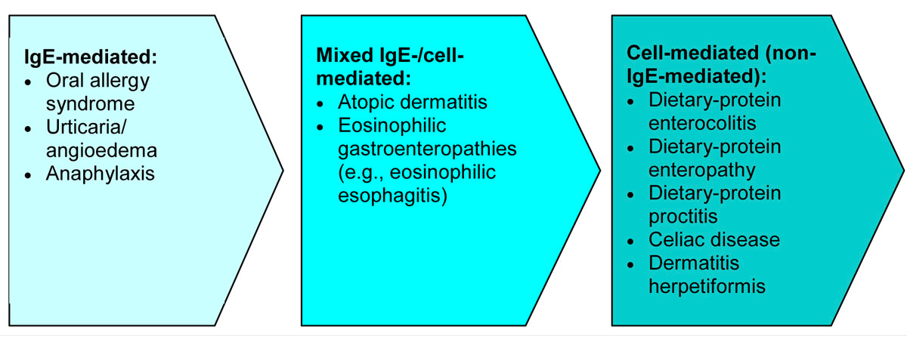
Immune Mediated
Notes:
IgE mediated – immediate reaction
Mixed – typically delayed

Slide 7
IgE mediated food allergy
Notes:
Let’s start with IgE mediated food allergy. This is what is typically presented in the media etc. and is what is typically thought of as “Classic Food Allergy”, Gel and Coombs Type 1 hypersensitivity reactions.
OAS, Urticaria/angioedema, Anaphylaxis

Slide 8
Prevalence
7-8% of all children in first 3 years of life, 2-3% of adults
  Infants with moderate to severe AD at highest risk
  Of food allergic children, peanut is the most prevalent allergen, followed by milk and then shellfish
National surveys suggest that the prevalence of peanut allergy has tripled since the 1990s
  Some studies are based on self report, which tends to overestimate the prevalence
Gupta, R, et al. The Prevalence, Severity and Distribution of Childhood Food Allergy in the United States. Pediatrics 2011; 10.1542/ped.2011-0204

Slide 9
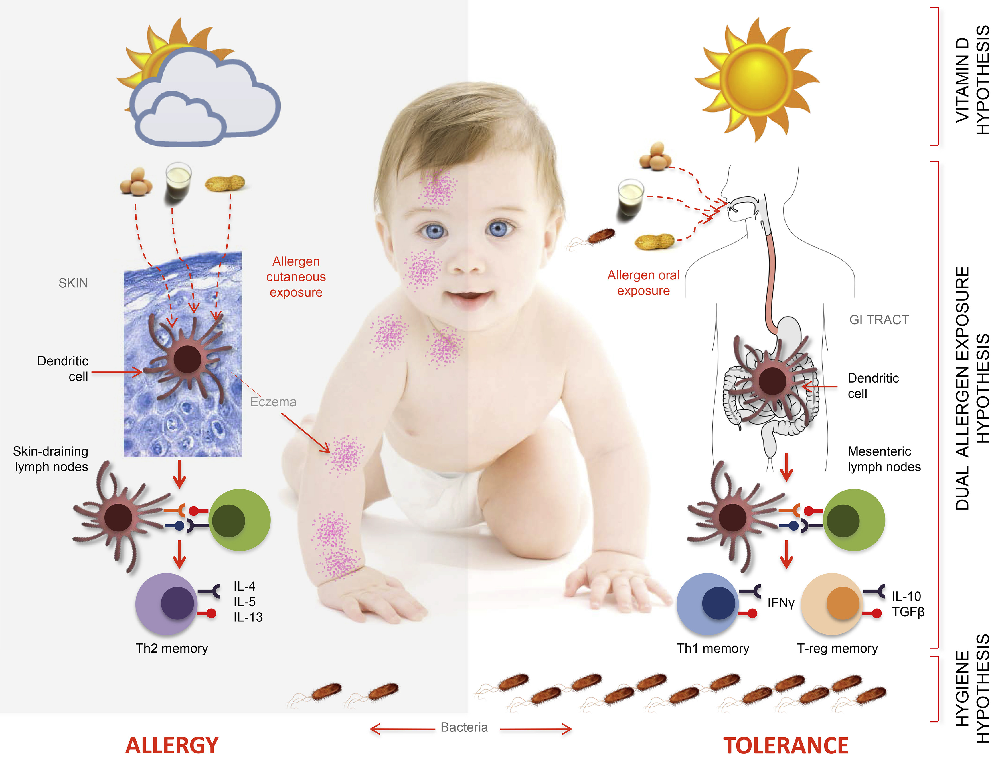
Journal of Allergy and Clinical Immunology 2016 137, 998-1010DOI: (10.1016/j.jaci.2016.02.005)
Notes:
How does FA develop? Several hypotheses exist; may be some combination of factors/influencers, such as genetics, microbiome, home environment, etc.
Baby on the right was born via vaginal delivery with exposure to vaginal flora. She was raised in the country/rural area, where she could play outside, free of environmental irritants and pollution, she was able to avoid unnecessary antibiotics in infancy/family did not treat viral URIs with antibiotics. She is a “free range” baby. She does not have eczema, or if she does it appears here to be well controlled likely due to aggressive moisturization (BID Vaseline) to her whole body and use of topical steroid creams/ointments on inflammatory patches until these areas are well healed. She has an oral route of food exposure – eating a varied diet from an early age (4-6 months old). When introduced orally, peanuts, eggs, milk (and the other things babies put in their mouths-bacteria) go into the gut where the dendritic cells and the food proteins bond, invoking TH1 memory cells and T-reg memory cells, which release IFN-gamma, IL10, and TGFbeta, which are associated with food tolerance/protection from food allergy.
On the left, the baby was born via C-section. She had several ear infections in early childhood and viral URIs which were always treated with antibiotics. She lived in a busy city, was kept indoors often due to inaccessibility of open outdoor spaces such as pastures/grassy areas. She clearly has eczema, which looks to be patchy, red, and broken open. This impaired skin barrier is the site of allergen exposure/introduction for this baby, who has food products introduced into poorly controlled eczema (peanut dust, etc). This cutaneous exposure again instigates bonding of dendritic cells in the skin with the food proteins, however the TH2 memory cells are primed, releasing IL4,5,and 13 which are associated with allergic response. This baby has been primed (her first/early exposures are cutaneous), and she develops sensitization this way so that when foods are introduced orally with solid food introduction, this baby has an allergic reaction.
There are also studies investigating role of Vitamin D deficiencies in the formation of allergies. At this time, no specific Vitamin D supplementation is advised.
Probiotics in otherwise healthy infants? I advise a well-rounded diet and yogurt.

Slide 10
Allergens
Over 170 foods have been described as triggers of food related reactions
8 foods account for 90% of food allergies
  peanut, tree nuts, fish, shellfish, milk, egg, wheat, soy, and seeds
  New: 9th “big” allergen: SESAME
Different patterns of consumption and allergic sensitization seems to influence the relevance of specific foods in different parts of the world
  Studies of European patients have identified, in addition to the most common allergens, other prevalent foods allergens including celery, mustard, sesame, lupine, and stone fruits
Notes:
Important to know the BIG 8
-- In kids: most prevalent 1) peanut, 2) milk, 3) shellfish

Slide 11
Characteristics of food allergens
Must be able to survive digestion and elicit an immunological response when exposed to the mucosal immune system
Such characteristics are thought to include
  water solubility
  glycosylation residues
  relatively low molecular weight
  resistance to digestion by heat and proteases
  abundance within the food source
IgE antibodies may be directed to a variety of potential allergenic proteins in foods, and in some foods there are multiple allergenic proteins
Notes:
Food proteins with allergenic potential resist the process of digestion and destruction by way of these characteristics.
Most food allergies are associated with the protein in the food.

Slide 12
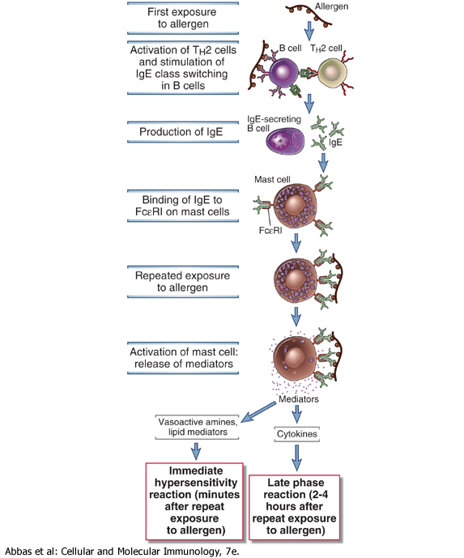
Notes:
The allergen binds to receptors on B cells, which activates TH2 cells. The B cell starts producing extra IgE which then binds to FC epsilon RI which is the high-affinity IgE receptor (found on epidermal Langerhans cells, eosinophils, mast cells, and basophils). So now there is this IgE/FCeRI complex, that when re-exposed to the allergenic substrate, triggers the activation of these mast cells to release chemical mediators (cytokines, interleukins, leukotrienes, prostaglandins, and histamine) that promote inflammation. So the mast cells spill out all these mediators which leads to symptoms (inflammation, vasodilation, urticaria, consequences of inflammation (angioedema, wheezing).

Slide 13

Symptoms Consistent With IgE Mediated Reactions
Skin: most common
Respiratory
GI
Circulatory
Misc
Notes:
urticaria, flushing, angioedema, acute contact urticaria
• RESP (Upper/Lower): wheezing, shortness of breath, throat tightness, cough, hoarse voice, chest pain/tightness, trouble swallowing, itchy mouth/throat, nasal stuffiness/congestion • GCirculation: pale/blue color, low pulse, dizziness, lightheadedness/passing out, low blood pressure, shock, loss of consciousness • Skin: hives, swelling, itch, warmth, redness, rash • Stomach: nausea, pain/cramps, vomiting, diarrhea (< 5% will have diarrhea, so not very common and it is often not concerning as the symptom is so far down the GI tract**) • Other: anxiety, feeling of impending doom, itchy/red/watery eyes, headache, cramping of the uterus

Slide 14
Characteristics of IgE mediated food reaction
Rapid onset after ingestion (eg, within minutes to 2 hours)
Small amount allergen ingested can give serious reaction
Reproducible
Allergic response seen in AD may occur hours later and look different
Notes:
Very rarely is food the culprit of a reaction that occurs > 2 hours after eating. So when you think about someone who has hives 6 hours later, or “the next day”, this is not food allergy (timing doesn’t fit).
Food has been thought to be a trigger in severe/refractory AD (not mild/mod) only 25-30% of the time, so this is a very infrequent subset of patients with eczema. This has to be a food commonly ingested as well. This allergic response is mixed IgE and cell mediated, and does not manifest as hives/swelling/respiratory distress/GI.

Slide 15
History
Time from ingestion to symptoms
Which symptoms?
  Do they sound IgE mediated?
Number of occasions
Quantity required
Most recent/length of time since reaction
Other factors: exercise, medication, alcohol
Notes:
So the patient comes into your office with their parent concerned about a possible food allergy. What do you want to know? How much did patient ingest? How long after eating did symptoms start, and what were the symptoms? How long did the symptoms last? Did the patient require treatment/medical evaluation/hospitalization? How many times has this happened? Has it happened outside of meal times/food exposure? Has the patient tolerated this food since the last reaction? Any relation to exercise? Any new meds?

Slide 16
So what about processing foods?
Thermal treatments (i.e. baking) can reduce the allergenicity of certain foods, like egg or milk
This can allow for reintroduction of problem foods earlier than otherwise possible
Some cooking practices, particularly roasting compared with boiling, may potentiate the allergenic activity of peanuts
Notes:
Eating the baked milk or baked egg will increase tolerance, usually after 6 months of regular ingestion, of the whole food product – like scrambled egg or liquid milk.

Slide 17
Near fatal/fatal anaphylaxis
Most commonly associated foods:
  Peanut
  Tree nut
  Shellfish
  Fish
Related to several factors including
  Being an adolescent
  Underlying respiratory disease (asthma)
  Concomitant use of beta blockers
  Non-cutaneous reactions
  Delayed epinephrine
Regarding nuts: > 50% of FA fatalities were in patients with mild previous reactions
Notes:
Define Anaphylaxis: ABCs and 2 organ systems
Only approved treatment of anaphylaxis is epinephrine. Other supportive measures ok only after epi in.
Peanut allergy affects approximately 0.6% of the general population and is the most common cause of fatal food-induced anaphylaxis, with those at greatest risk being adolescents with asthma.
In predicting severity of FA reactions, consider older children/adolescents, those with larger SPT/specific IgE, decreased time between eating food and onset of reaction, prior noncutaneous reactions, and prior severe reaction.

Slide 18
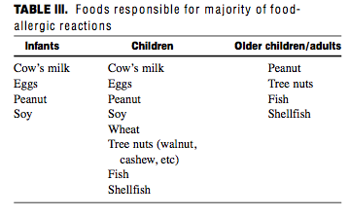
Common foods by age

Slide 19
Diagnosis
Isolated ingestion of allergen on several occasions leading to reaction plus positive SPT or ImmunoCAP (sometimes called RAST or specific IgE)
WHAT HAPPENS WHEN YOU EAT THE FOOD?
Notes:
This is important to understand that a clinical reaction is imperative to diagnose food allergy. One can have positive testing, but without a clear history of reactivity (supported with REPEATED INGESTIONS LEADING TO REACTIVITY), it isn’t food allergy. Positive testing in the absence of symptoms is merely sensitization, not food allergy.

Slide 20
Skin testing
Highly sensitive ~85%
Less specific ~40-80%
  Well suited for foods for which you have high suspicion
  Poor prognostic capability if not truly allergic – high false positive rate!
PPV < 50% (presence of IgE antibody but no hypersensitivity)
No intradermal testing to foods
  Higher rate of false positives
  Can elicit systemic reactions
“Consequently, panels of food allergy tests should not be performed without consideration of the history because one may be faced with numerous irrelevant positive results (particularly in disorders with high total IgE antibody).”
Notes:
SPT dependent upon wash-out time for AH. No AH prior to testing.
Test sensitivity is the ability of a test to correctly identify those with the disease (true positive rate), whereas test specificity is the ability of the test to correctly identify those without the disease

Slide 21
Skin testing preparations
Commercial food extracts
  stable proteins
  peanut, milk, egg, tree nuts, fish, shellfish
Prick-prick
  Extracts from foods with heat labile proteins

Slide 22
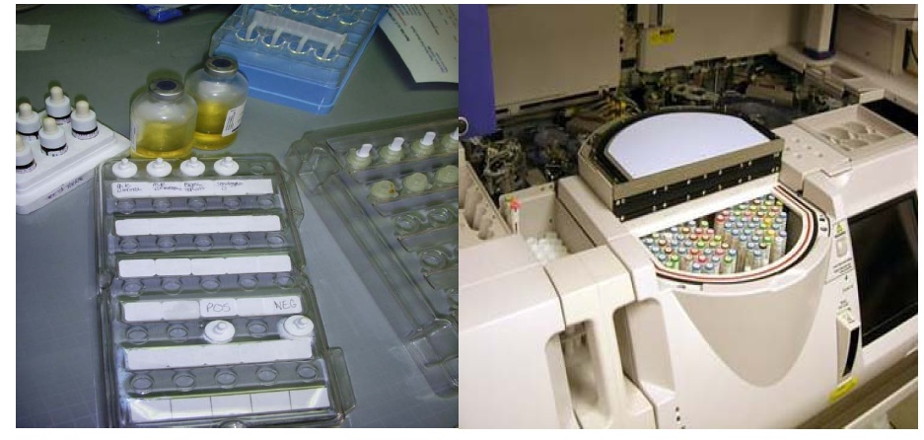
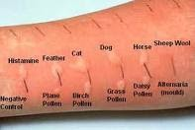
Skin Testing for IgE mediated Allergy is preferred over in vitro testing
Notes:
Skin testing for IgE-mediated allergy is preferred over in vitro testing for most allergens, because skin testing is more rapidly obtained, less expensive, and more sensitive.
Downfall – typically only available in allergist office, requiring holding AH.

Slide 23
Specific IgE: Immunocap

Slide 24
ImmunoCAP
Previously known as RAST
Use for patients with dermatographism, severe AD and limited surface, patients who can’t discontinue antihistamine, recent anaphylaxis
Cheap, easy
Trend outgrowth especially in peanut allergy
The precise sensitivity of specific IgE immunoassays compared with skin prick/puncture tests is approximately 70% to 75%.
Tables for interpretation
  H. Sampson, give the IgE level above which there is a 95% PPV that patient will react if challenged with the food
  Age specific
  Simberloff, et al: Standardized Clinical Assessment and Management Plan (SCAMP) for Food Challenges
Notes:
Limitations to specific IgE include: they are problematic for venoms, foods, some pollens, molds, latex, and drugs.

Slide 25
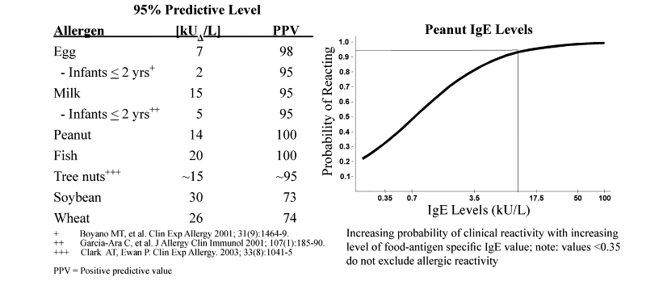
Notes:
Important to note that peanut specific IgE of < 0.35 does NOT exclude allergic reactivity. You can also see that those with PN sIgE > 14 have a 95% probability of reacting.
These values are different for various foods (and also vary by age), and this is another reason why it is important not to draw panels of many foods as the interpretation of these labs is best left to someone with considerable experience and training in interpreting these tests.
I use the SCAMP criteria to guide my decisions about avoidance/clinic challenge/eating at home.

Slide 26
Component testing
Most applicable for peanut allergy
Assays for specific IgE to the different Ara h peanut antigen components
  Ara h 2
  Ara h 1 and Ara h 3
  Ara h 6 cross reacts with Ara h 2 (typically these are found together)
  Isolated Ara h 8 sensitization has been reported to be associated with no or mild symptoms among peanut-sensitized subjects
    may indicate tolerance or oral allergy syndrome
Milk, egg, hazelnut, shrimp
Notes:
One can be allergic to one or more different parts of the peanut. Each of these components are associated with different risks, 2 and 6 are associated with severe/systemic reactions, while monosensitization to ara h 8 is assocciated with only local symptoms, oral pruritus, and is cross reactive with birch pollen.
I primarily use this with egg and peanut.

Slide 27
Atopy patch testing
Useful for non IgE mediated sensitivity
Most commonly used for T-cell mediated conditions such as AD
Opinions differ on the utility
* Food allergy testing is not recommended for EoE
Notes:
My colleagues and I do not use this at all in my practice any longer.

Slide 28
What about other tests?
There are methods of allergy testing that the American Academy of Allergy, Asthma & Immunology (AAAAI) believes are not useful, effective or may lead to inappropriate diagnosis and treatment. These include:
allergy screening tests done in supermarkets or drug stores,
home testing
applied kinesiology (allergy testing by testing muscle strength or weakness)
cytotoxicity testing for food allergy
Rinkel skin titration method
provocative neutralization testing
Immunoglobulin G (IgG) testing for food allergy
Sublingual provocation

Slide 29
Common foods, interesting trivia

Slide 30
Cow’s milk
2.5% of infants, 0.2% adults
Most achieve tolerance (approximately 85%) by the age of 3 to 5 years
Can usually tolerate extensively hydrolyzed formulas based on cow’s milk protein (approximately 98%) or soy (approximately 85%)
IgE antibodies to casein and whey (beta-lactoglobulin and alpha-lactalbumin) proteins most commonly
Cow’s milk cross reacts with other mammal’s milk i.e. goat (90%)
  Not mare or human
Approximately 10% react to beef
CM can be denatured by heating it such that some allergic individuals do not recognize baked milk as allergenic
Notes:
Most common allergen in young children, and most common food associated with fatal anaphylaxis in children (in general PN is most common).
Alimentum, Nutramigen.
We do not recommend avoiding beef for children with CM allergy.

Slide 31
Egg
Approximately 1.3-2.5% of infants and young children, 0.2% adults
Major allergenic proteins are in egg white (ovalbumin, ovomucoid (heat-stable), ovotransferrin)
Egg allergic children sometimes tolerate egg in baked products or have contact urticaria from egg interaction, but eat it without symptoms

Slide 32


Slide 33
Peanut
Approximately 0.8% children, 0.6% adults
Most common in fatal food-induced anaphylaxis
Approximately 20% of children with a peanut allergy established under the age of 2 years will outgrow it
Recurrence of resolved peanut allergy has been observed
  Thought to be affected by not complying with recommended diet

Slide 34
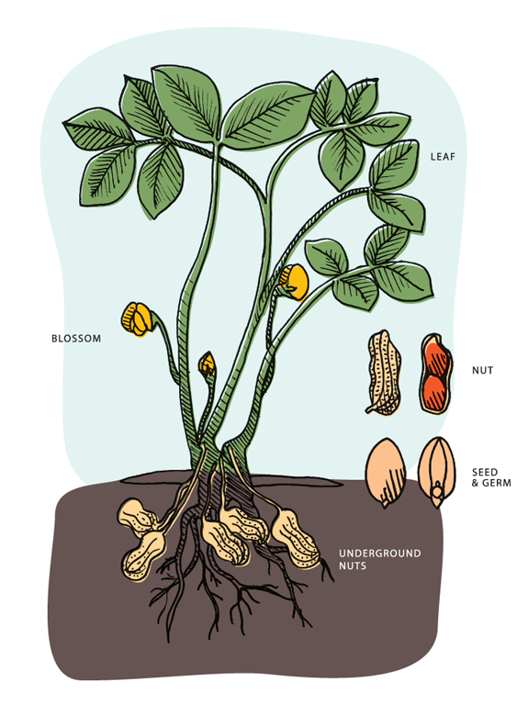
Peanut allergic patients tolerate other legumes (95%), including soy
Highly refined peanut oil tolerated (Chick Fil A = OK)
Notes:
It is unnecessary to empirically recommend soy/legume avoidance to those with PNA.
HOWEVER – peanut co-allergy with tree nuts can be anywhere from 20-68%. May be worth recommending avoidance of any tree nuts the child is not known to tolerate, and advise children tolerating tree nuts to continue to do so cautious of cross-contamination with peanut.
FDA does not require peanut oil to be labeled as an allergen. Studies show highly refined oils can be safely eaten by those with food allergies. These contain extremely small levels of allergenic peanut protein. This is what chick Fil A uses to cook their nuggets in, and it is SAFE for people with peanut allergy to eat. However, peanut oil that is expeller pressed, extruded or cold pressed does contain peanut protein and must be clearly listed on an ingredient label as "peanut". These types of peanut oil should be avoided by those with peanut allergy.

Slide 35
Soybean
Prevalence not widely studied, thought to be 0.3% to 0.4%
  typically transient
Soybean oil usually okay
High in vitro cross reactivity, but oral food challenges have demonstrated low clinical cross-reactivity in soy allergic children, typically transitory
  peanut, soybean, lima beans, pea, garbanzo bean, green bean
Notes:
Soy is a legume; low clinical cross reactivity with other legumes; no need to recommend avoiding all legumes if soy allergic.

Slide 36
Tree nut
Almond, walnut, cashew, Brazil nut, pistachio, hazelnut, pecan
0.2% of children, 0.5% adults
20-68% of peanut allergic people are also allergic to tree nut

Slide 37
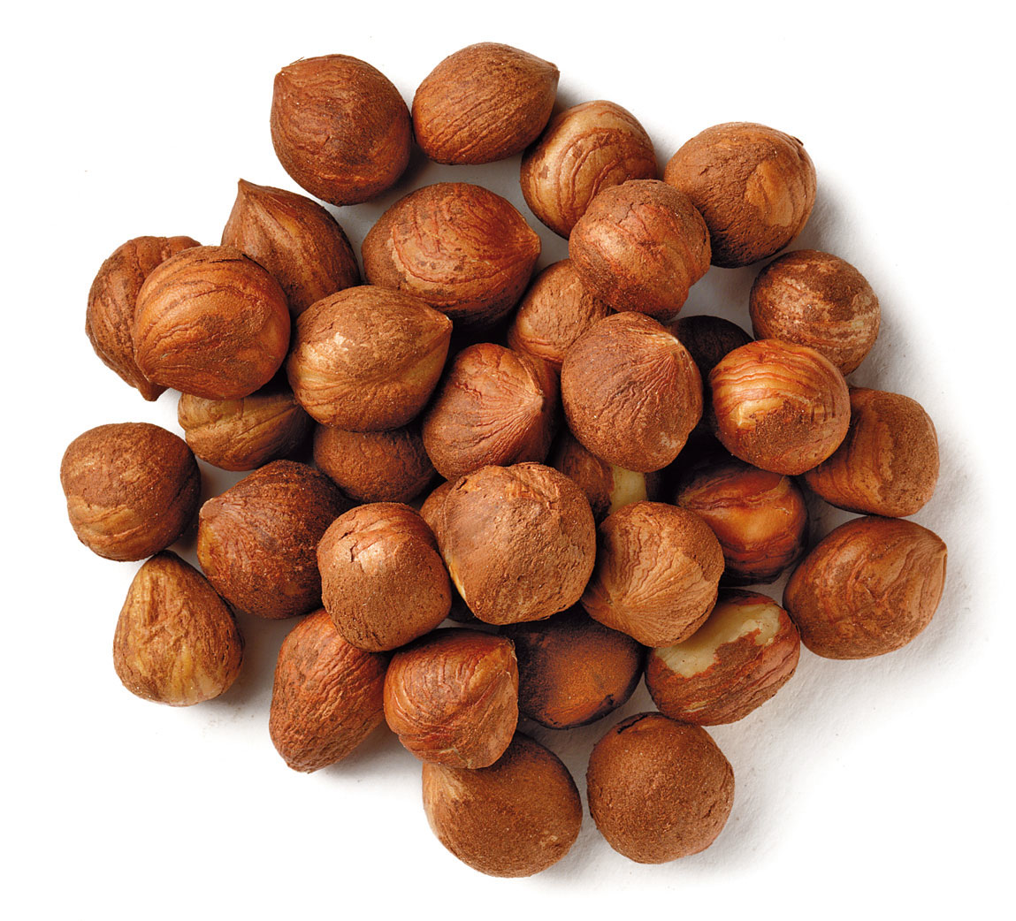
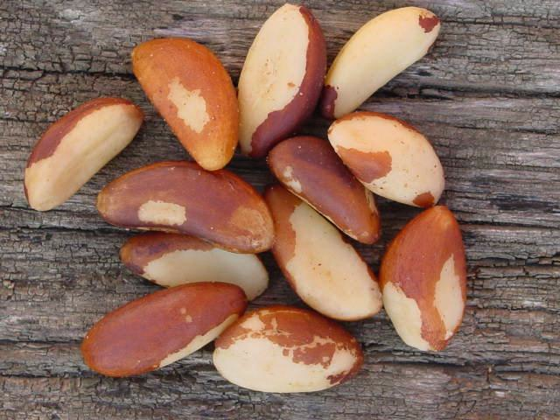
Quiz
Notes:
Hazelnut and brazil nut

Slide 38
Tree nuts
Allergens in tree nuts are highly homologous and can crossreact
  pistachio and cashew
  pecan and walnut
  First manifestation of allergy to another nut can be on the first known exposure
  Recommend avoidance of all tree nuts that one is not known to tolerate
Notes:
Almond and hazelnut can also go together but in clinical practice I see this much less commonly.

Slide 39
Fish
0.1% children, 0.4% adults
Potentially severe
Common to have reactions to multiple fish
Typically long lived allergy
Common in areas of world where fish is major source of protein
There have been case reports of anaphylaxis with aerosolized fish exposure
Notes:
Fish is also unique in that it’s proteins can become aerosolized when cooking/frying and can be inhaled, causing systemic allergic reaction. One fatality due to aerosolized fish exposure last year, and have been several case studies of anaphylaxis with aerosolized exposure. This is not the case with smelling peanut butter, for example.

Slide 40
Fish
Dominant allergen in finned fish is parvalbumin
  Both fresh and salt water fish
Patients with fish allergy should be cautious about ingestion of other fishes until safely eaten(? Oral challenge)
Notes:
There is a degree of cross reactivity between various finned fish, but not all fish are cross reactive, meaning you can be allergic to one fish and not another. Typically it is recommended to avoid “all fish” if you are allergic to one.

Slide 41
Shellfish
0.2% children, 0.5-2% adults
High risk of cross-reactivity between crustaceans
  Less well defined between mollusks and crustaceans
Potentially severe
No cross-reactivity between fish and shellfish
No documented relationship between reactions to radiocontrast media and allergy to fish, crustacean shellfish, or iodine
  RCM reactions are non IgE mediated
Notes:
When someone is allergic to shellfish it doesn’t mean that they need to avoid contrast media for imaging studies; reactions to RCM are non-IgE mediated.

Slide 42
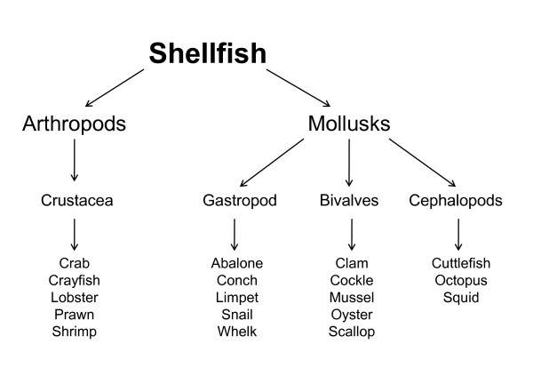

Slide 43
Getting the history
What happens when you eat the food?
How much did you eat? Other foods ingested concurrently?
How long after eating did you have symptoms?
How long do symptoms last?
Did you have to seek care or use treatment?
Have you tried the food again?
Have you tolerated the food prior to the reaction?
Common culprit foods
History of other allergic conditions?

Slide 44
Physical Examination
Acute Reaction
Follow up care
  Signs of other atopy/allergic stigmata
  Dennie Morgan lines
  Eczema lesions
  Wheezing
  Rhinitis/pale, boggy turbinates

Slide 45
Management: IgE mediated FA
Education
Avoidance
Reading labels
  A great resource is the FARE website
Epinephrine
Serial testing
Oral challenge
PN OIT – palforzia: FDA approval 1/31/2020
Notes:
www.Foodallergy.org
Avoid food, prepare for accidental ingestion, reinterrogate, eat/desensitize

Slide 46
Management in your office
Epinephrine
+ diphenhydramine/albuterol
Oxygen
Role of steroids?
Biphasic reactions – may occur in up to 20% of anaphylaxis – patient well for >1 hour, with recurrence of symptoms up to 72 hours later.
Notes:
After reviewing the published evidence, the authors state that the use of corticosteroids has no role in the acute management of anaphylaxis. The report notes that the time to onset of corticosteroid effect is too slow to prevent severe outcomes, such as cardiorespiratory arrest or death, which tend to occur within 5-30 minutes for allergens such as medications, insect stings and foods. They also state that patients with complete resolution of symptoms after treatment with epinephrine do not need to be prescribed corticosteroids.

Slide 47
Will they outgrow it??
Most children with food allergy eventually tolerate milk, egg, wheat, and soy.
It does seem that kids are outgrowing these allergies later than we previously thought
  Milk: 19% at age 4 years, 64% at age 12 years, and 79% by age 16 years.
  Egg: similar to milk
  Wheat: 29% by age 4 years and 65% by age 12 years
  Soy: 25% by age 4 years and 69% by age 10 years
  May suggest that we can follow kids with less frequent retesting, especially if their levels are high
Allergies to peanut, tree nuts, fish, and shellfish do seem to stick around more often but some kids do resolve them
  20% become tolerant to peanut
  10% to tree nut
  The rate of resolution is probably slightly lower for fish and shellfish

Slide 48
How do we know if they have outgrown it?
Serial testing every 1-2 years
Downtrending results
Consider observed food challenge
Tolerance of accidental ingestions
Notes:
Always ask about accidental exposures/ingestions as this can be very telling of sustained allergy.

Slide 49
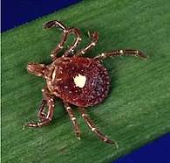
Alpha gal
Sort of newly described delayed systemic reaction to red meat
Due to the production of IgE to alpha-galactose (which is an alpha linked glycan) in susceptible subjects, secondary to a tick bite.
  Carbohydrate epitopes such as α-galactose tend to be more stable to food processing procedures than proteins, which respond to many of these procedures by altering their shape and thereby changing their IgE reactivity.
Alpha-gal specific IgE will recognize epitopes present in all mammals, and thus all of these meats should be eliminated from the diet.
Think of this in patients with urticaria, angioedema, and/or anaphylaxis occurring 3 to 6 hours after eating beef, pork, lamb, and venison
Notes:
Won’t talk much about this – other than you can think about alpha gal in a patient who has anaphylaxis in the middle of the night or without clear trigger – this is delayed 3-6 hours after eating mammalian meat.

Slide 50

Alpha gal prevalence
Self reported alpha-gal allergy in the US, 3/2017 (Zee Maps)
Notes:
Even in the Southeast region where I live, I rarely see Alpha gal in children.

Slide 51
Oral allergy syndrome
Localized IgE-mediated allergy, usually to raw fruits or vegetables, and confined to the lips, mouth, and throat (patient can tolerate these when cooked)
Most commonly affects patients who are allergic to pollens (commonly ragweed and birch).
Symptoms include pruritus and/or tingling of the lips, tongue, roof of the mouth, and throat with or without swelling.
Systemic reactions are rare
No need to avoid
Notes:
This is related to nasal allergies overflowing into the mouth. We don’t typically do allergy testing for this. Some nuts are implicated so if symptoms are limited to oral itching and the patient is avoiding, should be pursued further.

Slide 52
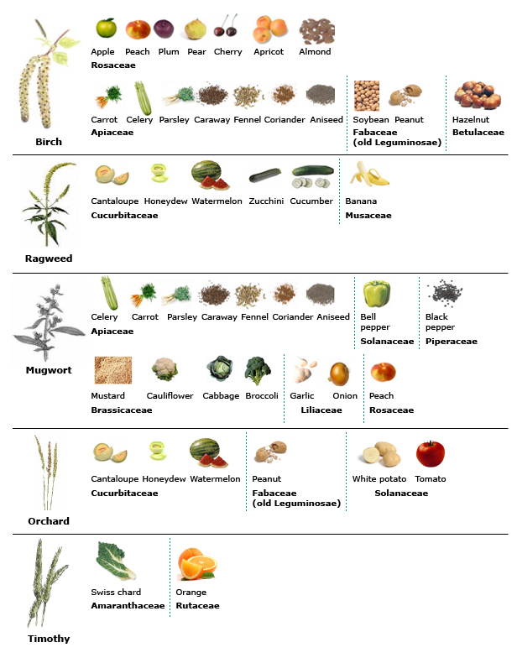
Cross-reactivity patterns in oral allergy syndrome (pollen-food allergy syndrome)

Slide 53
Notes:
Let’s shift gears to discuss non-IgE mediated food allergy

Slide 54
Non IgE mediated food allergy

Slide 55
Food protein induced enterocolitis syndrome (FPIES)
Most severe end of the spectrum of food protein induced GI disease in infants
Symptom pattern is determined by the frequency and dose of food allergen in the diet
Chronic symptoms develop with regular intake of the food (i.e. formula) and include intermittent but progressive emesis, diarrhea (with or without blood), and FTT.
Acute symptoms develop with intermittent exposure or re-exposure after a period of food avoidance
  Manifests as severe, projectile, and repetitive emesis starting within 1 to 3 hours of food ingestion (delayed)
  Associated features include pallor and lethargy, with or without diarrhea
  Hypotension has been reported in up to 15% of reactions.
Notes:
Zofran

Slide 56
FPIES
Most commonly attributed to cow’s milk and soy in the first 3-6 months
Also occurs to solid foods around 4-7 months (most commonly rice and oat)
  Barley, chicken, turkey, egg white, green pea, peanut, sweet potato, white potato, corn, fruit protein, fish, and mollusks have also been described
Notes:
There is no testing for this; the diagnosis is clinically made. These infants often require IV resuscitation for water loss due to repeated emesis.

Slide 57
Lab abnormalities: FPIES acute reaction
Neutrophilia
Eosinophilia
Thrombocytosis
Metabolic acidosis
Methemoglobinemia
Notes:
These lab findings can support a diagnosis of FPIES

Slide 58
FPIES: Diagnosis
History
Response to elimination diet
  Should see improvement of emesis and diarrhea within a few hours in patients with acute and within days in patients with chronic FPIES
Oral food challenge (usually done in an infusion clinic with IV access)

Slide 59
Management
Use hydrolyzed formulas in these patients as there is risk of concomitant soy and milk FPIES
  Approximately half of children will react to both milk and soy, and of those, 25% will also react to rice or oat
  Cautious introduction of those foods
A proportion of children will develop IgE sensitization to the food of concern, so there is a role for testing
When to reintroduce? 12 to 18 months after the last reaction, in a supervised setting (with IV fluids and an IV in place)
  60% lose sensitivity to milk and 25% to soy by age 2
  Some patients maintain sensitivity beyond age 6
Notes:
Alimentum, nutramigen

Slide 60
Mixed IgE/non IgE

Slide 61
Eosinophilic esophagitis
Thought to involve both IgE and non-IgE mediated mechanisms
Strongly associated with other atopic disorders
Feeding dysfunction
Vomiting
Abdominal pain
Dysphagia
Food impaction
Notes:
Think of this in your atopic patients who have trouble with frequent vomiting, dysphagia, FTT, food sticking.

Slide 62
Diagnosis/Treatment
Symptoms plus an esophageal biopsy that show greater than 15 eosinophils per HPF, after at least 6-8 weeks of acid suppression
Biopsy is only diagnostic method at this time
Skin testing is not useful
Medical therapies vs dietary elimination
Clinical trials - biologics
Send patients to the combined Allergy/GI “EGID” clinic
Notes:
Many respond well into remission on PPI. Others require topical swallowed steroids. Elimination diets are another approach; best guided with aid of nutritionist and limited to a period of time until remission can be achieved.

Slide 63
What’s New

Slide 64
Notes:
LEAP study – Learning Early About Peanut. It was observed that children in Israel have far lower rates of peanut allergy than western nations and this was proposed to be due to the fact that Israli babies eat peanut protein from a very early age in the form of Bamba. This is a nutritional supplement used in infants.
Over 600 children between 4 and 11 months of age at high risk for peanut allergy were randomized to either consume or avoid peanut until age 5 in order to compare the incidence of peanut allergy between the two groups. Children in the peanut consumption arm of the trial ate a peanut-containing snack-food at least three times each week, while children in the peanut avoidance arm did not ingest peanut-containing foods.
Of the children who avoided peanut, 17% developed peanut allergy by the age of 5 years. Remarkably, only 3% of the children who were randomized to eating the peanut snack developed allergy by age 5. Therefore, in high-risk infants, sustained consumption of peanut beginning in the first 11 months of life was highly effective in preventing the development of peanut allergy.

Slide 65
What do we consider a LEAP baby?
Send a baby with moderate to severe eczema to allergist for peanut and egg testing prior to introduction
If testing is indicative of potential allergy, we’ll do first peanut introduction in clinic

Slide 66
Notes:
Putting this into clinical practice:
If early signs of atopy:
Mild/mod eczema
No atopy
** there is no role for testing siblings if they are otherwise healthy

Slide 68
Immunotherapy for foods
FDA Approval of Palforzia Jan 2020
Trials for tree nuts, egg, milk
Induces a state of unresponsiveness to the foods, with daily ingestion
It works, but side effects are common and can be severe
  Anaphylaxis, development of eosinophilic esophagitis
Shown decrease in skin reactivity as measured by SPT and increased threshold for challenge
Increase in specific IgG4

Slide 69
Palforzia
Only available to trained providers (will not be generally accessible)
Requires frequent daily dosing adjustments in clinic, then home with a maintenance dose. Updosing every 2 weeks done in office.
Side effects mainly GI; family needs to demonstrate preparedness to treat anaphylaxis, which was seen in clinical trials.
Academic food allergy centers are starting to roll this out (FDA approved 2020, but COVID delayed)

Slide 70

Food challenge!
Notes:
https://www.clinicaladvisor.com/slideshow/slides/food-allergies/

Slide 71
What does a food challenge look like?
If skin prick testing and/or specific IgE favorable, schedule for a 4-hour appointment block, off antihistamines
Feed small and increasing amounts of the food in 15-20 increments over about an hour until protein level is reached (set by ACAAI)
Monitor during feeding and for 1 hour after
This captures 95% of risk

Slide 72
Food challenges
Family must have in-date epi pens in case of late reaction
Food can only be eaten with parent/guardian for 1 year after passing challenge
If epinephrine is given twice in clinic, EMS transport to ED for extended monitoring

Slide 73
So what are our recommendations?
In 2000, the AAP recommended delaying the introduction of allergenic foods in hopes of preventing the development of FA.
The incidence of FA rose during the subsequent decade, so those recommendations have been revised to advise early peanut introduction (4-6 months).
Breastfeed if possible
For a baby who is high risk for FA and is not being breastfed, hydrolyzed formula (like Alimentum) is the better option to help prevent the development of allergic disease

Slide 74
Try non allergenic foods first: i.e. fruits and vegetables
We recommend introducing the potentially allergenic foods at home, not at a restaurant or daycare
If there is no reaction, gradually increase the amount
Patients with severe or difficult to control atopic dermatitis or with a known food allergy can benefit from evaluation by an allergist prior to introducing further allergenic foods.
Human fetal T cells are responsive as early as 22 weeks gestation, both to the positive (microbial exposure and diet) and the negative (cigarette smoke, pollution)

Slide 75
Recommendations cont’d
No need to limit foods in breastmilk as this may actually increase tolerance in infant to allergenic foods and even environmental allergens
Complementary foods can be introduced between 4 and 6 months of age.

Slide 76
Thank you
Lauren Carlson, MSN, APRN, FNP-BC
Stacy Dorris, MD
The Vanderbilt Pediatric Allergy and Immunology Clinic, Nashville, TN

Slide 77


Questions?
kim.woodward@vumc.org
Notes:
My grandson, Ki, reminds us that food should be fun!

