Slide 1
Why is water important?
By: isabella maday, 8th grade, houston middle.
A presentation about the reasons it is important to stay hydrated, brought to you by the hydrate for health Gmsd contest.

Slide 2
Let's go way back!
For as long as anything on earth has lived water has been as necessity For any living thing. there have been wars fought over water sources and animals migration path is sometimes solely based on following water sources. in the bible, the story of the 10 plagues of egypt describes one of the plagues being all the water turning to blood making it undrinkable. This is why in the present day pollution is such a huge problem. But regardless water is and always will be one of the most important resources our planet offers.

Slide 3
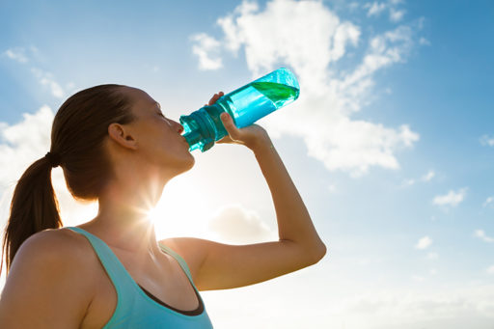
Why does our body need water?
The human body cannot function without water. Part of the chemical compound of water is oxygen, if we don’t drink enough water our body is only getting oxygen from what we breathe in. Our organs also need water to function, when we are dehydrated our organs go into panic mode and the more dehydrated you are the more at risk your organs are of shutting down. When you are dehydrated you face an aptitude of unpleasant symptoms like, a pounding headache, your tongue is dry and you get very dizzy often times. This is why it is important to stay hydrated throughout the day, especially if you lead an active lifestyle.

Slide 4
The pros of drinking water!
It helps with metabolism and digestion, also helps support gut health.
It makes you feel more energized throughout the day.
It cushions your joints making it easier to be active.
You feel fuller when you drink water regularly so you Don't eat as much.
It helps with period cramps, which we all support!
It will help clear your skin of acne and will make your skin look healthier.
It flushes bacteria out of your bladder, which helps prevent infection.
It helps Normalize blood pressure and stabilizes your heart beat.
Helps Regulates body temperature.
Aids your body in maintaining a healthy electrolyte, or sodium, balance.
Carries nutrients to your cells throughout your body.
Helps prevent constipation.
When your body is able to carry out these functions regularly that means you are properly hydrated!

Slide 5
WATCH THIS VIDEO FOR MORE INFORMATION!
https://www.youtube.com/watch?v=9iMGFqMmUFs

Slide 6
THE END! I HOPE YOU LEARNED ABOUT THE IMPORTANCE OF WATER! :)

