Slide 1
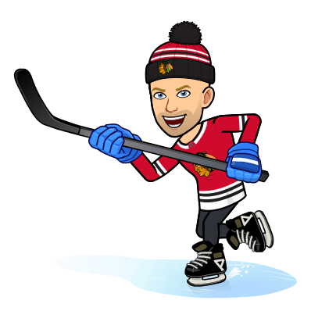
Virtual Hockey Unit
Schedule:
Day 1: Rules & History
Day 2: Offense
Day 3: Defense
Day 4: Workout & Quiz

Slide 2
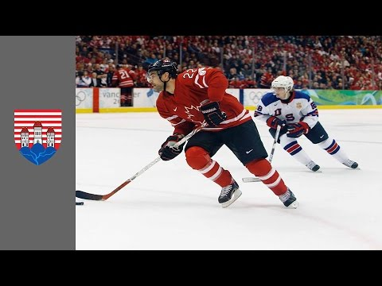
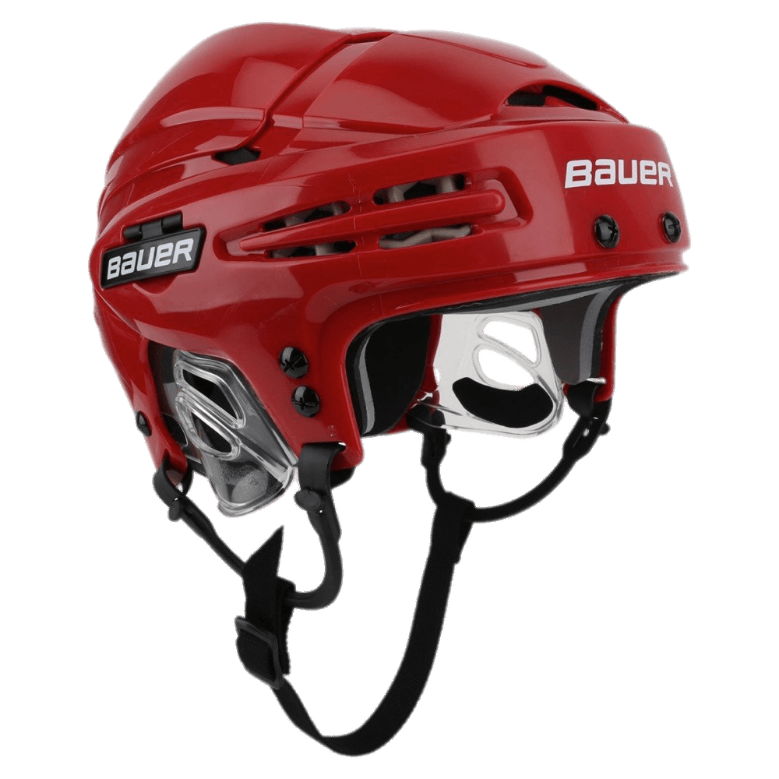
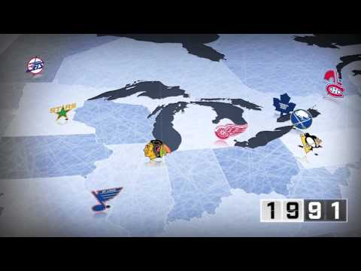
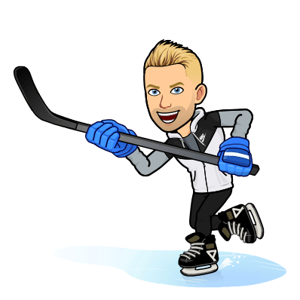
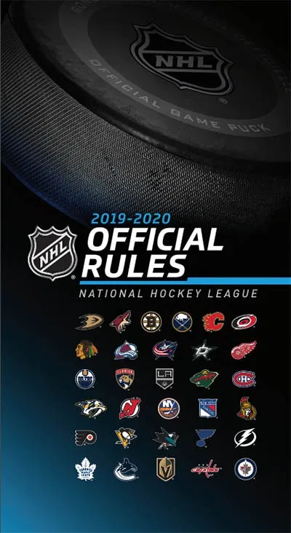
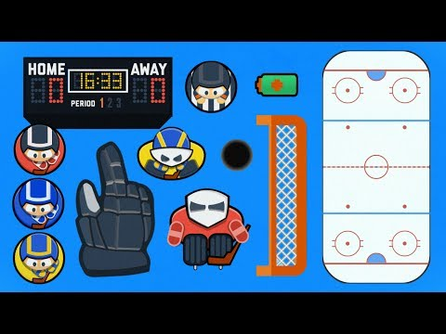
Day 1: History
HIstory
NHL Teams through the years
Rules
Notes:
In Canada, before this game was called "hockey" what did Canadians call this ball and stick game?
Which is not one of the original 6?

Slide 3
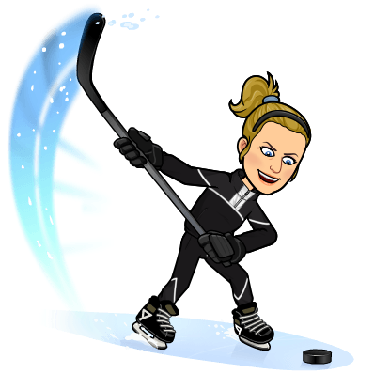
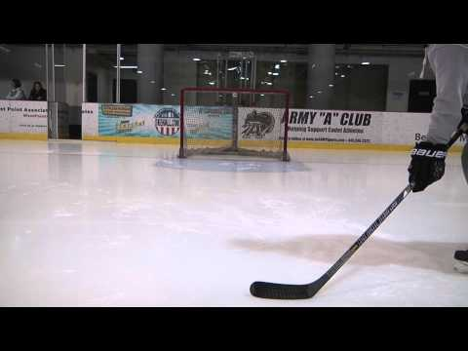
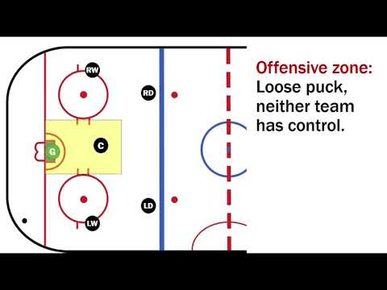
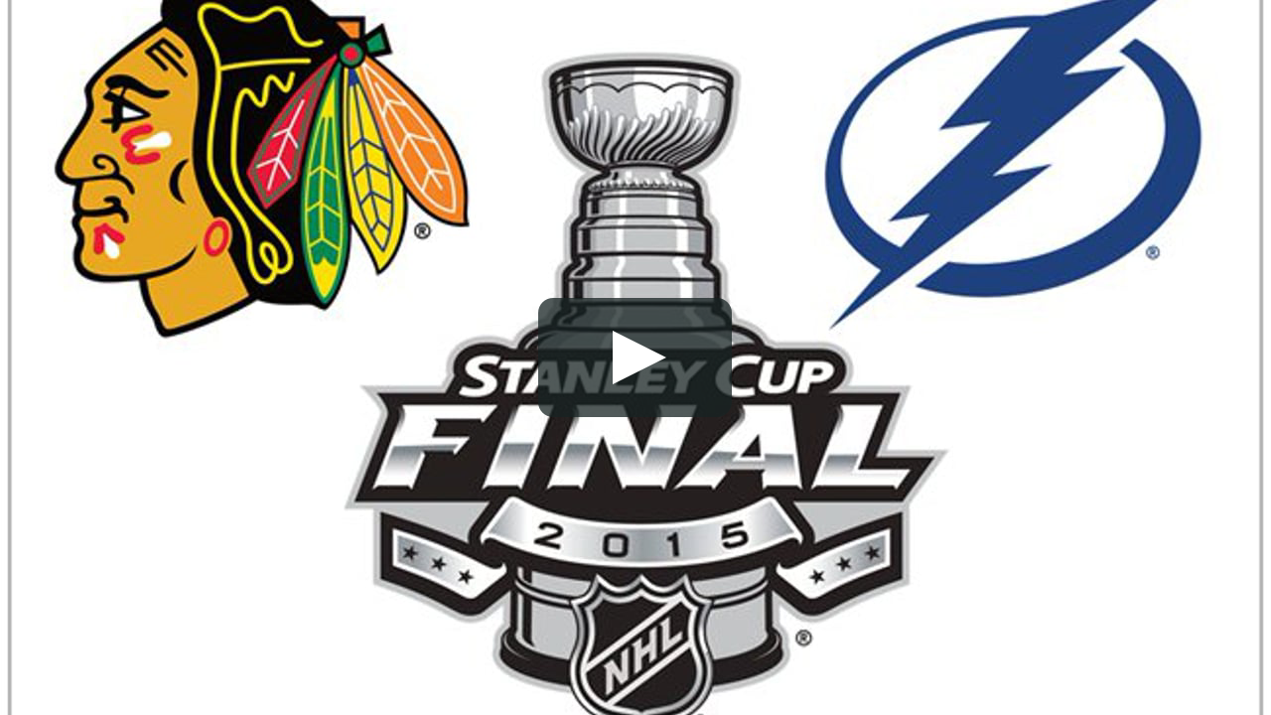
Day 2: Offense
10 CreditPoints Extra !
5th Grade
6th Grade
7th Grade
8th Grade
Notes:
Name the three types of shots in hockey.
-Wrist shot, Slap shot, and Backhand shot

Slide 4
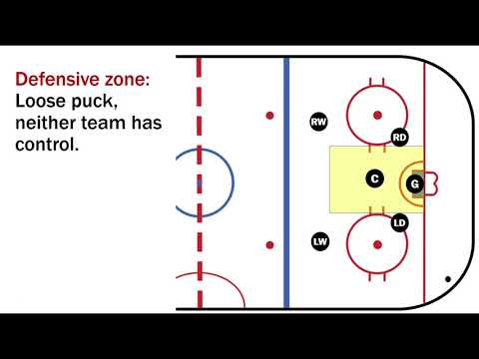
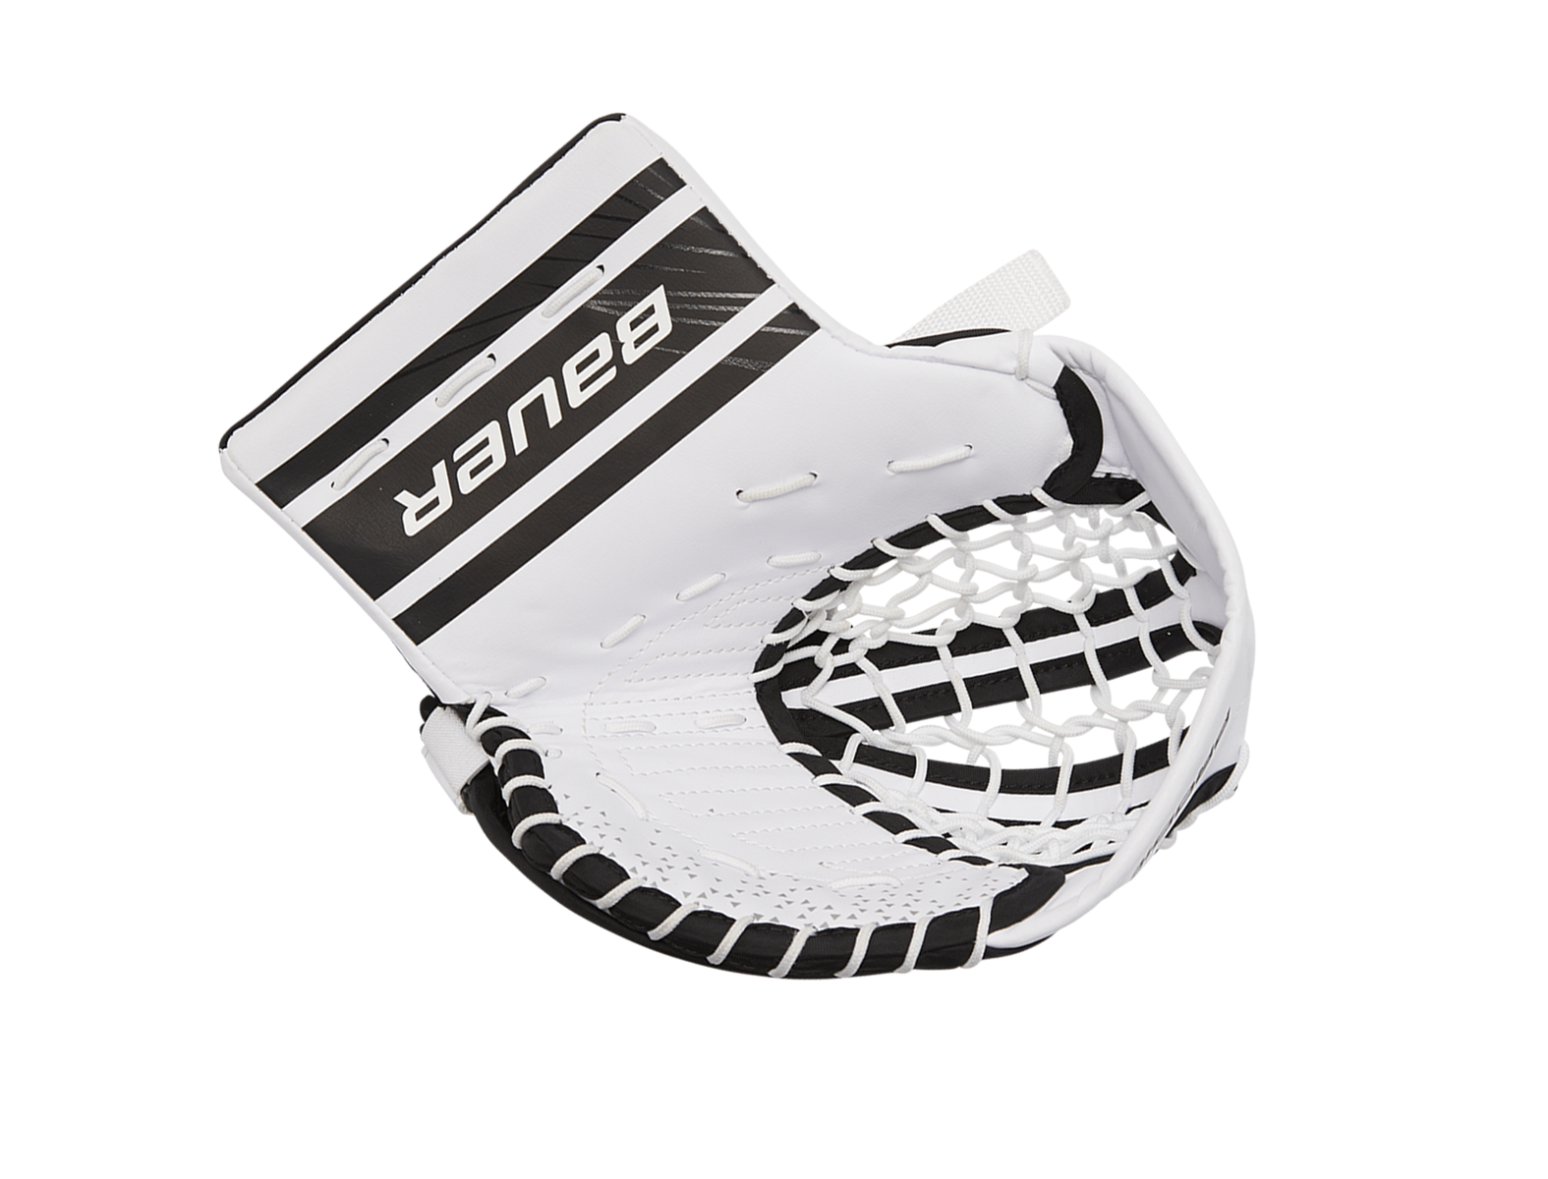
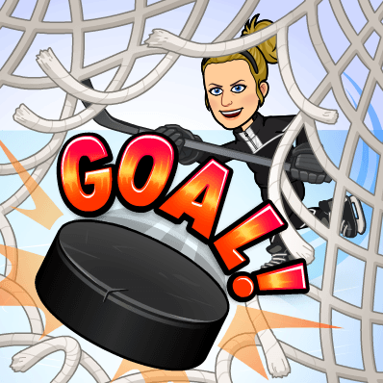
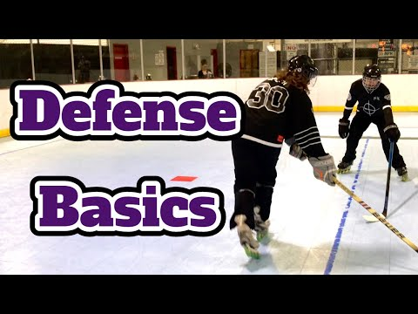
Day 3: Defense
Notes:
As a defensive player, why would it be beneficial to force the offensive players towards the outsides of the rink?

Slide 5
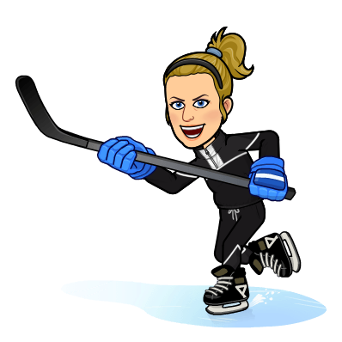
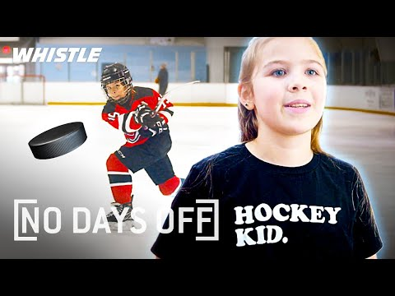
Day 4: Workout and Quiz
[No Days Off]
20 Minute Hockey Workout
10 CreditPoints Extra !
5th Grade
6th Grade
7th Grade
8th Grade

