Slide 1
Tobacco
What is it, and what does it do?

Slide 2
Tobacco is a green, leafy plant that is grown in warm climates.

Slide 3
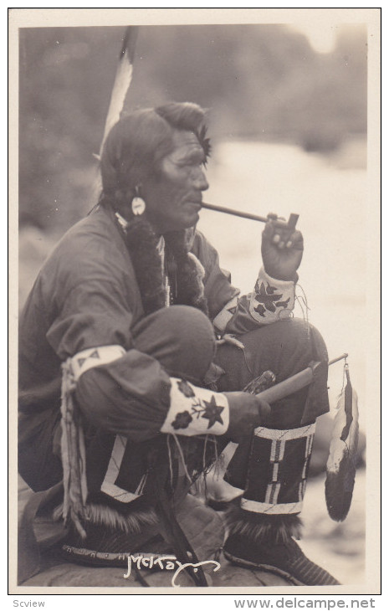
Tobacco was grown by American Indians before the Europeans settlers arrived. Native Americans smoked tobacco through a pipe for special religious and medical purposes. They did not smoke every day.

Slide 4
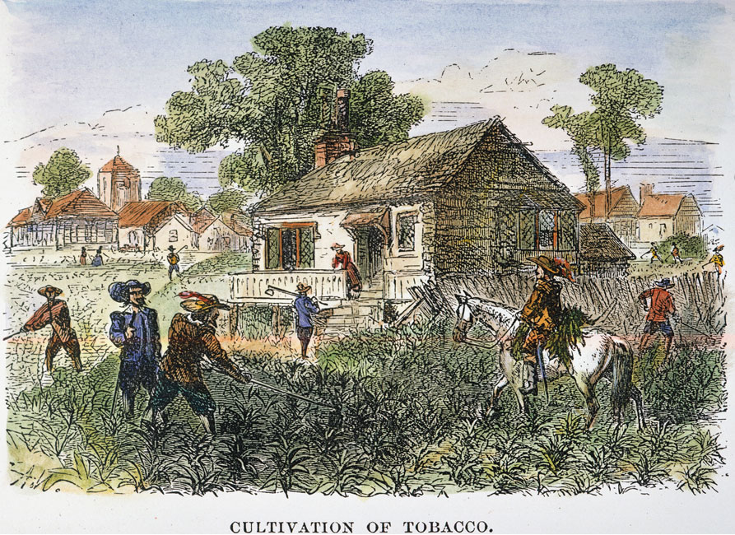
Tobacco was the first crop grown for money in North America. In 1612 the settlers of the first American colony in Jamestown, Virginia grew tobacco as a cash crop.

Slide 5
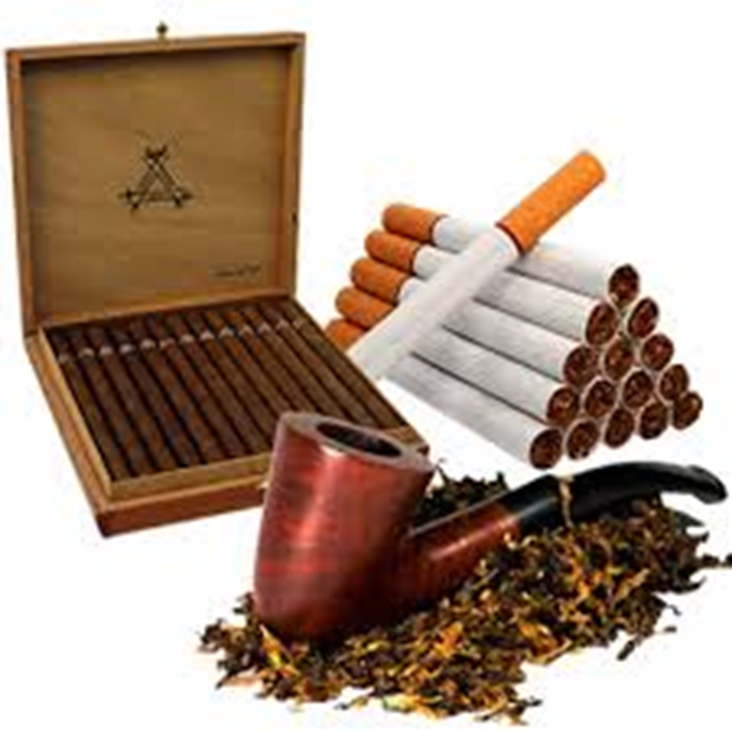
By the 1800's, many people had begun using small amounts of tobacco.
On average, people smoked about 40 cigarettes a year.

Slide 6
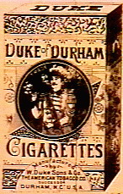
The first commercial cigarettes were made in 1865 by Washington Duke on his 300-acre farm in Raleigh, North Carolina.
His hand-rolled cigarettes were sold to soldiers at the end of the Civil War.

Slide 7
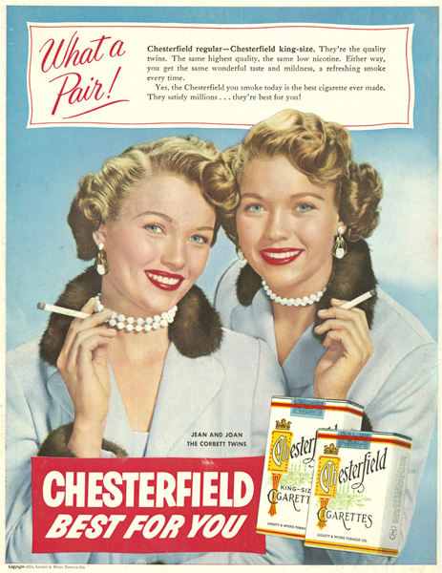
The American Tobacco Company and Phillip Morris were selling their cigarettes mainly to men, but everything changed during World War I and World War II when they started marketing them to women.

Slide 8
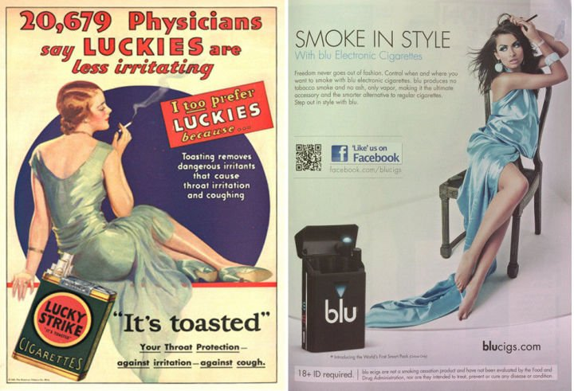
Advertising makes it look glamorous.

Slide 9
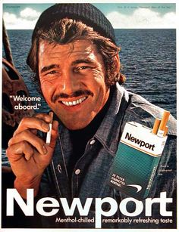
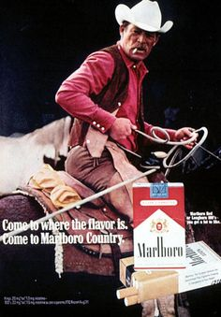
And manly.

Slide 10
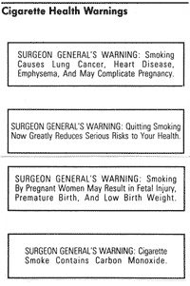
In 1964 the Surgeon General of the U.S. wrote a report about the dangers of cigarette smoking. He said that the nicotine and tar in cigarettes cause lung cancer.

Slide 11
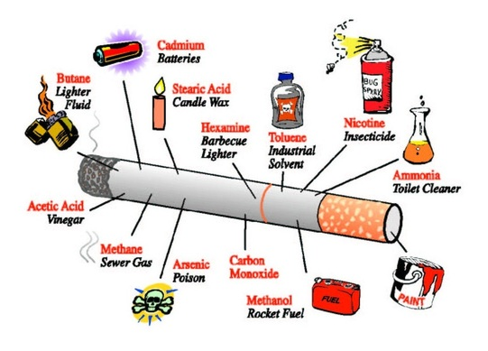
However, nicotine is one of the more than 4,000 chemicals in cigarettes and its smoke. It is the chemical that makes tobacco addictive or habit forming.

Slide 12
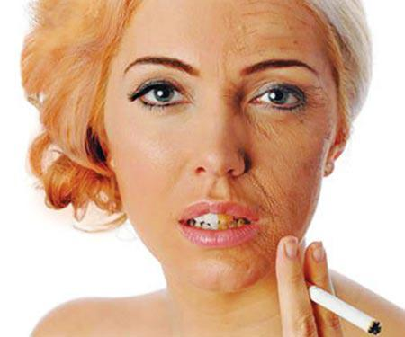
What is the cost?
Premature aging
On average, a smoker will look 19 years older because smoking reduces the amount of oxygen in the blood.

Slide 13
Financial Cost
They are expensive. Someone smoking a pack a day spends about $160 a week on cigarettes, which is nearly $8,500 each year.
Home, health, and life insurance rates are higher for smokers.
On average, smokers will typically pay
15-20% higher premiums than non-smokers

Slide 14
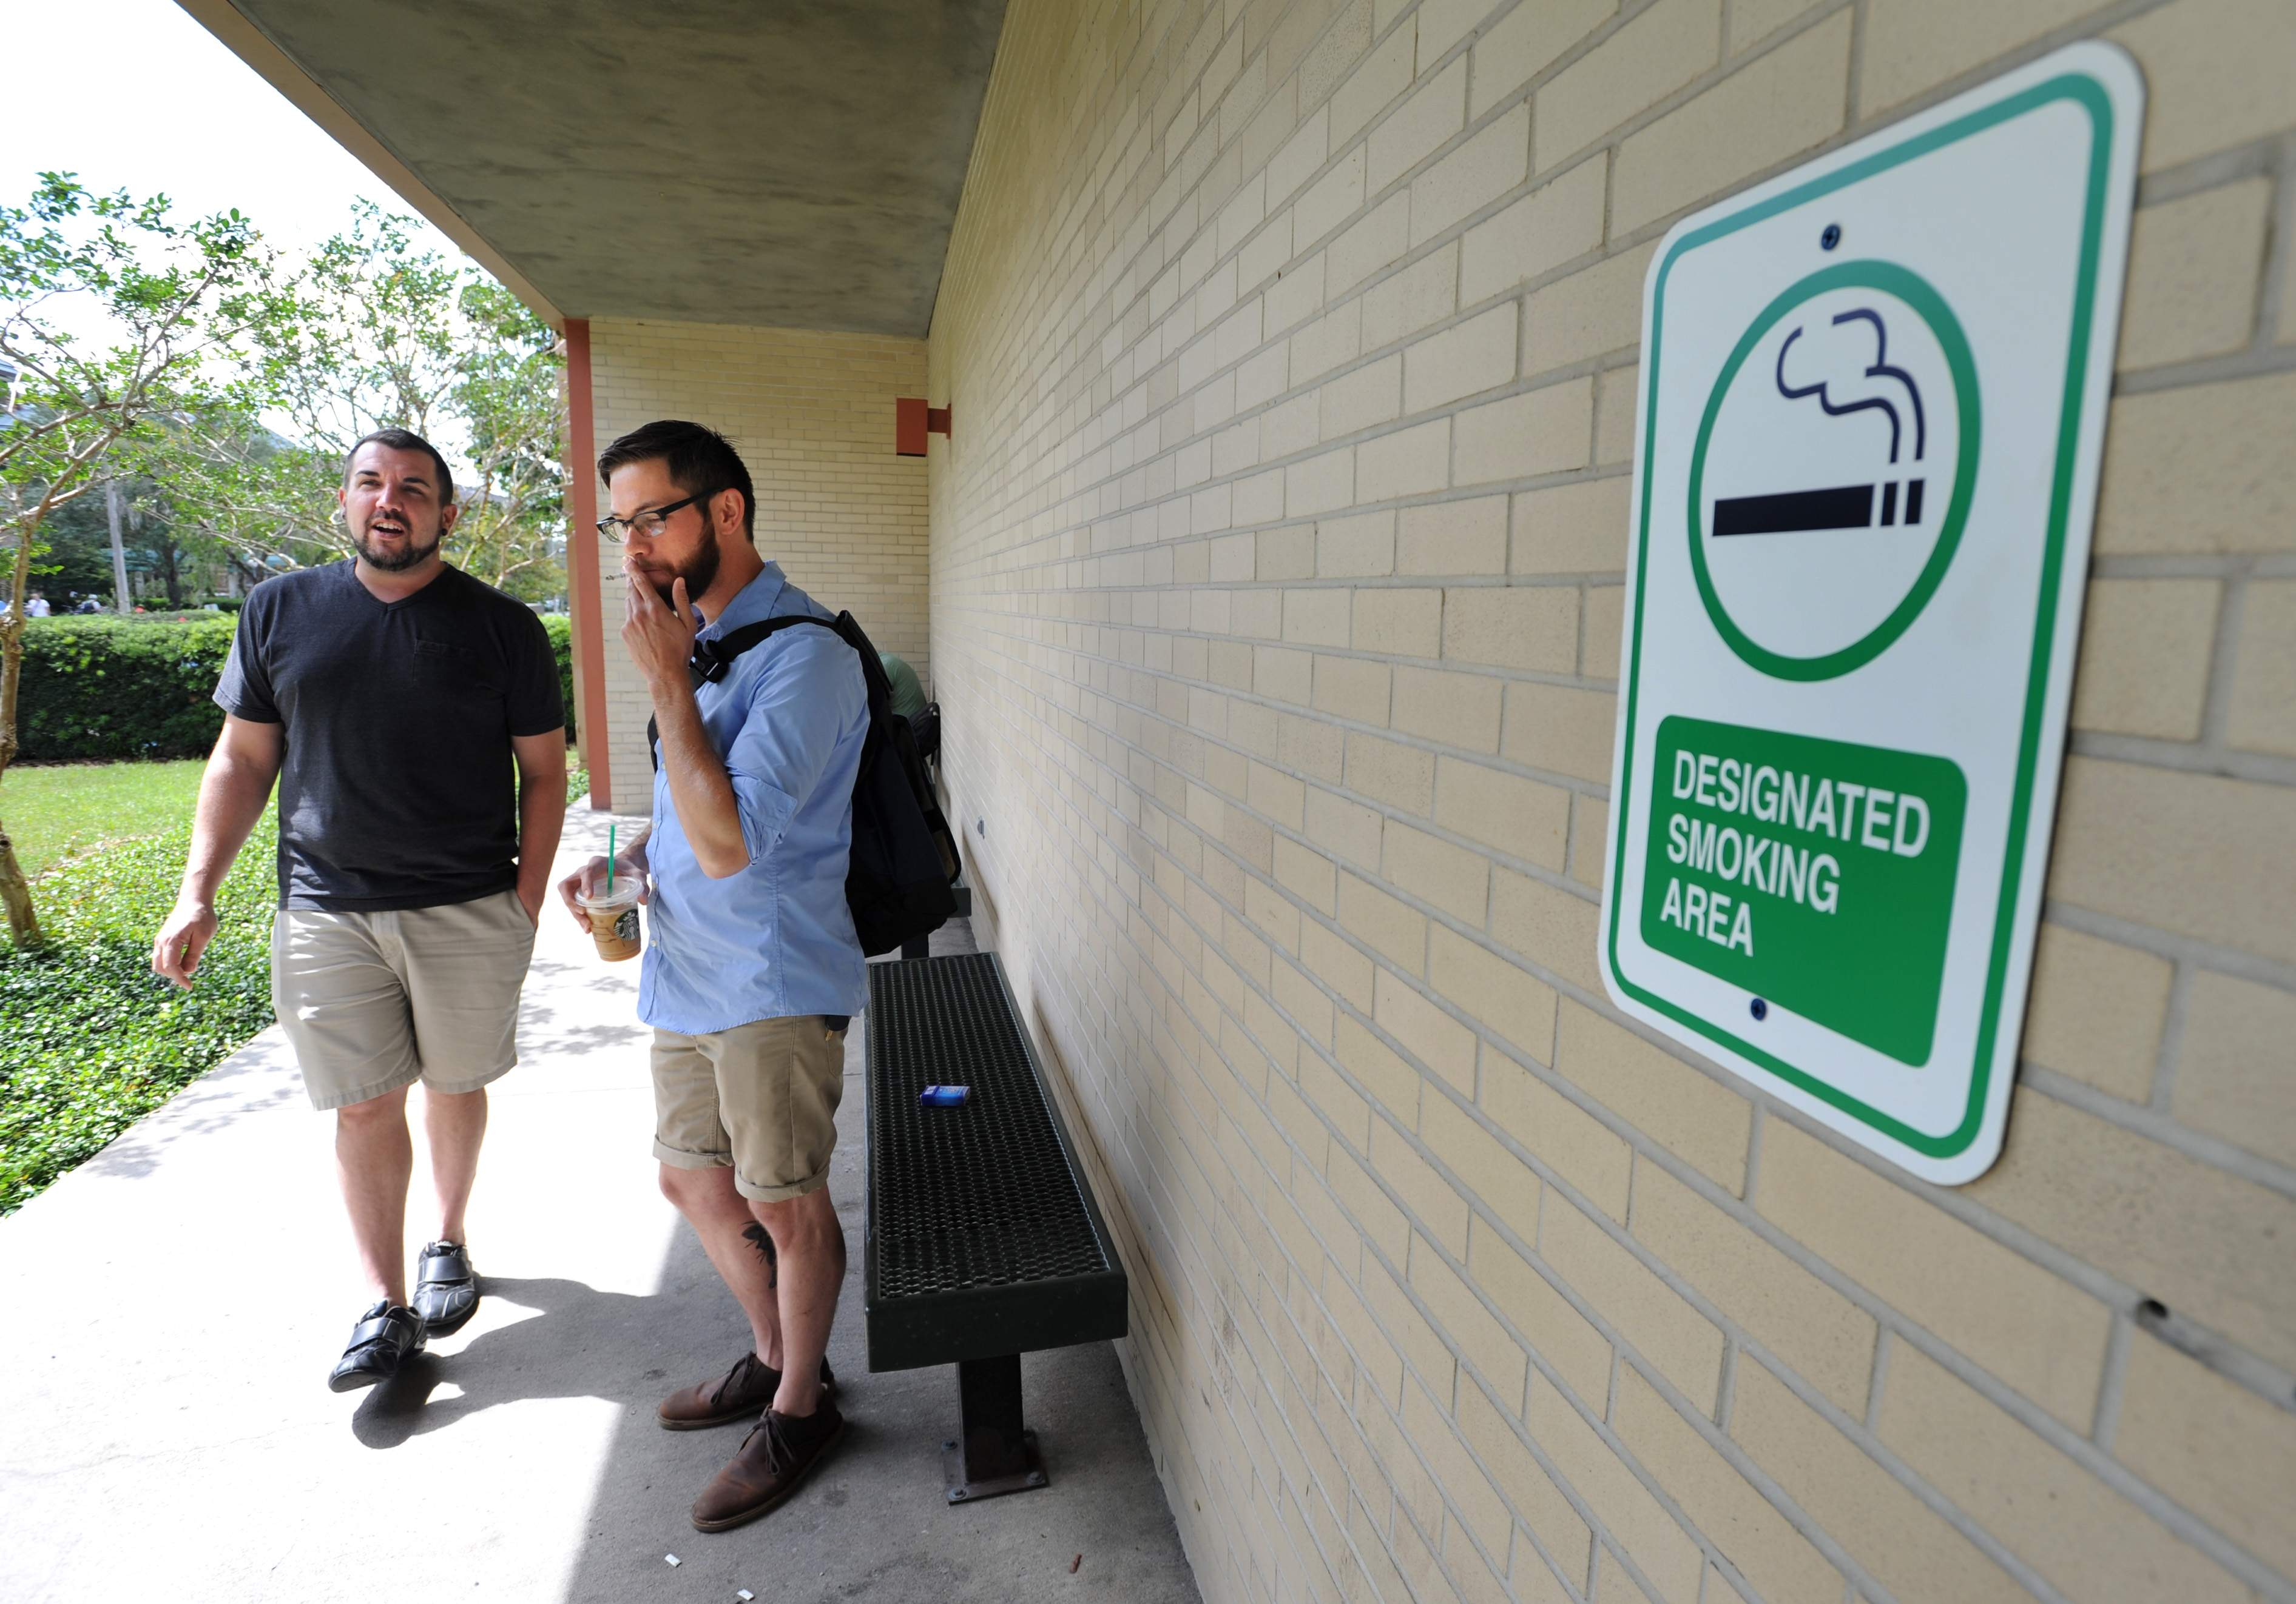
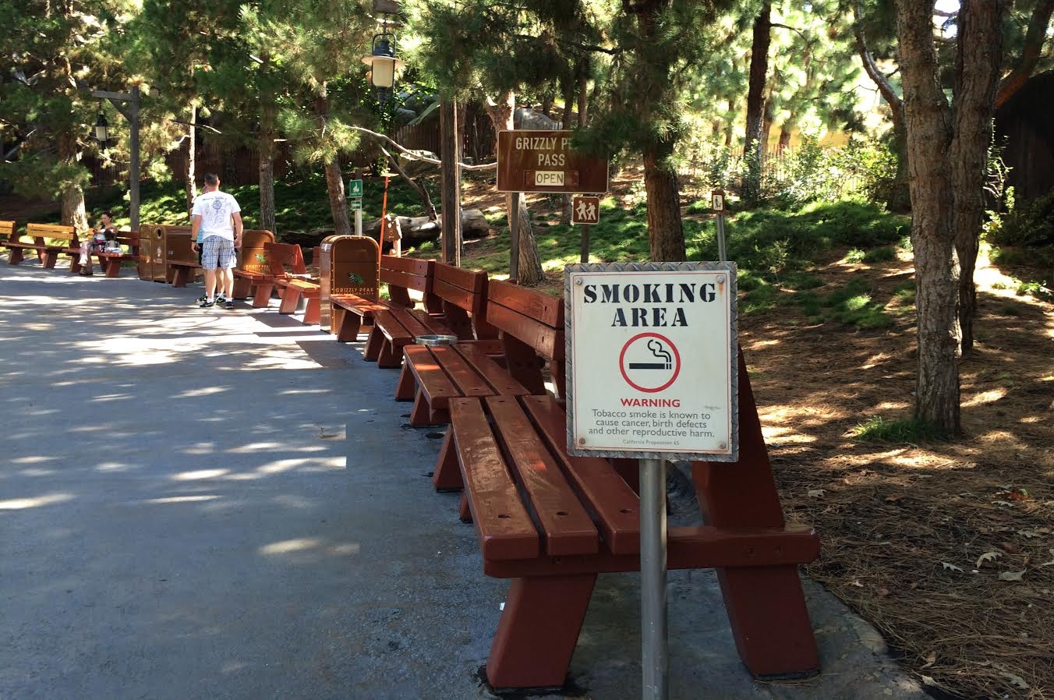
Social – You are isolated. You can only date
certain people. You can only smoke in certain
places.

Slide 15
Premature death
Life expectancy for smokers is at least 10 years shorter than for nonsmokers.
Quitting smoking before the age of 40 reduces the risk of dying from smoking-related disease by about 90%.

Slide 16
Smoking causes…
-cancer (especially lung cancer)
-heart disease
-hypertension
-stroke
-emphysema
-COPD
-other respiratory illnesses and complications

Slide 17
The Good News…
There are many ways to quit!
-cold turkey
-behavior therapy
-nicotine replacement therapy
-medicine

Slide 18
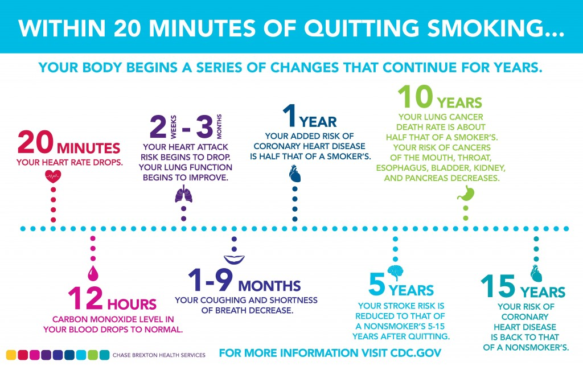

Slide 19
Resources
https://longandhappylife.wordpress.com/2014/12/26/considering-goals-for-2015-within-20-minutes-of-quitting-smoking/
http://www.biocaretherapy.com/what_is_in_a_cigarette.htm

