Slide 1
Healthy & Active Germantown
Gmsd employee’s discounts & special services

Slide 2
Healthy & active germantown
Healthy & Active Germantown is an initiative founded during the summer of 2020 to aid in increasing the awareness of healthy and physical activity offerings in Germantown and neighboring areas.
Local businesses have partnered with Healthy & Active Germantown to support our mission by providing products, services, and opportunities to GMSD teachers, employees, students, and parents to increase our health and activity awareness.
Our mission is to make Germantown the healthiest and most active city in the state of TN.

Slide 3
Healthy & active germantown gmsd
Components of our model
Components of our model
Physical Fitness
Physical Health
Mental Health
Nutrition
Health & Beauty
Cleanliness & Personal Hygiene
Hormone & Energy Levels
Pain & Discomfort Treatment
Recreational Fitness & Activities
Wellness

Slide 4
Atc fitness
GMSD employees can get their first month free by showing ID badge.
Only have to pay the annual rate of $35 to start the annual membership.
Available at any location (2 locations in Germantown)

Slide 5
Cycle bar 7685 Farmington Blvd Suite 101, Germantown, TN 38138
GMSD employees & staff will receive a special offer of $99 unlimited/month
Must email Germantown@cyclebar.com and show proof of GMSD employment (picture) in email.

Slide 6
Germantown athletic club 1801 Exeter Rd, Germantown, TN 38138
$0 Application fee if you choose to pay for the membership in full for 6 or 12 months.
$25 application fee if you choose to pay for the membership by monthly automatic draft. *Normal application fee is $99

Slide 7
Crossfit sopo Germantown 3100 Village Shops Dr #18, Germantown, TN 38138
Beginner Package is 15% off for all GMSD staff and employees (show ID badge to confirm you’re an employee with GMSD).
Unlimited Membership is 15% for all GMSD staff and employees (show ID badge to confirm you’re an employee with GMSD).
Periodic sales and special offerings will come from Cross-Fit SOPO Germantown and will be shared with all GMSD staff.

Slide 8
F45 Germantown 7850 Poplar Ave Suite 20, Germantown, TN 38138
1 week free pass for all GMSD employees

Slide 9
Virtual yoga gmsd Website
Program is available for ALL GMSD students, teachers, staff, and parents.
Kid’s Registration & Adult’s Registration
Programs are customizable based on your needs, such as chair yoga or trauma informed yoga.
Yoga is separated into grade bands: Elementary, Middle, H.S. and Adults

Slide 10
USA Karate
GMSD employees and families will receive the following offers:
1 Free Virtual Class (Adults & Kids)
Try a class for Free (Adults & Kids)
1 week of martial arts for $19.75 (Adults & Kids)

Slide 11
Border martial arts academy 4644 Merchants Park Cir #900, Collierville, TN 38017
GMSD teachers, students, and staff can receive unlimited fitness kickboxing for only $69.99 a month
GMSD will get 50% their jiu-jitsu/self defense program (valid through may)
Show GMSD id badge to receive these special offers

Slide 12
Fundamental fitness greta Hauberg 699 Oakleaf Office lane, suite 106, Memphis, tn 38117 (901) 303-8191
“Start a healthy habit” package at a discount: The initial evaluation plus 2 training sessions a week for 4 weeks for $525 (that’s $95 off for GMSD employees ONLY).
“Your first 1 hr massage” for $80 (savings of $20 for GMSD employees ONLY).

Slide 13
Fundamental fitness greta hauberg
Trainings can be done virtually and/or in-person. However, the initial evaluation needs to be done live.
Don’t miss out on this opportunity for excellent massage therapy and personal training at a discounted rate just for you!
Email: gretaheals@yahoo.com

Slide 14
The Chiro place 3615 S Houston Levee Rd, collierville, TN 38017 (901) 221-7173
GMSD employees will receive a ”New Patient Offer” of Examination, consultation, and x-ray for only $30!
Neck or back aches? Joint pain? Headaches? Sinus problems? Pregnant? Athlete? Come see us!
Call for Appointment: 901.221.7173
www.thechiroplace.net

Slide 15
The chiro place visit any of 3 locations

Slide 16
Regal pharmalab 1352 Cordova Cove Germantown, TN 38138 ​ Office (901) 757-9434 Fax (901) 757-1194 ​ Hours: M-F - 9am-5pm Closed for lunch everyday 1:00-1:30 PM
FREE Vitamin and Nutrient Consultation to explore any potential deficiencies due to diet, lifestyle and/or medications that can create unintended deficiencies; CALL LOCATION TO SET UP APPOINTMENT
10 % OFF any Vitamin or Supplement for daily dietary supplementation; IN-STORE PURCHASE ONLY
10 % OFF the Immune Booster Pack (Basic, Advanced or Complete) for daily immune protection; IN-STORE PURCHASE ONLY
Must show GMSD ID Badge to receive special offers

Slide 17
Summit yoga 6645 Poplar Ave #208, Germantown, TN 38138
GMSD staff & employees will receive 20% any regular priced class packages

Slide 18
Tacos 4 life
All GMSD employees will receive a 10% discount off their entire order.
Show your GMSD I.D. badge when you pay to receive this exclusive offer.
Offer only valid at 3565 S Houston Levee Rd, Collierville, TN 38017

Slide 19
The fresh market 9375 Poplar Ave, Germantown, TN 38138
GMSD Employees can receive a FREE 20 oz cup of coffee from our local The Fresh Market.
Each month The Fresh Market will have new offerings that will be extended to our GMSD community!

Slide 20
City silo 5101 Sanderlin Ave #104b, Memphis, TN 38117 (901) 729-7687
All GMSD employees will receive 10% off their orders when they present their GMSD ID badge.
Check out their menu:
thecitysilo.com

Slide 21
Juice plus+ www.EatYourVeggie.NET
With every Adult purchase of our Fruits & Veggie Blend (20 immune building fruits & veggies), you'll receive a FREE ORDER for a child (3yrs up through college) for 4 years, as long as you are on the product!!!
Now through the end of December, receive a bag of our delicious vanilla or chocolate plant protein mix for FREE*!
To get started, contact Miranda Griffin - Wellness Coordinator - 901-859-2410

Slide 24
Tiger nutrition 3315 Hacks Cross Memphis, TN 38125
Germantown Municipal School District Employees will receive $1 off any of the drinks they order. (Show your GMSD I.D. badge when making purchase).

Slide 25
Smoothie king 7820 Poplar Avenue, Germantown 901-309-8039
Germantown Municipal School District Employees will get a free Enhancer added to their drink when they purchase a 20 oz or larger smoothie!!
Only valid at this location

Slide 26
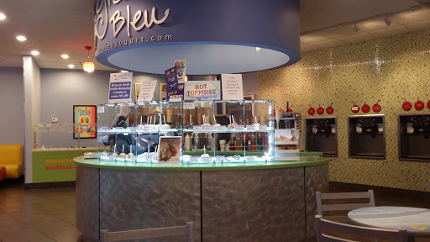
Gracie bleu frozen yogurt 9155 Poplar Ave, Germantown, TN 38138
Enjoy a healthy snack to satisfy your sweet tooth.
All GMSD employees will receive 20% off their purchase from Gracie Bleu Frozen Yogurt
Must show GMSD I.D. badge

Slide 27
Gnc
Sign-up for their loyalty program (Free) to earn points that can be used as cash.
GNC has vitamins, minerals, pre and post workout supplements, and weight loss supplements.

Slide 28
Java café 3133 Forest Hill Irene Rd, Germantown, TN 38138
Feeling Hungry? Need great food for a teacher gathering or administrator’s meeting? Order from java café
Orders over $100 will receive free delivery for GMSD employees only

Slide 29
Tuuwa products 235 Germantown Bend Cove, Cordova, TN 38018
Any purchase made by a GMSD teacher, employee, or parent will help GMSD athletics! A % of funds that come from GMSD purchases will be given back to the district to aid in athletics through the athletics training program.
Products are lotions and oils that aid in reliving pain. Products are 100% natural and are backed by shark tank investor, Kevin Harrington
https://tuuwa.com/
Show GMSD ID badge and/or use following code: GMSD 20-21

Slide 30
Tuuwa

Slide 31
tuuwa

Slide 32
Buff city soap 1730 S Germantown Rd Suite 121, Germantown, TN 38138
GMSD employees will receive a 10% discount at Buff City Soap locations when they show their GMSD ID badge.

Slide 33
Cypress Naturals Memphis Artfully Crafted Bath and Body Products www.cypressnaturalsmemphis.com
It is our pleasure to offer GMSD employees (only) a 25% discount on regularly priced items purchased through our website: www.cypressnaturalsmemphis.com
DiscountCode: drallefoster25
Questions? cypressnaturalsmemphis@gmail.com
local pickup only at our Germantown studio*
Discount good through: Offer valid from October 1- October 30

Slide 34
Ageless men’s health 9067 Poplar Ave #109, Germantown, TN 38138
GMSD employees will receive a FREE evaluation (normally $75)
Must have GMSD ID to receive promotion

Slide 35
Hotworx 9155 Poplar Ave Suite 25A, Germantown, TN 38138
GMSD employees will receive one FREE session & FREE enrollment if they decide to join!
Must show ID badge to receive offer.

Slide 38
Honey spray tans Mobile Spray Tanning www.thehoneyspraytans.com contact@thehoneyspraytans.com IG: @thehoneyspraytans (901)410-1616
GMSD employees will receive a 10% discount when booking online with GMSD-10 promo code.
Honey Spray Tans is a Memphis-based mobile spray tan provider founded by two sisters to bring you a flawless tan in the comfort and convenience of your own home.
Solutions are all natural, paraben free, and 100% vegan. No orange tones, odor, or sticky feeling!

Slide 39
Family leisure 2120 Whitten Rd, Memphis, TN 38133 (901) 371-9090
GMSD Employees will receive 10% off all in-stock patio furniture
GMSD Employees will receive $500 off in-stock hot tubs.
Must show your GMSD ID badge!

Slide 40
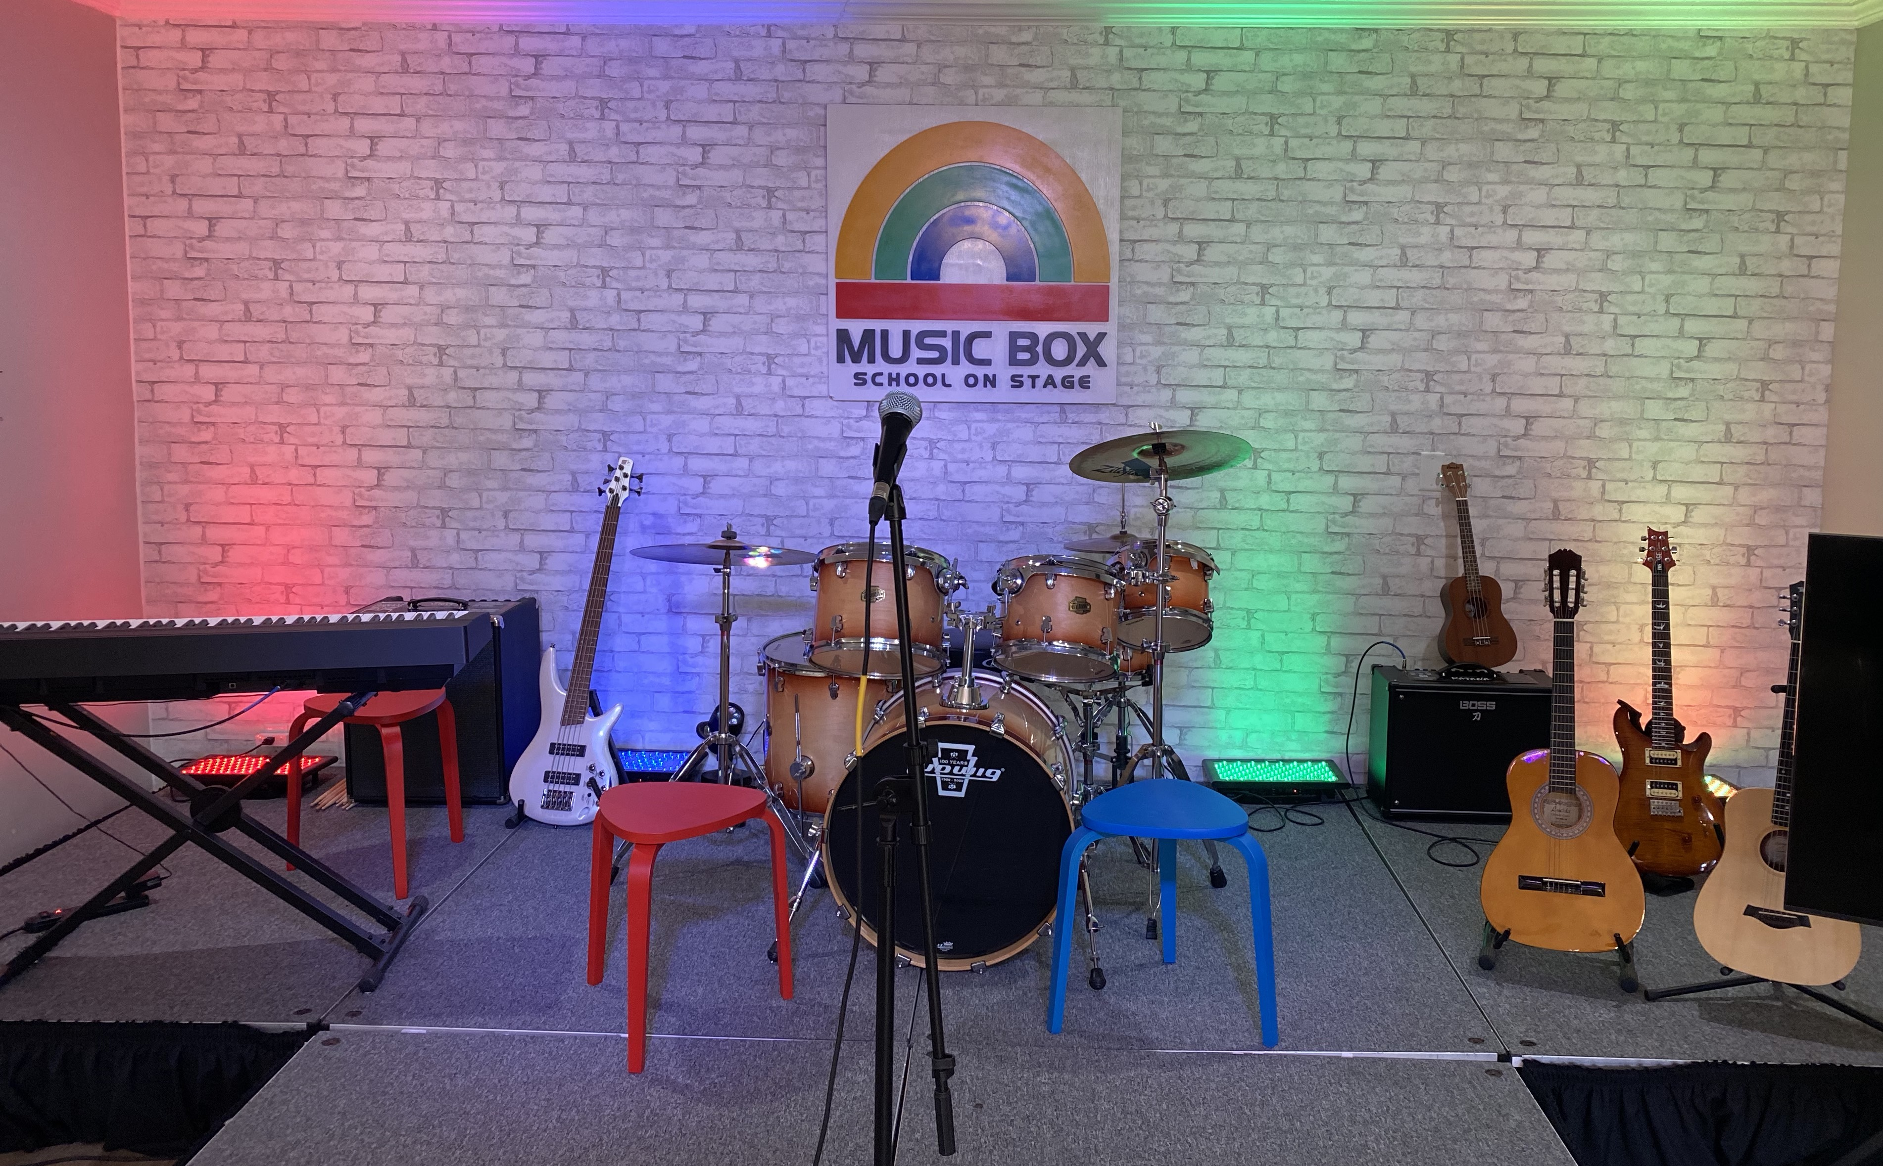
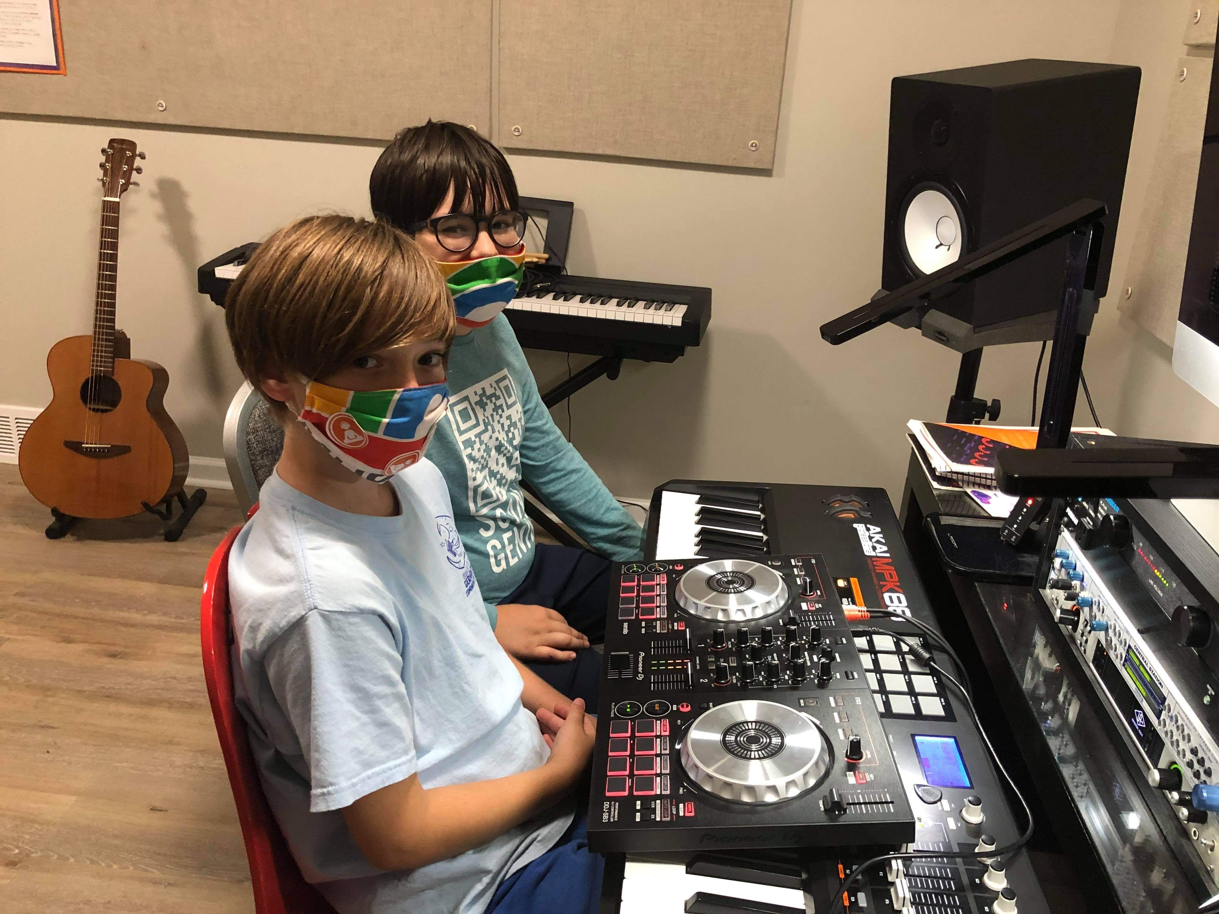
7516 Capital Dr. Germantown TN 38138 (901) 626 0973 (text or call) www.musicboxinc.com
info@musicboxinc.com
GMSD employees and students receive 10% off lesson tuition for 3 months or 10% of camp tuition (with code “GMSD”)
We teach guitar, piano, drums, bass, ukulele and voice. Kids and adults. In-person and on-line. In English and Spanish
Free trial lessons and school tours. No contract requirement

Slide 41
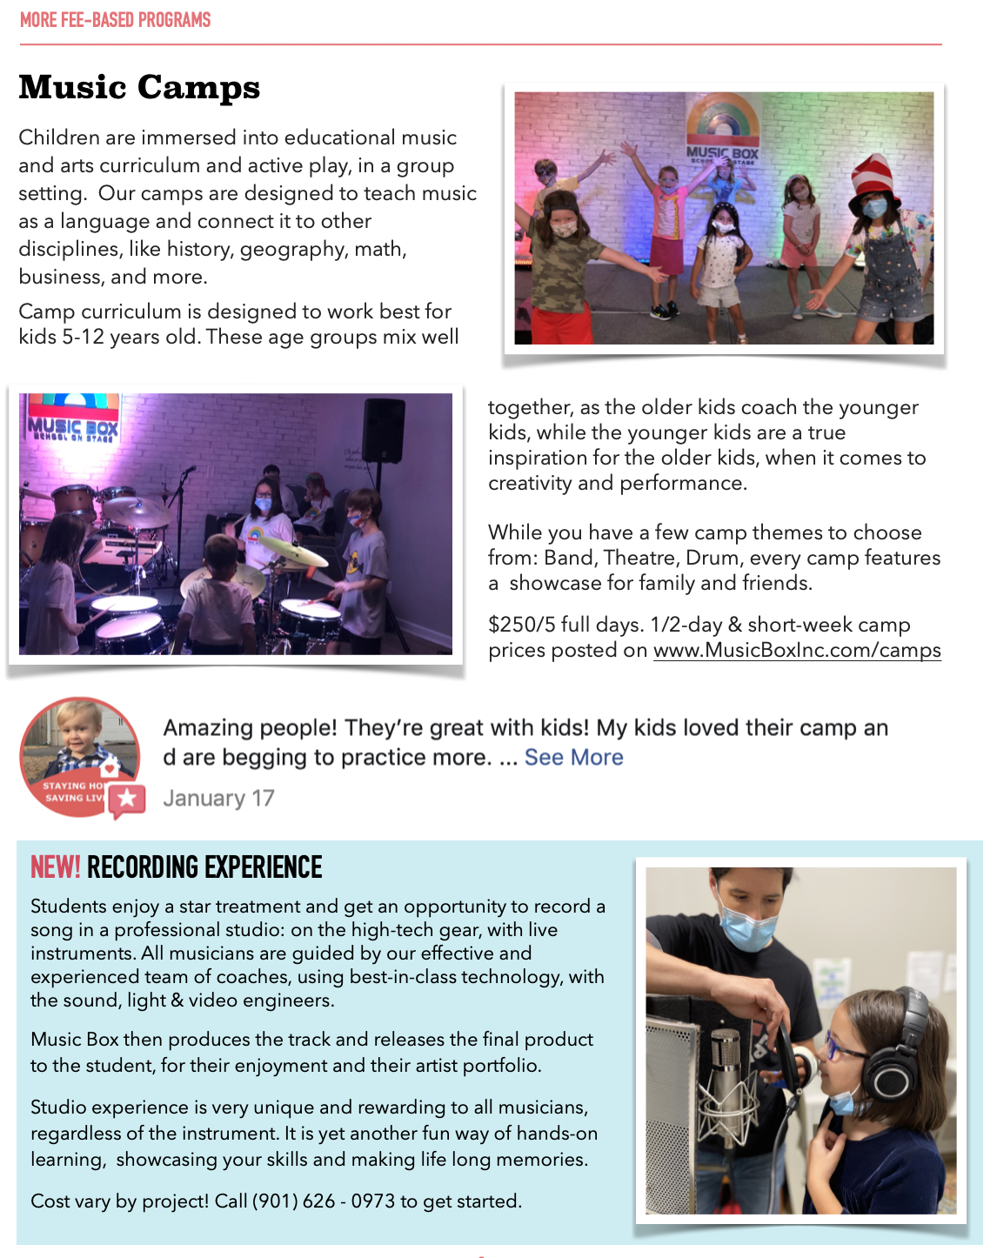

Slide 42
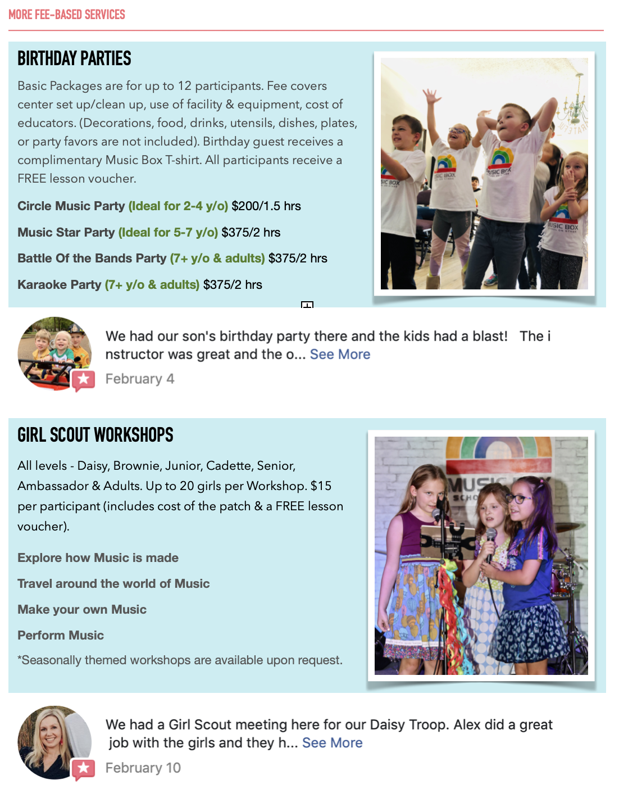

Slide 43
Barnes & noble
Save 20% off publisher’s list price on all purchases for classroom use.
Discounts of up to 25% off the publisher’s list price during Educator Appreciation Days.
Sign Up For Free

Slide 44
Performing arts of Germantown 7863 Farmington Blvd, Germantown, TN 38138
For any new customers, who are Germantown employees , we would love to waive our $35.00 new student registration fee, and offer a 10% discount for the first month of Dance.
For beginner dancers, this offer is good thru October 2020. For dancers with experience, this offer is good thru September 2021. .
Please call 901-754-0024 for more information.

Slide 45
Ultimate ballroom dancing 7990 Trinity Rd #106, Cordova, TN 38018
GMSD Employees will get a $10 discount on the *above program.
Introductory offer will be $20 off if you mention you’re a GMSD employee

