Slide 1

Healthy Breakfast

Slide 2
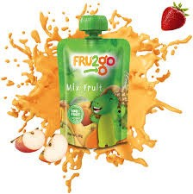
About
FRU2go
FRU2go is 100% pure fruit snack without any preservatives, artificial flavours or colour. Manufactured in our state of the art plant, the product goes through very stringent quality process before it is offered to you for consumption.

Slide 3
Interesting, right?
This is just a sneak preview of the full presentation. We hope you like it! To see the rest of it, just click here to view it in full on PowerShow.com. Then, if you’d like, you can also log in to PowerShow.com to download the entire presentation for free.

