Slide 1
Health / Lifetime Wellness Standards
2018-2019 Implementation

Slide 2
How it happens

Slide 3
Initial Meeting
Committee met at Montgomery Bell State Park December 1st – 3rd, 2015
During this meeting the committee members were given a training on the process of revising state standards.
They were trained on the first day and then had two full days to write.

Slide 4
Timeline
December 2015: 3 day training
January – March 2016: CSH Regional Professional Developments
April 2016: Draft was posted online for public feedback
June 2016 : Feedback sent to committee and Final Draft was developed
July 22, 2016: Went to Tennessee State Board of Education for first read. Passed on First read
October 14, 2016 : Final reading of standards at the Tennessee State Board of Education - Passed
The 2017-18 SY will be a “training year” and then they will be fully implemented in the 2018-19 SY.

Slide 5
The Process
The Committee:
The committee was chosen through an application process and is made up of current health education, physical education, school counselors, teachers(K-12), higher education, and coordinated school health coordinators with health education background.
There are representatives from all 3 Grand Regions (West, Middle, East)

Slide 6
Theory Behind Standards

Slide 7
Content vs Skill Based Learning
Content-Based Instruction | Skill-Based Instruction
The central focus is on acquiring content knowledge through gathering and organizing facts, dates, and names. | The central focus is on learning transferable skills that help students independently make meaning from new information.
Students are engaged in classroom activities that help them study and memorize information. Learning is dependent on the teacher. | Students reach mastery of skills and critical content knowledge through a process of rehearsal and relearning of ideas
Assessments are used to measure what students have memorized. Little to no reteaching occurs. | Assessments are used to measure growth and to identify supports to help students meet standard.
Reading, writing, and speaking tasks are assigned for points and may not teach students what it means to read and write in a particular discipline. | Reading, writing, and speaking in the content area is explicitly taught and practiced.
Information is given to students through worksheets or PowerPoint. Ideas are copied from a screen and onto notepaper. | Information is learned through a process of analysis, evaluation, application, and synthesis. Higher level thinking as defined by Bloom, Costa, and Webb is the focus of daily academic work.
The classroom teacher does most of the thinking and presents solutions. | Students are taught how to think critically and are expected to solve problems on their own.
Students are asked to take notes on what they read and answer comprehension questions as a way to assess understanding of the reading. | Students engage in authentic experiences. They practice various skills and explore written and spoken texts as readers and writers. Students seek to understand how meaning is constructed in texts.

Slide 8
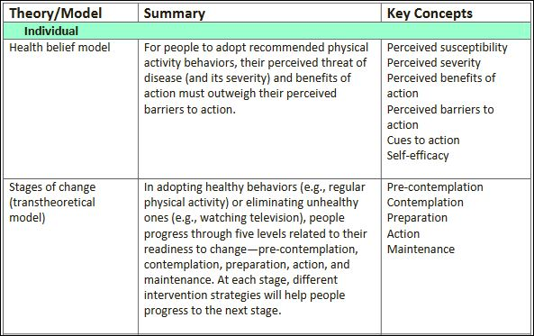
Examples of Health Theories

Slide 9
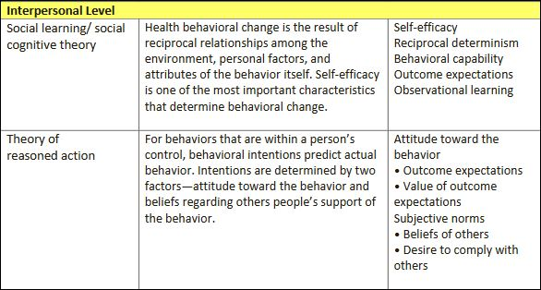
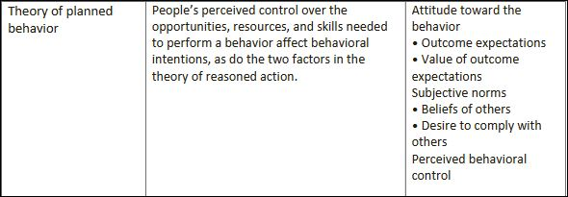
Examples of Health Theories (cont.)

Slide 10
Question 31. Percentage of students who ever tried cigarette smoking, even one or two puffs

Slide 11
Question 52. Percentage of students who used heroin one or more times during their life

Slide 12
ACTIVITY Transtheoretical Model

Slide 13
Prochaska and DiClemente's Transtheoretical Model of Change
In Stages of Change Theory, motivation or influence to change originates in a single person
Behavior modification occurs in stages, over time
These stages describe an individual’s attitude toward the change

Slide 14
Stage One: Precontemplation
Represents those individuals who have no desire to change behaviors in immediate future
Some in this stage are unaware of behavior
Some aware of behavior consequences but continue anyway
Rationalizing makes sense
Previous failures at behavior modification

Slide 15
Precontemplation: The Four R’s
Reluctance
Not fully conscious of behavior’s impact
Rebellion
Resistant to being told to behave differently
May be due to prolonged fears
Adolescence
Resignation
Overwhelmed by thought of change
Previous unsuccessful attempts may contribute
Rationalization
Excuses

Slide 16
Stage Two: Contemplation
Individual is aware of the desired behavior
Benefits
Barriers (finances, time, support)
Intent to change behavior within six months
Six-month term based upon behavior modification research
Change planned based on interpretation of benefits and barriers
Research begins

Slide 17
Stage Three: Preparation
Serious consideration of behavior change within 30 days
Continued research
Strategies for change created
Previous attempts to change may have occurred (smoking cessation for a week, e.g.)
The individual is most ready for change at this stage

Slide 18
Stage Four: Action
A distinct change in behavior occurs
Change is consistent
Visible
Receives the most recognition
Requires the greatest commitment
Relapse common in this stage

Slide 19
Stage Five: Maintenance
Should be at least six months after the behavior change, may last for years
The changed behavior will dictate amount of time needed in this stage
Major changes will probably require more time
Minor changes will probably require less time
Individual’s self-efficacy is highest at this stage

Slide 20
Stage Six: Termination
Behavior change has been permanently adopted
100% self-efficacy
No temptation to relapse
Often, a more realistic goal is permanent maintenance
Termination difficult or impossible to achieve

Slide 21
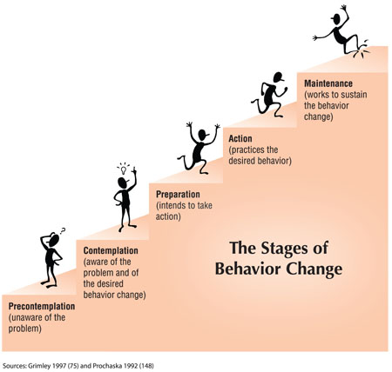
Transtheoretical Model

Slide 22
Structure

Slide 23
The Layout
The Tennessee Health Education Standards document is divided into three (3) grade levels: Grades K-5; Grades 6-8 and Grades 9-12.
The Health Education Standards represent the skill, knowledge or behavior outcome of the student at the completion of a grade.

Slide 24
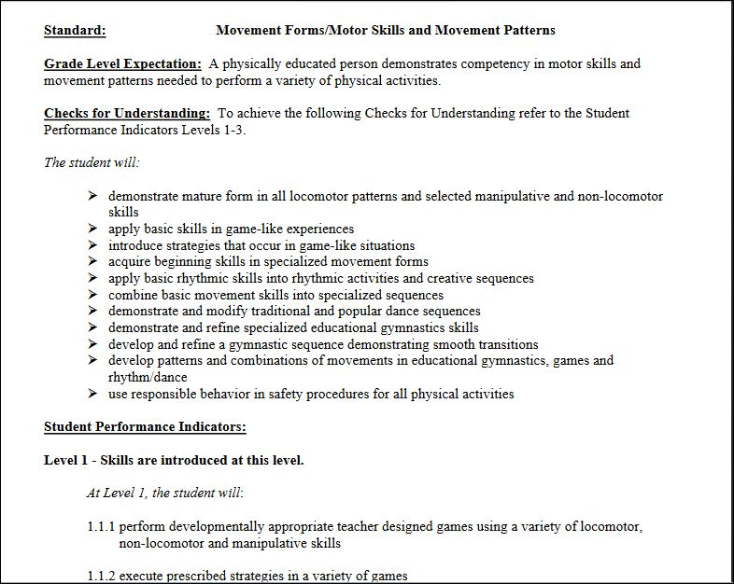
2. Clear, measurable, specific outcome
Previous Years Standard Example:

Slide 25
1. Formatting Consistency
Physical Education Standard
Health Education Standard
Notes:
No more standard → learning expectations → performance indicators → sample performance task structure; everything you need to know is in the standard statement itself.

Slide 26
3. Grade specific rather than grade banded
Grade Banded
Grade Specific

Slide 27
Key Definitions/Descriptions for the Format
Component: a grouping of similar skills, knowledge or behaviors. Each document has five (5) components specific to the grade level. See the grade level introduction provided within each of the three documents for further explanation
Subcomponent: a more refined grouping of similar skills, knowledge or behaviors within a component. Each subcomponent is identified by a title.

Slide 28
Components
Personal Wellness (PW)
Mental & Emotional Wellness (EW)
Disease Prevention (DP)
Safety (S)
Human Growth & Development (HGD)
“Component Extension”
Definition: The component extensions are ideas to
further challenge students in a particular subcomponent

Slide 29
How to Find the Standard
Step 1: Determine Component
Step 2: Determine Sub-Component
Step 3: Match to the specific grade
Step 4: Find the Standard
1
3
2
4

Slide 30
4. Sequential Progression of knowledge & skills
IDENTIFY
COMPILE
DEVELOP

Slide 31
Questions

Slide 32
Q & A

Slide 33
Mark A. Bloodworth, Ed.S. (abd) Data & Fiscal Analyst Office of Coordinated School Health
TN Department of Education 710 James Robertson Parkway Andrew Johnson Tower, 11th Floor Nashville, TN 37243 mark.bloodworth@tn.gov
615-806-0217

