Slide 1
Virtual Football Classroom
Topic 1: Rules and History
Topic 2: Offense
Topic 3: Defense
Topic 4: Training Camp

Slide 2
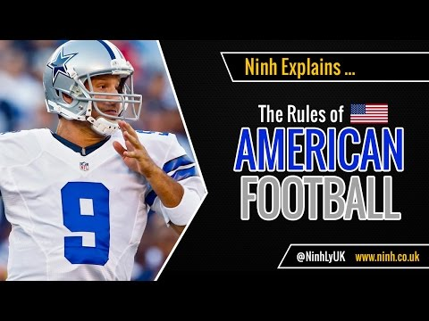
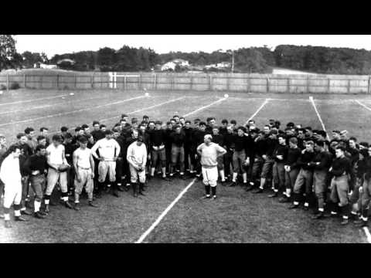
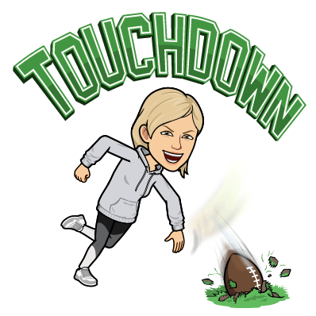
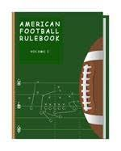
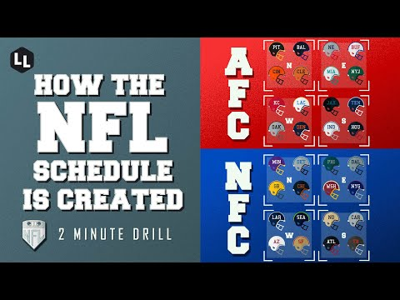
Rules and History

Slide 3
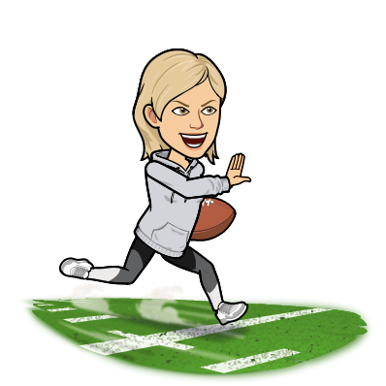
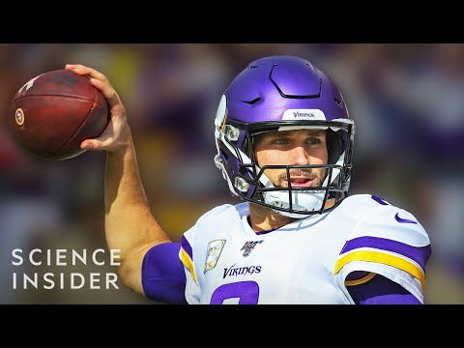
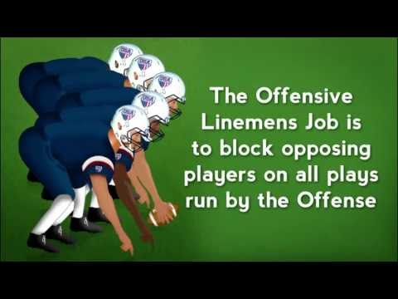
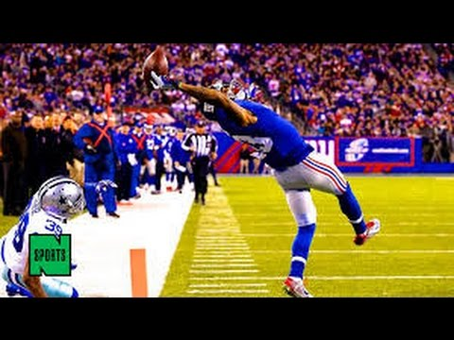
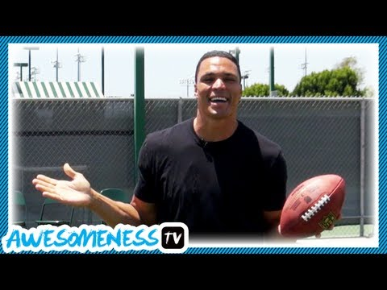
Offense
How to Throw a Spiral
NFL Offensive Positions
NFL Greatest Catches
How to Catch
#7 is my personal Favorite!
Notes:
What # catch was your personal favorite after watching the NFL’s Greatest Catch video?

Slide 4
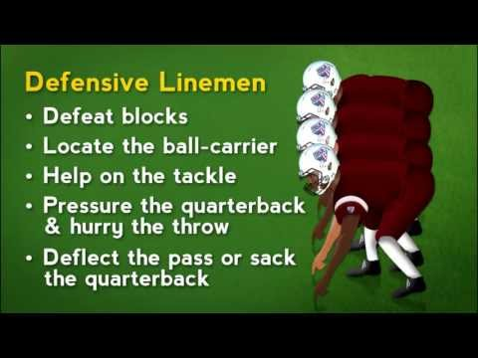
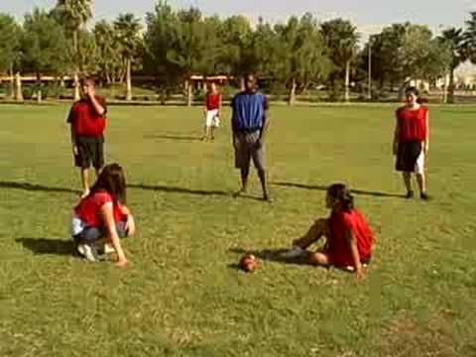
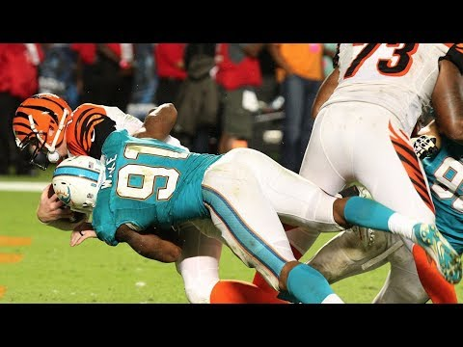
Defense
American Football Defensive Positions
Flag Football Defensive Positions
Quarterback Sacks

Slide 5
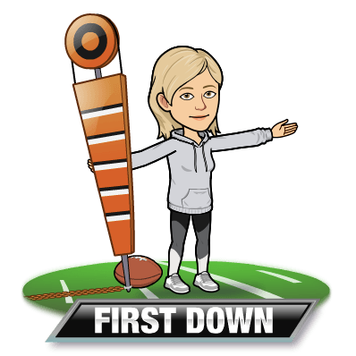
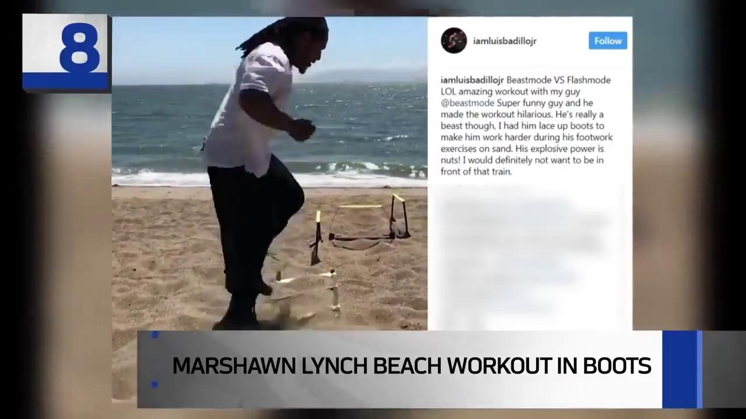
Training Camp
NFL players are workout warriors. Today you will have the opportunity to watch some of the most unique ways players prepare for the season. Also watch the video on how you can create your own workout from your own living room. Finally, make sure to complete the exit slip..
Notes:
Which component of fitness (cardiovascular endurance, muscular strength, muscular endurance, or flexibility) is most important for a football player to have and why?

