Slide 1
The Olympic Games in 2021, one year late, Tokyo will host the event and will feature new Olympic sports, including surfing, sport climbing, skateboarding, baseball and karate.

Slide 3
Directions
Step 1: Pick the olympic event you would want to compete
Step 2: Stand on the side of the event you chose
Step3: Perform/Complete the exercise on that side.
Step 4: Have fun and Let the games begin!

Slide 4
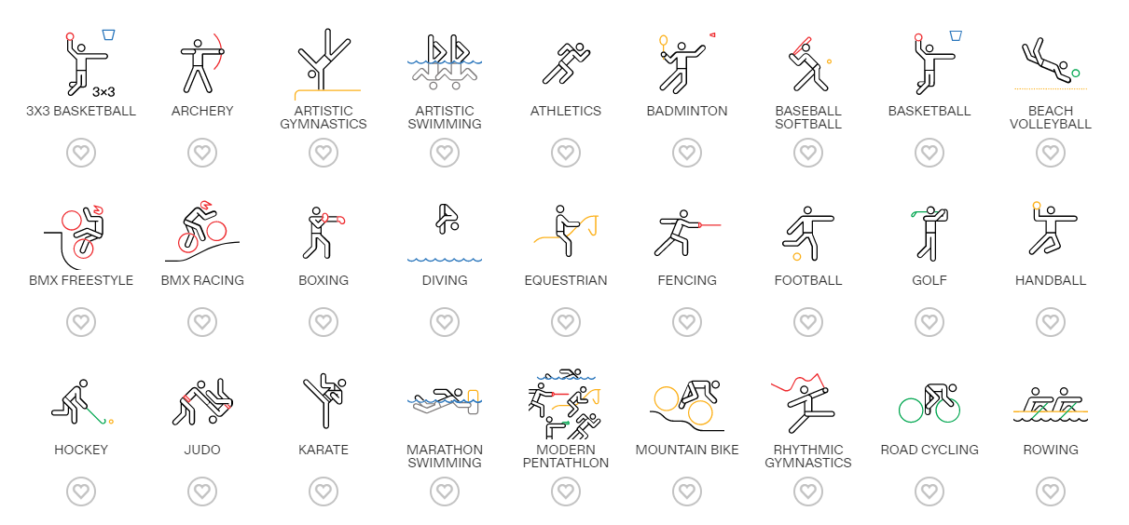

Slide 6
3v3 Basketball
Archery

Slide 7
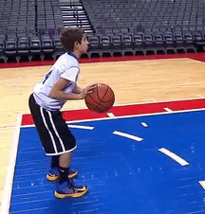
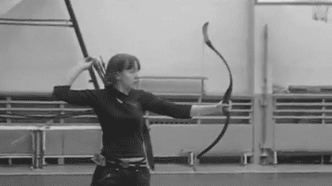
3v3 Basketball
Archery

Slide 8
Badminton
Baseball

Slide 9
Baseball
Badminton

Slide 10
Team Handball
Volleyball

Slide 11
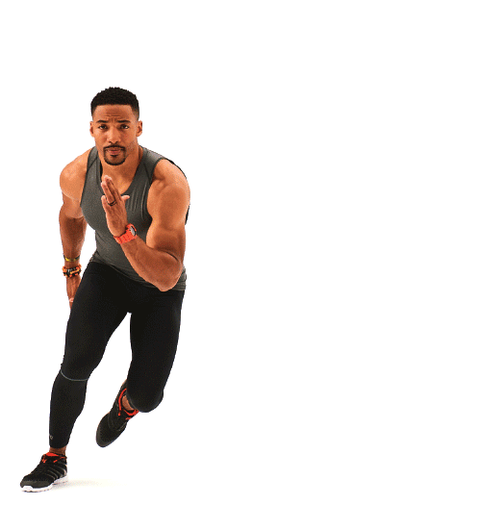
Team Handball
Volleyball

Slide 12
Artistic Swim
Artistic Gymnastics

Slide 13
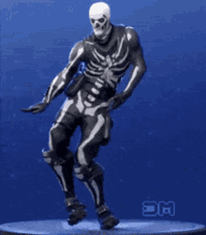
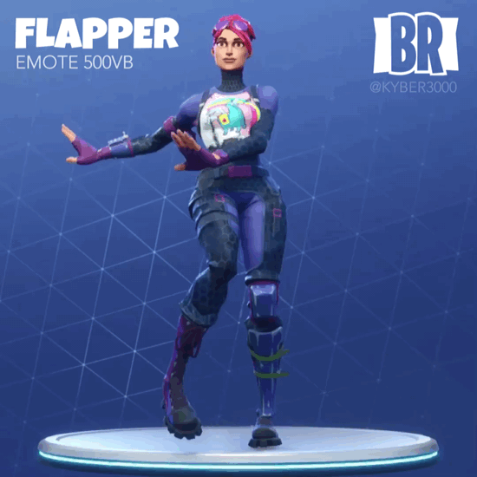
Artistic Swim
Artistic Gymnastics

Slide 14
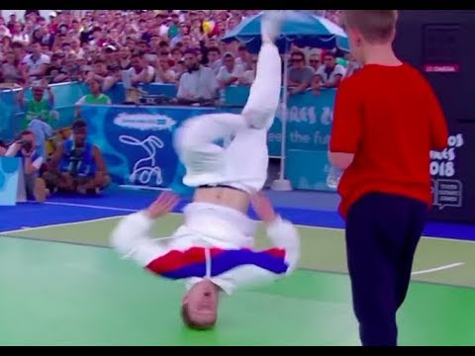
Figure Skating
Break Dancing

Slide 15
Figure Skating
Break Dancing

Slide 16
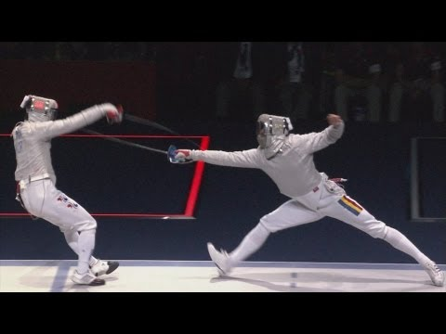
Equestrian
Fencing

Slide 17
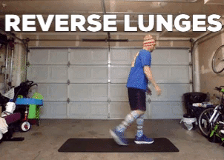
Equestrian
Fencing

Slide 18
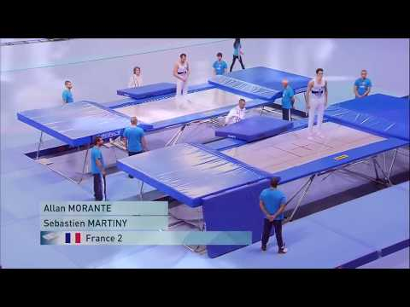
Futsal
Trampoline

Slide 19
Futsal
Trampoline

Slide 20
Skateboarding
BMX Freestyle

Slide 21
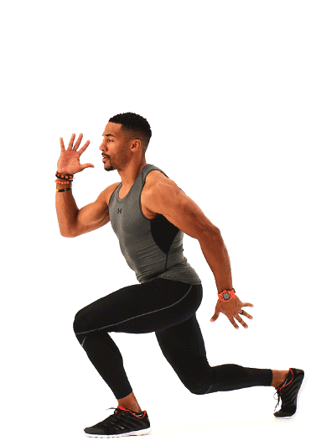
Skateboarding
BMX Freestyle

Slide 22
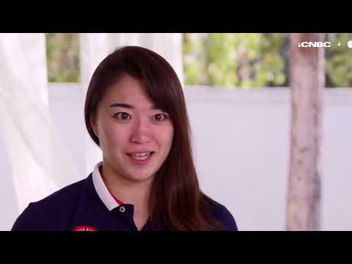
Karate
Judo

Slide 23
Karate
Judo

Slide 24
Great Job! You Are A Champion!

