Slide 1
I’m
BURSTING
TO KNOW

Slide 2
WHAT IS SOMETHING YOU CANNOT LIVE WITHOUT?
WHAT NETFLIX SHOW HAVE YOU BINGE WATCHED MORE THAN ONCE ?
WHAT IS YOUR FAVORITE SONG? OR WHO IS YOUR FAVORITE MUSIC ARTIST?
WHAT IS YOUR FAVORITE ICE CREAM FLAVOR? CONE OR CUP?

Slide 3
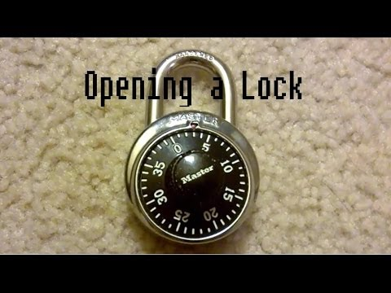
HOW TO OPEN A MASTER LOCK HINTS
STEP 1: Turn your dial to 0
STEP 2: Turn the dial THREE turns to the RIGHT, then stop when the first number lines up with the indicator.
STEP 3: Turn the dial TWO turns to the LEFT, passing the first number, and stop when the second number lines up with the indicator.
STEP 4: Turn the dial ONE turn to the RIGHT and stop when the third number lines up with the indicator.
STEP 5: Either pull up on the shackle, or pull the lock down to open the lock.

