Slide 1
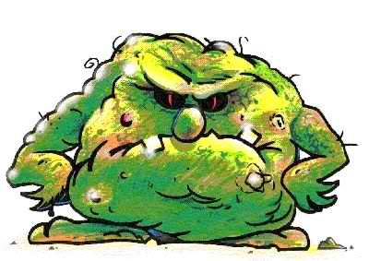
This is Germ. He makes our bodies not clean.

Slide 2
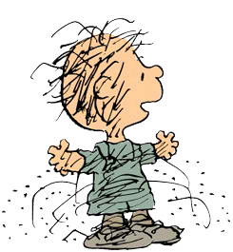
Keeping your body clean
is an important part
of keeping you healthy
and helping you feel good.

Slide 3
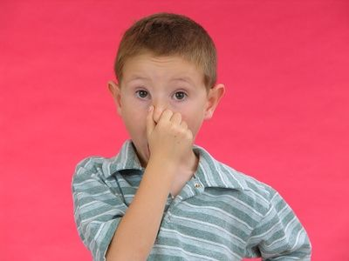
When your body is not clean,
you may smell.

Slide 4
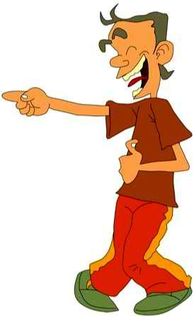
When your body is not clean,
people may make fun of you.

Slide 5
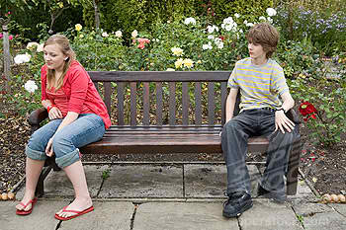
When your body is not clean,
people may not want to be by you.

Slide 6
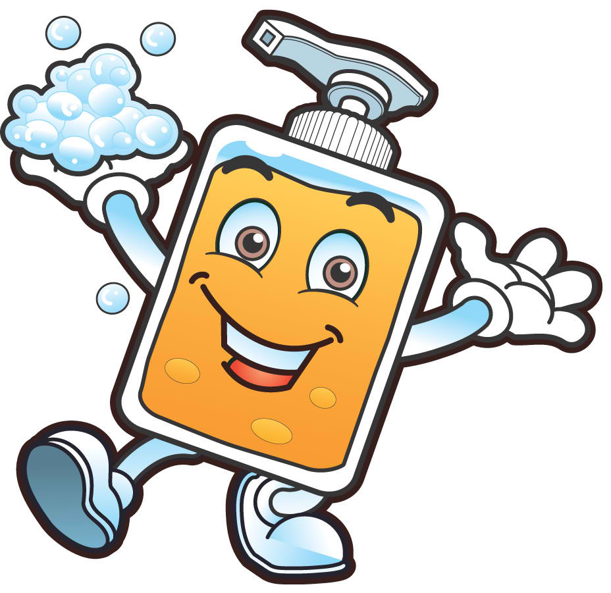
Clean bodies are very important!
Here’s how to make sure
you have a clean body…

Slide 7
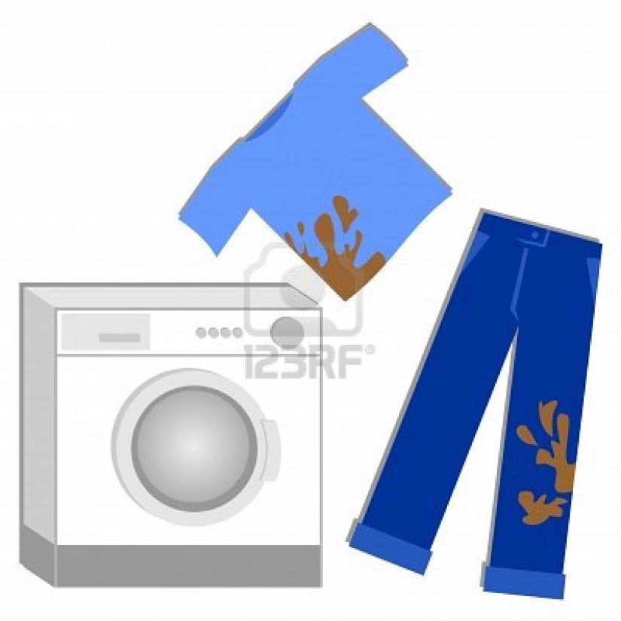
Clean Clothes
Clothes can get stained, dirty, and grubby,
so you need to change them often.
If the clothes smell or have dirt on them,
they need to be washed.

Slide 8
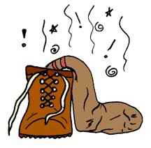
Clean Shoes
Your feet sweat and the sweat gets into your shoes and makes them smell.
Take off your shoes right when you get home and let them air out until the next day.

Slide 9
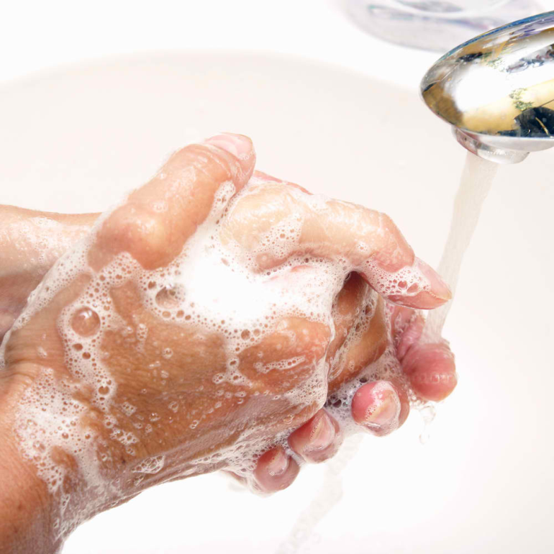
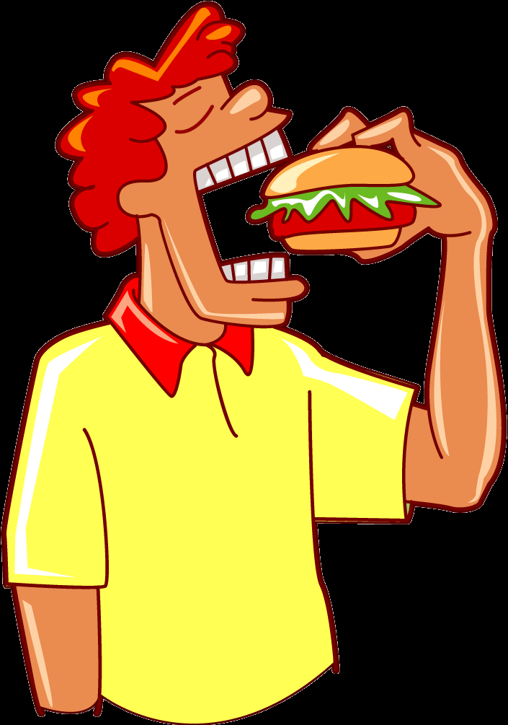
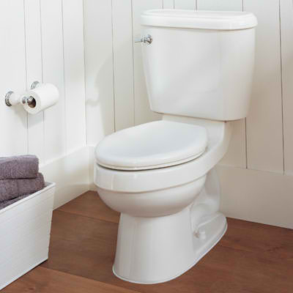
Clean Hands
Your hands touch a lot of germs and bacteria!
Wash your hands with soap and water
after using the bathroom
and before you eat

Slide 10
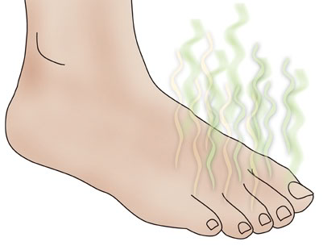
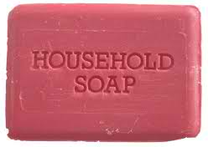
Clean Feet
Wash your feet everyday

Slide 11
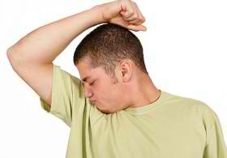
Using deodorant
When you get older,
your armpits begin to smell.
Use a deodorant under your armpits.
A shower or bath is the best thing
for stinky and dirty skin.

Slide 12
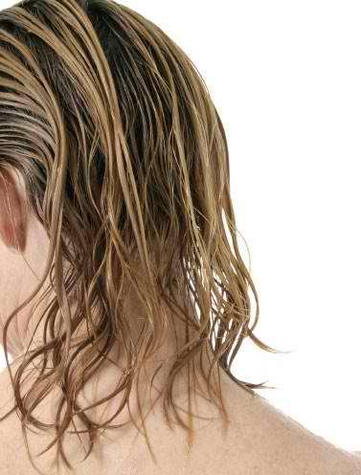
Clean Hair
Your hair can catch sweat, dirt, and oil.
This makes your hair look greasy and dirty.
You need to wash your hair regularly with shampoo and clear water.

Slide 13
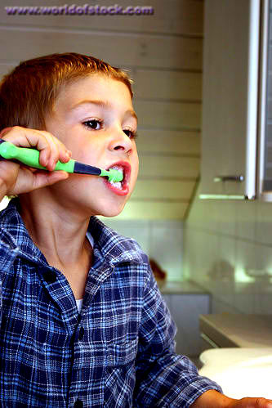
Clean Teeth
You should brush your teeth twice a day
(when you wake up, and before you go to bed)

Slide 14
Now make a poster
of how to have a clean body…
You can write about:
Clean clothes
Clean shoes
Clean feet
Using deodorant
Clean hair
Clean teeth

