Slide 1
Create a Virtual Run
By: Andrew Martin
Coordinated School Health Supervisor
Germantown Municipal School District

Slide 2
What is a virtual run challenge?
Challenge or initiative created to engage a group or district.
Platform allows for data collection and endless possibilities
Core academics are easily integrated make this a multi-faceted approach to instruction

Slide 3
Why a virtual run challenge?
Engage a small and/or large populous at the same time.
Technology integration creates endless possibilities.
Data tracking makes for valuable resources and future referencing.
Safe and engaging during Covid.

Slide 4
How do I get started?
Select a platform that you’ll use to structure your virtual run (i.e. how will you promote this initiative)
Social media, district-wide communications, websites, etc. are great options for promoting and showcasing results/updates.
Use a Google Form to have participants submit miles/steps (spreadsheets can be generated from a Google form to showcase results/data).
Select your target audience (grade level, entire school, entire district, etc.)

Slide 5
What are the goals you have for this initiative?
Create some personal short & long-term goals that you’d like to see come from this virtual run
Offer participants a form that will allow them to display their own short & long-terms goals to make this more meaningful.

Slide 6
How will you provide encouragement once started?
Consider virtual exercise platforms that can be used to allow participants to earn steps or exercise minutes that can be converted to miles
Send out weekly updates on the overall progress or miles earned to showcase the group’s success.
Motivational quotes and short videos are great resources that should be sent out.

Slide 7
Create a Google Form
Set-up a Google account (if you don’t already have one)
Input the questions into the form that you want participants to answer
Include informational texts, images, and videos to inspire and communicate to participants.
Example: Virtual Run Challenge Form

Slide 8
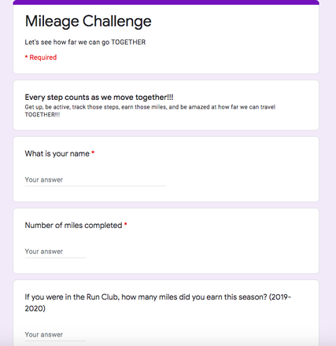

Slide 9
Google Form
Let’s take a closer look at creating your own Google form.
Create a Google account
Go to “Google Forms”
https://www.google.com/forms/about/

Slide 10
Generate Data Reports
Google Forms allows you to create a google sheet (excel spreadsheet) that will have the results from the questions you create for your Google Form.
If you want specific data points, make sure you’re asking the right questions.

Slide 11
Academic Integration
Virtual runs present a unique educational opportunity to include core academics into what you’re offering.
Strengthen the mind, body, and spirit through this challenge.
Look at the possibilities:
Math = Students can add up their own miles and/or their own steps/activity minutes to convert to miles.
Science = Offer human science info for the various muscles and body systems in play via this challenge.
Geography = Include the locations that students reach by adding up their miles and showing them how far they’ve traveled throughout the challenge.
History = Include historical facts about the places and people in various cities/states they reach.

Slide 12
Math Integration
Allow students to add up their miles and/or use a formula to convert their steps or activity minutes into miles.
Ex: 15 minutes of dancing = 1 mile
2,500 steps = 1 mile

Slide 13
Virtual platforms to use for exercise minutes:

Slide 14
Activity Chart Example

Slide 15
Science Integration
Select specific exercises and/or activities for students to complete (Ex: Push-ups)
Have group discussion or assignments based on muscle groups and/or energy systems used.
Use my Anatomy & Physiology pages from my website as a valuable science resource: https://www.thephysedexpress.com/anatomy--physiology.html
Lessons, activities, assignments, quizzes, tests, escape rooms and much more can be found by visiting the above link.
Click on the ”Muscle Wiki” image to have a comprehensive list of exercises generated just by clicking on a muscle group.

Slide 16
Geography Integration
Select a starting point for this journey (city/state you live in).
Use the miles your group earns to see how far they can travel
Use Google maps to input the miles and share the maps with your group to generate excitement.
Give facts about landforms, etc. from the various places your group reaches on this challenge.

Slide 17
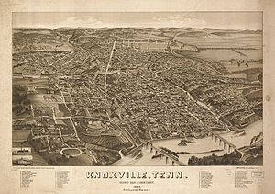
History Integration
Incorporate facts about the history of the cities, states, and famous people from those places your group will reach.
Make the assignments or challenges meaningful.
Allow students to research historical facts from places they reach on this journey.
Ex: Group reaches Knoxville, TN
Select facts from a Google search:
History of Knoxville, Tennessee

Slide 18
Integrate whatever seems beneficial and meaningful to YOUR group!
ELA skills
Communication skills
Nutrition & Health
Weather & Climate

Slide 19
Words of Encouragement
Consider getting video shout outs from people in your community and/or recognizable figures!
You’d be amazed at who’d be willing to support you by asking!
Social Media is a huge benefit for reaching out to others.
Video message from Pauls Pujats

Slide 20
Words of Encouragement
Micah “The Marine” Herndon
Famously can be seen crawling to the finish line of the 2019 Boston Marathon.
Video message from Micah

Slide 21
Virtual runs can be for a fundraiser or theme
Raise money via participation in a virtual run, such as “Breast Cancer Virtual Run” to raise money for American Cancer Society.
View Google Form
Link spot to provide donations in your Google Form.

Slide 22
View my archived virtual runs
Virtual run challenge I created for my students when teaching at Grahamwood Elementary School (Memphis, TN).
Used this as our main PE class when schools were closed down due to initial Covid outbreak.
https://www.thephysedexpress.com/virtual-run-challenge.html

Slide 23
Visualize your own!!!
Take a couple of minutes to reflect and think about the virtual run you’d create.
Theme?
Integrated?
Audience?
Communications?

Slide 24
Questions for the Presenter…
Andrew Martin
School Health Supervisor (GMSD)
901-288-9718
Andrew.martin@gmsdk12.org
https://www.thephysedexpress.com/

