Slide 1
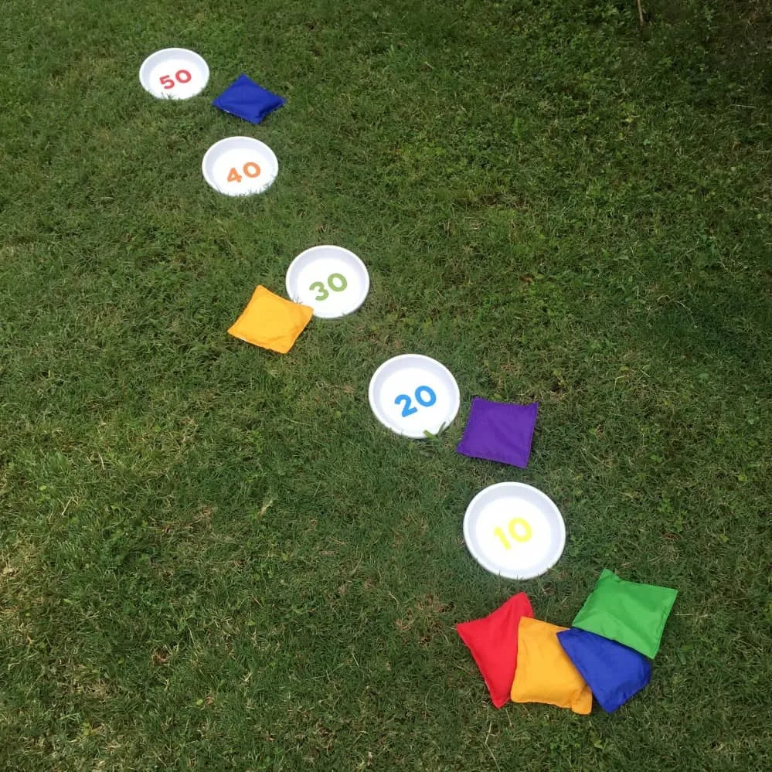
Backyard Games Day 5

Slide 2
Keep It Up Challenge
Or a zip lock bag!!!)

Slide 4
Penguin Race Challenge

Slide 6
Bean Bag Toss
Materials:
5 paper plates (or sheets of paper)
5 Sock balls (or bean bags if you have them)
Set up:
Number the plates 10, 20, 30, 40, 50
Space the plates out about a foot apart
Directions:
Toss your bean bag, if it lands on a plate, score that number of points.
Once all bean bags are tossed, run and collect them, keep going until time is expired.

