Slide 1
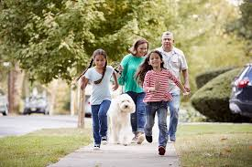
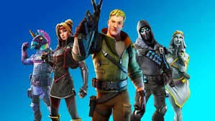
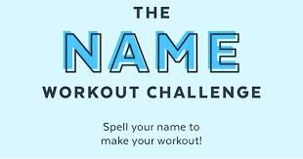
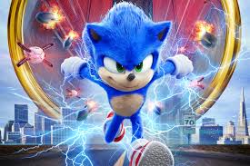
P.E. Choice Board
Family walk scavenger hunt | Fortnite Fitness
 |  | Here Comes the Boom Dance
Minions Board Game

