Slide 1
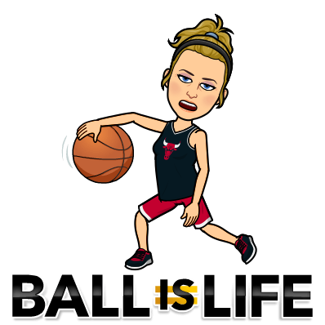
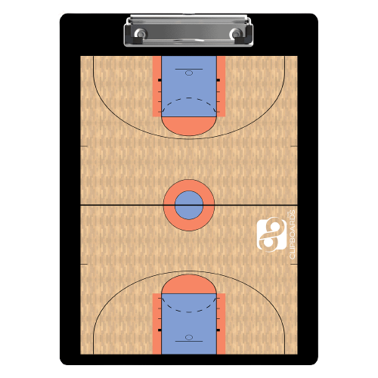
Basketball Virtual Unit
Day 1: Rules and History
Day 2: Offense and Shooting
Day 3: Defense and Test

Slide 2
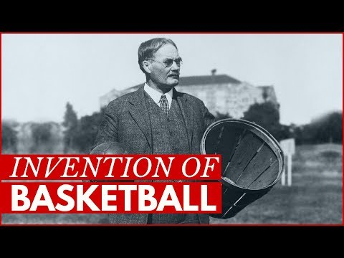
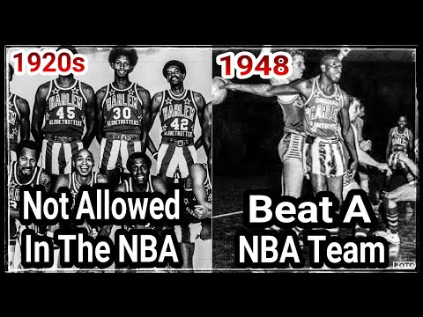
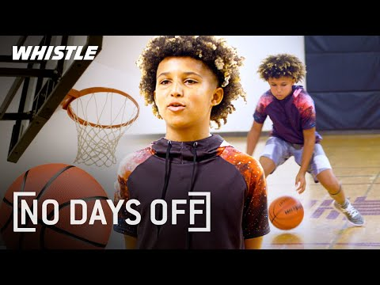
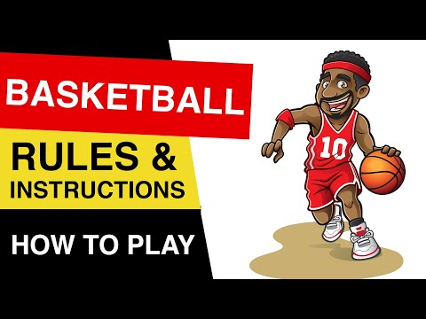
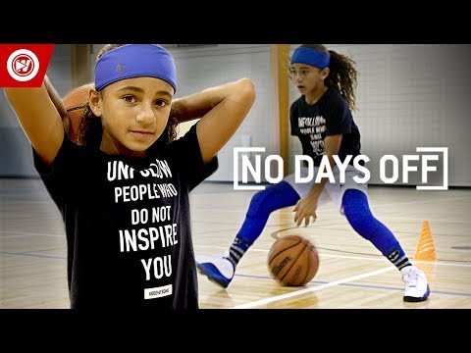
Day 1: Rules & History
History
Harlem Globetrotters
[No Days Off]
Rules
10 CreditPoints Extra !
5th Grade
6th Grade
7th Grade
8th Grade
Notes:
Challenge: Create Spin ball on your finger.

Slide 3
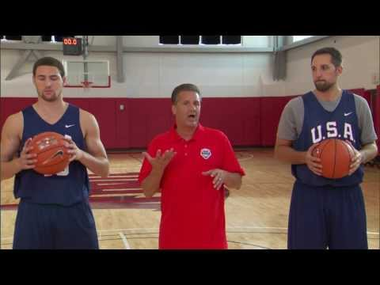
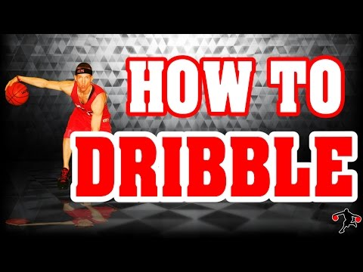
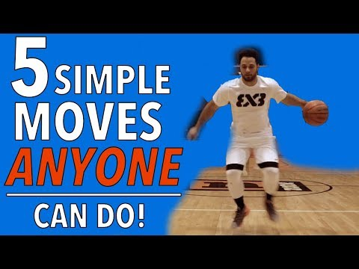
Day 2: Offense & Shooting
10 CreditPoints Extra !
5th Grade
6th Grade
7th Grade
8th Grade
Notes:
Challenge: Create your own hoop and sock ball a film a trick shot.

Slide 4
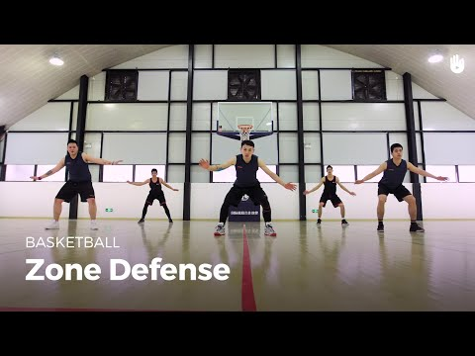
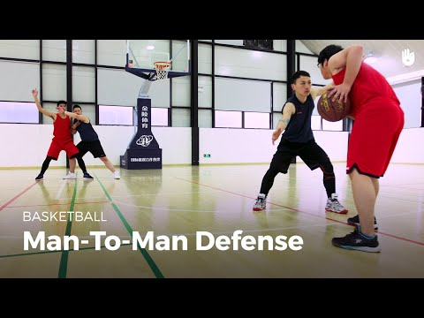
Day 3: Defense and Test
Zone Defense
VS.
Man to Man Defense
One of the best defensive players of all time!

