Slide 1
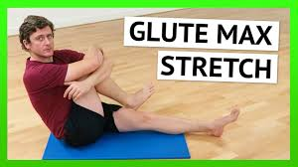
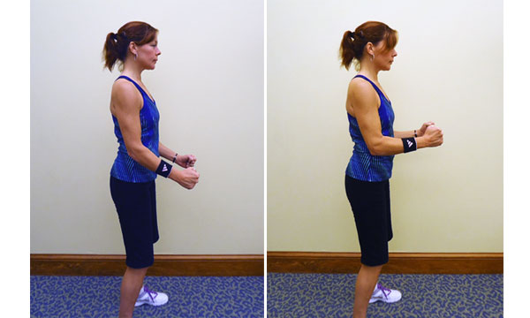
10
10
Isometric
exercise
10
10
10
10
10
10
Front crawl
Jumping Jacks
10
Curls-bicep
10
overhead
10
10
Knee lifts
10
10
Lateral
Arm
Raises
10
Heel Lifts
K. Catalfamo- HAPE

Slide 2
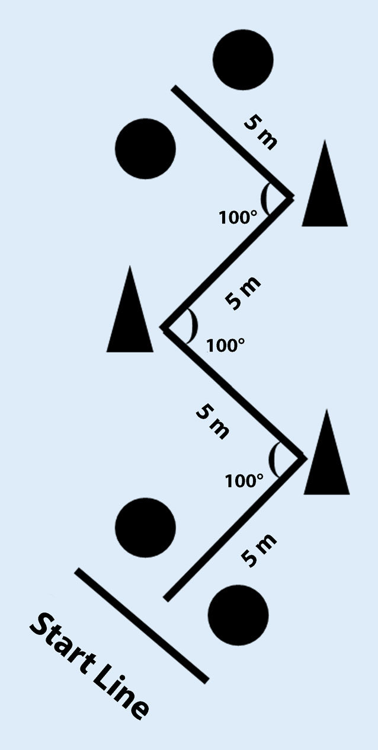
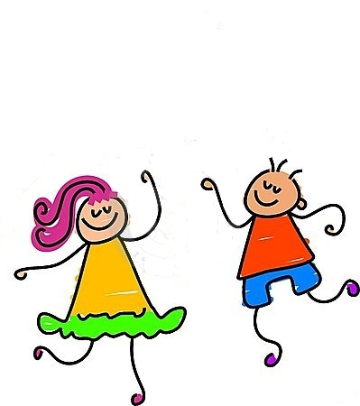
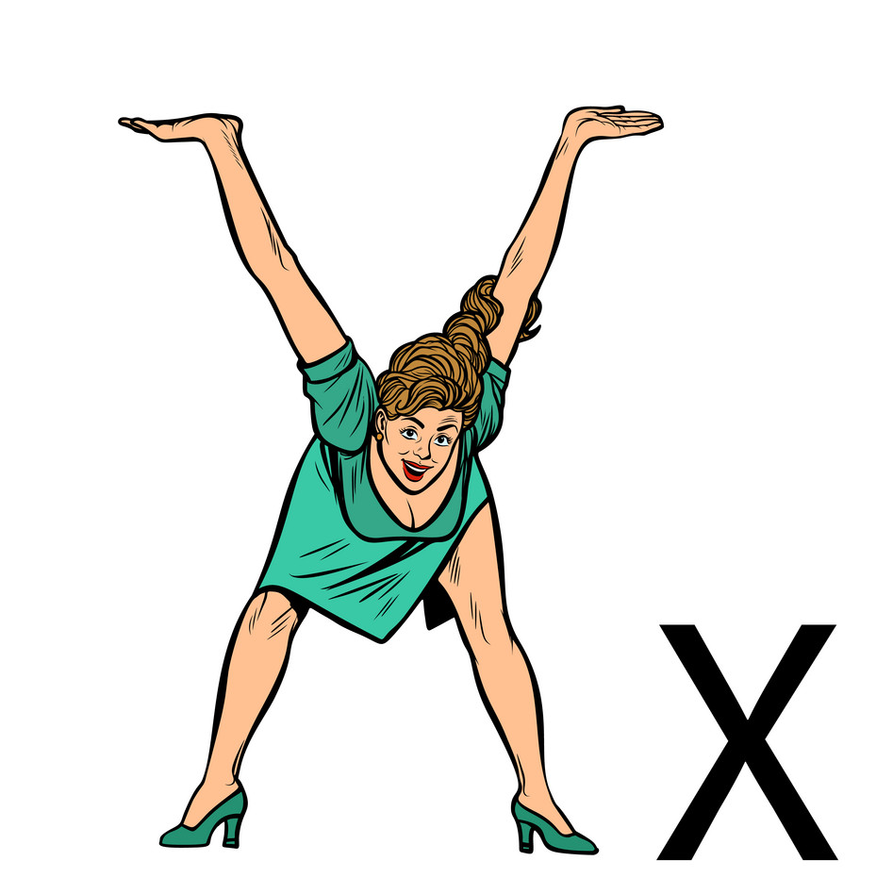
Quick Jabs
10
30 seconds
10
Yoga
Pose
V-sit
Make “v”
Rope Climbing
Hold 10
10
10
Zig Zag Moves
Feet or Hands
10
Alphabet
Workout
Side Bends
30
Wiggle 30 seconds
10
Create a
30 seconds
twists
K.Catalfamo – Adapted PE & Health

