Slide 1
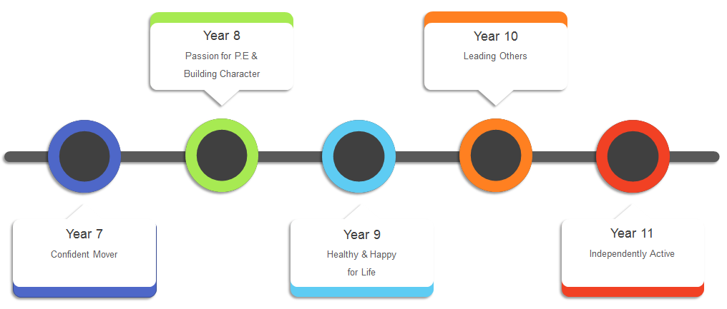
Our Intent
To cultivate a passion for lifelong learning and enjoyment of Physical Education where students constantly strive to ‘believe in their best’. Develop physical literacy, knowledge, understanding and confidence to lead a healthy active lifestyle. To enable students to develop core values, character and life skills to equip them for employment in their personal lives.
P.E is much more than just playing sport, it is a vehicle for developing the three main domains of learning:
Head
(Thinking)
Heart
(Feelings)
Hands
(Physical)
Knowledge
Communication
Skill Development
Decision Making
Team Work
Fitness Levels
Analyse & Evaluate
Commitment
Skill Application
Leadership
Resilience
Performance
Problem Solving/Creativity
Self-Regulation
Tactics & Composition
Curriculum Themes
Year 8
Year 10
Passion for P.E &
Building Character
Leading Others
Year 7
Year 9
Year 11
Confident Mover
Healthy & Happy
for Life
Independently Active
“BELIEVE IN YOUR BEST”

Slide 2
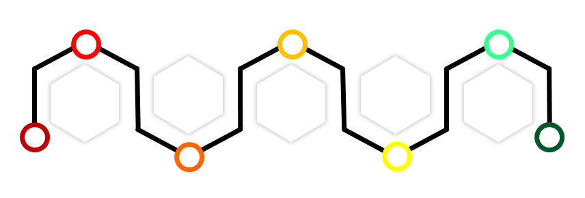
Our Intent
To cultivate a passion for lifelong learning and enjoyment of Physical Education where students constantly strive to ‘believe in their best’. Develop physical literacy, knowledge, understanding and confidence to lead a healthy active lifestyle. To enable students to develop core values, character and life skills to equip them for employment in their personal lives.
P.E is much more than just playing sport, it is a vehicle for developing the three main domains of learning:
Head
(Thinking)
Heart
(Feelings)
Hands
(Physical)
Knowledge
Communication
Skill Development
Decision Making
Team Work
Fitness Levels
Analyse & Evaluate
Commitment
Skill Application
Leadership
Resilience
Performance
Problem Solving/Creativity
Self-Regulation
Tactics & Composition
“BELIEVE IN YOUR BEST”
Year 7
Year 9
Year 11
Confident Mover
Healthy & Happy
For Life
Independently Active
Passion for P.E &
Building Character
Leading Others
Year 8
Year 10

Slide 3
“BELIEVE IN YOUR BEST”
Year 8
Year 10
Passion for P.E &
Building Character
Leading Others
Year 7
Year 9
Year 11
Confident Mover
Healthy & Happy
for Life
Independently Active
Our Intent
To cultivate a passion for lifelong learning and enjoyment of Physical Education where students constantly strive to ‘believe in their best’. Develop physical literacy, knowledge, understanding and confidence to lead a healthy active lifestyle. To enable students to develop core values, character and life skills to equip them for employment in their personal lives.
P.E is much more than just playing sport, it is a vehicle for developing the three main domains of learning:
Head
(Thinking)
Heart
(Feelings)
Hands
(Physical)
Knowledge
Analyse &
Evaluate
Problem
Solving/
Creativity
Skill
Development
Skill
Application
Tactics
&
Composition
Decision
Making
Leadership
Fitness
Levels
Performance

Slide 4
“BELIEVE IN YOUR BEST”
Our Intent
To cultivate a passion for lifelong learning and enjoyment of Physical Education where students constantly strive to ‘believe in their best’. Develop physical literacy, knowledge, understanding and confidence to lead a healthy active lifestyle. To enable students to develop core values, character and life skills to equip them for employment in their personal lives.
P.E is much more than just playing sport, it is a vehicle for developing the three main domains of learning:
Head
(Thinking)
Heart
(Feelings)
Hands
(Physical)
Knowledge
Analyse &
Evaluate
Problem
Solving/
Creativity
Team
Work
Resilience
Skill
Development
Skill
Application
Tactics
&
Composition
Decision
Making
Leadership
Communication
Commitment
Self-
Regulation
Fitness
Levels
Performance
Curriculum Themes
Year 7
Year 9
Year 11
Confident Mover
Healthy & Happy
For Life
Independently Active
Passion for P.E &
Building Character
Leading Others
Year 8
Year 10

