Slide 1
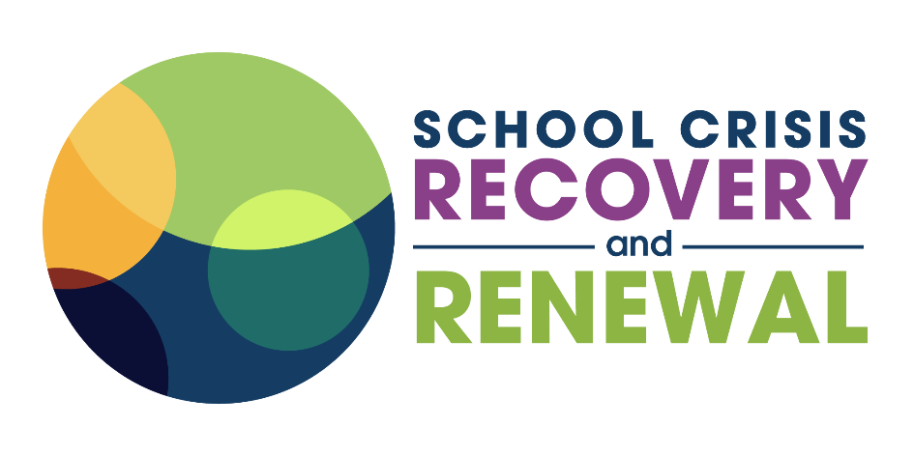
Renewal After School Crises - The Fourth "R"
2021 CSH Institute
Tuesday, March 3, 2021
7:30 AM-8:30 AM PT /9:30 AM - 10:30 AM CT/ 10:30 AM - 11:30 AM ET
Notes:
Leora

Slide 2
DISCLAIMER
This training is offered through the National Child Traumatic Stress Network (NCTSN) and The School Crisis Recovery and Renewal (SCRR) and is funded by the Center for Mental Health Services (CMHS), Substance Abuse and Mental Health Services Administration (SAMHSA), U.S. Department of Health and Human Services and jointly coordinated by the University of California, Los Angeles, and Duke University, and is administered by the Center for Applied Research Solutions (CARS). The views, opinions, and content expressed in this presentation do not necessarily reflect the views, opinions, or policies of SAMHSA.
Notes:
Leora

Slide 3
Today’s Team
Leora Wolf-Prusan, EdD
She/hers
Project Director, SCRR
&
Oriana Ides, MA, LPCCI, PPS
She/hers
Field Coach, SCRR

Slide 4
Grounding & Settling in
Notes:
Oriana
https://metoomvmt.org/wp-content/uploads/2020/10/2020-10-27_SurvHealingProg_SupportMaterial_NurturingResiliency-1.pdf

Slide 5
AGENDA
01
Welcome, introduction to us, to our project, and to today
Renewal in the context of school crisis: 5 concepts
Coping, resilience, post-traumatic growth theory, healing, & meaning making
02
03
School crisis renewal leadership-practices to make our work grow
04
Thank you, Closing, Upcoming opportunities + How we can support you

Slide 6
Introduction to the School Crisis Recovery & Renewal Project

Slide 7
WHAT IS SCRR?
Promoting effective and sustainable change in the ways school communities and school leadership builds the skills, knowledge, and attributes necessary to recover and renew after a crisis.
www.schoolcrisishealing.org
School crisis readiness is essential. Response is critical.
And: what happens after matters, too.
Notes:
Project purpose
The School Crisis Recovery and Renewal (SCRR) project supports educators, school staff, and school-based clinicians to effectively implement trauma-informed crisis response, recovery, and renewal strategies.
Our Services
Provides training and technical assistance (TTA) services and resources to state and local education agencies (SEAs/LEAs); district teams; school leaders; school mental health providers, support staff, and educators; community partners; and other school mental health stakeholders
Creates curricula, training opportunities, and best-practice resources to promote long-term recovery and renewal after school crisis
Offers intensive consultations to a small number of districts and schools who have experienced crisis readiness and response support, and are ready for and interested in making meaning of their experience(s)
Cultivates effective and sustainable school leadership so that school communities build the skills, knowledge, and attributes necessary to recover and renew after a crisis
Is educator and student centered and directed

Slide 8
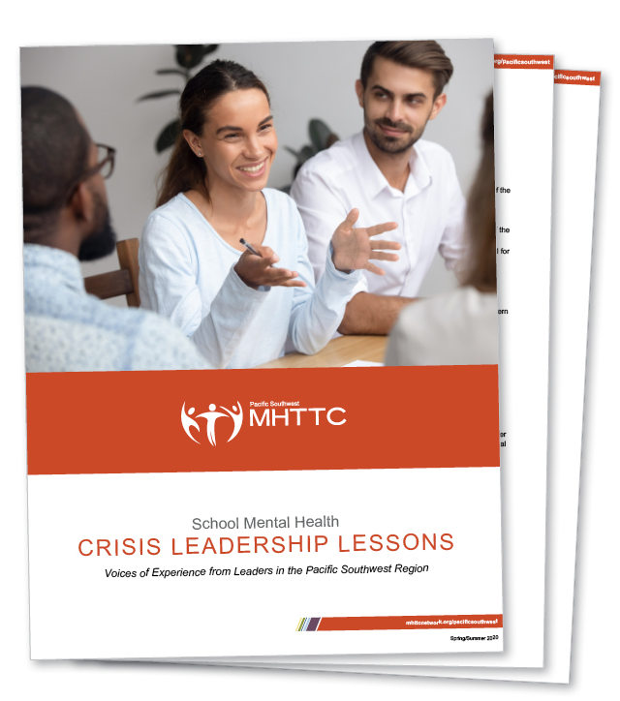
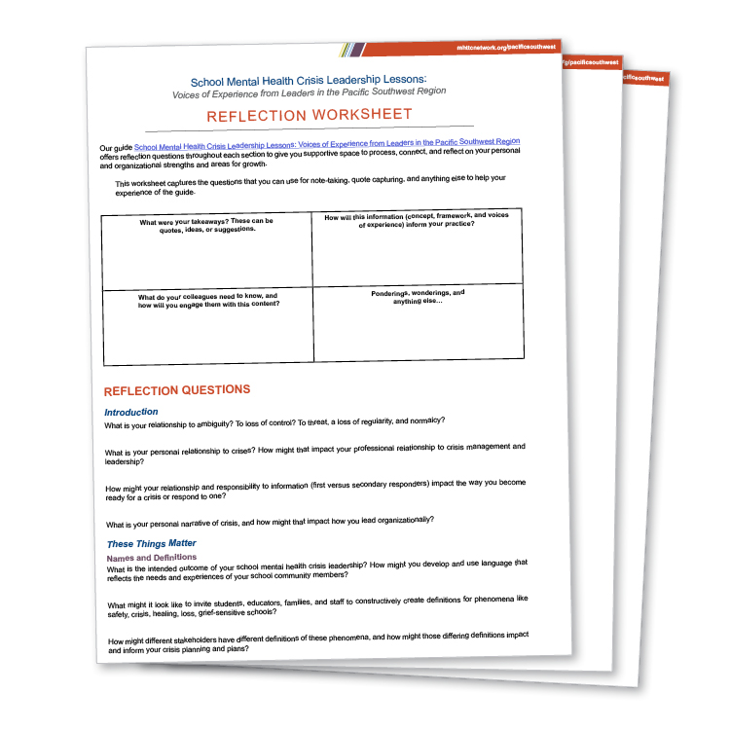
Guidepost document
School Mental Health Crisis Leadership Lessons: Voices of Experience from Leaders in the Pacific Southwest Region
Guide
Complementary Reflection Worksheet
LEARN MORE AT:
Bit.ly/smh-crisis-leadership-lessons

Slide 9
Readiness (Before a big thing)
Response (During a big thing)
Recovery (the week, month, year after a big thing)
Renewal (A year + after a big thing)
Past, present & future
Present
Past & the present
Present & the future
Competencies, Collaboration & Communication
Protection & reduction of harm; mitigation of panic, identifying harm tipping points, responding to death and grief
Connectedness & Commonality
Safety & Stabilization, Remembrance & Mourning, Reconnection & Integration (adapted from Herman,, 1992)
Constructing a coherent narrative: what happened to us? With us? By us?
Name, navigate, normalize
Healing & meaning Making
Creating & reimagining
School Crisis Readiness, Response, Recovery & Renewal
Notes:
Leora
The renewal phase requires crisis leadership after the first year, first three years, five years or more after a harmful event or crisis is experienced. “Renewal” is our adaptation and combination of meaning-making (Neimeyer, 2001), building and fostering resilience (Ungar, 2011), post-traumatic growth theory (Calhoun & Tedeschi, 2006), and organizational change after crisis.

Slide 10
When you hear the word “Renewal,” what word or image comes up for you?

Slide 11
“…We tend to fail to see that when we ask human beings to show up without their full self, without their full, catastrophic self, with all of the messes that they are, with all of the discomfort, when we deny that we hold certain belief systems from our childhood, that we created those belief systems to survive the challenges of our childhood — what we are cutting ourselves off from is the very source of much of our creativity, much of our innovation…
…And the result is that our organizations are actually less productive, less imaginative; not just poor workplaces for individuals to be, but poor places for collaboration and creativity and spontaneity and laughter and humor, because we have cut off, if you will, limbs. We have cut off part of ourselves in a bid to live into that credence that you leave the personal at the door, and you don’t actually bring it into the workplace.”
–Jerry Colonna

Slide 12
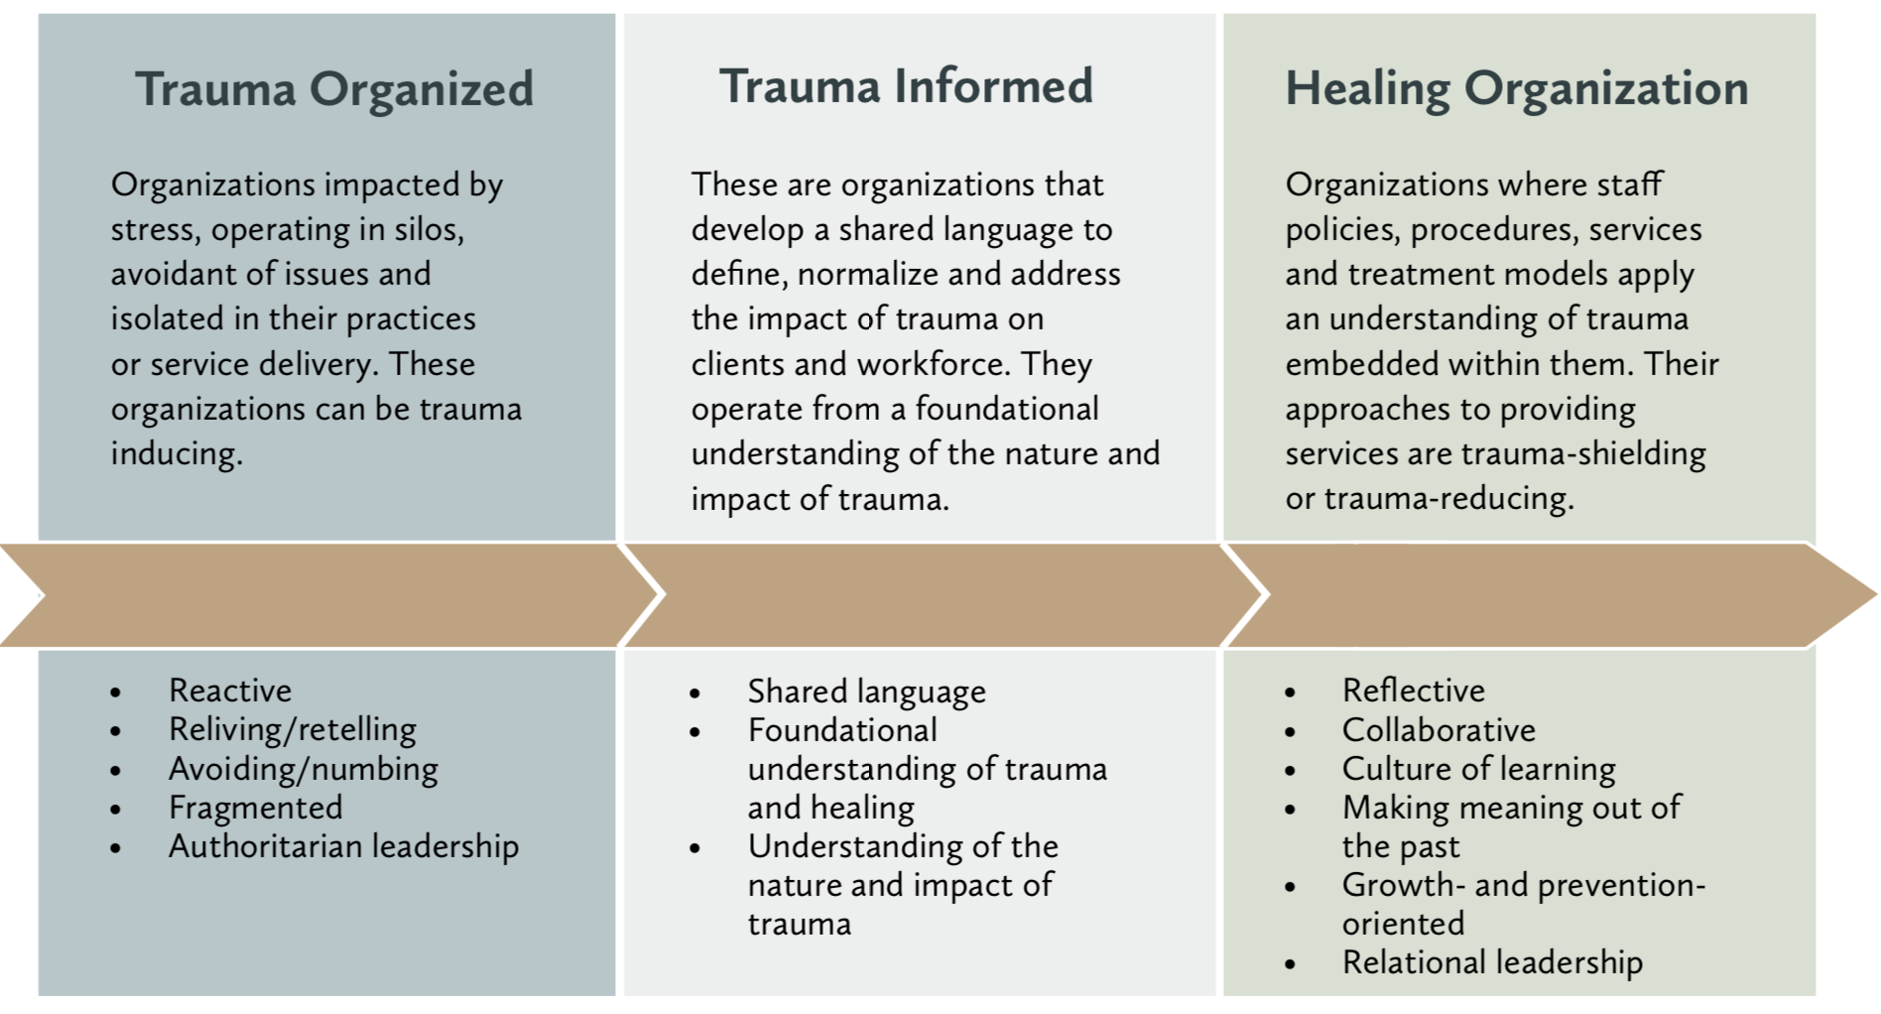
Trauma Transformed (T2): www.traumatransformed.org

Slide 13
How do we know when we’re moving from RECOVERY into renewal? In our bodies? In our school cultures?

Slide 14
Recovery Step 1:
Establish safety & stabilization
Recovery Step 2:
Reconstruct the story (the event, the response to the event, the responses of people in the community to the event, the responses of society to the event)
Recovery Step 3:
Reconnection with life: Social action
Renewal:
Reflection
Integration of learnings and new awareness
Analysis of root causes (examining the crisis and experience of the crisis from a social justice frame)
Commitment to action (interruption, generation, and informing future crisis work)
A big thing happens or continues to happen (e.g., the crisis) → disempowerment, disconnection
(based on Herman, 1992)
Notes:
Herman offers that safety = control over the body then of the environmental
Step 2 = messy timeframe.
Belonging, becoming, beyond
Brain stem, limbic system, prefrontal cortex

Slide 15
School Crisis Renewal What is School Crisis Renewal? And What Could It Be?
Nayyirah Waheed

Slide 16
RENEWAL CONCEPT #1 COPING

Slide 17
Coping
Strategies & tools to ground to respond
Individualized
Can be adaptive, socially validated or invalidated
“When an individual believes they have the resources to respond effectively to the challenges of a stressor or change.”
Folkman & Lazarus, 1988; Lazarus & Folkman, 1987
Notes:
Coping involves spending mental energy in a way that can reduce stress.
Whether conscious or subconscious, the ultimate goal of all coping mechanisms is to solve a problem and return homeostasis.
Coping strategies can be positive or negative, depending on whether they increase or reduce mental wellbeing.
Coping is dependent on personality patterns and perceptual experiences.
The strategies one choose for adapting to a situation is highly individualized. Coping is never the same for two people.
Lazarus and Folkman (1984)
Take a moment to reflect on what strategies and tools are helping you ground and respond
How do we believe that we have the resources to respond?

Slide 18
Coping.
Pause.
Take a moment to reflect on what strategies and tools are helping you ground and respond.
What’s coming up for you?
How do we believe that we have the resources to respond?

Slide 19
RENEWAL CONCEPT #2: RESILIENCE
“It doesn't really matter if we have different definitions of resilience.
It matters that we continue to have a conversation about resilience because the meta-message is that the experience of trauma does not only yield pathology.”
-Dr. Rachel Yehuda

Slide 20
“In the context of exposure to significant adversity, resilience is both the capacity of individuals to navigate their way to the psychological, social, cultural, and physical resources that sustain their well-being, and their capacity individually and collectively to negotiate for these resources to be provided in culturally meaningful ways.” (Ungar, http://resilienceresearch.org/)
Community Resilience: The ability of a community to adapt to and even thrive in the face of adversity and traumatic events, thus reinforcing community healing and reducing trauma-inducing conditions (Pinderhughes, 2016)
“The process of adapting well in the face of adversity, trauma, tragedy, threats or even significant sources of stress.”(APA, 2014)
The capacity of a dynamic system to adapt successfully to disturbances that threaten the viability, the function, or the development of that system (Masten 2014a, 2014b).
“A process to harness resources in order to sustain well-being.” Dr. Catherine Panter-Brick
“ Resilience is the ability to navigate adversity and bounce back from difficult life events. Being resilient does not mean that an individual doesn’t experience stress, emotional upheaval, or suffering. Rather, resilience includes working through challenges, emotional pain, and trauma to increase one’s capacity to move through challenge.” Katie Hurley, Everyday Health
Notes:
An asset-driven strategy acknowledges that young people are much more than the worst thing that happened to them, and builds upon their experiences, knowledge, skills, and curiosity as positive traits to be enhanced.…
Ginwright, S. (2018, May 31). The Future of Healing: Shifting From Trauma Informed Care to Healing Centered Engagement. Retrieved from https://medium.com/@ginwright/the-future-of-healing-shifting-from-trauma-informed-care-to-healing-centered-engagement-634f557ce69c

Slide 21
Vicarious Resilience
A process, not an outcome
Notes:
There are many definitions of resilience.
How might you choose one that will define your community’s shared mission & vision?
E.G. Masten = positive adaptation
Resilience is contagious
Connection, support
Affirmation, acknowledgement
BONNIE BERNARD
Social Competence
Ability to elicit positive responses from others creating positive relationships with both adults and peers;
Problem-solving skills
Facilitating seeing oneself in control and resourcefulness in seeking help from others;
Autonomy
Developing or fostering a sense of one’s own identity and an ability to act independently and exert some control over one’s environment;
A sense of purpose and future
Articulated goals, educational aspirations, persistence, hopefulness, and a sense of a bright future.

Slide 22
Resilience.
Pause.
“The way to us is us. An integrated us.”
What elements of your community, before, during, and after a crisis, do you want to integrate into your life?
Cherríe Moraga 4-17-19

Slide 23
Resilience is the bounce back* and post-traumatic growth is the transformation.
Cassie
Shortsleeve
*Ok, but we know its not just about the bounce back…

Slide 24
RENEWAL CONCEPT # 3: POST TRAUMATIC GROWTH THEORY (PTG)
Nayyirah Waheed

Slide 25
Post Traumatic Growth Theory (PTG)
Centrality
The degree to which an individual believes a negative event has become a core part of their identity
Rumination
Intrusive
Re-assessment
Pre-conceived notions of the world
What is just?
Deliberate
Proximity
Physical closeness can lead to more likely to experiencing post-traumatic stress symptoms.
The more emotionally close to the crisis event a person is, the more likely they are to also experience post-traumatic growth.
Wozniak, J. D., Caudle, H. E., Harding, K., Vieselmeyer, J., & Mezulis, A. H. (2020). The effect of trauma proximity and ruminative response styles on posttraumatic stress and posttraumatic growth following a university shooting. Psychological Trauma: Theory, Research, Practice, and Policy, 12(3), 227-234
Notes:
Posttraumatic growth (PTG) is positive transformation following a traumatic experience. PTG, commonly measured with the Posttraumatic Growth Inventory (PTGI; Tedeschi & Calhoun, 1996)
“the degree to which an individual believes a negative event has become a core part of their identity,”
One possible explanation for the contribution of deliberate rumination to PTG is finding meaning. In the aftermath of a traumatic event, many individuals search for meaning in their experience. Those who engage in purposeful cognitive processing of the event may be more likely to find the meaning that helps rebuild or reaffirm the challenged assumptive world.
Wozniak, J. D., Caudle, H. E., Harding, K., Vieselmeyer, J., & Mezulis, A. H. (2020). The effect of trauma proximity and ruminative response styles on posttraumatic stress and posttraumatic growth following a university shooting. Psychological Trauma: Theory, Research, Practice, and Policy, 12(3), 227-234. https://doi.org/10.1037/tra0000505

Slide 26
Cryder, C.H., Kilmer, R.P., Calhoun, L.G., & Tedeschi, R.G.(2006). An exploratory study of posttraumatic growth in children following a natural disaster. American Journal of Orthopsychiatry, 76, 65-69.

Slide 27
PTG.
Pause.
How do you know- in your body-when something is growing within?
How do we know- in our practice (clinical, teaching, youth-partnership, leadership)- when we have transformed?
Notes:
positive change after trauma has also been conceptualized as a coping strategy for managing the negative psychological consequences of experiencing a traumatic event VS positive change as an outcome of experiencing trauma rather than a recovery process.
5 factors of PTG: relating to others, new possibilities, personal strength, spiritual change (distinct), and appreciation of life (high inter correlations)
https://www.psychologytoday.com/us/blog/buddhist-psychology-east-meets-west/202005/post-traumatic-growth-and-covid-19

Slide 28
RENEWAL CONCEPT #4: HEALING

Slide 29
Healing
Root cause focused
Meaning making: Coherent narrative, story of self, collective
Restoration of Purpose, Quality of Life, and Identity
To Make Whole
Repair
“Healing-centered engagement…focuses on asset-driven strategies that highlight possibilities for well-being.
Healing-centered engagement has an explicit focus on restore and sustaining the adults who attempt to heal youth—a healing the healers approach.”
-S. Ginwright (2018)
Notes:
An asset-driven strategy acknowledges that young people are much more than the worst thing that happened to them, and builds upon their experiences, knowledge, skills, and curiosity as positive traits to be enhanced.…
Ginwright, S. (2018, May 31). The Future of Healing: Shifting From Trauma Informed Care to Healing Centered Engagement. Retrieved from https://medium.com/@ginwright/the-future-of-healing-shifting-from-trauma-informed-care-to-healing-centered-engagement-634f557ce69c
Ruptured story → coherent narrative

Slide 30
We don’t heal only for the sake of feeling good.
We heal so that we can act and organize.
We heal so that we can use the lessons gained through the wounds of our trauma to make necessary change in our world.
- Prentis Patrice Hemphill
Notes:
We want the good stuff to come in, but the bad stuff to stay out.
Its active, not passive.
It’s a decision.

Slide 31
What would be different?
What would you be doing more of or less of?
How might you respond to one another’s requests differently?
How might you make requests differently?
How would you make reflection, resilience and renewal a priority?
What it would feel like if your TEAM had a culture of
Healing & Accountability?
Adapted from: https://www.compasspoint.org/blog/organizational-self-care-why-it-matters-and-what-it-could-look-your-organization
Notes:
MOVE TO NEXT WEEK?

Slide 32
Healing.
Pause.
If healing were central to everything we did in our work, what might be different?
What would have to change?

Slide 33
RENEWAL CONCEPT #5: MEANING MAKING
Bowlby, 1980
Neimeyer, 2001
Dual Process Model (DPM), Stroebe and Schut, 2001
Gillies & Neimeyer, 2006
Kessler, 2020

Slide 34
Meaning Making- David Kessler (2020) reminds us that:
Meaning is relative and personal.
Meaning takes time; you may not find it until months or years after loss.
Meaning doesn’t require understanding; it’s not necessary to understand why someone died in order to find meaning.
Even when you do find meaning, you won’t feel it was worth the cost of what you lost.
Your loss is not a test, a lesson, something to handle, a gift, or a blessing; loss is simply what happened to you in life and meaning is what you make happen.
Only you can find your own meaning.
Meaningful connections heal painful memories.

Slide 35
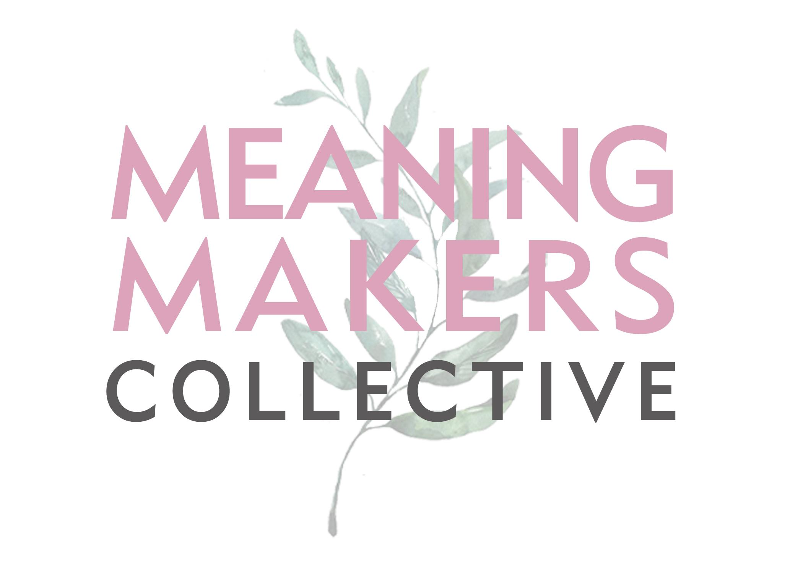
The world is not given, it is made, and we need all of us.
www.MeaningMakersCollective.com
Notes:
Michelle

Slide 36
MEANING MAKING.
Pause.
How do you understand your Self in relation to the big thing that happened? Is happening?
How do you understand the people you are in relationship with?
What matters, now?

Slide 37
So… wait…what does this all mean for us? For our school crisis renewal leadership?

Slide 38
School mental health crisis renewal leadership:
Leads for learning, reflection, and storytelling: who are we because of this event? Who have we become through this experience? How have we emerged?
Connects the personal to the professional and the professional to the personal
Creates space for the survivors to make meaning of their experiences. How do we grow through a big thing to lessen the traumatic impact on ourselves, school stakeholders, and communities?
Revisits the protocols, policies, and practices related to readiness, response, and recovery based on the learnings from the aftermath
Is attuned to the needs of members who were involved in the event or experience, whether still a part of the community or not (e.g., alumna)
Focuses on transformation, opportunity, and discussion (Ulmer et al., 2007)
Foundationally comprised of meaning-making and reflection, both at the personal (self) and collective levels

Slide 39
School Mental Health Crisis Renewal Leadership Reflection Questions:
What does it look like to hold and create culture and climate after an event (or ongoing experiences)?
How might school and mental health leadership engage in renewal (vs. rebuild)?
How might bridging your personal and professional stories support your leadership?
What might you need to protect?
What supports may you need in navigating where the lines blur, and where the lines bold?
What does “healing” mean to you?

Slide 40
“…We tend to fail to see that when we ask human beings to show up without their full self, without their full, catastrophic self, with all of the messes that they are, with all of the discomfort, when we deny that we hold certain belief systems from our childhood, that we created those belief systems to survive the challenges of our childhood — what we are cutting ourselves off from is the very source of much of our creativity, much of our innovation…
…And the result is that our organizations are actually less productive, less imaginative; not just poor workplaces for individuals to be, but poor places for collaboration and creativity and spontaneity and laughter and humor, because we have cut off, if you will, limbs. We have cut off part of ourselves in a bid to live into that credence that you leave the personal at the door, and you don’t actually bring it into the workplace.”
–Jerry Colonna
Notes:
We want the good stuff to come in, but the bad stuff to stay out.

Slide 41
Taking Time to Reflect
3:
Takeaways, ideas, quotes, pieces that you want everyone to know
2:
Wonderings, questions, curiosities
1:
Ah ha, appreciation for yourself, connection to what you are feeling and doing

Slide 42
CLOSING & Looking ahead Ways to further learning with us How to get involved How to access TA

Slide 43
Request technical assistance! Share resources! Suggest a topic for future trainings!
https://schoolcrisishealing.org/get-involved/

Slide 44
Our National SERVICES
Provides training and technical assistance (TTA) services and resources to state and local education agencies (SEAs/LEAs); district teams; school leaders; school mental health providers, support staff, and educators; community partners; and other school mental health stakeholders
Creates curricula, training opportunities, and best-practice resources to promote long-term recovery and renewal after school crisis
Offers intensive consultations to a small number of districts and schools who have experienced crisis readiness and response support, and are ready for and interested in making meaning of their experience(s)
Cultivates effective and sustainable school leadership so that school communities build the skills, knowledge, and attributes necessary to recover and renew after a crisis
Is educator and student centered and directed
Discussion Hours
Research Publications
Tools
Webinars
Individual Coaching
Newsletters
Regional Trainings
Annual Conference
Individual Consultation

Slide 45
What can you get from collaborating with us?
Connect
Connect with fellow school crisis recovery and renewal leaders: strengthen connections with peers across the country with shared or like experiences
Resource
Resource one another to develop leadership skills
Craft
Craft recovery and renewal policies and practices
Access
Access school crisis thought leaders, experts, and researchers from across the country
Gain
Gain supportive, solution-focused coaching to help navigate crisis challenges
Explore
Explore foundational and canonic content related to school crisis recovery & renewal
Engage in
Engage in workshops, webinars, seminars, coaching sessions, crisis leadership labs, resources, and so much more to help you plant and grow
Share
Share learning opportunities, resources, conferences, and more
Engage in
Engage in Communities of Practice, Networks of Practice, and rich learning.

Slide 46
Contact Info
Email: SCRR@cars-rp.org
Phone: (888) 597.0995
Website: www.schoolcrisishealing.org
Get social with us!
Facebook: @scrr.project
Instagram: @scrr_project
Twitter: @scrr_project

Slide 47
References
Bottomley, J. S., Burke, L. A. & Neimeyer, R. A. (2015). Domains of social support that predict bereavement distress following homicide loss: Assessing need and satisfaction. Omega, DOI: 10.1177/0030222815612282.
Calhoun, L. G., & Tedeschi, R. G. (1998). Beyond recovery from trauma: Implications for clinical practice and research. Journal of Social Issues, 54, 357-371.
Calhoun, L. G., & Tedeschi, R. G. (2004). The foundations of posttraumatic growth: New considerations. Psychological Inquiry, 15(1), 93-102.
Calhoun, L. G. , & Tedeschi, R. G. (Eds.) (2006). The handbook of posttraumatic growth: Research and practice. Mahwah, NJ: Lawrence Erlbaum Associates Publishers. https://ptgi.uncc.edu/publications/
https://elemental.medium.com/post-traumatic-growth-might-be-the-silver-lining-of-trauma-heres-how-to-harness-it-2b097a5d2ba7
Kilmer, R. P., & Gil-Rivas, V. (2010). Exploring posttraumatic growth in children impacted by Hurricane Katrina: correlates of the phenomenon and developmental considerations. Child development, 81(4), 1211–1227. https://doi.org/10.1111/j.1467-8624.2010.01463.x
Neimeyer, R. A., Burke, L. A. & Lawson, K. (2013). Community-based participatory research in bereavement: Bridging research and practice in the wake of traumatic loss. Grief Matters: The Australian Journal of Grief and Bereavement, Autumn, 8-14.
Osofsky J, Osofsky HJ, Kronenberg M, Cross T. The aftermath of Hurricane Katrina: Mental health considerations and lessons learned. In: Kilmer RP, Gil-Rivas V, Tedeschi RG, Calhoun LG, editors. Helping families and communities recover from disaster: Lessons learned from Hurricane Katrina and its aftermath. Washington, D.C.: American Psychological Association; (in press).
Pinderhughes H, Davis R, Williams M. (2015). Adverse Community Experiences and Resilience: A Framework for Addressing and Preventing Community-Level Trauma. Prevention Institute, Oakland CA.
Rozalski, V., Holland, J. M. & Neimeyer, R. A. (2016). Circumstances of death and complicated grief: Indirect associations through meaning made of loss. Journal of Loss and Trauma, DOI: 10.1080/15325024.2016.1161426.
St. Andrews, Alicia (2013). Trauma & Resilience: An Adolescent Provider Toolkit. San Francisco, CA: Adolescent Health Working Group, San Francisco
Ungar, M. (2011). Community resilience for youth and families: Facilitative physical and social capital in contexts of adversity. Children and Youth Services Review, 33(9), 1742–1748.
Wozniak, J. D., Caudle, H. E., Harding, K., Vieselmeyer, J., & Mezulis, A. H. (2020). The effect of trauma proximity and ruminative response styles on posttraumatic stress and posttraumatic growth following a university shooting. Psychological Trauma: Theory, Research, Practice, and Policy, 12(3), 227-234. https://doi.org/10.1037/tra0000505
“Healing Justice Is How We Can Sustain Black Lives” (Hemphill, 2017) https://www.huffpost.com/entry/healing-justice_b_5899e8ade4b0c1284f282ffe

Slide 48
Resources
Adolescent Health Working Group Provider Toolkit-Trauma & Resilience (St. Andrews, 2013): https://ahwg.org/download/trauma-and-resilience-2013/
After Parkland, How Grief Can Become Posttraumatic Growth for Student Activists https://abcnews.go.com/Health/parkland-grief-posttraumatic-growth-student-activists/story?id=53329388
You’ve Heard of Post-Traumatic Stress, but What About Post-Traumatic Growth? https://blogs.scientificamerican.com/observations/youve-heard-of-post-traumatic-stress-but-what-about-post-traumatic-growth
Post-Traumatic Growth After a School Shooting (2020) https://www.psychologytoday.com/us/blog/hope-resilience/202006/post-traumatic-growth-after-school-shooting
https://healgrief.org/lets-talk-death/robert-neimeyer/?gclid=CjwKCAiA3abwBRBqEiwAKwICA4qaW4sorGoAX-rlhrvJxQegMvQT8gucCIKherwu0n9PkFXaNn7oNxoCXj0QAvD_BwE; www.robertneimeyerphd.com
http://www.drpaulwong.com/transformation-grief-meaning/
https://medium.com/@ginwright/the-future-of-healing-shifting-from-trauma-informed-care-to-healing-centered-engagement-634f557ce69c
https://flourishagenda.com/healing-centered-engagement/

Slide 49
THANK YOU FOR ATTENDING!
We need to hear from you to keep bringing you these no cost resources!
Please take a few minutes to give us your feedback! We use it to plan our future events—and we are required to include it in our reports for our funder.
The feedback form will appear on your screen when the webinar ends and is also included in the follow-up email sent immediately following the webinar.

Slide 50
Thank you.
SAMHSA’s mission is to reduce the impact of substance abuse and mental illness on America’s communities.
www.samhsa.gov
1-877-SAMHSA-7 (1-877-726-4727) ● 1-800-487-4889 (TDD)

Slide 51
APPENDIX

Slide 52
What might trauma informed school crisis sound like? Look like? Feel like?
Safety
Ensure physical and emotional safety, recognizing and responding to how racial, ethnic, religious or sexual identity may impact safety.
Trustworthiness
Foster genuine relationships and practices that build trust, making tasks clear, maintaining appropriate boundaries and creating norms for interaction that promote reconciliation and healing. Understand and respond to ways in which explicit and implicit power can affect the development of trusting relationships.
Choice
Maximize choice, addressing how privilege, power, and historic relationships impact both perceptions about and ability to act upon choice.

Slide 53
What might trauma informed school crisis sound like? Look like? Feel like?
Collaboration
Honor transparency and self determination and seek to minimize the impact of the inherent power differential while maximizing collaboration and sharing responsibility for making meaningful decisions.
Empowerment
Encouraging self-efficacy, identifying strengths, and building skills which lead to individual pathways for healing while recognizing and responding to the impact of historical trauma and oppression.
Equity
A state of being in which an individual’s outcomes are no longer predictable by race or other demographic factor. The process of giving individuals what they need, not just what's "equal".

