Slide 1
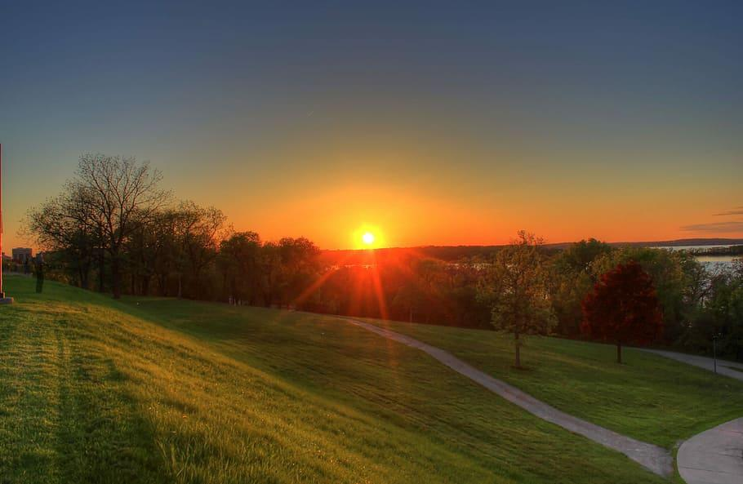
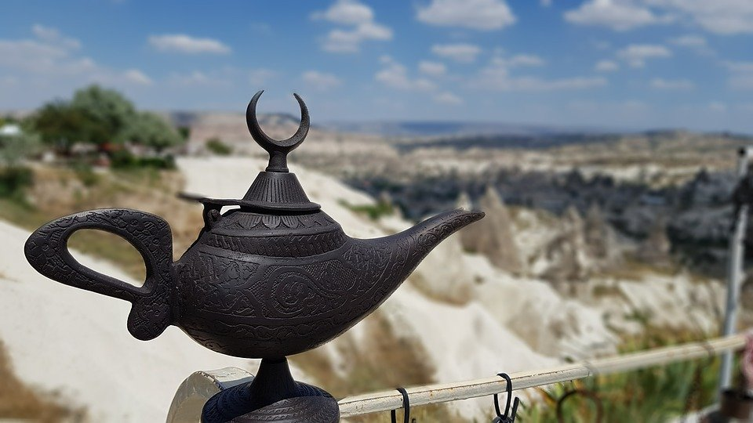
by Becky Foellmer @Foes4Sports from a share by Dr. David G. Thoele, M.D.
Dr. Thoele writes that his research showed the 3MMM decreases stress for parents, kids and health practitioners. He further states: “I have used the 3MMM with thousands of people, and many who didn’t think they could write have started a reflective writing practice.”
Note: this can be used multiple times to create a journal of sorts, by duplicating the blank slide. Add to Google Classroom as “make a copy for each student”.
Today's Date
3 Minute Mental Makeover
3MMM
3 Things For Which You Are Grateful
The Story of My Life in Six Words
3 Wishes
Pretend you rub a magic lamp. List your wishes.
Be specific: ex: My dog when she wags her tail.

Slide 2
Today's Date
3 Minute Mental Makeover
3MMM
3 Things For Which You Are Grateful
The Story of My Life in Six Words
3 Wishes
Pretend you rub a magic lamp. List your wishes.
Be specific: ex: My dog when she wags her tail.

