Slide 1
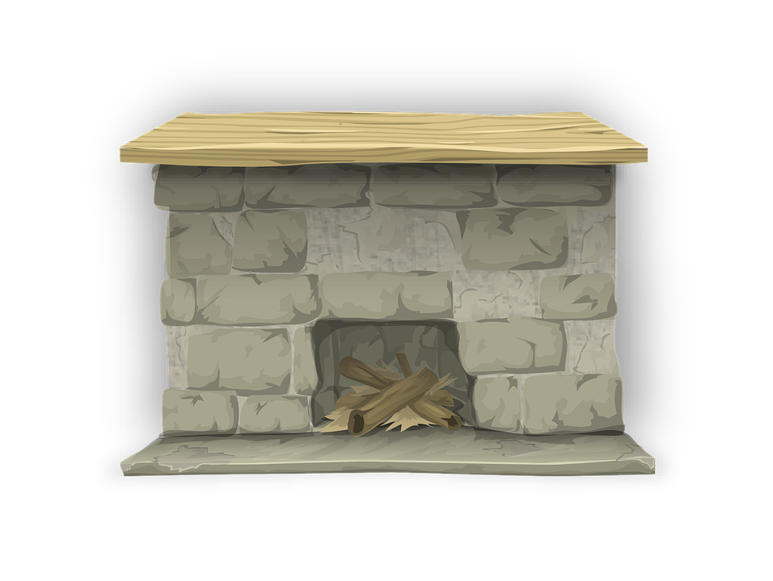
22 Seconds Challenges
02/22/2022
1 | 2 | 3 | 4 | 5
6 | 7 | 8 | 9 | 10
11 | 12 | 13 | 14 | 15
16 | 17 | 18 | 19 | 20
21 | 22
Notes:
Original Creator was Zeeba Pavri. Here is a link to the original ELA version slideshow that I edited into a PE version:
https://docs.google.com/presentation/d/17_PjxiD_MFMLU0YOifOTjhcpbzQKjne0M4HYTwZS82Q/edit?usp=copy

Slide 2
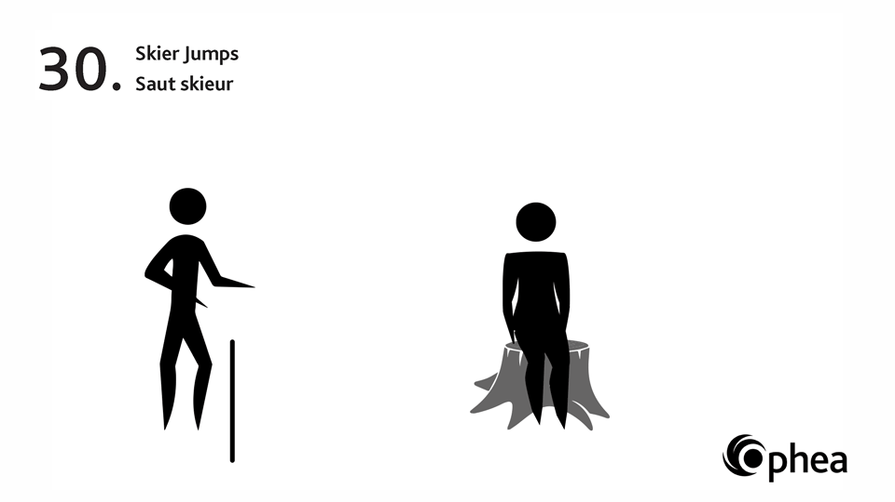
How many skier jumps can you do in
22 seconds?

Slide 3
Can you low row for
22 seconds?

Slide 4
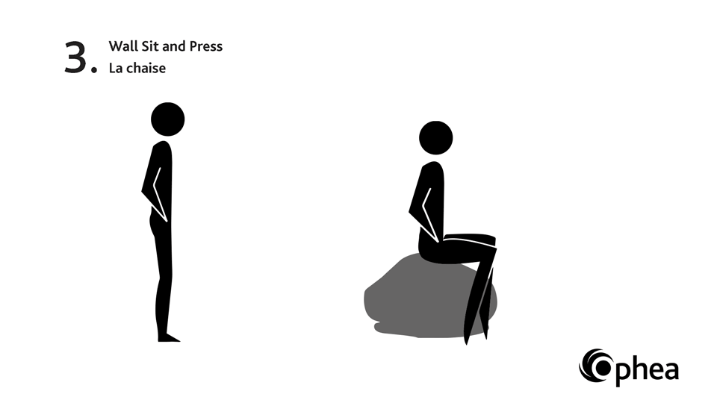
Can you do a wall sit for 22 seconds?

Slide 5
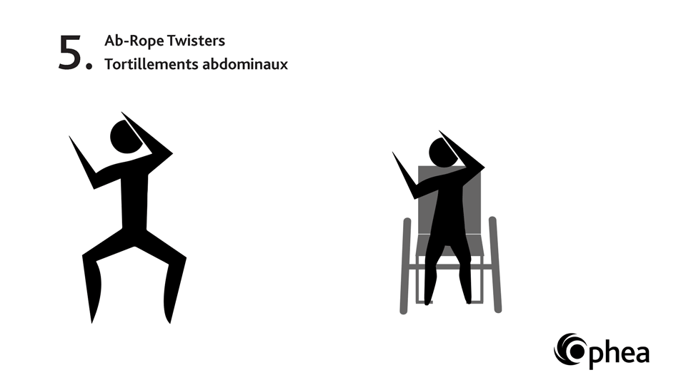
How many ab rope twisters can you do in
22 seconds?

Slide 6
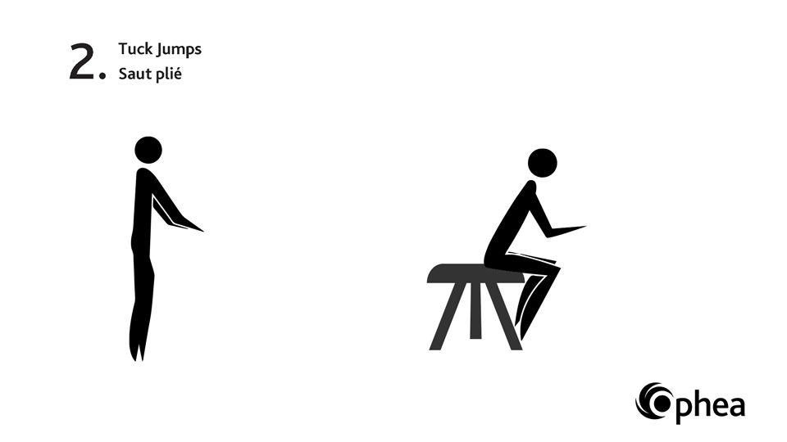
How many tuck jumps can you do in 22 seconds?

Slide 7
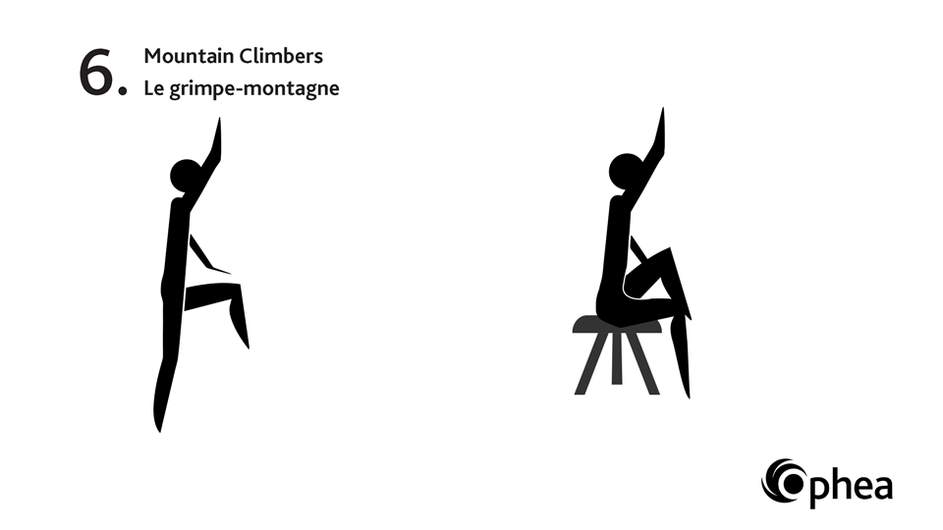
How many mountain climbers can you do in
22 seconds?

Slide 8
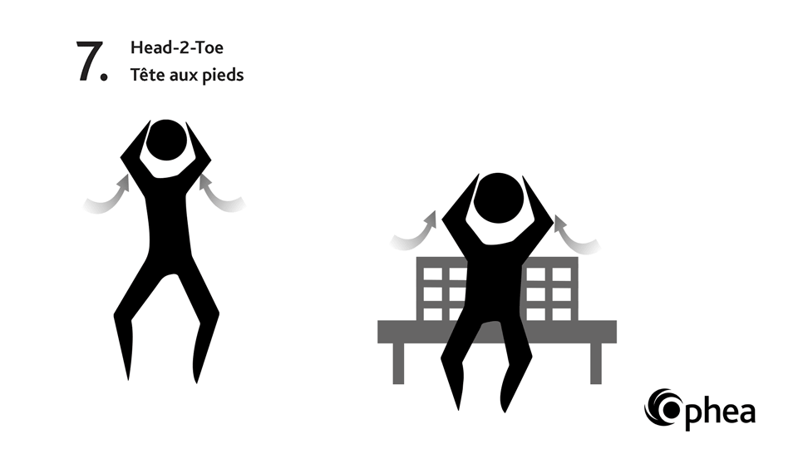
How many times can you do head-2-toe in
22 seconds?

Slide 9
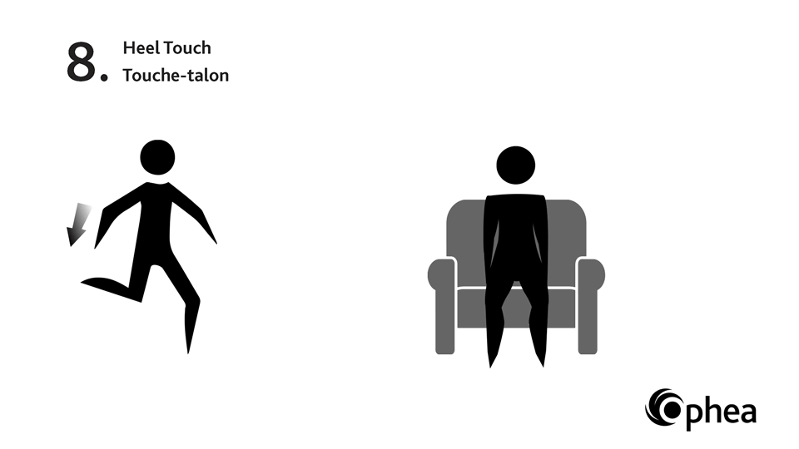
How many heel touches can you do in
22 seconds?

Slide 10
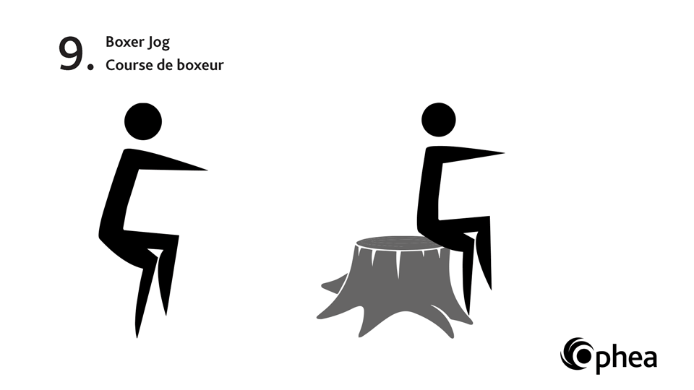
Can you boxer jog in place for
22 seconds?

Slide 11
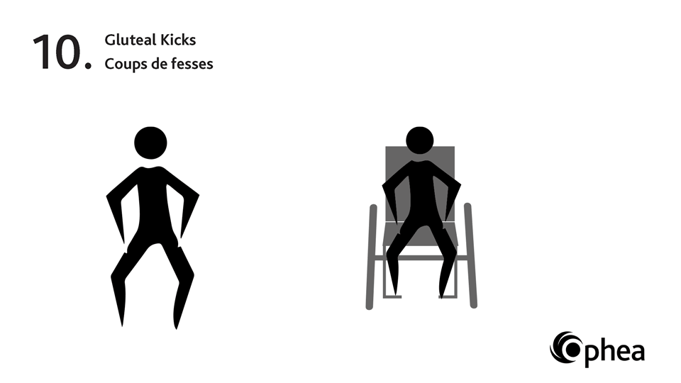
How many gluteal kicks can you do in
22 seconds?

Slide 12
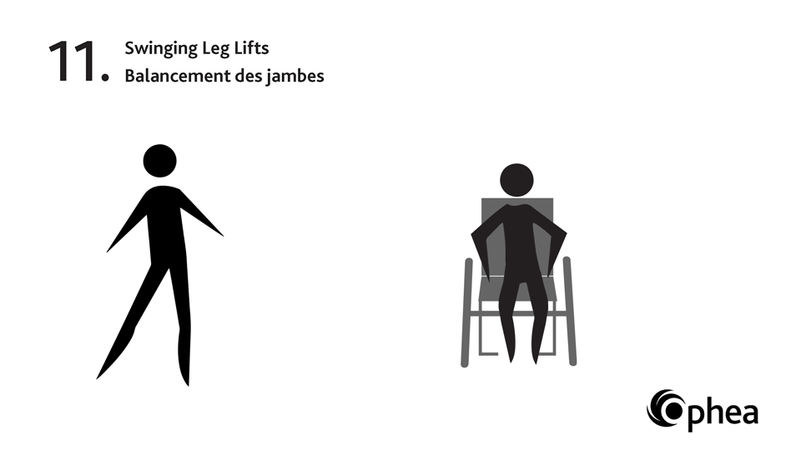
How many swinging leg lifts can you do in
22 seconds?

Slide 13
How many raise the roofs can you do in 22 seconds?

Slide 14
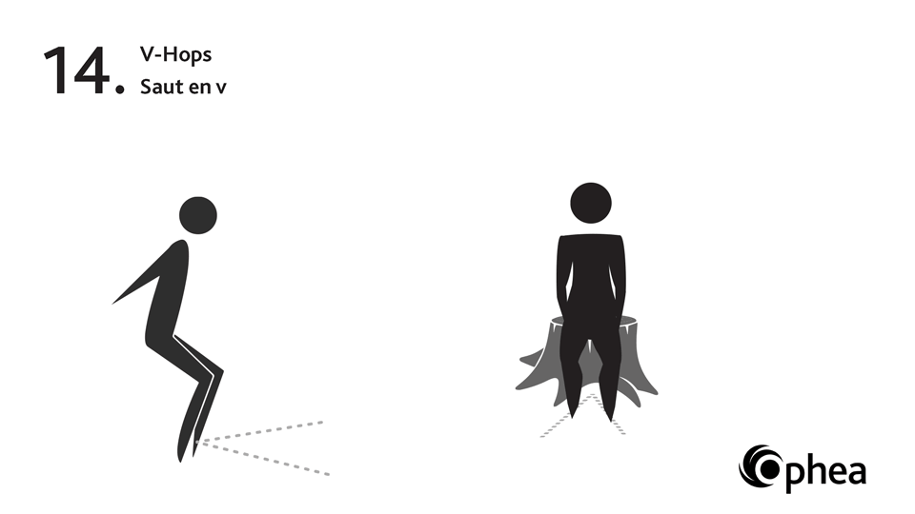
How many V-hops can you do in
22 seconds?

Slide 15
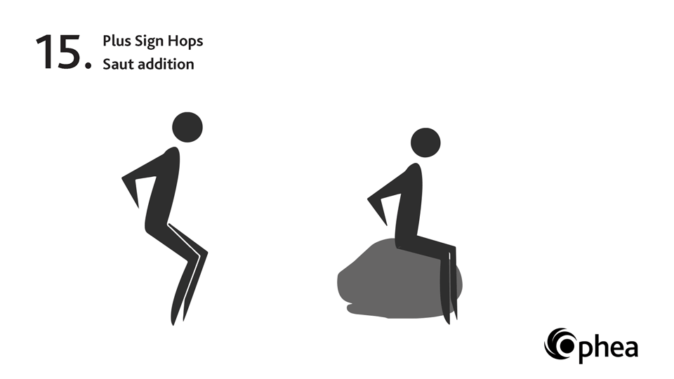
How many plus sign hops can you do in
22 seconds?

Slide 16
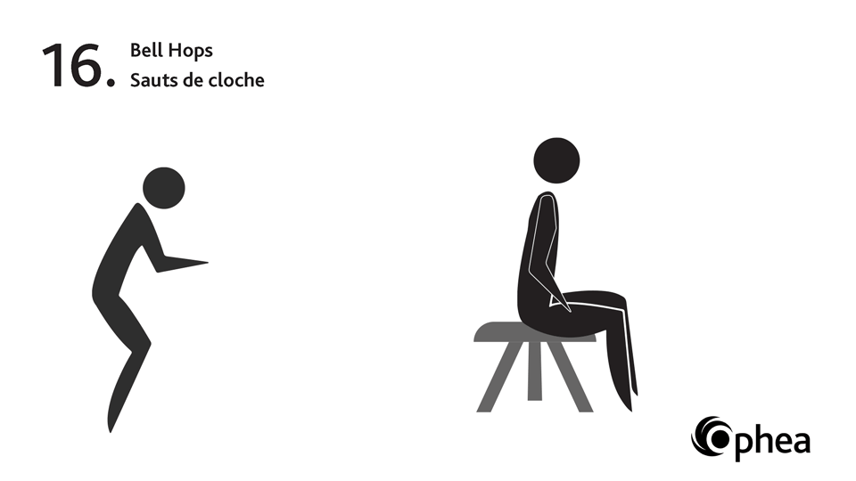
How many bell-hops can you do in 22 seconds?

Slide 17
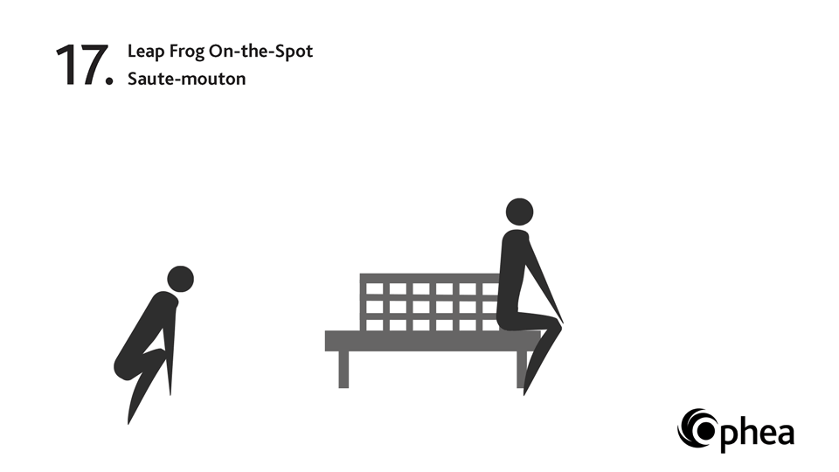
How many leap frogs can you do in 22 seconds?

Slide 18
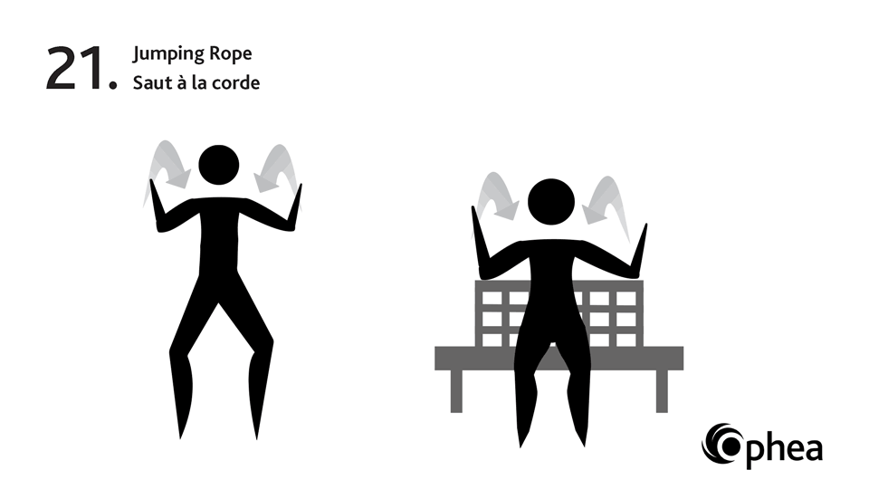
How many times can you jump rope in
22 seconds?

Slide 19
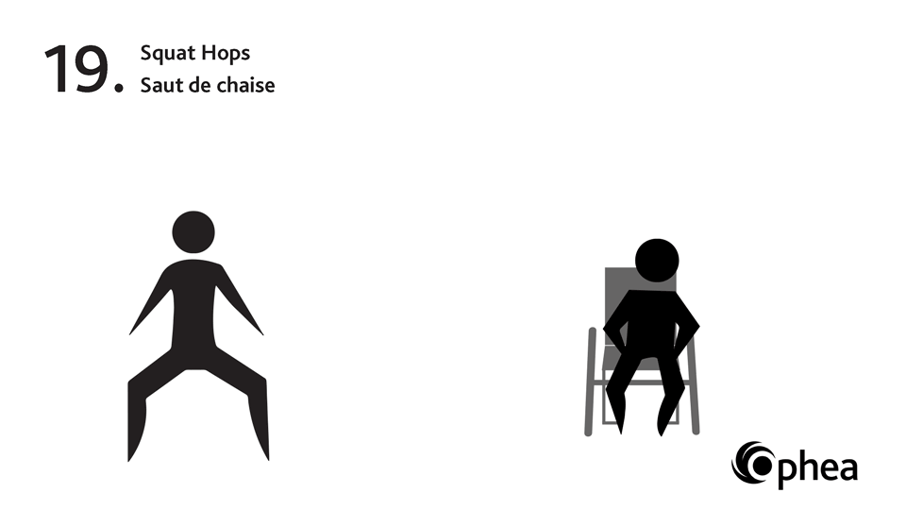
How many squat hops can you do in 22 seconds!

Slide 20
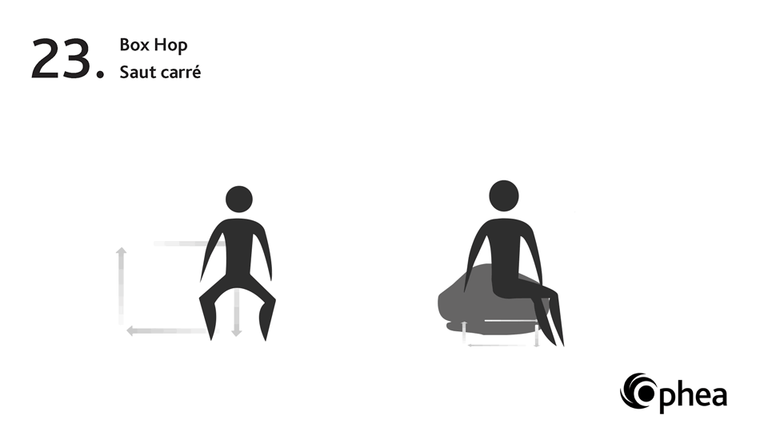
How many box hops can you do in 22 seconds?

Slide 21
How many X Jumps can you do in 22 seconds?

Slide 22
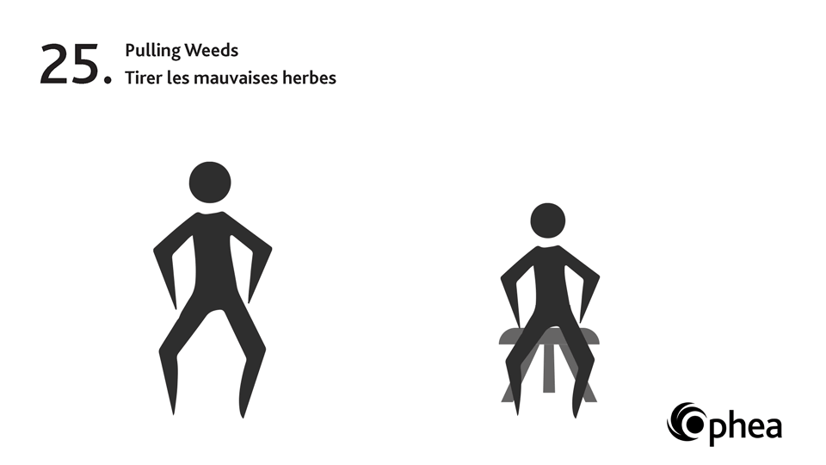
How many pulling weeds can you do in 22 seconds?

Slide 23
How many flutter kicks can you do in 22 seconds?

