Slide 1
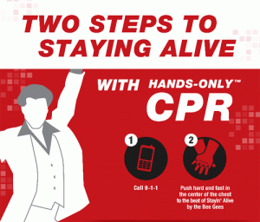
CPR EXPOURE FOR SENIORS
Cassandra R. Turner, PhD, HPELW Advisor
Mrs. Kelley Greene, HPELW Instructional Advisor

Slide 3
Tennessee Law and CPR Instruction
Tennessee lawmakers made great strides in 2002, when they passed legislation authorizing CPR instruction, techniques and skills in junior high and high schools.
This information was voluntarily taught during the wellness/health classes.

Slide 4
Unfortunately – not all students got the hands-only-practice during this instructional time.
The American Heart Association felt that this effort would be solidified by making Hands-Only CPR training a requirement
for students to graduate from Tennessee schools.

Slide 5
During the 2012 Tennessee General Assembly, the American Heart Association worked to pass , Senate Bill 1680/House Bill 1519, which was introduced by Senator Jim Tracy (R –Shelbyville) and Representative Mike Turner (D- Old Hickory).
This Bill added the “Hands-Only” training component to CPR instruction already being taught to Tennessee high school students.

Slide 6
The goal of this legislation is to educate a new generation of Tennesseans about how to properly administer CPR.
This law does not require full certification, but cognitive and psychomotor “Hands-Only” practice.

Slide 7
As of Spring 2014, “Hands Only” CPR/AED is offered through the Lifetime Wellness classes in only 15 High Schools Many students did not receive training for various reasons
Addressing the New Law

Slide 8
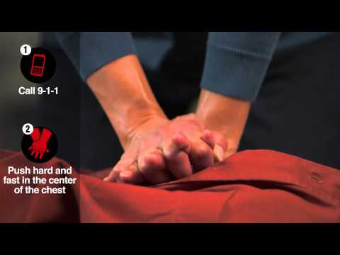
Ensure that all high school seniors are exposed to the following CPR elements.
Defibrillator(AED)Training
Hands-Only CPR Training

Slide 9
Where are we now and what do we need to do to ensure that high school seniors are trained prior to graduation?

Slide 10
Additional District Departments Affected
Special Education Home Bound
Regular Home Bound
Virtual School

Slide 11
2017-2018 Combine Department Training Efforts
JROTC
Will require that CPR training is included across their curriculum
CTE
Provides student CPR/AED training in two courses
(Health Education & Culinary Arts)
HPELW
All Lifetime Wellness classes
Coordinated School Health
School Nurses

Slide 12
Collaborative Partners Training Efforts
(Fire Department EMT) Bolton & Germantown only
American Heart Association donated 18 training kits to high schools Lifetime Wellness classes and train HPELW teachers
Heart Beat CPR train seniors, First Responder Students, Virtual School, HPELW teachers and some Lifetime Wellness students and Alternative Schools
University of Tennessee MERI Grant-Homebound, Virtual School, Lifetime Wellness classes

Slide 13
22016 Number of Students Trained in 2016-2017
Seniors 7,284 | Lifetime Wellness 8,607 | Total 15,891

Slide 14
Schools touched in 2014-2015 (Lifetime Wellness Classes only)
Bolton
Cordova
Hillcrest
Melrose
East
White Station
Sheffield
Woodale
Germantown
Manassas
Sheffield
n=7,912
Students touched should be seniors this 2017-2018 school year.

Slide 15
Lifetime Wellness students missing that will be seniors in 2017-2018
Kingsbury
Westwood
Mitchell
Whitehaven
Hamilton
Carver Success Academy
Northeast Prep
Hamilton
Booker T. Washington
Craigmont
Douglass
Special Ed Homebound
Regular Homebound
Virtual School
Overton
Central
Kirby
White Station
Oakhaven
Trezevant
Raleigh Egypt
Southwind

Slide 16
Keep in mind that not ALL students take Lifetime Wellness!!!!!!! How will those students receive “Hands Only” CPR/AED training?

Slide 17
What additional avenues can be used for “Hands Only” CPR/AED training?
CTE-Health Education
CTE-Culinary Arts
JROTC
Coordinated School Health
Outside Partners
SCS Nurses

Slide 18
What about Homebound students?
Can return to home school (after scheduled return date)to receive training
Can receive a Medical waiver if physically unable to perform task

Slide 19
Why is documentation important? To ensure that students received training!
Transferring students
Expelled students
Newly enrolled students to the district
Online students
Homebound students
Adhering to Superintendent’s Hobson request
Meeting State Compliance

Slide 20
Suggested Training Timeline
Seniors-Twice a year check
(September & March)
CTE-Classes
(According to curriculum)
Collaborative Partners-October & January
Lifetime Wellness
(February)
JROTC
(According to curriculum)

Slide 21
Who’s training students
Lifetime Wellness teachers
CTE instructors
JROTC instructors
SCS Coordinated School Health Team
SCS Nurses
Collaborative Partners
EMT
University of Tennessee Health Science-MERI
Heart Beat CPR

Slide 22
How do we document student training?
Power School
Click on the Family Life tab
Go to the Comment section
Input-CPR/AED training date

Slide 23
Next Steps
Meet with Directors
Inform ILDs
Inform principals
Provide summer Hands Only CPR?AED training for teachers and students
Review with teachers the CPR training materials during DLDs
Site visit with both principals and Physical Education teachers
Continue to provide training to those schools without CPR kits
Review documentation process

Slide 24
How can you help? Group Recommendations
Career & Technology
Make “Hands Only CPR/AED a mandatory safety class element
Load the student completion information
into eTiger
Have senior groups at CTE centers
Purchase CPR kits for Health Science feeder middle schools
SMS-Options placed on transcript
Data base that is file Pro-Maker
Homebound documents on their application
Senior checkout
Equipment lost or stolen must be replaced and purchased

