Slide 1
Teacher note: additional info here.
From Robert Kaplinsky
Notes:
Engage - Have students discuss what 2000 calories looks like.

Slide 2
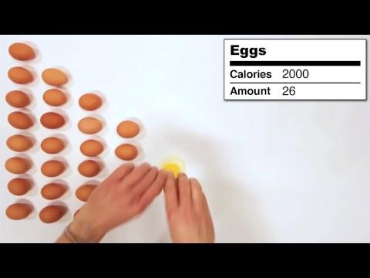
Step 1: Watch the video and see how many of each food are in 2000 calories.
If you can’t access the embedded video click here: https://youtu.be/rgaqwFPU7cc
Notes:
Explore

Slide 3
Step 2: Choose your favorite food in the video and construct an equation that will calculate the number of calories in 1 of your food choice.
Once you have an equation and the solution, submit your answer in Google Classroom. (See the example.) Once you submit your answer, you will be able to see your classmate’s responses.
Notes:
Explain

Slide 4
Notes:
http://robertkaplinsky.com/work/what-does-2000-calories-look-like/

Slide 5
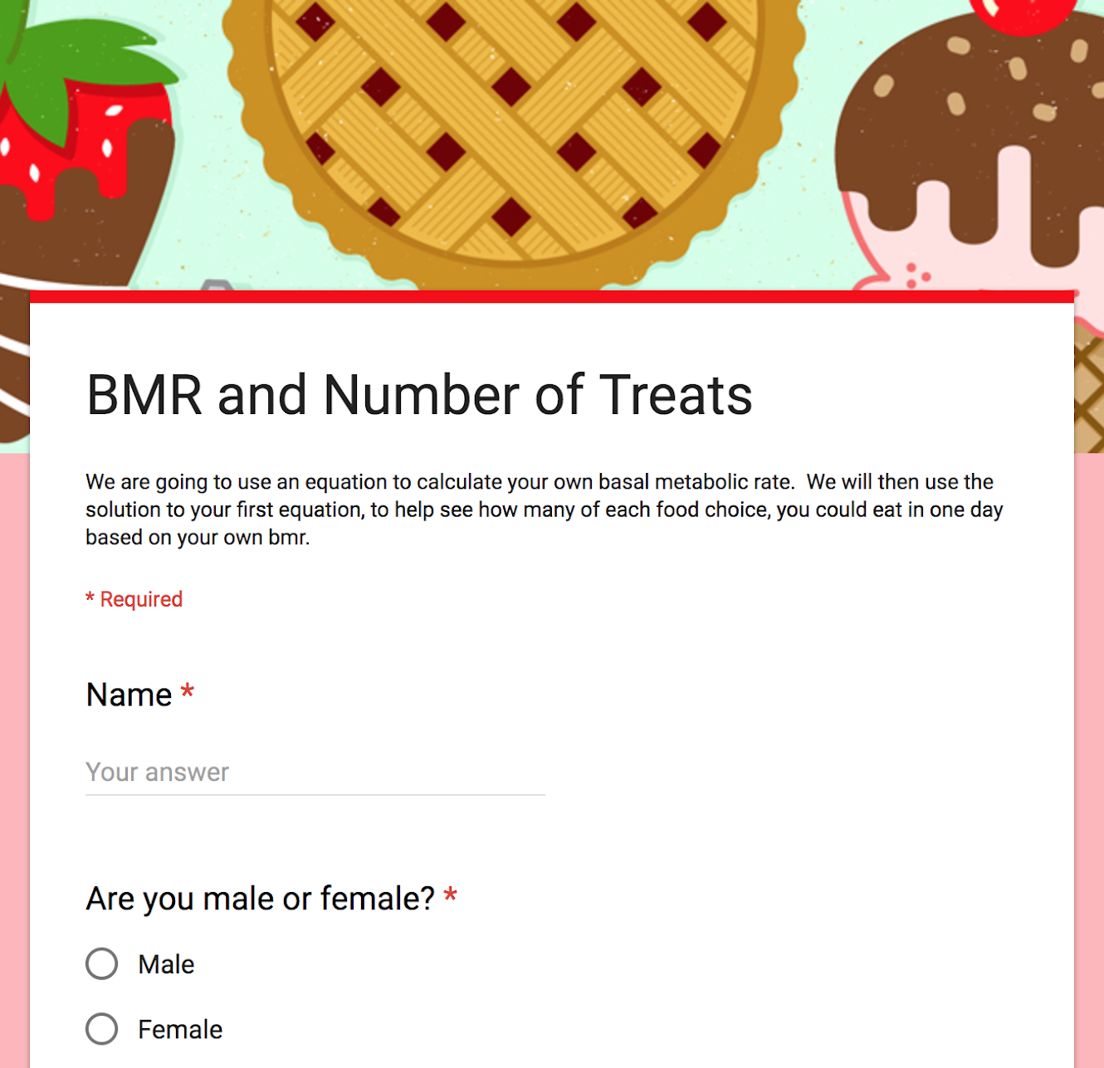
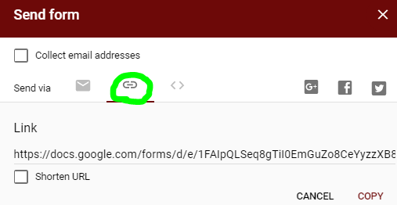
The Challenge
How many ____________could you eat if you only
wanted to eat exactly _______________calories?
Step 3: Calculate your BMR then construct an equation to determine how many of your food you can eat based on your personal BMR. Click on the picture to open the form.
Note to teachers:
Click here to make a copy of the above form. Then go to “send” and the link icon
to get the link to add to the picture above.
Notes:
Apply/Reflect

Slide 6
Extension - Time to Exercise!
Research how many calories are burned doing your favorite activity, exercise, or sport.
If you were to eat 10 of your food choice, how many minutes would it take you to burn off the calories from your food?
Demonstrating your findings with the method of your choice.
It can be a blog post, Google Slides post, video, etc. Choose what you think will be best for you!
Notes:
Extend

