Slide 1
Pandemic Vaccination Campaign Schools, Vaccines, and a Magic 8-Ball
CHS Institute | March 3, 2021

Slide 2
VPD and Immunizations Program
Vaccines For Children Program
Entitlement program providing vaccines to under/uninsured children <19yo
625 partners vaccinate ~800K TN children
Annual budget $119M
Manages 2M vaccine doses/year
Tennessee Immunization Information System (TennIIS)
Statewide immunization registry
>8.2M patients, >78M vaccinations
Vaccine-Preventable Diseases Program
Investigates and mitigates vaccine-preventable disease outbreaks
Pandemic preparedness
Pandemic Vaccine Allocation and Distribution
COVID-19 vaccine for ~6.8M Tennesseans

Slide 3
State of the World
https://coronavirus.jhu.edu/map.html

Slide 4
SARS-CoV-2 v Influenza
1918 H1N1 Avian Flu (“Spanish Flu”)
50M global deaths
670,000 US deaths
1957-1958 H2N2 Avian Flu (“Asian Flu”)
1.1M global deaths
116,000 US deaths
1968 H3N2 Avian Flu
1M global deaths
100,000 US deaths
2009 H1N1 Swine Flu
~500,000 global deaths
12,469 US deaths
SARS-CoV-2 COVID-19
2,487,497 global deaths (13 months)
502,681 US deaths (13 months)
https://coronavirus.jhu.edu/

Slide 5
Flu?
https://www.cdc.gov/flu/weekly/index.htm

Slide 6
State of the Country
https://coronavirus.jhu.edu/map.html

Slide 7
State of the State of COVID-19
https://tn.gov/health

Slide 8
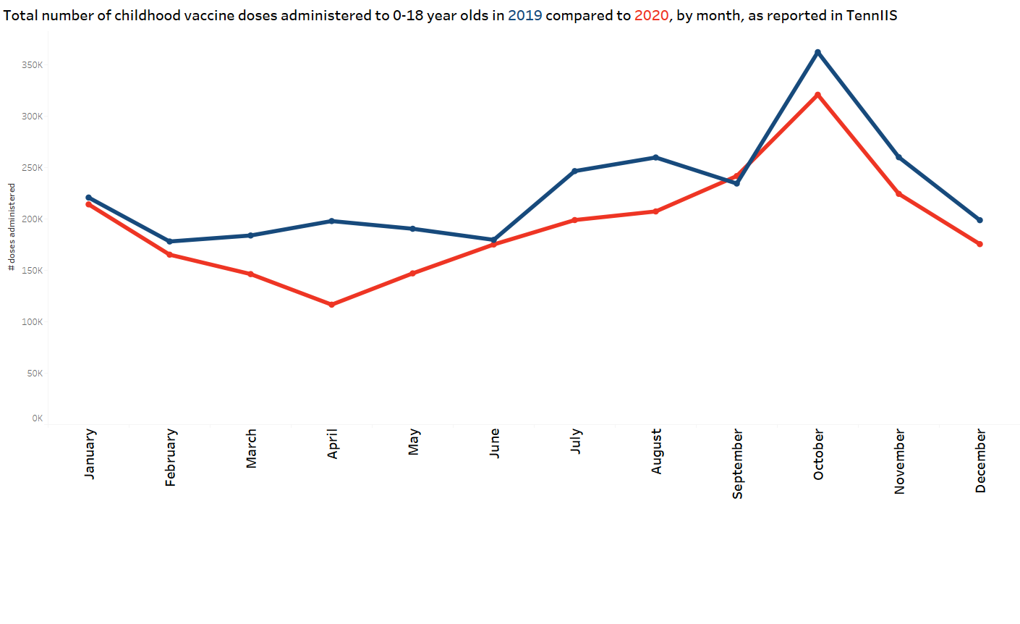
Childhood Vaccinations 2019 v 2020
Month | % change (2020 vs. 2019)
January | -3%
February | -7%
March | -20%
April | -41%
May | -23%
June | -3%
July | -19%
August | -20%
September | 3%
October | -11%
November | -14%
December | -12%

Slide 9
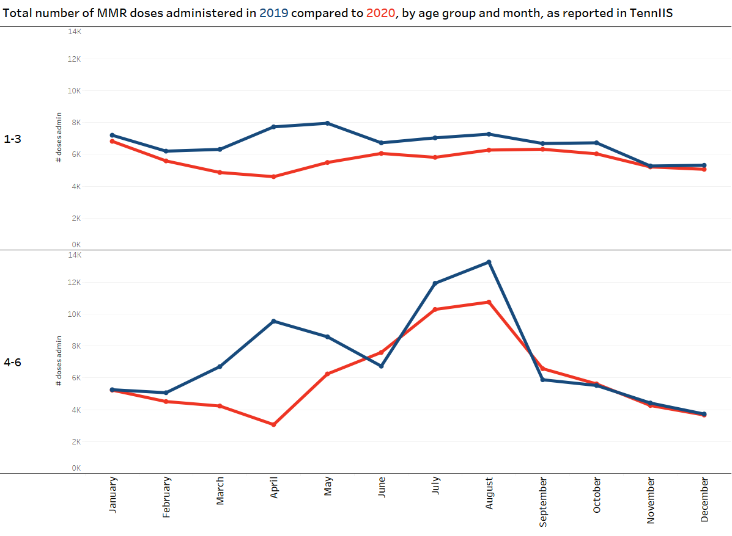
MMR Vaccinations 2019 v 2020
Month | % change (2020 vs. 2019)
 | 1-3 YO | 4-6 YO
January | -5% | 0%
February | -10% | -11%
March | -23% | -37%
April | -40% | -68%
May | -31% | -27%
June | -10% | 13%
July | -17% | -14%
August | -14% | -19%
September | -5% | 12%
October | -10% | 2%
November | -1% | -4%
December | -5% | -2%

Slide 10
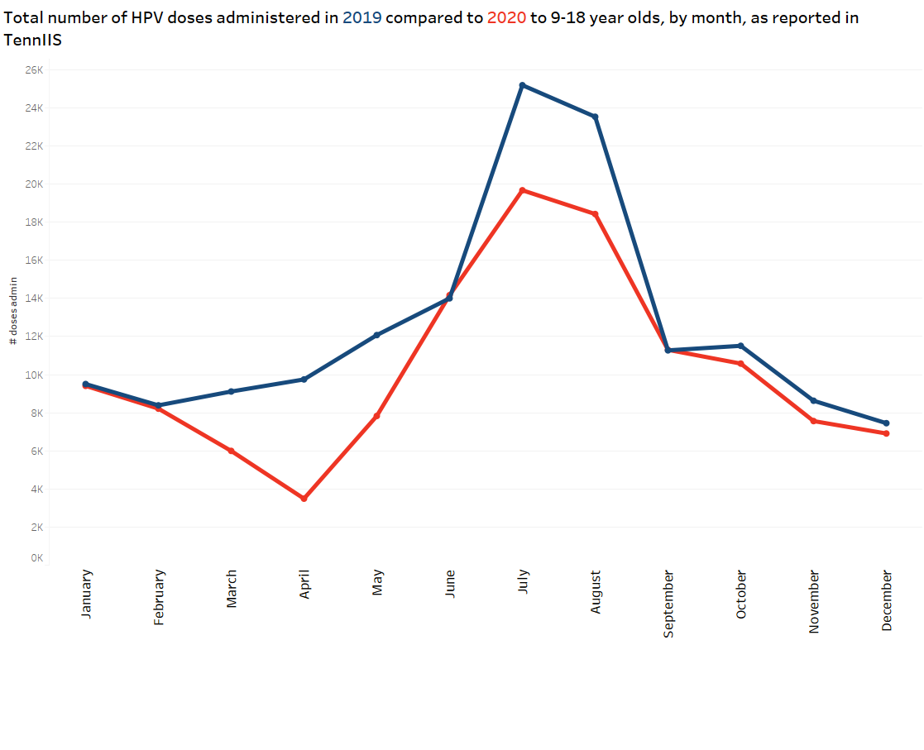
HPV Vaccinations 2019-2020
Month | % change (2020 vs. 2019)
January | -1%
February | -2%
March | -34%
April | -64%
May | -35%
June | 1%
July | -22%
August | -22%
September | 0%
October | -8%
November | -12%
December | -7%

Slide 11
Children and COVID-19
Children and COVID-19: State-Level Data Report (aap.org)

Slide 12
Children and COVID-19: State-Level Data Report (aap.org)

Slide 13
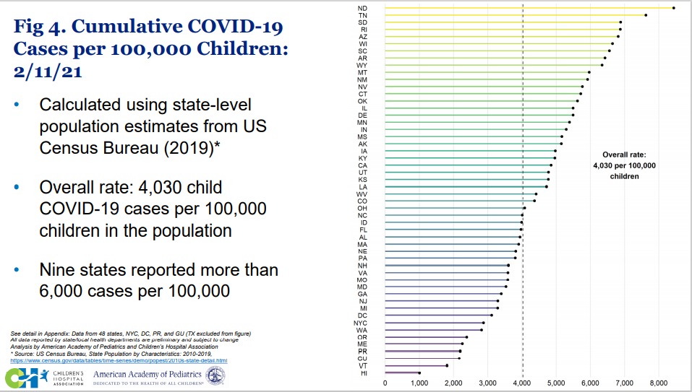
Children and COVID-19: State-Level Data Report (aap.org)

Slide 14
Children and COVID-19
Multi-System Inflammatory Syndrome in Children (MIS-C)
Onset after recent SARS-CoV-2 infection
Typically school-aged but has been reported <1yr-20yrs
Fever, marked inflammation
Cardiac, renal, respiratory, GI, dermatologic, neurologic and/or hematologic involvement
Most require ICU for ventilatory support, dialysis
Many have permanent heart damage
Health Department-Reported Cases of Multisystem Inflammatory Syndrome in Children (MIS-C) in the United States ​ | CDC

Slide 15
MIS-C
Health Department-Reported Cases of Multisystem Inflammatory Syndrome in Children (MIS-C) in the United States ​ | CDC

Slide 16
As Soon As They Can…
“The AAP recommends that anyone 16 years of age and older who meets criteria in phased implementation groups, as recommended by the ACIP, receive the COVID-19 vaccine.”
Interim Guidance for COVID-19 Vaccination in Children and Adolescents (aap.org)

Slide 17
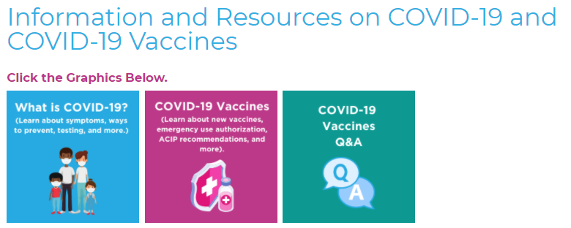
Resources for Families

Slide 18
It’s Not ALL Doom and Gloom

Slide 19
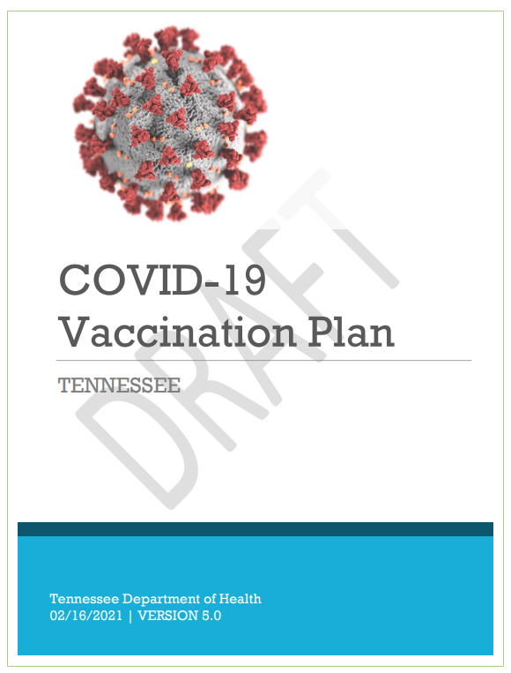
COVID-19 Vaccine Update Brief
www.tn.gov/health
Click here

Slide 20
Vaccine Allocation Phases (Revised)
Equity is a crosscutting consideration:
In each population group, vaccine access should be prioritized for geographic areas
identified through CDC’s Social Vulnerability Index or another more specific index.
Age-Based Criteria:
Risk-Based Phases:
75+
70+
65+
25+
16+
55+
45+
35+
1c
2a/b
3
1a1
1a2
1b
Inpatient and other high-exposure HCW
Residents and staff of LTCF
>18 yr old unable to live independently
Medically fragile individuals ages 16-17 yrs
First Responders
All other HCW
Funeral/
Mortuary
Language and sign-language interpreters working in healthcare
CMS workers in health care with direct patient exposure
K-12 and childcare staff
First responder operations personnel
Persons with high-risk comorbidities
Caregivers of children with high-risk comorbidities
Critical infrastructure
(see definition)
Congregate
living
Grocery workers
Corrections residents
Staff of overnight camps
Dec.
Jan.
Feb.
------------------To Be Determined ---------------------------------
Refer to age-based criteria for all other industries and general population.
December 2020
January 2021
February 2021
March/April
Q2/Q3
Q3/Q4
Revised February 16, 2021. Estimated timeline and phases are preliminary and subject to change.

Slide 21
Vaccine Allocations and Roll-Out
 | December | January | February | March…
Total Doses Received | 247,375 | 606,925⁺ | Est. 718,940⁺ | TBD
Positioning | Hospitals Health Depts *Federal LTCF Program | Health Depts Hospitals Indy LTCF Pharmacies *Federal LTCF Program Indy Pharmacies Safety Net Clinics | Health Depts Hospitals Wal-Mart (federal and state programs) Safety Net Clinics Indy Pharmacies Schools (teachers) | Health Departments Hospitals Federal Pharmacy Program TBR sites Safety Net Clinics Indy Pharmacies Employee Health Clinics Physician’s offices
⁺ Includes first and second doses
*Federal LTCF partnership allocations are taken off the top of the state allocation

Slide 22
Vaccine Data Updates
1,604,870 doses delivered
1,165,626 doses administered*
48% given to ages >70yo
63% given to ages >60yo
10.9% of Tennesseans with at least one dose
768,780 people vaccinated
394,405 fully immunized
*as reported to the Tennessee Immunization Information System (TennIIS)

Slide 23
Coronavirus Vaccine Tracker
https://www.nytimes.com/interactive/2020/science/coronavirus-vaccine-tracker.html

Slide 24
Vaccine Safety

Slide 25
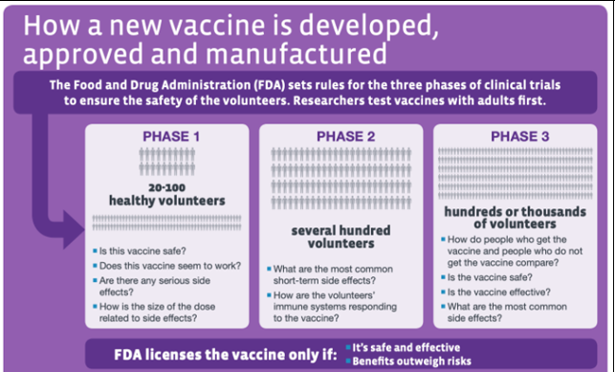
Vaccine Safety
Phase 1-3 Clinical Trials & Manufacturing
FDA Emergency Use Authorization (EUA)
ACIP Recommendations
Continuous Monitoring
Surveillance

Slide 26
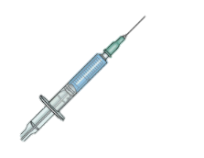
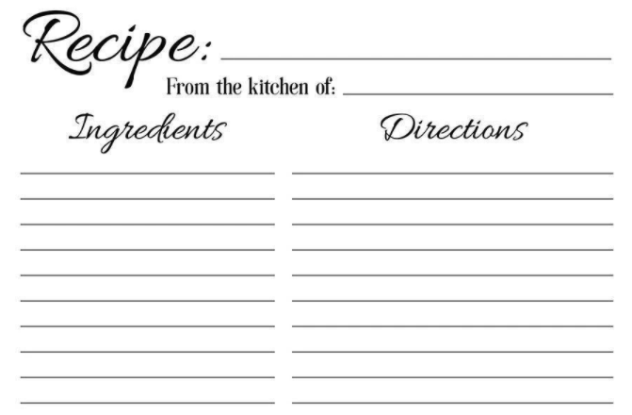
Pfizer/Moderna mRNA Vaccine
mRNA vaccines:
Work by giving the body a recipe to make the “spike protein”
Body makes antibodies to the protein
If the body ever sees the virus it will see that protein and know to destroy it
COVID-19 Spike Protein
Science
mRNA
Make spike protein

Slide 27
After Vaccination
Common side effects are soreness and redness at the injection site, headache, fatigue, muscle aches, fever, chills
May be worse after the second dose
Typically resolve after 24-48 hours
Vaccination does not alter PCR or antigen test results
Vaccine recipients do not need to quarantine for 90 days once fully vaccinated for two weeks
Continue to maintain physical distancing, wear masks, limit gatherings, and test and isolate if symptomatic

Slide 28
Disparities in COVID-19 Vaccination

Slide 29
Equity in Allocations

Slide 30
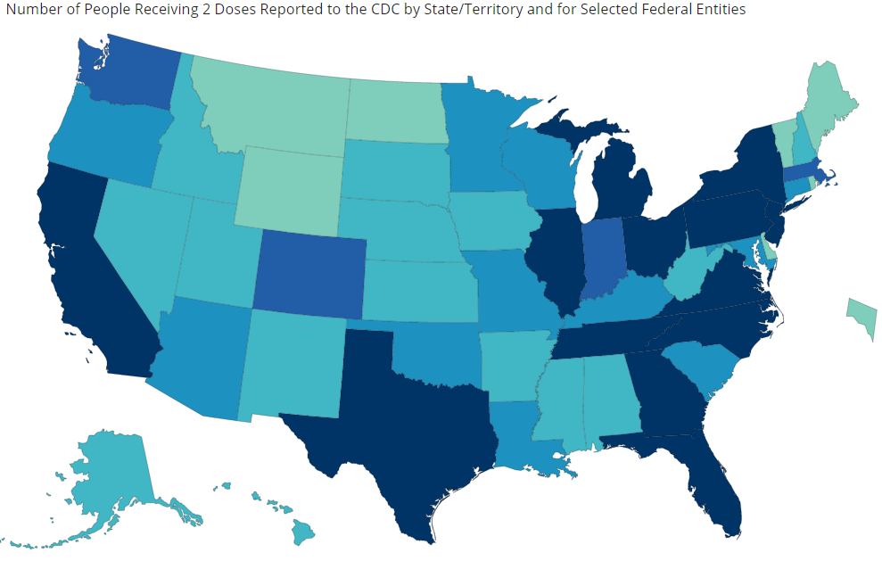
Following Progress: https://covid19.tn.gov
https://covid.cdc.gov/covid-data-tracker/#vaccinations

Slide 31
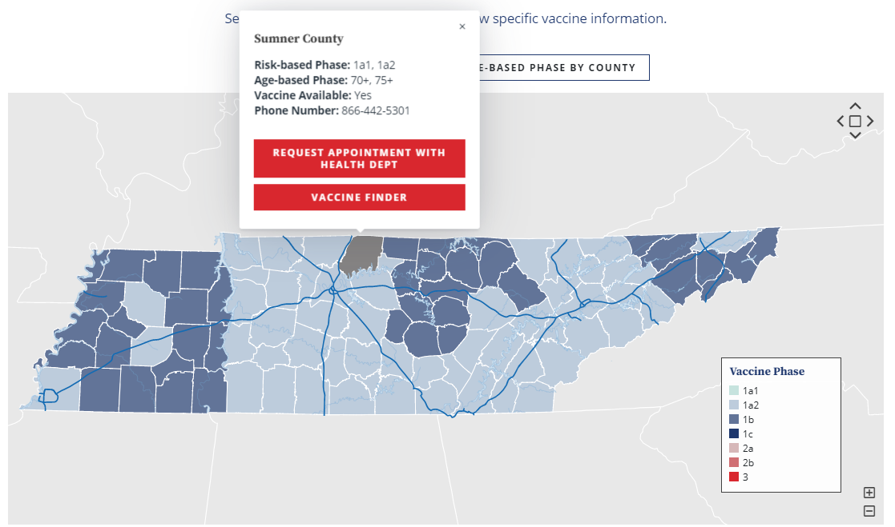
County Vaccine Availability:

Slide 32
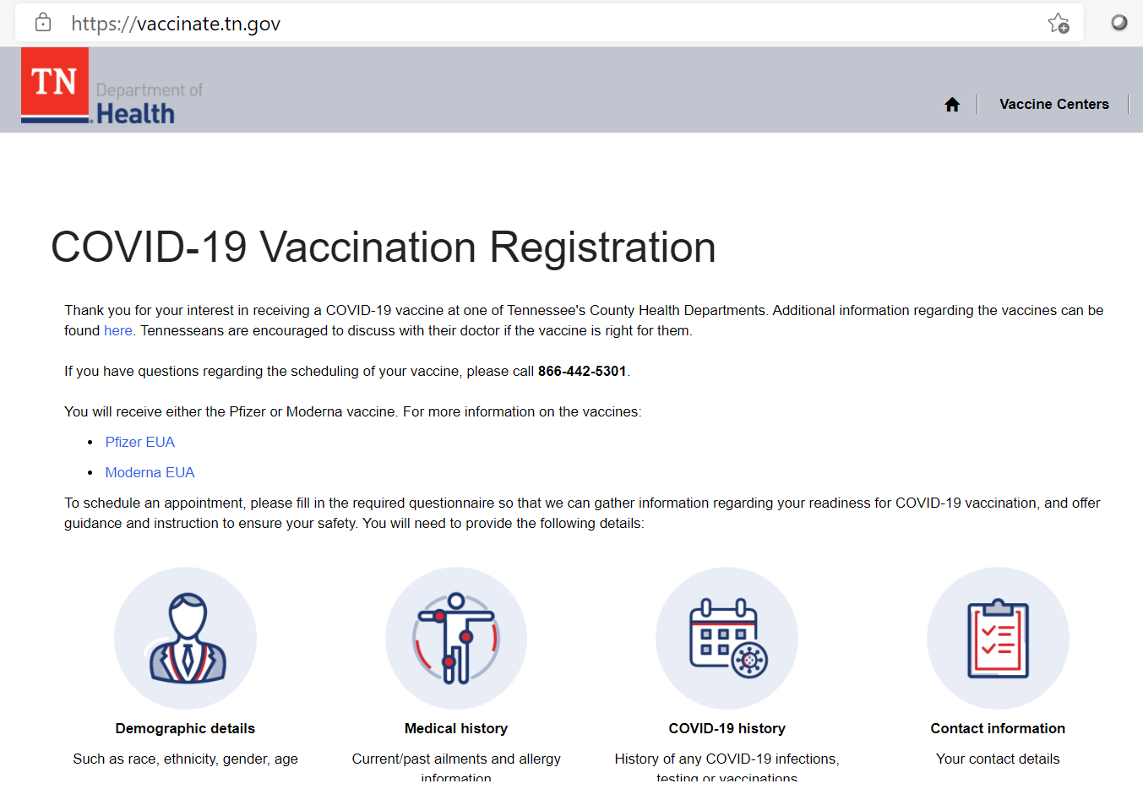
Getting Vaccinated vaccinate.tn.gov

Slide 33
FAQs
Where is it?
All 95 health departments
Some hospitals
Nearly all Wal-Mart pharmacies
11 Kroger pharmacies
Most local pharmacies
FQHCs and Community Health Centers in certain neighborhoods based on SES as supply allows
Coming soon to Food City pharmacies and other national chains
When can I get it?
https://covid19.tn.gov or https://vaccinate.tn.gov

Slide 34
Stay Safe While We Wait!

Slide 35
Thank you! 877-857-2945

