Slide 1
#WeDontPuff
Kaci R. Foster, MPH
Tobacco Prevention Coordinator
Shelby County Health Department

Slide 2
Topics
We will learn about
#WeDontPuff
Tobacco, vaping, secondhand and third-hand smoke
Saying “NO” to tobacco use

Slide 3
What is #WeDontPuff?
#WeDontPuff is a declaration that we will never use tobacco or nicotine products. It is a declaration that we will not inhale secondhand smoke from tobacco and nicotine products, that we will never use dip or chew, and that we are not going to use tobacco papers or products to smoke other substances. #WeDontPuff is a declaration that we will serve as positive role models for others in the community through our words and our behavior.
Notes:
Youth-inspired anti-tobacco campaign
Positive role models in the community
A tobacco-free generation

Slide 4
Why #WeDontPuff
1300
1600
Notes:
Each day, more than 1300 people in the U.S. die due to smoking – for each of these deaths, at least two youth/young adults become a regular smoker
The younger you are when you start smoking/using tobacco, the quicker and more likely you are to become addicted

Slide 5
Why #WeDontPuff
In 2019, 27.9% of Tennessee high school youth reported currently using any tobacco product, including e-cigarettes, cigars and smokeless tobacco
Notes:
125000 – number of kids who are currently under the age of 18 and alive in Tennessee who will ultimately die prematurely from smoking

Slide 6
Why #WeDontPuff
Life expectancy for smokers is at least 10 years shorter than life expectancy for non-smokers
Smoking kills more people than alcohol, AIDS, car crashes, illegal drugs, murders and suicides COMBINED¹
Notes:
125000 – number of kids who are currently under the age of 18 and alive in Tennessee who will ultimately die prematurely from smoking

Slide 7
What is Tobacco?
Plant
Contains nicotine, a highly addictive substance
Tobacco companies add over 7000 harmful chemicals
Notes:
more addictive, more attractive to kids and teens, and even more deadly
1492 – tobacco introduced to America by Christopher Columbus
1612 – first tobacco crop in Virginia
1901 – 3.5 billion cigarettes and 6 billion cigars are sold in America
1966 – warning labels are mandated on cigarettes
1987 – Aspen, CO becomes first city in U.S. to ban smoking in restaurants
2007 – TN passed a statewide smoking law that prohibits smoking in public places, unless otherwise exempt
2010 – 38 states are either smoke-free or have some type of tobacco ban

Slide 8
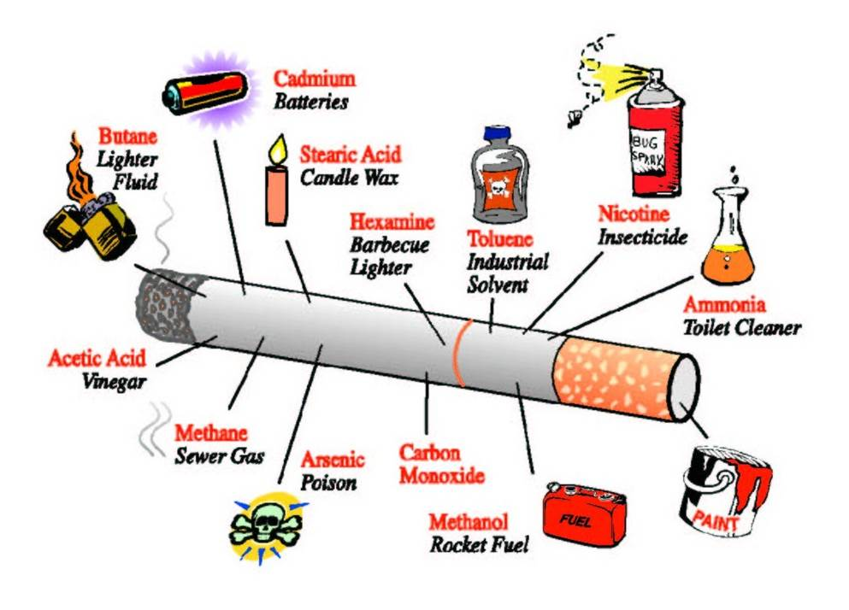
Harmful Chemicals in Tobacco Products
Nail Polish Remover (Acetone)
Toilet Cleaner (Ammonia)
Rat Poison (Arsenic)
Lighter Fluid (Butane)
Battery Acid (Cadmium)
Sewer Gas (Methane)
Rocket Fuel (Methanol)
Carbon Monoxide
Nicotine

Slide 9
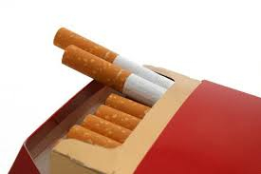
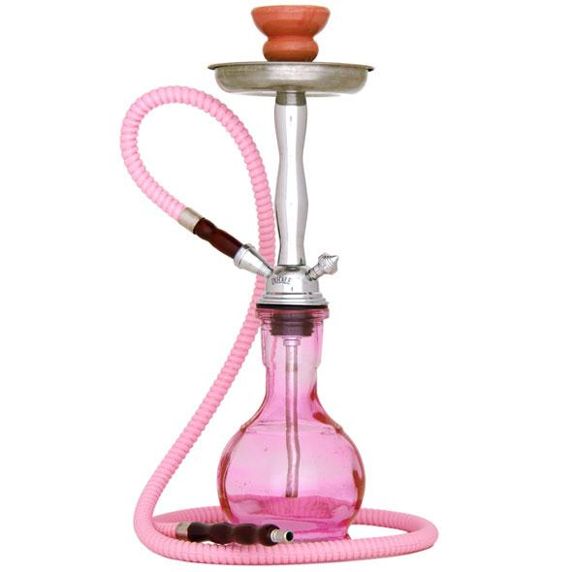
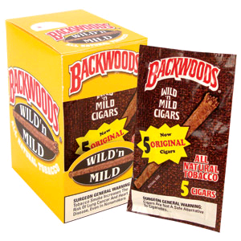
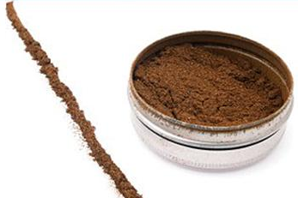
Tobacco & Nicotine Products
Traditional
New Generation
Notes:
Cigarettes
Pipes
Cigars (Papers) - Contain toxic smoke
Are cheaper than cigarettes
Have a higher risk of developing cancer
Flavored cigars are popular with youth
Promoted as a symbol of status, wealth and class
Cigarillos
Chewing Tobacco
Snuff

Slide 10
New Generation

Slide 11
Hookah
Notes:
Hookah smoke associated with increased risk of oral, lung and bladder cancer plus clogged arteries and heart disease
Smoking on a shared mouthpiece can spread herpes
1 hour of smoking hookah = smoking 100 cigarettes
Glowing charcoals increase risk of cancer due to toxic agents like carbon monoxide, heavy metals and other cancer-causing chemicals

Slide 12
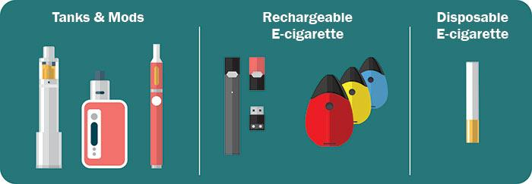
Vaping
E-cigarettes
Hookah Pens
Mods
Vape Pens
Tanks
JUUL

Slide 13
ENDS
High school students who had never smoked but reported ever using e-cigarettes are more likely to start using combustible tobacco after one year compared with high school students who never used e-cigarettes.

Slide 14
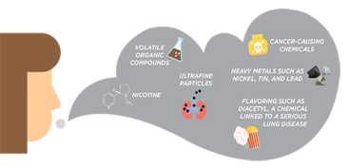
Vaping
No tobacco smoke
Aerosol (vapor)
Mistaken for water vapor
Fine particles contain toxic chemicals
Notes:
E-cigarettes are just as addictive as traditional cigarettes
One vape pen/JUUL cartridge contains about the same amount of nicotine as a pack of cigarettes.
Extra-strength cartridges or increasing the e-cigarette’s voltage will supply a higher concentration of nicotine
Greater chance of using traditional tobacco products later in life
Explosions and burns have been reported with e-cigarettes while recharging the devices, due to defective batteries.
Accidental exposure to liquid from e-cigarettes has caused acute nicotine poisoning in children and adults.
Ingredients:
Nicotine, flavorings, propylene glycol (lab-made liquid used to make artificial smoke), glycerin (sweetener)

Slide 15
Vaping & COVID-19
Notes:
https://med.stanford.edu/news/all-news/2020/08/vaping-linked-to-covid-19-risk-in-teens-and-young-adults.html
https://healthier.stanfordchildrens.org/en/vaping-covid-19/

Slide 16
Consequences of Tobacco Use
Death
Cancer
Lowered Immunity
Heart Disease
Stroke
Poor Oral Hygiene
Other various illnesses
Notes:
Death – cigarette smoking is the leading cause of preventable death in the U.S.
Cancer – primarily lung cancer, but can occur anywhere in the body
Lowered Immunity
Heart Disease
Stroke
Poor Oral Hygiene
Male/Female Reproductive Diseases
Other various illnesses
http://www.lung.org/stop-smoking/smoking-facts/health-effects.html
American Lung Association
https://www.cdc.gov/tobacco/data_statistics/fact_sheets/health_effects/effects_cig_smoking/index.htm
Center for Disease Control

Slide 17
Consequences of Tobacco Use
Notes:
In 2018, TN was 43rd for tobacco use and 44th in total health status in the U.S.
http://www.lung.org/stop-smoking/smoking-facts/health-effects.html
American Lung Association
https://www.cdc.gov/tobacco/data_statistics/fact_sheets/health_effects/effects_cig_smoking/index.htm
Center for Disease Control

Slide 18
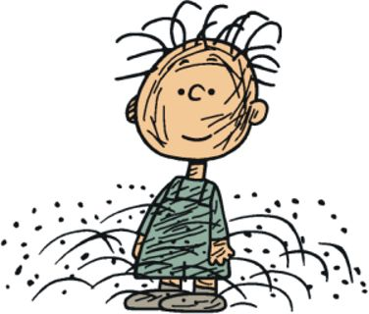
Tobacco Smoke
Secondhand
Third-hand
Notes:
Smoke from the lighted end of cigarette, pipe, cigar or tobacco burning in a hookah. This type of smoke has high concentrations of cancer-causing agents and is very toxic. These smaller particles make their way into the lungs and the body’s cells easily.
Secondhand smoke is also called environmental tobacco smoke.

Slide 19
What is Third-hand Smoke?
Third-hand smoke can be found on/in:
Clothes
Furniture
Curtains
Walls
Bedding
Carpets
Vehicles
Notes:
Third-hand smoke is residual nicotine and other chemicals left on a variety of indoor surfaces by tobacco smoke. This residue is thought to react with common indoor pollutants to create a toxic mix.

Slide 20
Risk Factors
Social/Physical Environment
Biological/Genetic Factors
Mental Health
Personal Views
Advertisement/Media
Accessibility/Availability of Tobacco Products
Notes:
Social/Physical Environment: Youth more likely to use tobacco if their peers use tobacco; more likely to use tobacco if a parent uses tobacco
Biological/Genetic Factors: Teens can feel dependent on nicotine sooner than adults
Mental Health: Strong relationship between youth smoking and depression, anxiety and stress
Personal Views: expecting positive things from smoking, i.e. stress relief or weight loss
Advertisement/Media:
Accessibility & Availability: products are easily accessible to youth and teens (from friends or relatives who are of age, at stores that don’t ID, or illegally)

Slide 21
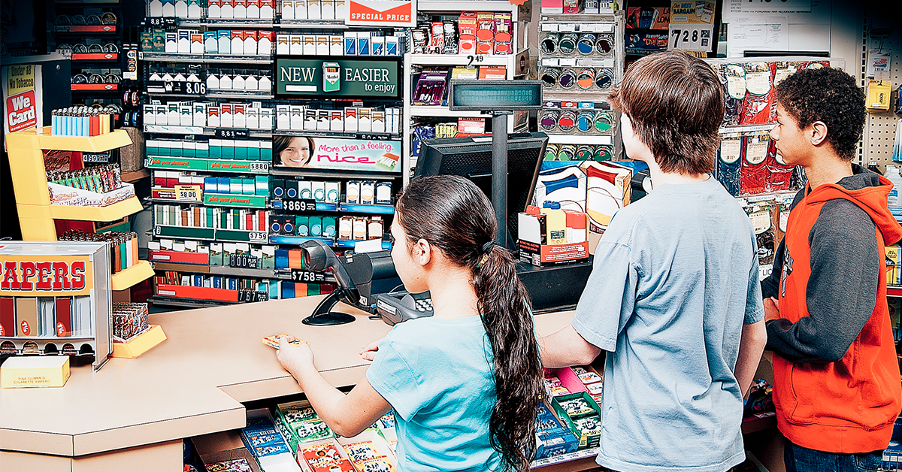
Tobacco Industry Targets Teens
Notes:
Social/Physical Environment: Youth more likely to use tobacco if their peers use tobacco; more likely to use tobacco if a parent uses tobacco
Biological/Genetic Factors: Teens can feel dependent on nicotine sooner than adults
Mental Health: Strong relationship between youth smoking and depression, anxiety and stress
Personal Views: expecting positive things from smoking, i.e. stress relief or weight loss
Advertisement/Media:
Accessibility & Availability: products are easily accessible to youth and teens (from friends or relatives who are of age, at stores that don’t ID, or illegally)
Tobacco product use is started and established primarily during adolescence (10-19)
9 out of 10 cigarette smokers first tried smoking by age 18; 98% by age 26
Flavorings make tobacco products more appealing to youth – 73% of HS & 56% of MS students who used a tobacco product in the last 30 days reported using a flavored tobacco product in that time
Increase in the use of electronic cigarettes/vapes is driving increases in tobacco use among youth – MS & HS students using e-cigarettes increased 1.5 million from 2017 to 2018

Slide 22
Resist Peer Pressure
Simple Rejection – “No”
Cold Shoulder Response – Ignore, Walk Away
Strength in Numbers – Hang out with other non-users
Give an Excuse – “My mom/dad/relative would kill me.”
Reverse the Pressure – “If you were really my friend, you wouldn’t ask me to do something that would harm me.”
Exchange Statement – “No thanks, let’s go [do something else] instead.
Self Statement – “I don’t smoke.”
Notes:
Simple Rejection – “No”
Cold Shoulder Response – Ignore, Walk Away
Strength in Numbers – Hang out with other non-users
Give an Excuse – “My mom/dad/relative would kill me.”
Reverse the Pressure – “Friends don’t ask friends to do things that would harm them.”
Exchange Statement – “No thanks, let’s go [do something else] instead.
Self Statement – “I don’t smoke.”

Slide 23
Why #WeDontPuff
#WeDontPuff because…
Most people choose not to smoke
Our health is important
We don’t think smoking is cool
We know that ENDS are this generation’s cigarettes
We don’t want to waste our money on cigarettes or other tobacco products

Slide 24
Refuse to be a Target. Resist the Pressure. Be the CHANGE!

Slide 25
Questions?

Slide 27
Contact Information
Kaci Foster, MPH
901.222.9528
Kaci.Foster@shelbycountytn.gov
Connect With Us:
www.ShelbyTNHealth.com
Facebook: Facebook.com/ShelbyTNHealth
Twitter: @ShelbyTNHealth

