Slide 1
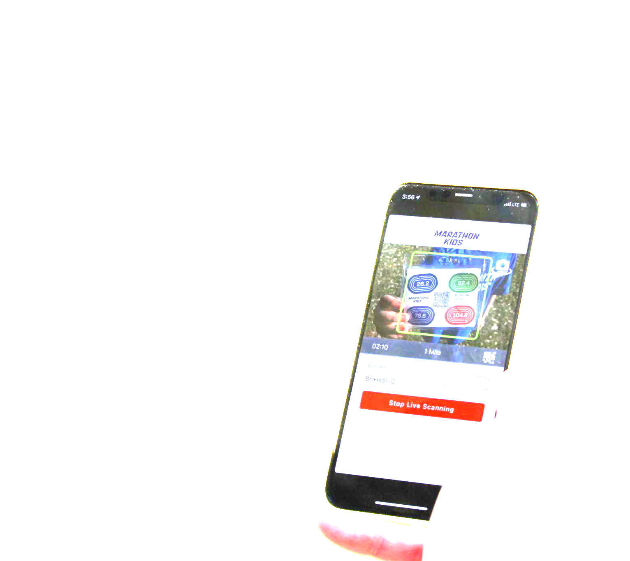
On a mission to get kids moving!
Notes:
Intro self
Marathon Kids is a nonprofit org on a mission to get kids moving throughout the day. They provide physical activity programming that includes a digital platform to tracks all types of physical activity.
What you are going to hear today is free, open to anyone in the US and it’s designed to support Physical Educators and get kids moving!
Anybody heard of Marathon Kids? Done the program before?
Has anyone used Digital platform before? EZ scan or Student lap tracker?
Raise your hand if you teach elementary, middle or high school.

Slide 2
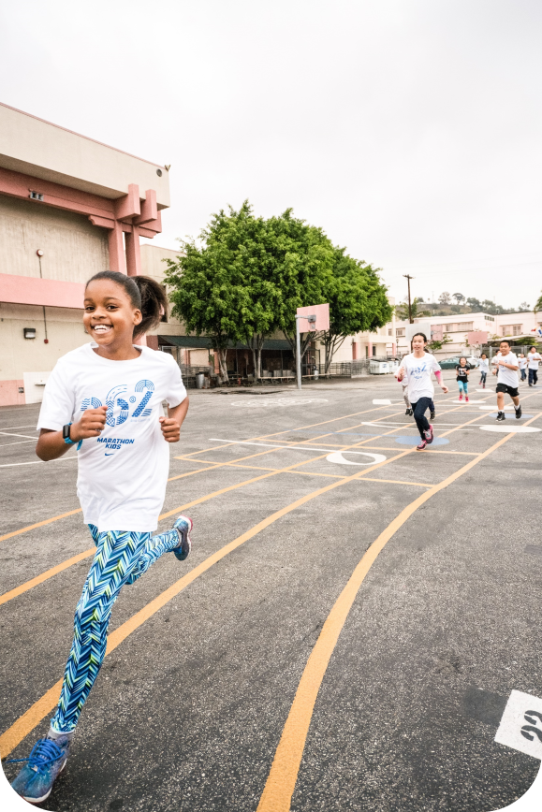
Why Marathon Kids?
Increase daily physical activity
Develop a growth mindset
Support Whole Child, School, & Community
Fun and all-inclusive experience
Notes:
The Marathon Kids program uses running to get kids active. What you will hear today is FREE!!

Slide 3
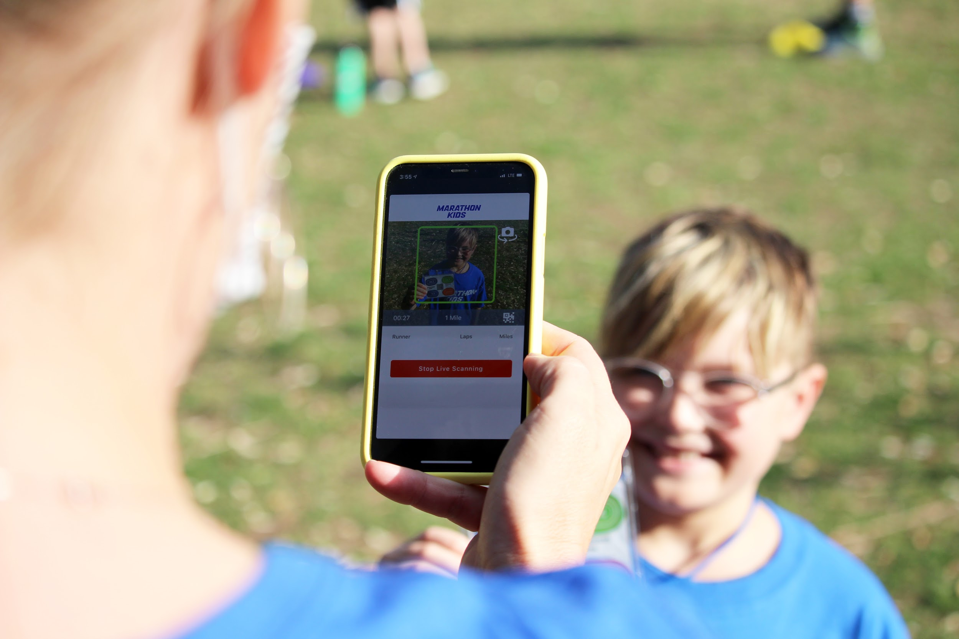
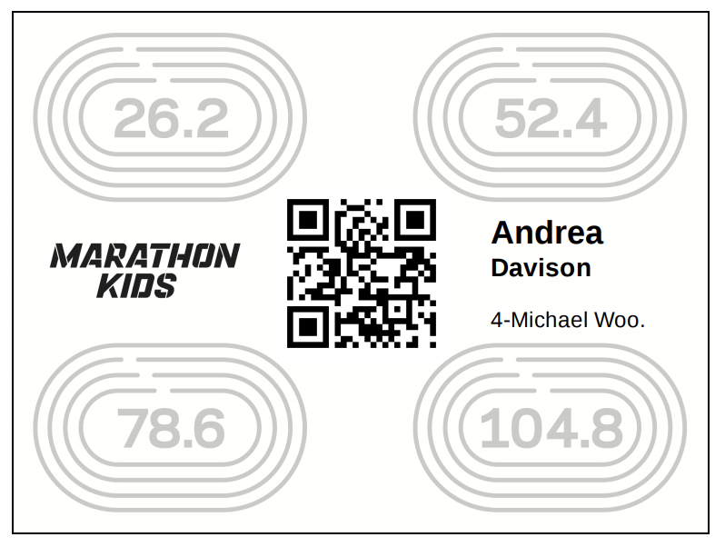
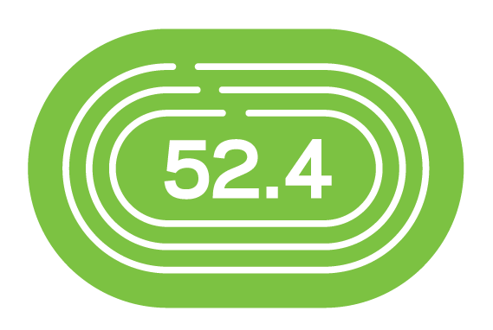
Goal-Driven Program
Unlocking potential, one mile at a time
Notes:
Marathon Kids provides physical activity program that includes a digital platform to tracks all types of physical activity.
So running, walking and minutes of any type of heart pumping exercise count towards mileage! Little by little laps turn into miles and miles turn into marathons. Marathon Kids encouraged self-paced movement.
Every 5 minutes of heart-pumping exercise as a .25 of a mile. So 20 minutes equals a mile! There’s flexibility in the type of activity kids can do to earn miles.

Slide 4
Research-proven methods
Six evidence-based pillars to long-term healthy behavior adoption
Goal Setting
Tracking
Modeling the Way
Kids develop a growth mindset setting big and small goals alike
Logging miles and measuring progress keeps kids motivated
Role models inspire kids to build new, healthy habits into their lives
Social Support
Celebrating
Rewarding
Moving together is more enjoyable when you feel the support of others
Big cheers and high-fives go a long way to foster long-term behavior adoption
Consistent, positive recognition fuels kids to keep striving for the next milestone
Notes:
The program is built on 6 pillars that naturally happen throughout the program whether you realize it or not.
The pillars strength and support growing kids self-efficacy (belief that they can achieve), self-confidence, and to create a team atmosphere and community around physical activity.

Slide 5
Start a run club
before/after school
Run during PE class or Classroom teacher
Implementation
Run Club
Classroom/PE
Programming is customizable
PE, before/after school, recess, and/or virtually
Parents log running miles
from home
Full-school
Virtual
Notes:
Marathon Kids is a customizable. There’s different ways to implement the program. That’s the beauty of the program and digital platform, there’s no 2 schools exactly alike so customize the program to meet your needs. REVIEW options above with group.

Slide 6
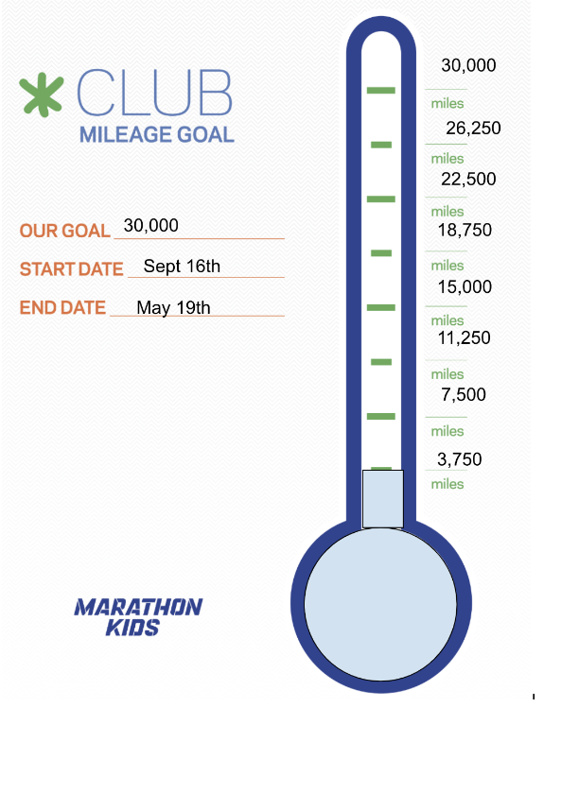
SET YOUR CLUB GOAL
Club Mileage Goal:
# of participants X # of miles on avg per week a student will complete = ______
Example, 1,000 x 1 mile a week = 1,000
Then,
_____ X # of weeks you will participate = GOAL
So,
1,000 x 30 weeks = 30,000 miles
Notes:
At the beginning of your season with Marathon Kids set a goal and establish a space where you can post updates and data! This resource can be found in the Resource Library within your account. MARATHON KIDS needs your help to reach 4.5 million miles! To set your club or school milage goal (read formula)

Slide 7
IT’S A TEAM EFFORT!
Bush Elementary
24,750 miles
5th Grade
2,280 miles
Mrs. Lane’s Class
456 miles
Anna Lopez
19 miles
Notes:
Whether your Marathon Kids program has 10 kids or 1,000 you are a team all trying to collectively reach your goal.
So if we look at Anna Lopez in 5th grade - she has 19 miles.
Those count towards her total miles. But Anna is in Mrs. Lane’s class
That class has 70 miles -- Anna a contributing participant along with all the kids in Mrs. Lane’s class
Then we look at 5th grade - Anna is in 5th grade.
She is helping that 5th grade total mileage grow
Anna is a participating member of Bush Elementary
And Bush Elementary is participating with Marathon Kids!

Slide 8
Questions?

Slide 9
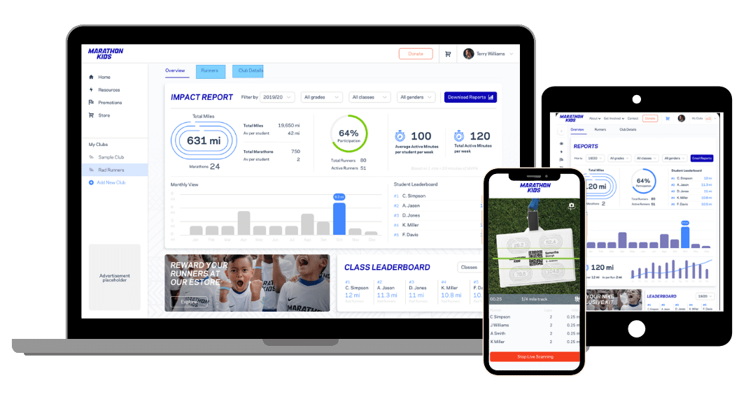
Marathon Kids Connect
A free, cloud-based platform that makes tracking and reporting on kids’ physical activity simple
Digital Platform
Mobile Scanning App
Notes:
Let’s track those laps and miles with tools that work together!
Marathon Kids is here to support physical activity champions by providing free tools and resources to make your job easier and to get kids moving!
Let’s talk about the digital platform and some cool features.

Slide 10
Marathon Kids Connect
Cloud-based
Platform
The real-time digital platform equips you to manage your program and monitor achievements all season long
Notes:
The digital platform comes in two parts.
The first part is a website where you manage your account, add runners, view data, print ID cards, and pull reports.
This platform is user friendly and easy to navigate.

Slide 11
Marathon Kids Connect
“
Scanning App
The determination and joy my students exhibit when reaching their goals keeps me returning to Marathon Kids.
Our mobile iOS and Android scanning app easily captures effort by reading unique participant QR codes that are auto-generated after rostering
Notes:
The second piece is a Scanner app that is available on iOS, Android, iPads, and tablets. Along with Chromebooks.
It is sole job is to scanner runner ID cards.
You can not see your account information here.
No wifi is required to scan ID cards but is required to login and select your club. Once your device is connected to wifi or with cellular service, student’s efforts syncs back to your account and each runner is given credit.
Parents and students do not have access to the scanner app.
Multiple scanners can happen at the same time. If kids go to the same device each time the laps tally up for that session.
Forward facing camera so it leaves you free to monitor kids.

Slide 12
Interactive Dashboard
Personalized
Account
Real-time Data
Our platform allows you to set goals and set the type of physical activity effort you want to track for your program
Notes:
Some of the features of the digital platform:
Dashboards are a great feature not only for you but other users and supporters that need access to help student’s get more minutes of physical activity.
Dashboards give you data at your fingertips!
You can invite an unlimited number of supporters to your account like classroom teachers and other staff members to be able to view the data, enter manual miles and help celebrate students.

Slide 13
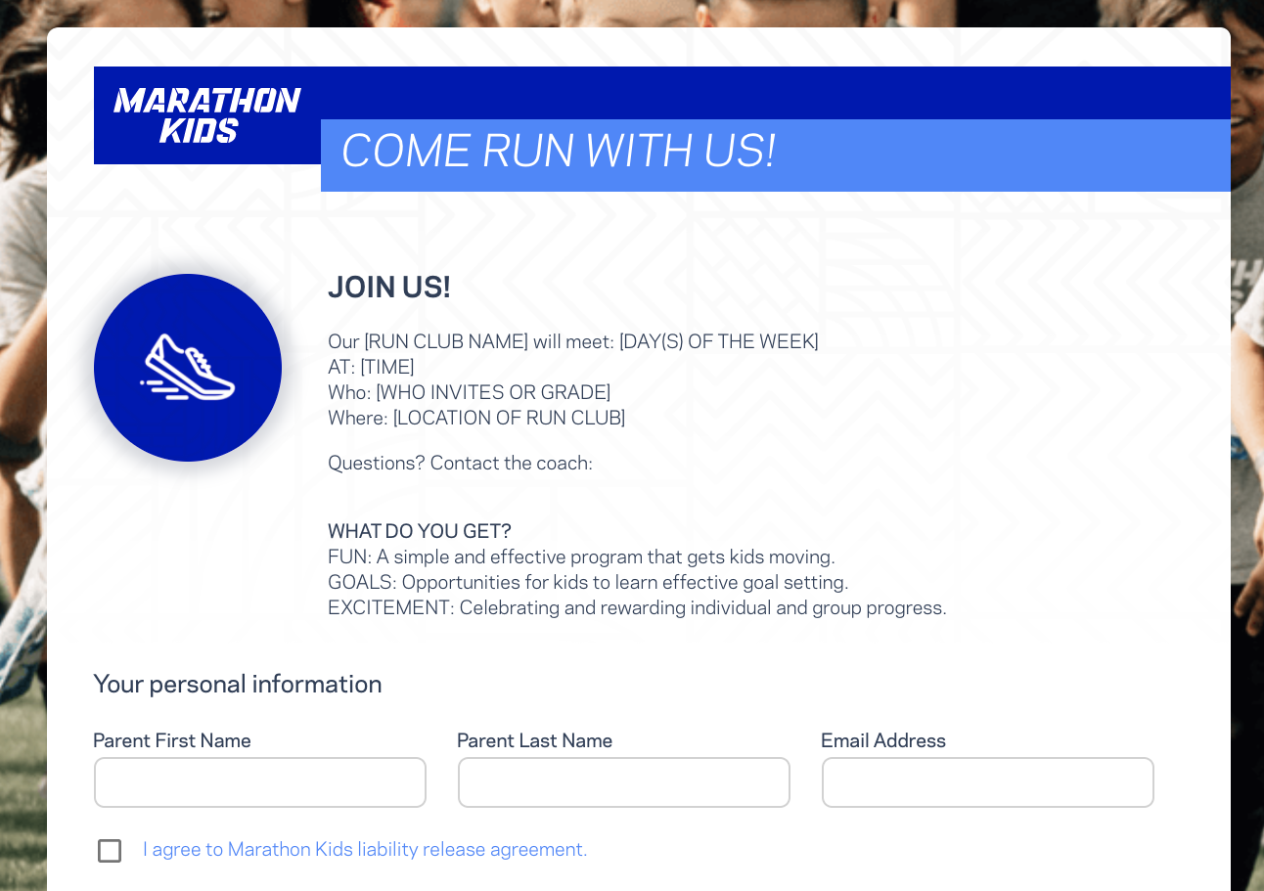
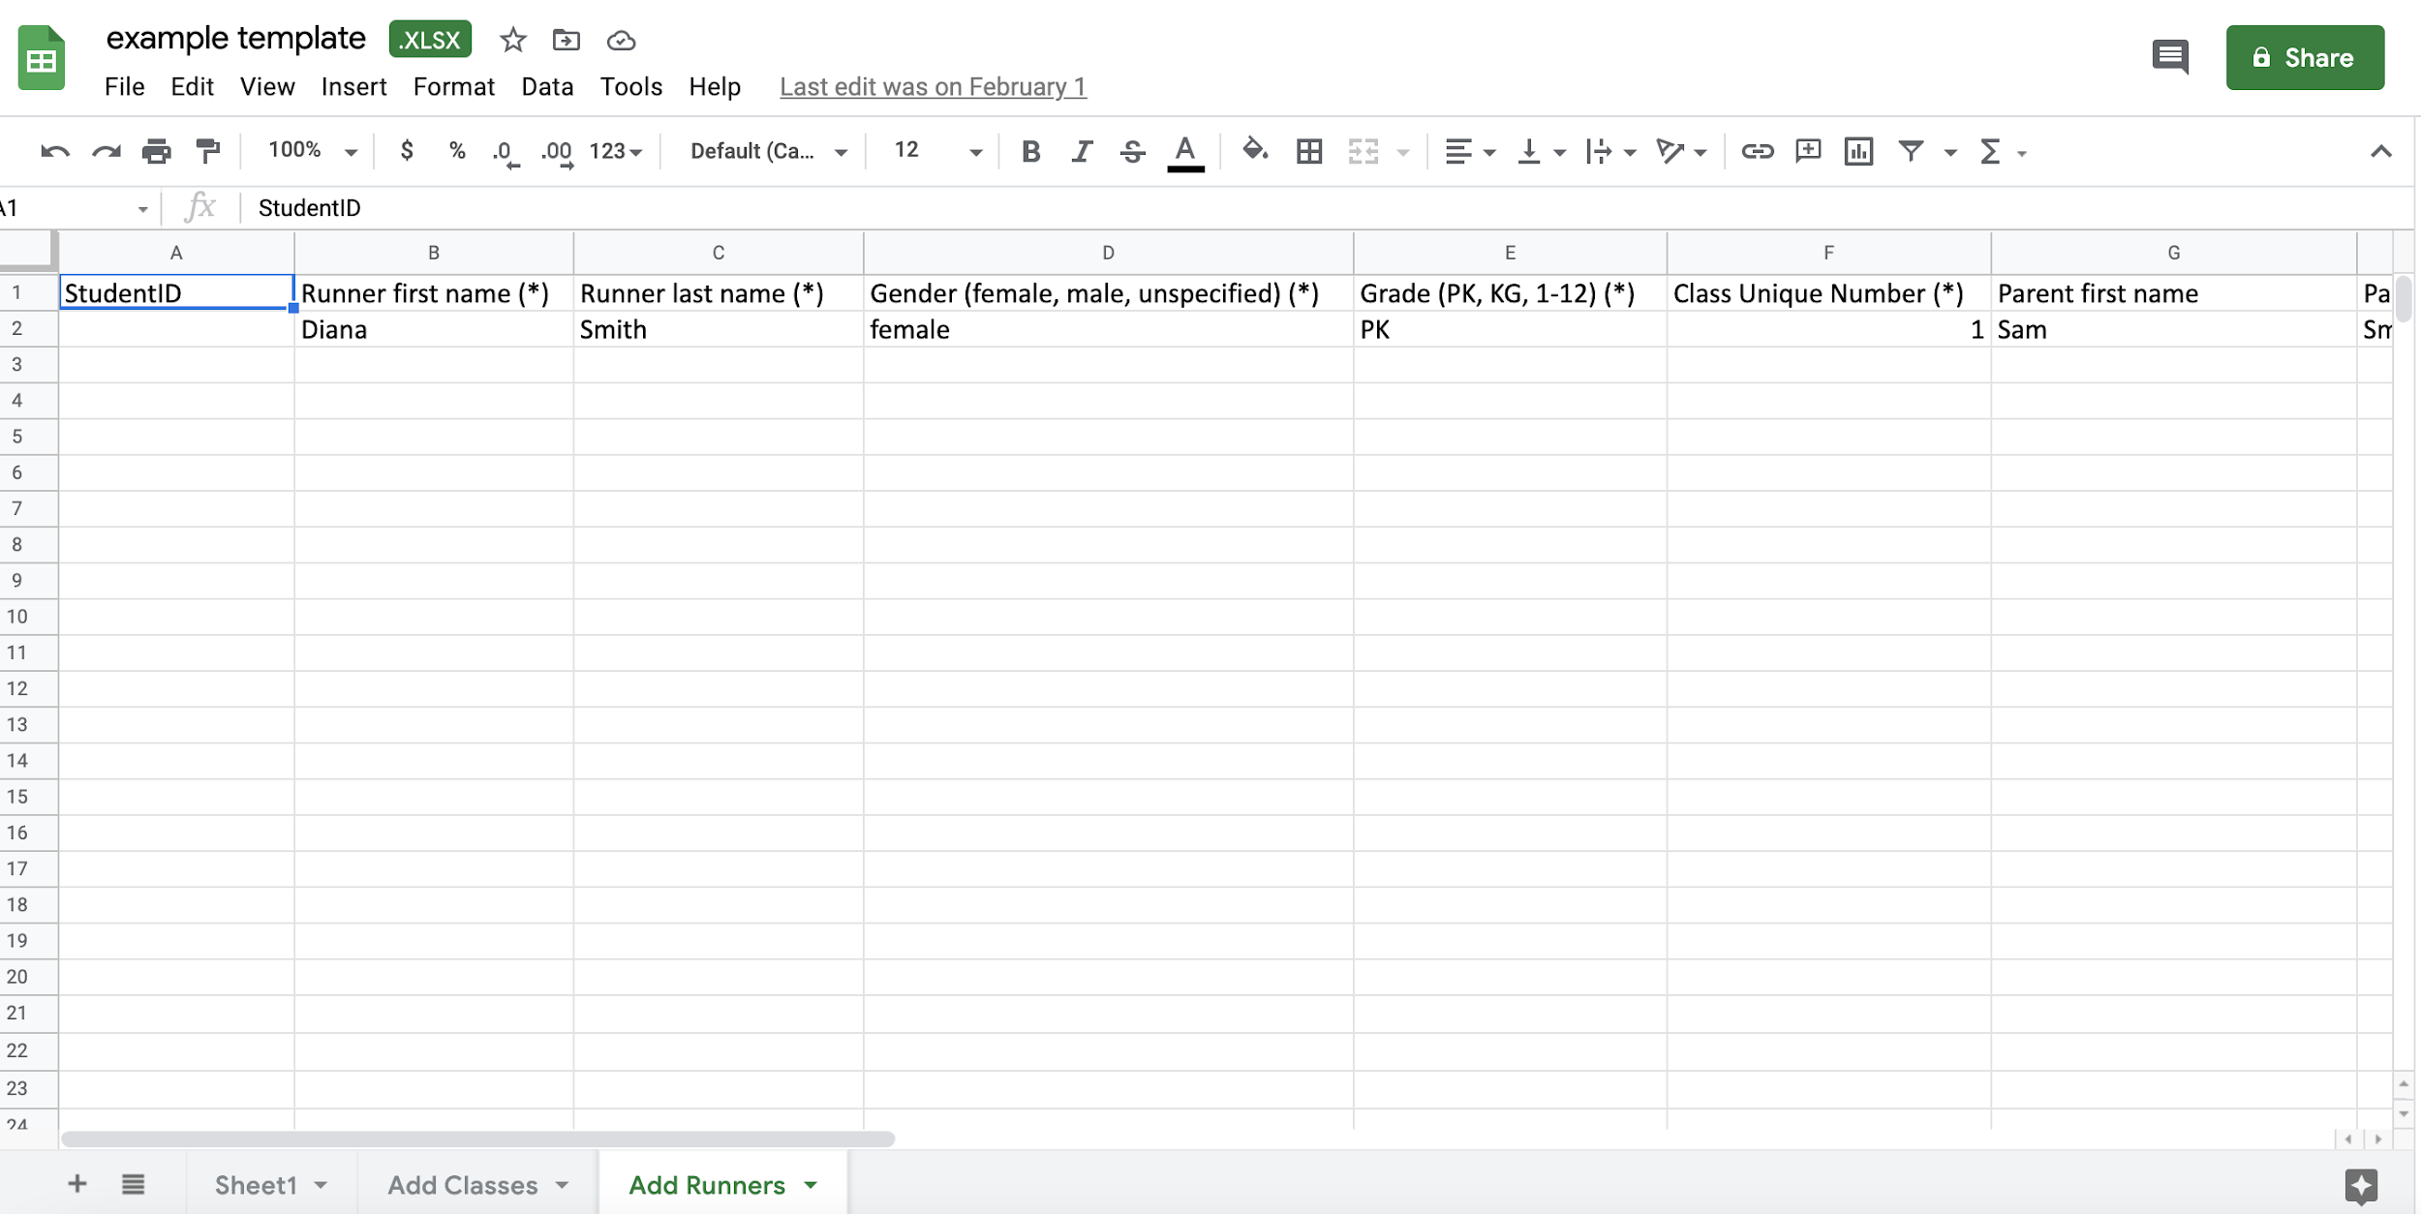
Manual Entry
Recruit -- Online registration
Roster Upload - add participants in bulk! Marathon Kids will do this for you. ID Cards
Ways to Add Participants
Manual Entry - Add participants anytime!
Notes:
There are 3 ways to add participants!
In bulk, use the Marathon Kids template to send your roster (unlimited number) and they will upload your roster of participants in one step!
Recruitment Tool -- if you don’t know who will participate, the recruitment tool allows you to customize an online registration form to share with parents to enroll their student.
Manual Entry -- add participants anytime! This is great for small clubs you can simply type in the student information and click save.

Slide 14
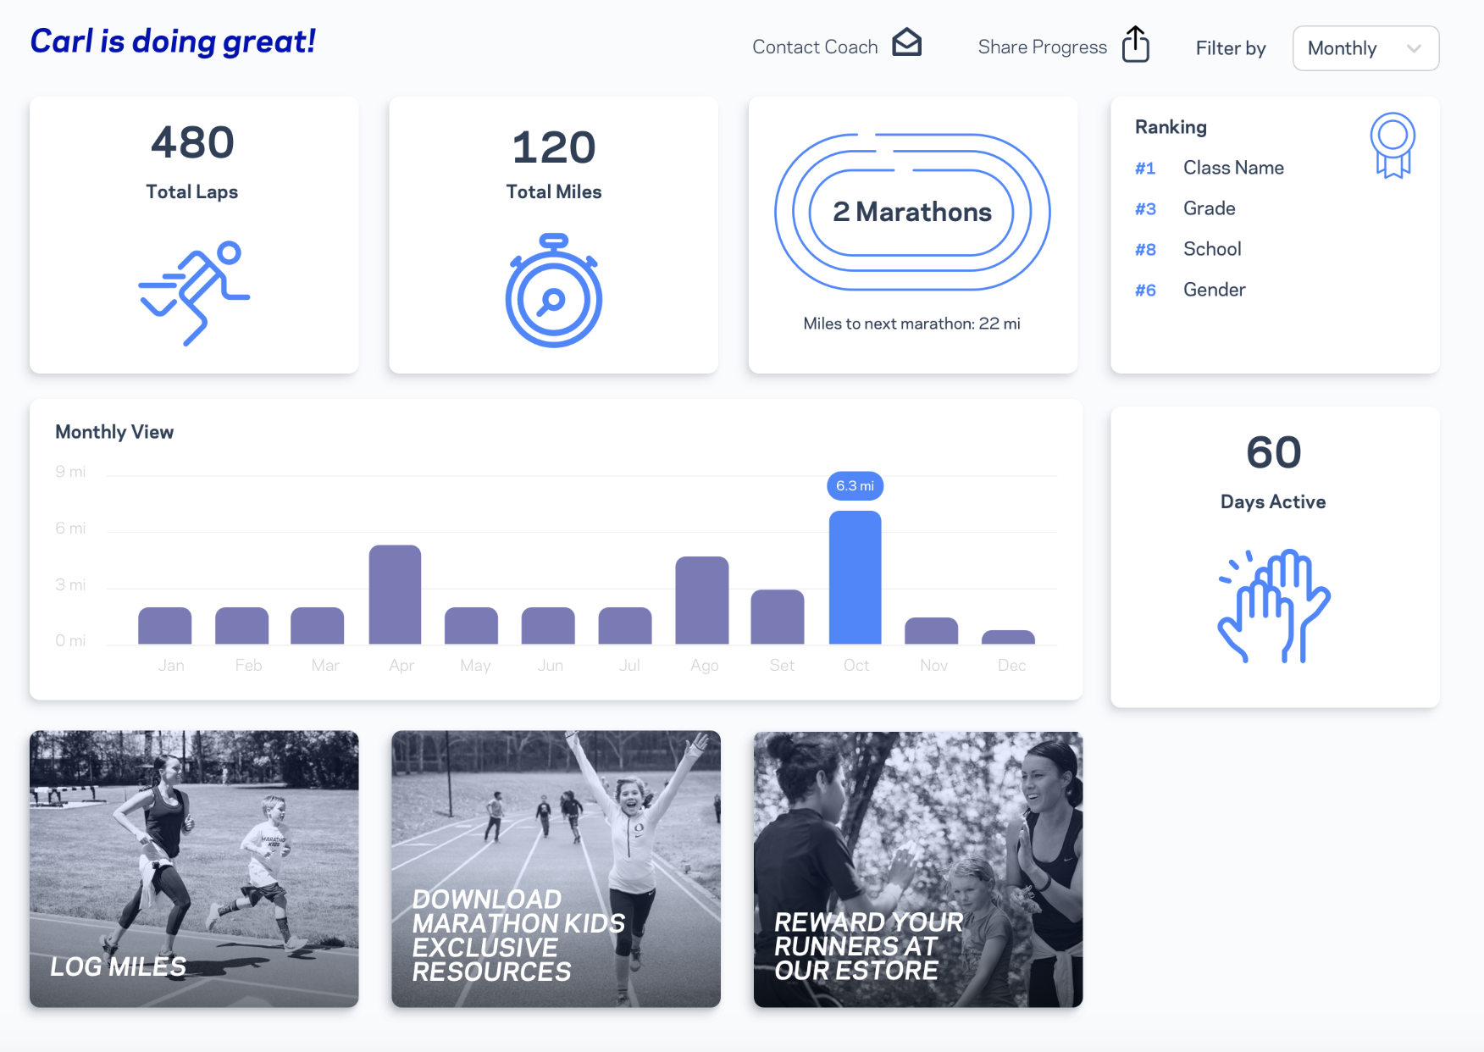
Parent Dashboard
Log miles from home
Access free resources
Follow & celebrate progress
Optional feature
Notes:
Optional feature is inviting parents.
When you add runners to the platform, you have the option of inviting parents at the time you upload a roster or manual add participants. If you use the recruitment tool parents are given the option to create accounts to be connected to their student.
If you choose to include parents an email gets triggered from the platform. parents have the option to create their account, they will have their own dashboard for each participating child, submit miles to the coach, and be able access to resources and the eStore.

Slide 15
Scan ID Cards
Scanning app easily captures effort by reading unique participant QR codes
Adding Miles/Minutes
Manual Add
Allows you to capture effort without using the scanner app and QR codes
Any form of activity counts as distance, whether you're scanning ID Cards or manually entering effort!
Parents Submit Miles
Parents can access their parent portal to log their child’s effort from home
Notes:
Student effort can be captured in three different ways.
1. Using the Scanner App. Each runner has their own unique ID card with a QR code. So as they complete laps or minutes of heart-pumping activity you scan their ID card to capture their effort. This data is sent back to your account, credits each runner and updates your data.
2. Manually Add laps or minutes of activity. This is a great way to capture indoor brain breaks and MVPA during PE class.
3. If you choose to invite parents they can follow their child’s progress and submit miles for coach approval. Keep in mind the parent piece is optional, you get to decide to include parents or not when you roster your students.

Slide 16
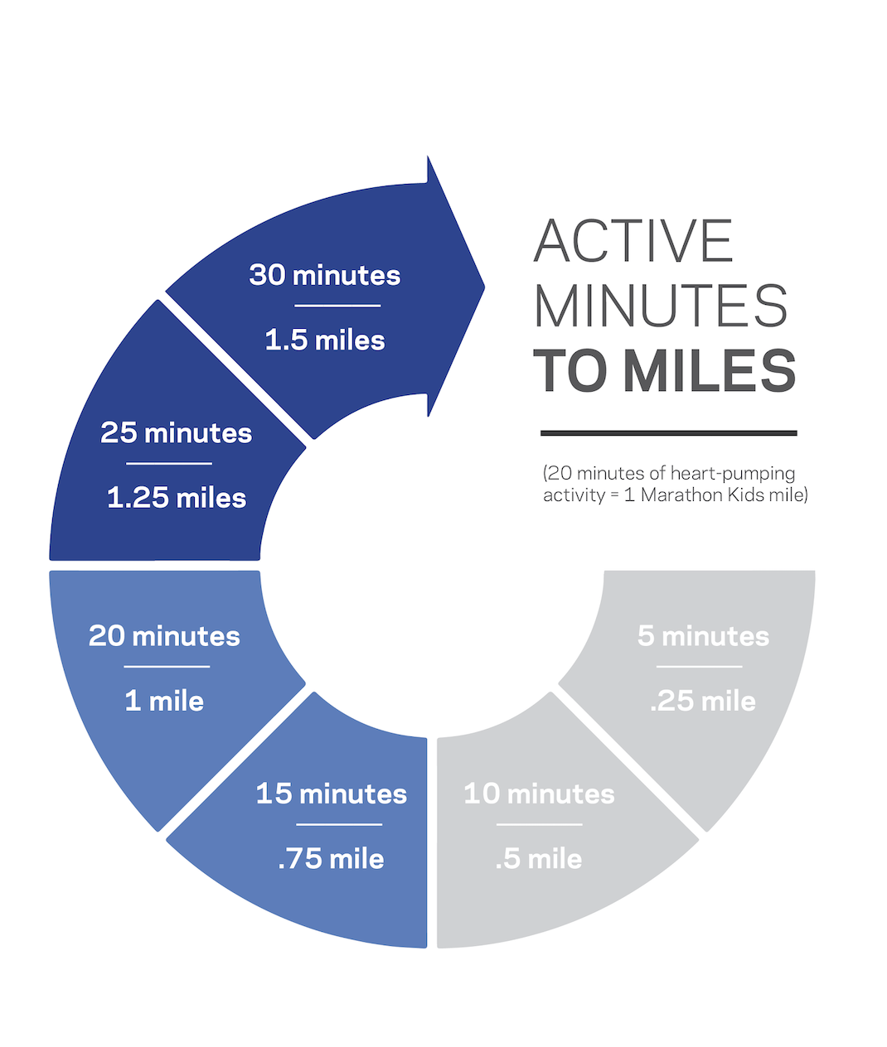
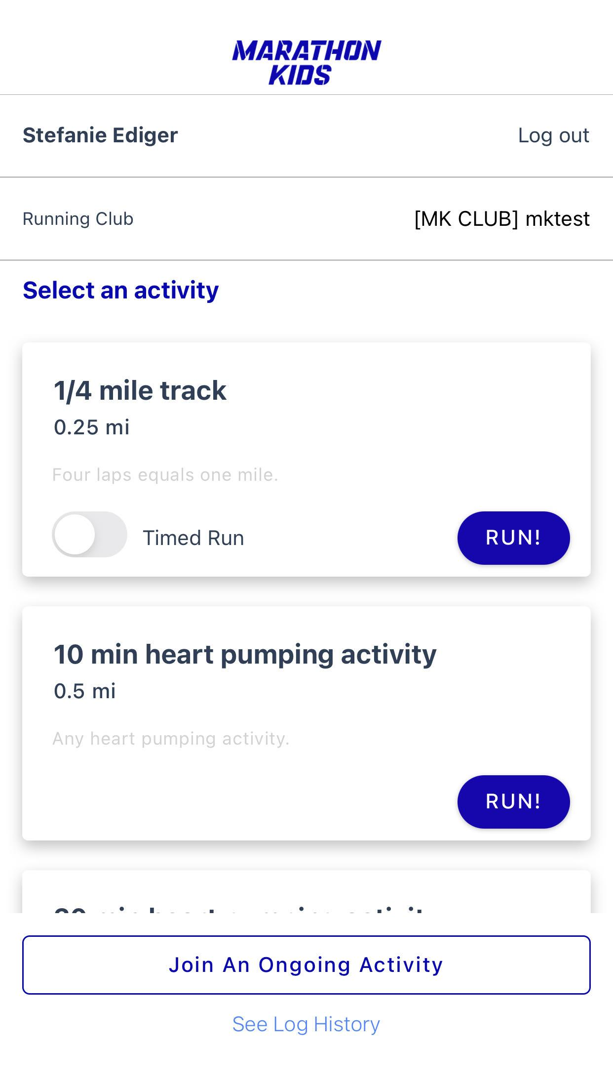
Set Tracks &
Activities
Notes:
It’s essential you set your lap distance within your account. Every school’s space is different.
Your track may be a field marked with four cones or a more defined space.
How many laps does it take to equal a mile?
Once you set this in your account -- your tracks and activities show up in the scanner app and that’s how it knows what to create each student.

Slide 17
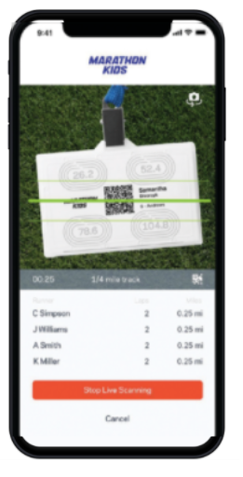
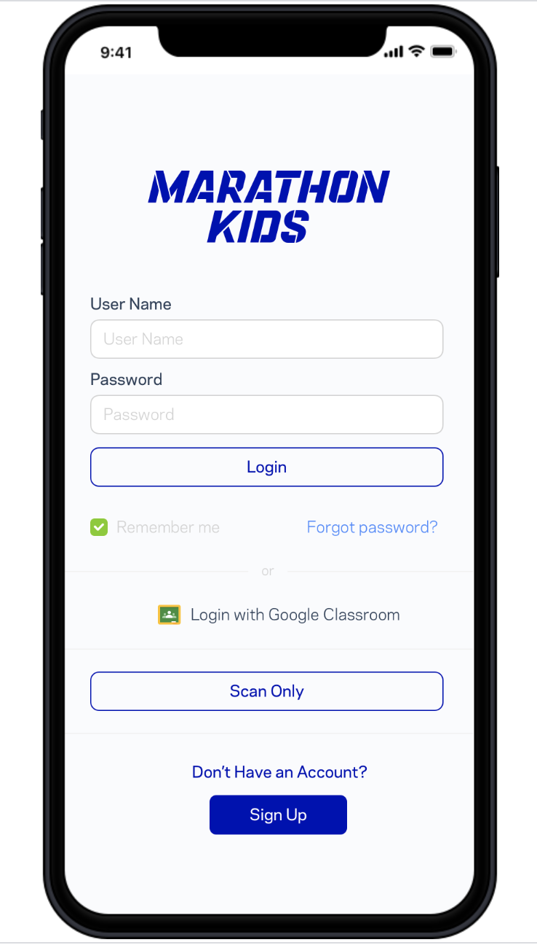
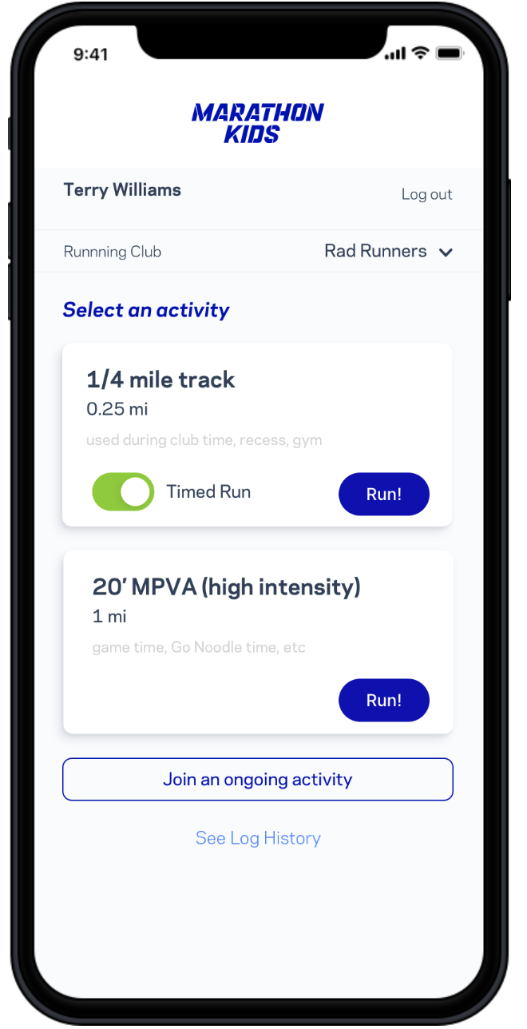
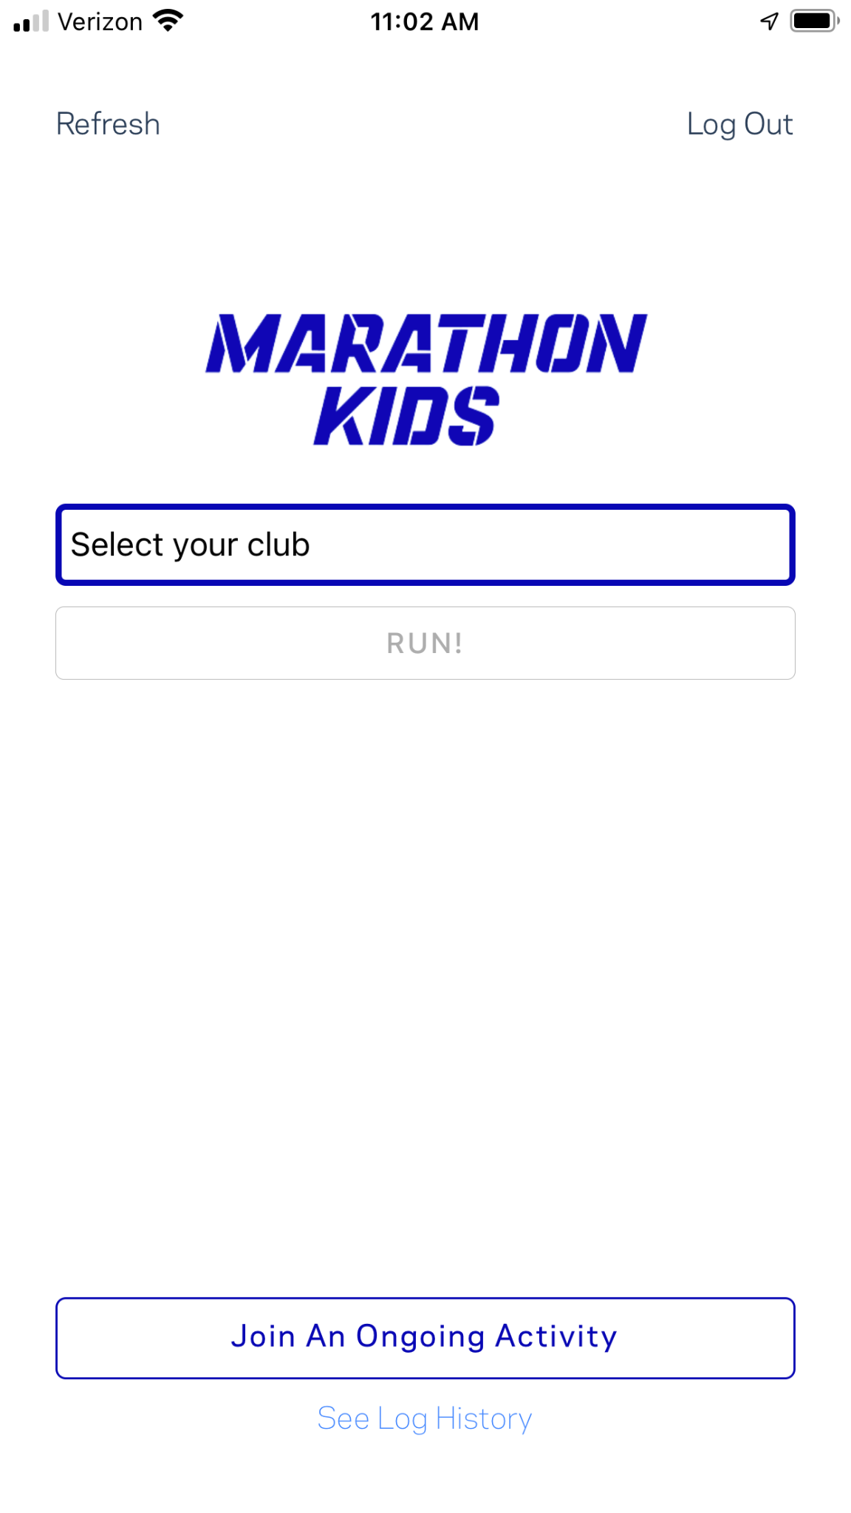
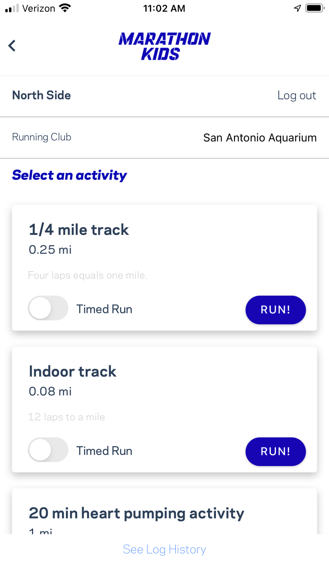
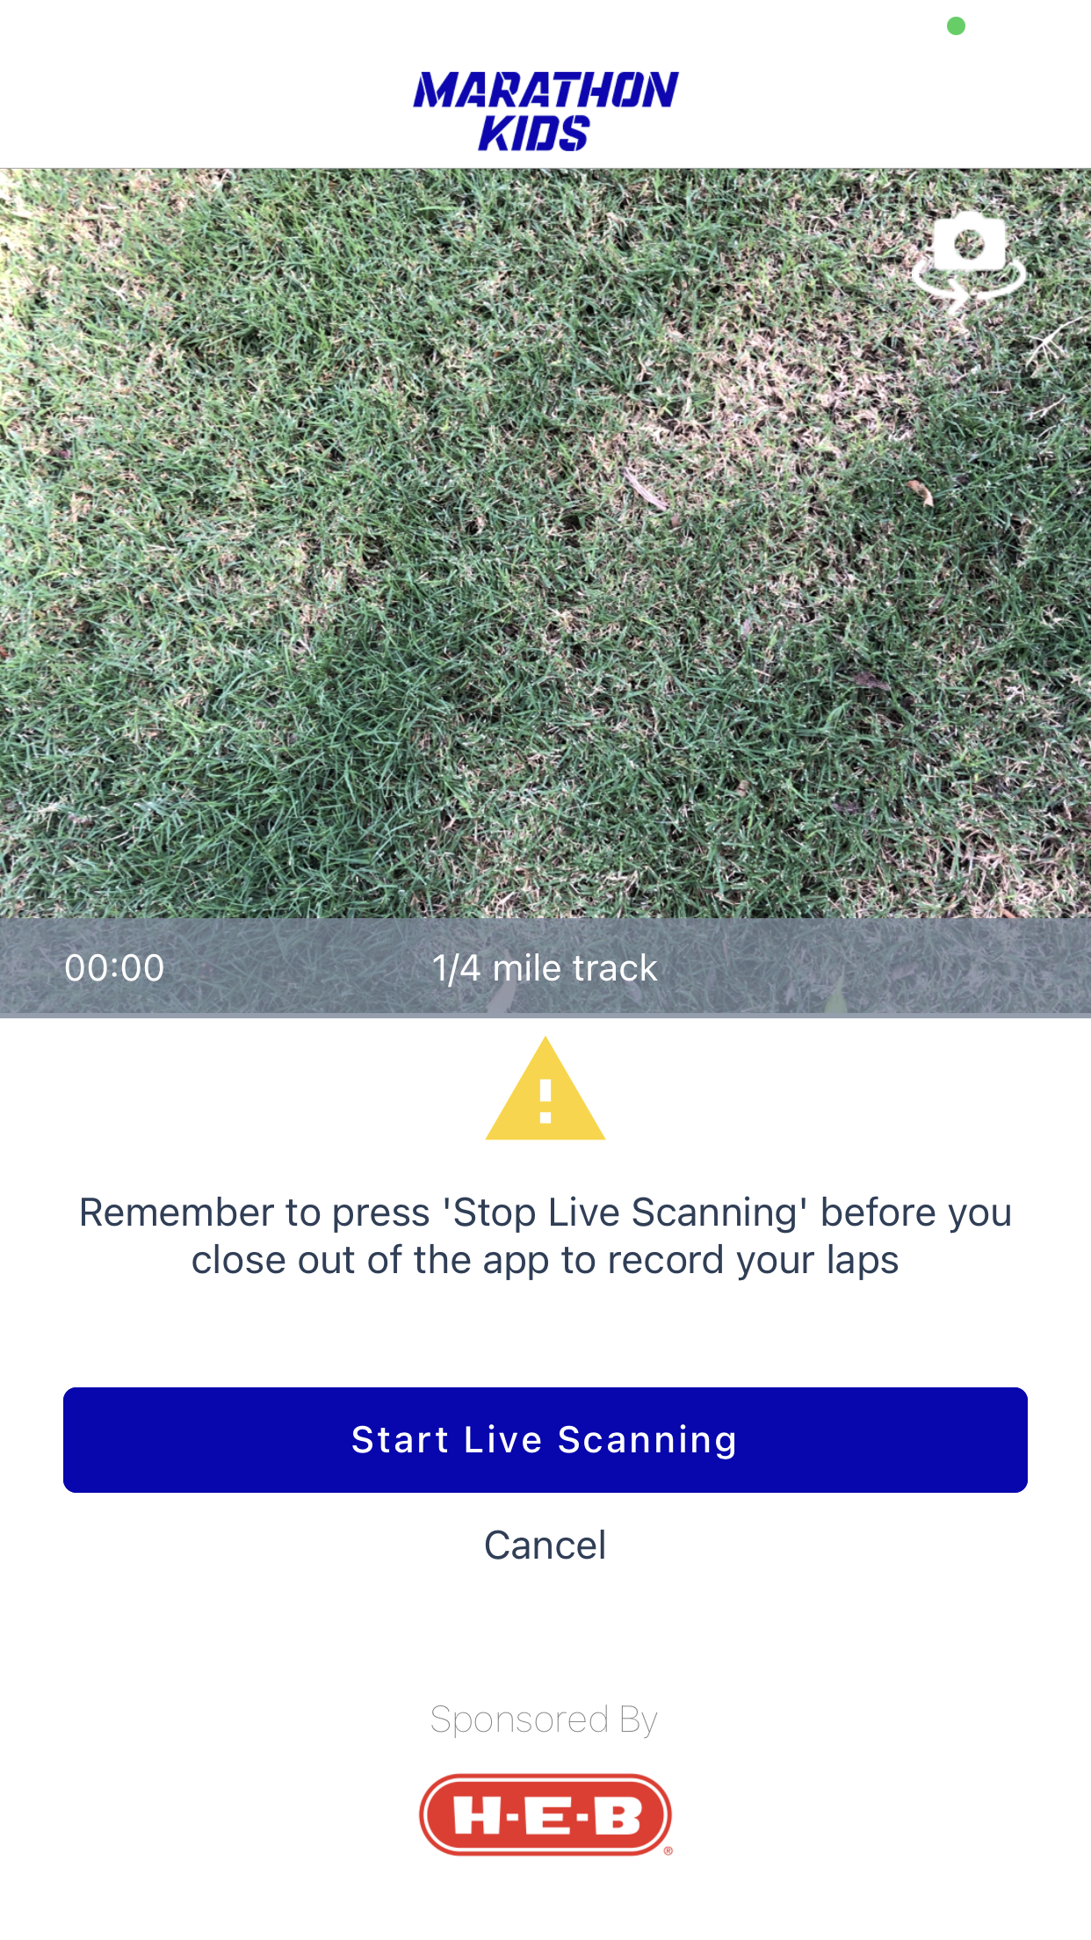
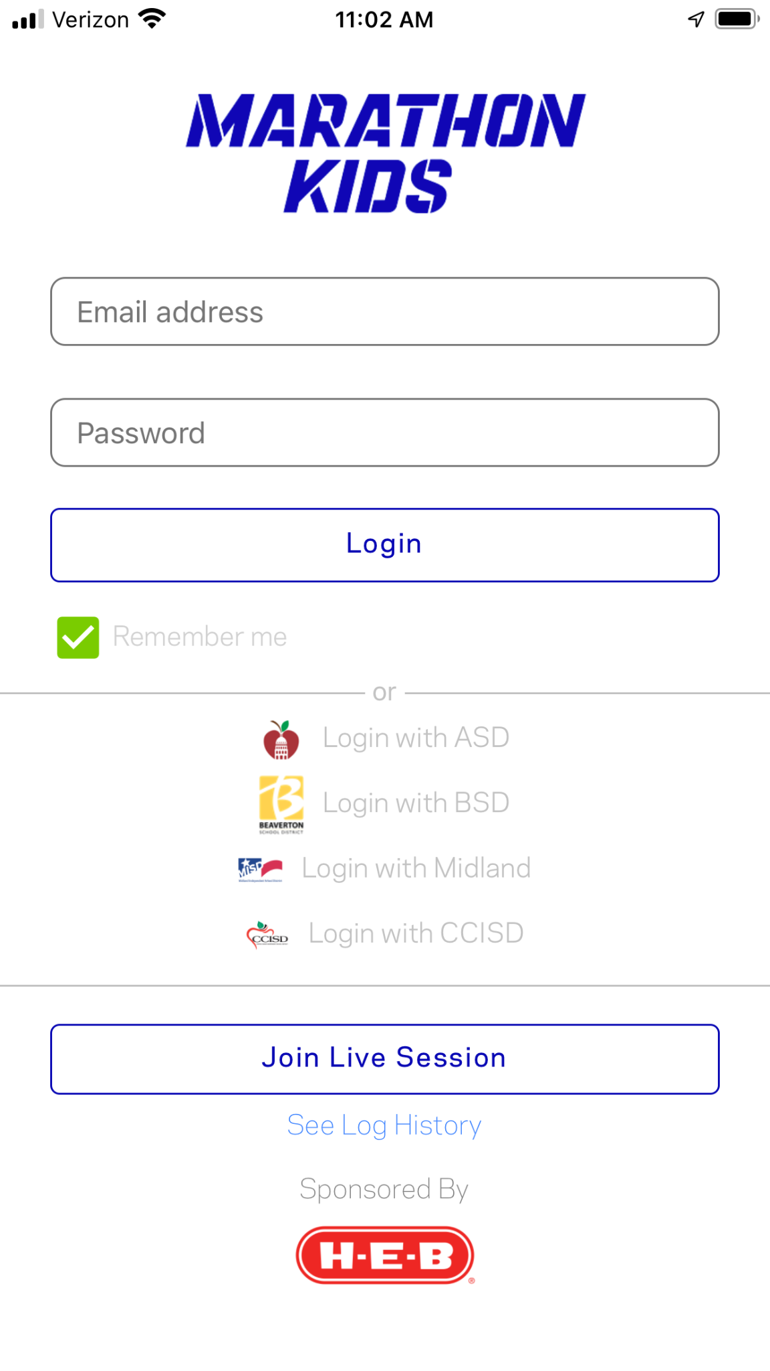
Mobile Scanner App
Notes:
The scanner app is simple to use:
Log in and choose your run club -- click run. Both of these steps you either need WiFi or cellular service.
Now you can take your device anywhere you need to scan ID cards.
Then you see your tracks and activity page, choose the track or activity and click Run.
Click Start Live Scanning
Kids take off and scan their ID card for every lap they complete

Slide 18
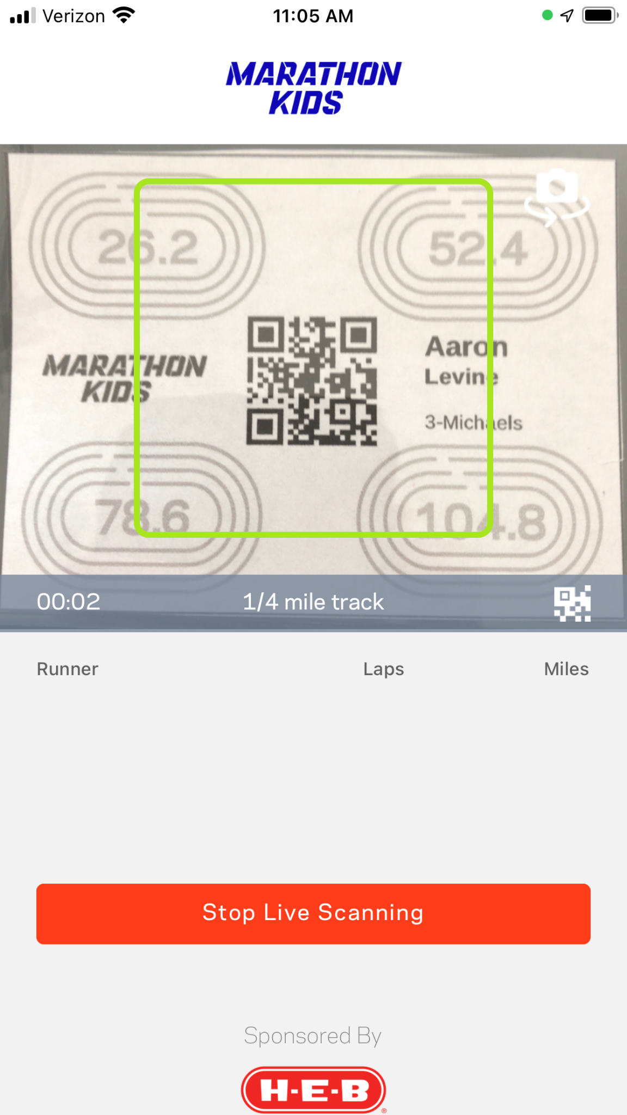
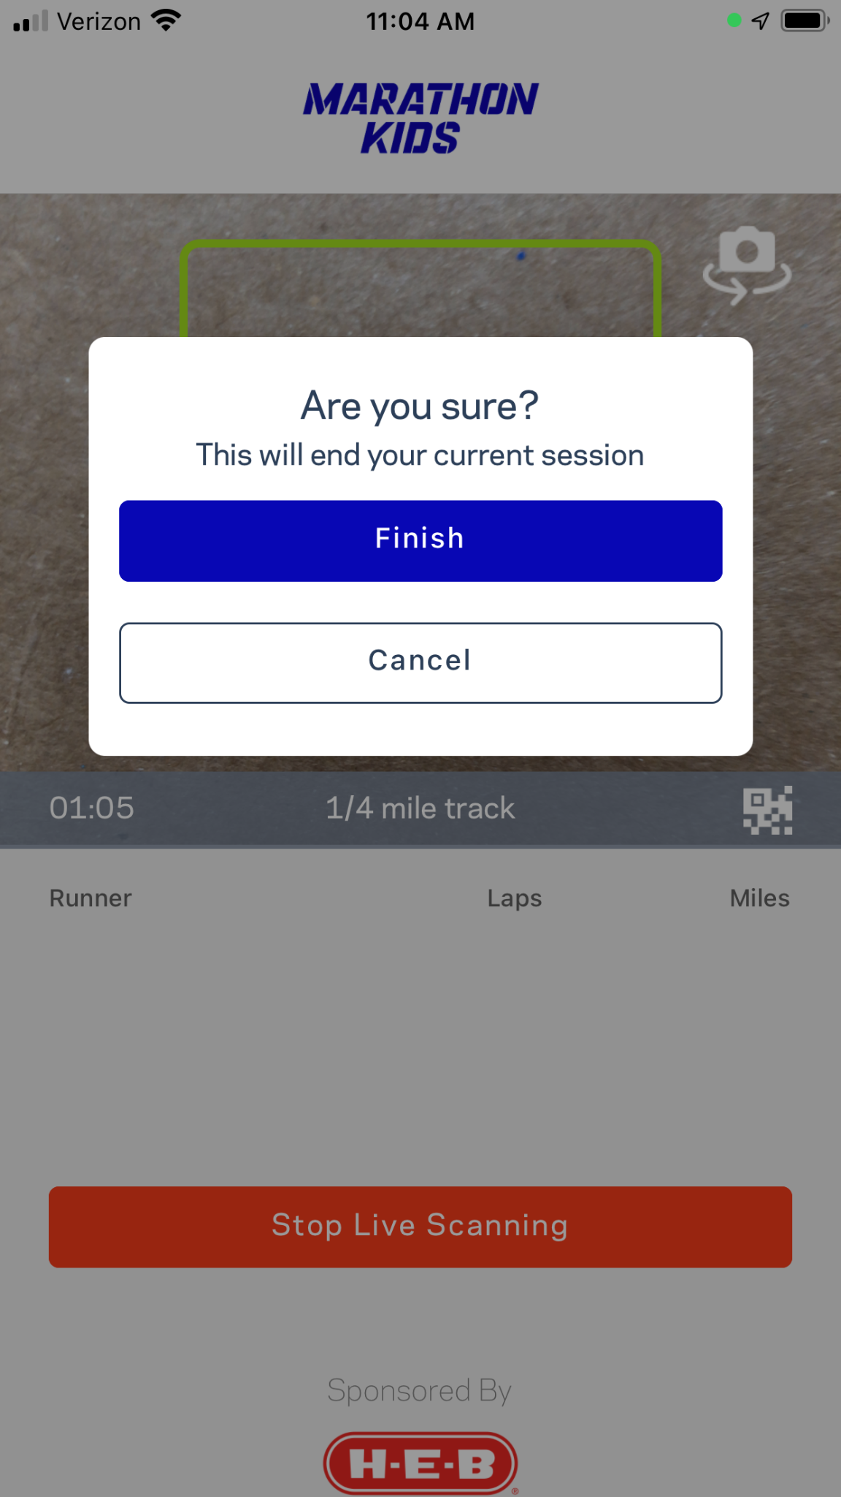
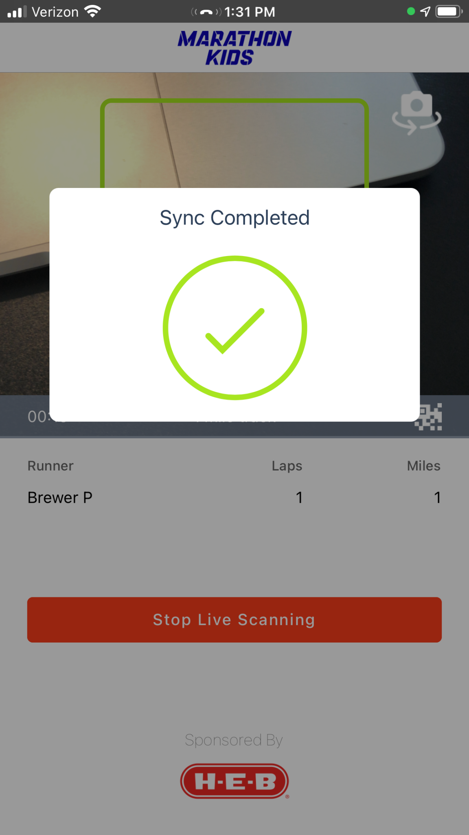
Mobile Scanner App
Notes:
When you are done -- click Stop Live Scanning
Then click Finish and Sync!
Wait for the green checkmark
If you ever get a failed sync it’s in your log history on the tracks and activity page and these can be resubmitted.

Slide 19
Supports goal setting
Make the Data Visible
Drives participant motivation
Provides positive recognition
Review captured effort to monitor progress of goals, report on physical activity for a particular event, and celebrate milestones
Celebrate all types of achievements
Notes:
The last two features I will point out -- one is the Reporting feature. This can help you celebrate your schools’ success and help build community around physical activity.
We have 6 reports you can pull as well as the quick data on your dashboard you can use to celebrate your school and runner’s success.
We highly suggest you create a visual spot, like a bulletin board, so everyone that walks by gets updated, celebrates, it draws curiousty. You can share celebrations on announcements, social media, class dogo, school newsletters and website.
So spread the word and make the results visible. This helps students feel a part of something bigger and helps them to stay motivated, plus can builds buy-in for physical activity and physical education.

Slide 20
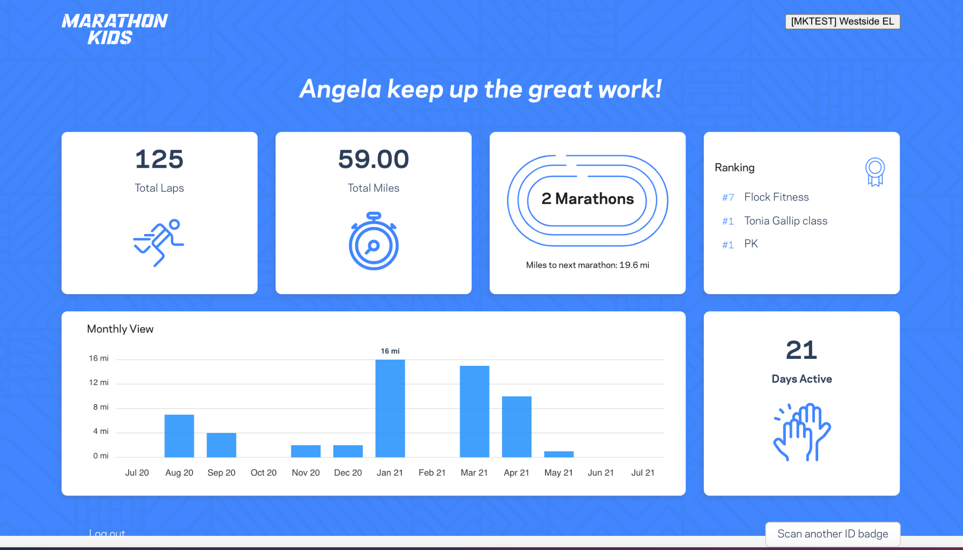
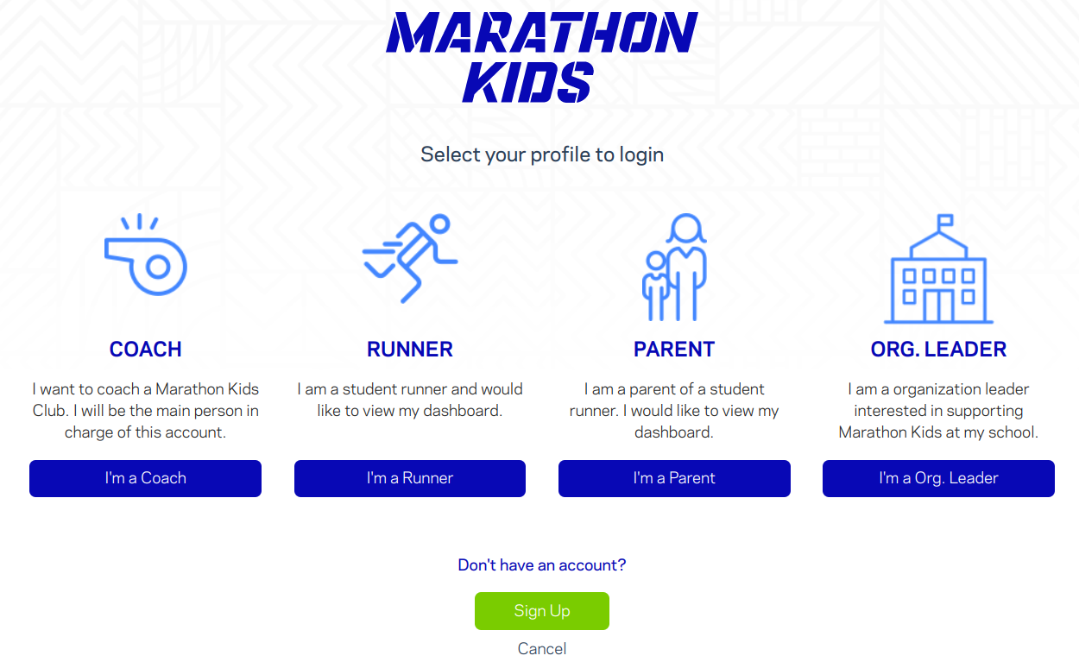
Participant Dashboard
Notes:
Another way to keep kids updated is with the Participant Dashboard.
Kids click I am Runner. Then scan their ID card with the device camera and their very own dashboard appears! If you give students a copy of their ID card they can check this from home and can’t cheat by having their ID.

Slide 21
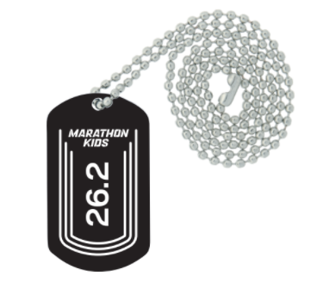
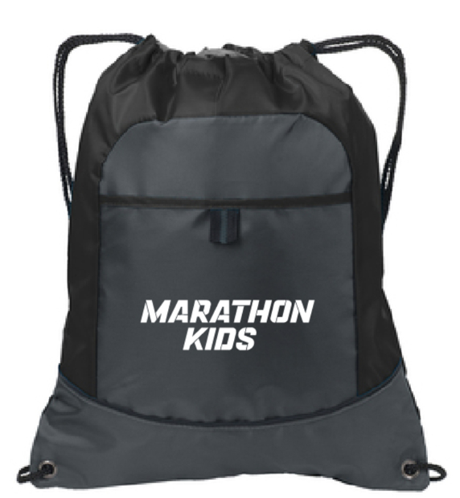
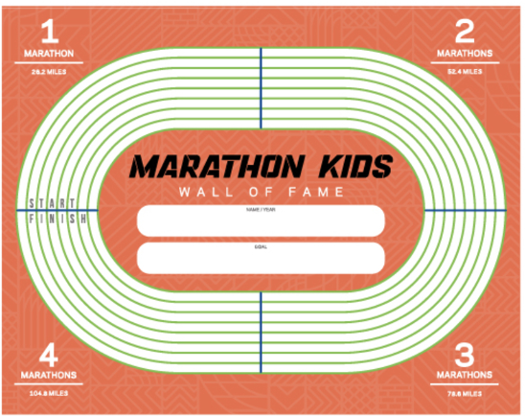
Participant Incentives
Online Store
Encourage your participants by purchasing rewards to celebrate accomplishments from our e-store
FREE Welcome Packet
Notes:
Reward as you wish.
Marathon Kids sends you a free welcome packet with a set of stickers for 100 kids in the event you’d like to use those for the ID cards but they have dog tags, drawstring bags, coach gear and other t-shirts in their store which you can access from your account.
We also provide two types of certificates within your account you can print for your students.

Slide 22
Questions?

Slide 23
Benefits of Marathon Kids
Eliminates manual tracking and data entry = More time for MVPA
Invite others as Supporters to help you = Multiple scanners during a session
Run Reports = Data for celebrating and building school support/buy-in
Tracking tools & resources for parents = More parent involvement
Track all types of physical activity = Encourages healthy competition

Slide 24
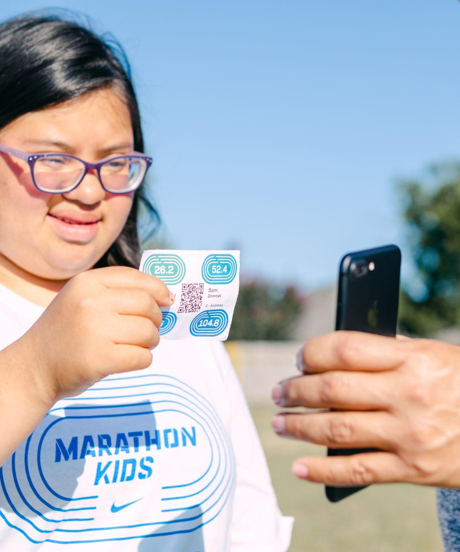
Next Steps
1. Make a Plan
marathonkids.org/start-guide/
2. Create your account
www.marathonkids.org
3. Email questions
support@marathonkids.org

Slide 25
Make us your school’s running partner
support@marathonkids.org
marathonkids.org
Notes:
And the last feature -- Marathon Kids has an eStore. All registered schools will receive a free welcome packet which includes a start set of sticker based rewards and our Hall of Fame poster kids can sign. You also have the option to purchase coach gear or premium incentives. Anyone with a Marathon Kids account, including parents, have access to the eStore.

Slide 26
Appendix

Slide 27
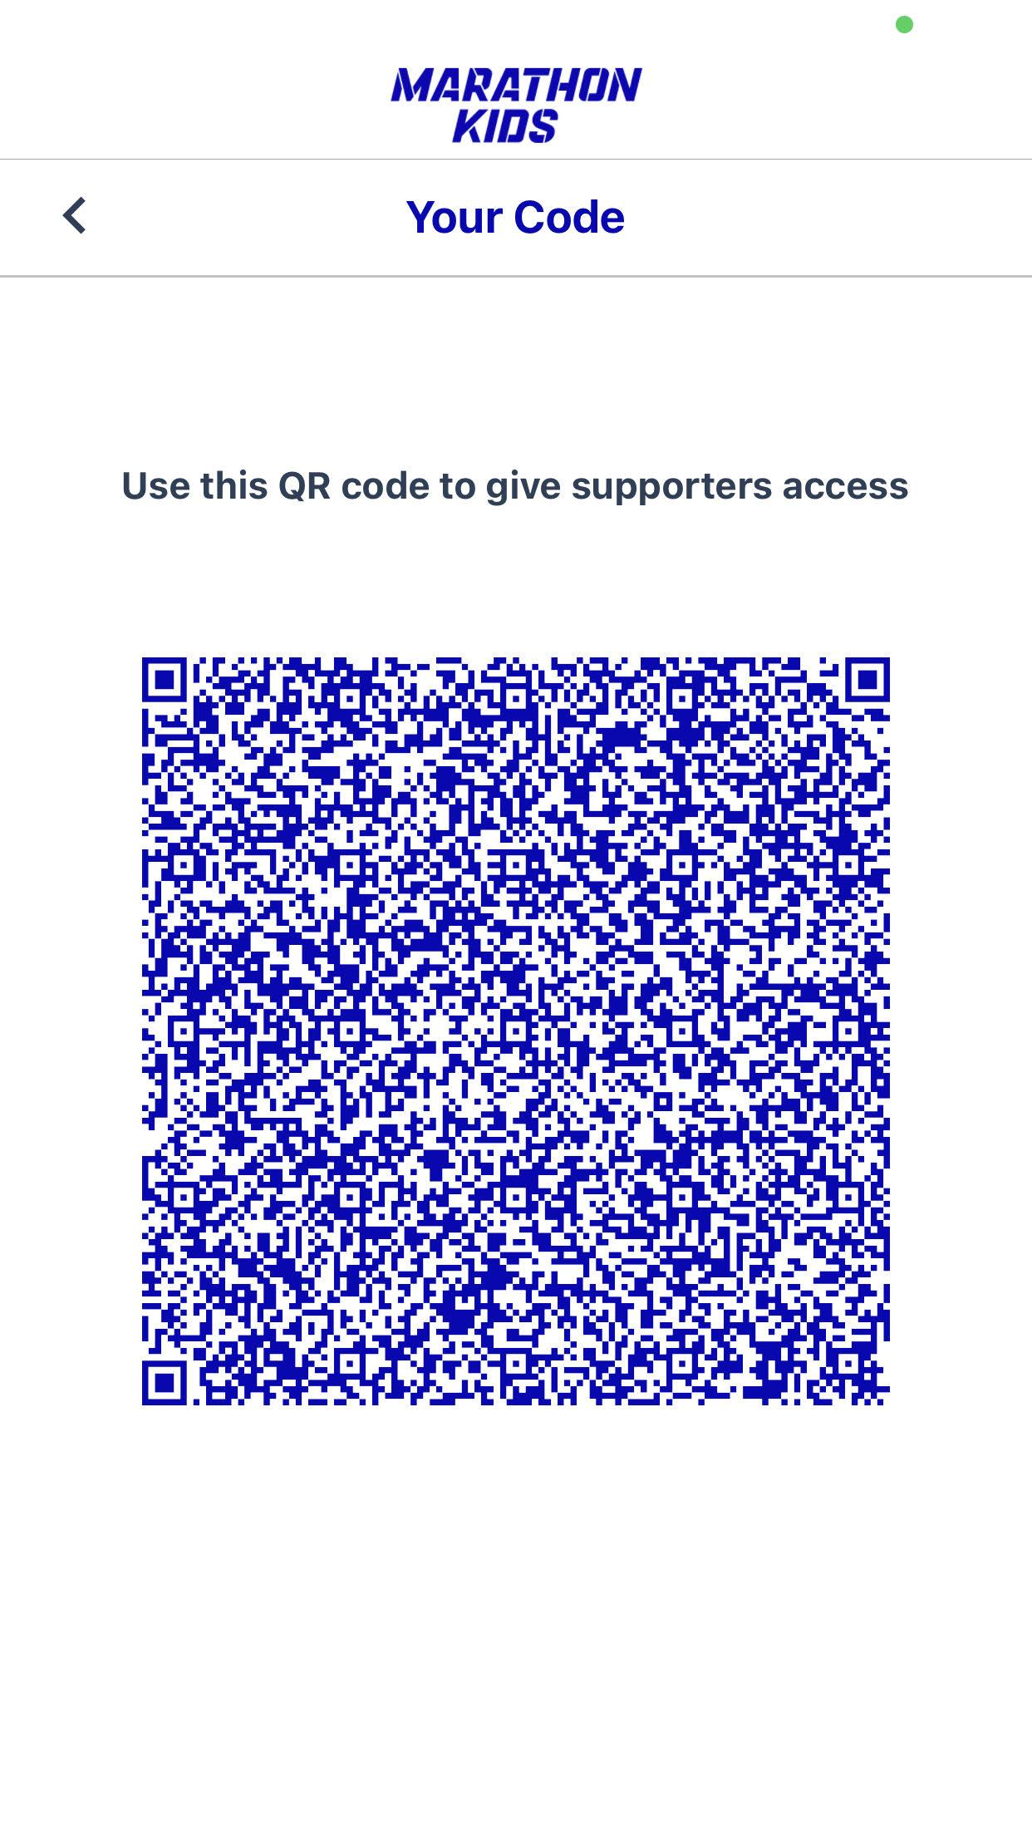
Volunteers Scanning
Volunteer selects “join live session” on their phone.
Coach or asst coach clicks the QR code. The volunteers scans it and they are ready to help!
Notes:
When you return to campus. If you have volunteers helping you, they will need to download the Marathon Kids app. They do not need login credentials
They will select “scan only” or “join a live session” .

