Slide 1
Everyday Driving Skills
Mr. Gravine
Driver Education

Slide 2
Introduction
This PowerPoint presentation begins by highlighting common vehicle collisions and major crash types among new drivers in PA. In addition, the safe driving skills listed below are described in this presentation.
Managing Space
Managing Speed
Negotiating Intersections
Negotiating Curves
Turning, Merging, and Passing
Negotiating Freeways and Interchanges

Slide 3
The Facts
Most crashes result from human error.
Either they fail to:
Control the Vehicle
Road system
Distraction
Poor decisions
According to Penndot, drivers less than 5 years experience are most likely to make errors that lead to crashes.
For 2011, one (1) out of ten (10) 16 year old drivers were in reportable crashes.
.

Slide 4
The top 10 reasons new drivers in Pennsylvania (16- and 17-year-olds) ended up in crashes in 2011.
Driving too fast for conditions
Proceeding without clearance after stopping
Improper or careless turning
Improper driving
Inexperience
Tailgating
Speeding
Over or under compensating a curve
Distractions
Sudden slowing or stopping

Slide 5
Common Major Crashes
Major crashes types
Single vehicle run off the road 1,2
Crashes at intersections 2
Head on crashes 1 2 3
Rear end crashes

Slide 6
Major types of crashes that affect new drivers (16 and 17-year olds)
1) Hitting a stationary object
2) Crashes where roads intersect, like driveways, entrance ramps, and in Intersections
3) Rear-end collisions
4) Head on collisions.
About 92 percent of all crashes and 93 percent
of the deaths resulting from crashes are associated with just these four (4) crash types.

Slide 7
What Went Wrong!!!!1
In this next clip please identify the crash type and why the crash occurred.
GO

Slide 8
Managing Speed
What is a safe speed?
How fast is too fast?
There are no simple answers to these questions because there is not a single speed that is safe at all times, ie.visibility, road and traffic conditions.

Slide 9
Managing Speed
TEEN CRASH FACT
“Driving too fast for conditions” is
the No. 1 reason 16 and 17-year-old
drivers are involved in crashes
Video Clips

Slide 10
Managing Speed
POSTED SPEED LIMITS
Posted speed limits indicate what the maximum safe driving speed is under ideal road, traffic and weather conditions.
Highway, 55-65mph
Urban Areas, 35mph
City/Residential 25mph.
In school zones, 15 mph

Slide 11
Managing Space
Why do we need to manage space?
If another driver makes a mistake, you will need time to react.

Slide 12
Managing Space
Space Cushion?
What is a safe following distance?
4 seconds
Sometimes you will need extra space:
Driving on roads the are slippery or not paved
Bad weather, raining, snowing, sleet, ice

Slide 13
Turning, Merging and Passing
Teen Crash Fact
Improper or careless TURNING is a common cause of crashes among new, young drivers. In 2005 improper or carless turning was the cause of 260 crashes involving drivers age 17 in Pa.

Slide 14
Turning
When making a turn you must concentrate on a few factors:
Speed is one of the most important factors.
When turning slow down to a speed that allows you to maintain control of your vehicle, allows you to stay in your lane during the turn and allows you to react to unexpected situations.

Slide 15
Turning
To complete a turn safely
1.Signal before you turn
2.Position your vehicle in the proper lane
3.Control your speed
4.Complete your turn in the proper lane

Slide 16
Merging
MERGING WITH TRAFFIC
Merging with traffic also demands good driver judgment. Whether you are changing lanes on a highway or entering a highway from a ramp, you need enough space to move safely into the traffic stream.
Entrance ramps for highways often have acceleration lanes. These lanes run beside main traffic lanes and should be long enough to allow you to accelerate to the speed of traffic before you enter the highway itself..

Slide 17
Merging
Follow These Three Steps to Merge with Traffic from an Acceleration Lane
1. Look for an opening in traffic.
check mirrors use turn signal check blindspot
2. Accelerate up to the speed of traffic.
3. Merge into the opening in traffic

Slide 18
Passing
Passing is an important part of driving; if not done properly, passing can be a very dangerous or even fatal maneuver.

Slide 19
Passing
1. Look for signs and pavement markings that tell you when you can or cannot pass safely under normal driving conditions. (Examples of these can be found in Chapter 2.)
2. Look ahead carefully before you start to pass and check for any dangers in the passing area, such as driveways from which a vehicle could enter the roadway during your passing maneuver.
3. Look in your side and rearview mirrors and quickly check your blind spots to make sure there are no vehicles about to pass you when you start to pass.
4. Before passing, make sure the passing lane is clear and give the proper turn signal to show you are going to change lanes. Signal early enough so others will know your plans in advance.
5. After passing, signal your plan to return to your lane.
6. Before you move back into the lane, make sure you can see both headlights on the front of the vehicle you passed in your rearview mirror.

Slide 20
NEGOTIATING INTERSECTIONS
TEEN CRASH FACT
Intersections are places where teenage drivers have a high percentage of their crashes. In over one-third (1/3) of the crashes involving 16-yearold drivers in Pennsylvania, the teen driver was pulling out from a stop sign or turning left across traffic

Slide 21
NEGOTIATING INTERSECTIONS
1. Drivers must yield to pedestrians.
2. Drivers turning left must yield to oncoming vehicles going straight ahead.
3. Drivers entering a circular intersection (or roundabout) must yield the right-of-way to drivers already in the circle.
4. A vehicle entering a public highway from an alley, private road or driveway must wait until the main road is clear.
5. At a four-way stop, all vehicles must stop. The first vehicle to reach the intersection should move forward first. If two (2) vehicles reach the intersection at the same time, the driver on the left yields to the driver on the right. If facing one another both can proceed with caution, watching for possible turns.

Slide 22
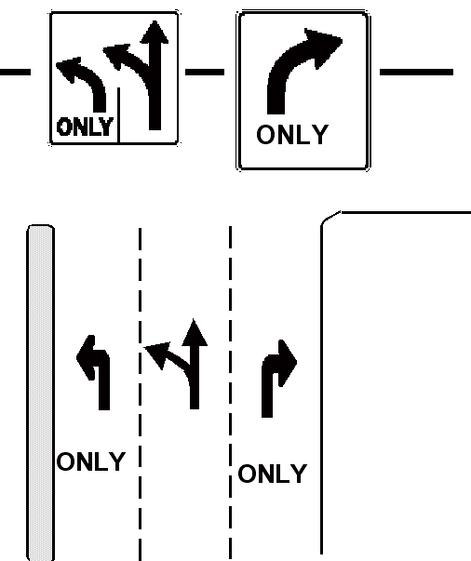
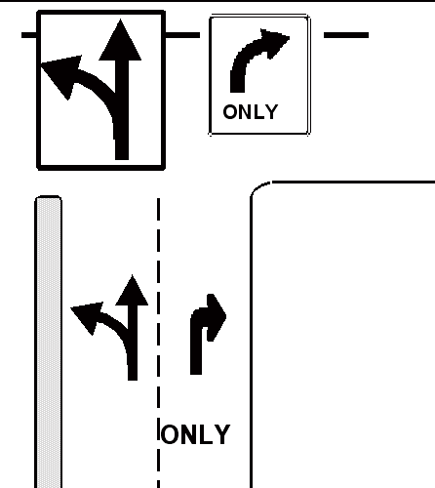
NEGOTIATING INTERSECTIONS
APPROACHING INTERSECTIONS

Slide 23
Negotiating Curves
TEEN CRASH FACT
The most frequent crash type for 16-year-old drivers in Pennsylvania is a single-vehicle, run-off-the-road crash. From 2007 to 2009, there were 2,969 crashes and 28 people killed.

Slide 24
Negotiating Curves
HERE IS HOW YOU CAN SAFELY DRIVE THROUGH CURVES:
1. The sharper the curve, the more you need to reduce your speed.
3. Look for traffic coming from the opposite direction. A speeder could easily stray into your lane.
4. For guidance about how to steer your vehicle, scan ahead and look at the inside edge of the curve. If there are multiple curves, look at the inside edge of each curve as far ahead as you can see.

Slide 25
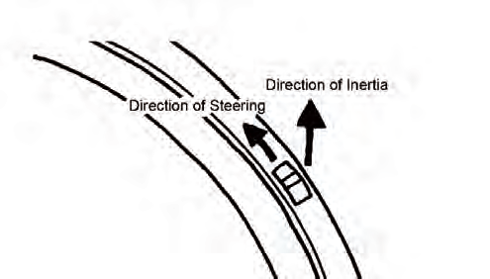
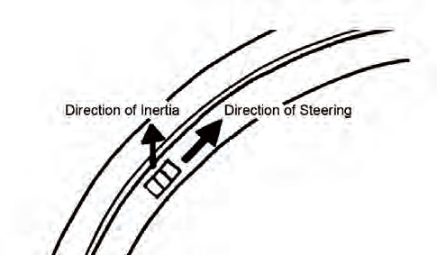
Negotiating Curves
Physics of Speeding

Slide 26
Parking
If the street you are on has a curb, park as close to it as you can, but no more than 12 inches away. If it has no curb, pull as far off of the roadway as possible

Slide 27
The End

