Slide 1


Concussion Screening
Wendy Ellmo MS CCC/SLP, BCNCDS, CBHC
Brain Injury Specialist

Slide 2





Brain Links is supported by the Administration for Community Living (ACL) of the U.S. Department of Health and Human Services under Grant No. 90TBSG0024-01-00 and in part by the TN Department of Health, Traumatic Brain Injury Program.
Notes:
We are federally funded through a grant from the Administration for Community Living and in part by the TN Dept. of Health, Traumatic Brain Injury Program. Brain Links is program of the TN Disability Coalition.

Slide 3
Brain Links
Statewide team of brain injury specialists
Who we are
We equip professionals to better serve people with TBI with current research-based training and tools.
What we do
Family-friendly educational materials
Resources for return to school and work settings
Toolkits for healthcare providers, school nurses, survivors and families, and other service professionals: tndisability.org/brain
YouTube Training Channel: youtube.com/@brainlinks830/playlists
Notes:
Brain Links is a statewide team of brain injury specialists.
We equip professionals to better serve people with TBI with current research-based training and tools.
We offer family friendly materials that are interesting and easy to use to serve people all ages.
We have free online toolkits and a YouTube training channel for you.

Slide 4

Agenda
Why Screen for Concussion?
Screening for Prior History of Concussion
Questions for Health History Form
Screening When Concussion is Suspected
Tracking a Child with a Concussion
Baseline Screening – usually for sports
Tools and ways to help
Notes:
"Traumatic brain injury (TBI) is a leading cause of death and disability among children and young adults in the United States. Each year an estimated 1.5 million Americans sustain a TBI. That’s someone every 9 seconds.”
With our time today, we’ll talk TBI & Concussion including a model for treatment.
We will look at the intersectionality with TBI and mental health and substance use disorder.
And how ACES contributes.
We will share some of our tools and ways to help.

Slide 5
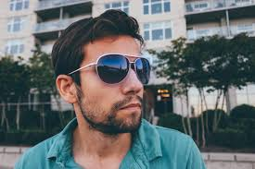
Nathan
Age: 10 months
Falls down a flight of steps
Crying, no loss of consciousness
Seen at hospital, “no concussion”
No recommendations
Bruising around his right eye for weeks
Age: 24 years
Is currently in prison
Is an addict (“tried everything”)
Can’t/won’t hold a job
Very smart but struggled in school
Few friends
Borderline personality disorder
Often, the parent or guardian may say, “He won’t get help.”
Notes:
This is a perfect example of why we need transitional services in medical care.
Nathan was injured as a baby, the injury was undiagnosed and he didn’t get follow up care.
Now, he’s in prison, had a drug addiction and struggles with employment, school and relationships. It could have been better for him.
Is he treating symptoms with drugs and alcohol? Having trouble with impulse control?
Now let’s look at a typical outcome years later.
Have to identify early. This injury occurred 23 years ago, the knowledge on TBI/Concussion wasn’t what we have now.

Slide 6

BRAIN INJURY
Facts & Statistics
EVERY 9 SECONDS
someone in the United States
sustains a brain injury
MORE THAN 3.6 MILLION
People sustain an
ABI each year
AT LEAST 2.8 MILLION
people sustain a TBI
each year
The total number of people who
sustain TBIs and do not seek
treatment is
UNKNOWN
www.biausa.org
68
Tennesseans experience a
traumatic brain injury EACH DAY
At least 5.3 million Americans live with a TBI-related disability.
That’s one in every 60 people.
Notes:
https://www.nashia.org/awareness/2020_awareness_toolkit.pdf

Slide 7
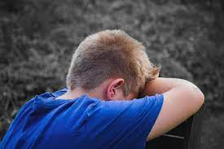
When MTBI Occurs in Preschool, then… at age 14 -16:
Significantly more likely to show symptoms of
ADD/ADHD
Conduct Disorder & Oppositional Defiant
Substance Use
Mood Disorder
McKinlay, et al (2009)
MTBI in childhood (up to age 16), then… at age 21 – 25:
More likely to abuse substances, commit violent and property offenses
McKinlay, et al (2013)

Slide 8


Ages 15-19 with TBI
Higher levels of
  Abuse of alcohol and/or drugs
  Anxiety
  Depression
  Attempted suicide
  Attention deficit and hyperactivity disorder (T Renn & C Veeh, 2019)
Notes:
Substance abuse – AAP suggests screening for drug and alcohol use at age 9.
Teen death increases following death of celebrities by suicide.
Deborah Little, PhD., webinar on Injury, Severity, Risk, Outcomes, and Surveillance.
“Youth age 15-19 with TBI attempt suicide at a greater rate than peers their same age without TBI”
https://reportingonsuicide.org/
http://suicidepreventionmessaging.org/
Brittany Willis| Suicide Prevention Program Director
Brittany.Willis@tn.gov
Wording is very important for describing suicide: people first, more below
https://www.irmi.com/articles/expert-commentary/language-matters-committed-suicide
Say Died of suicide Instead of Committed suicide
Suicide death instead of Successful attempt
Suicide attempt instead of Unsuccessful attempt
Say Person living with suicidal thoughts or behavior instead of Suicide ideator or attempter
Say Suicide instead of Completed suicide
(Describe the behavior) instead of Manipulative, cry for help, or suicidal gesture
Say Working with instead of Dealing with suicidal crisis

Slide 9
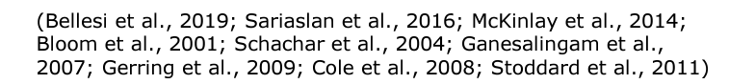
Pediatric Brain Injury also Associated with
Lower educational attainment
Increased rates of substance misuse
Less sophisticated interpersonal skills
Increased risk for psychopathology
Lower levels of prosocial behavior
Increased rates of aggression
Notes:
-TN has the highest incarceration rate of any state in our country.
Of those injured, nearly 1/3 report some involvement with the criminal justice system within 5 years post TBI.
Within the Justice System, 41% of Juveniles and 50-80% of adults have sustained a TBI.
-Juveniles in adult prisons were 50 more likely to report being attacked with a weapon by staff and one in ten juveniles report being “beaten up” by staff.
If you’re dealing with a juvenile getting out of the system, they need to be monitored and observed for TBI.
Incarceration - Tennessee has an incarceration rate of 853 per 100,000 people (including prisons, jails, immigration detention, and juvenile justice facilities)
According to the CDC - 25-87% of inmates report having experienced a head injury or TBI. https://www.cdc.gov/traumaticbraininjury/pdf/Prisoner_TBI_Prof-a.pdf
Children and teenagers who have been convicted of a crime are more likely to have had a pre-crime TBI and/or some other kind of physical abuse.
close to http://www.justicepolicy.org/images/upload/97-02_REP_RiskJuvenilesFace_JJ.pdfone in ten juveniles report being “beaten up” by staff.
The juveniles in adult prison were also 50 percent more likely to report being attacked with a weapon
…(at end) “In fact, more than half of those individuals with TBI who reported an incarceration history were found to belong to FOUR or more vulnerable groups.”
https://www.freeimages.com/photo/contemplate-1225745

Slide 10
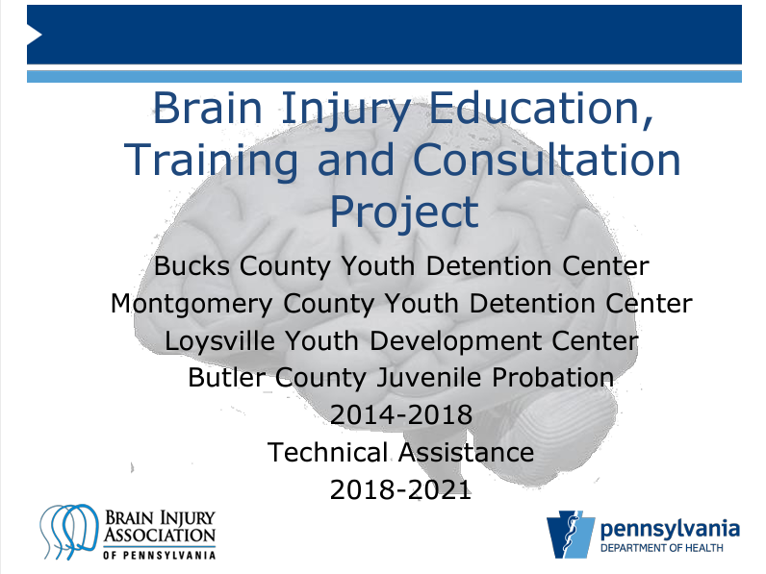
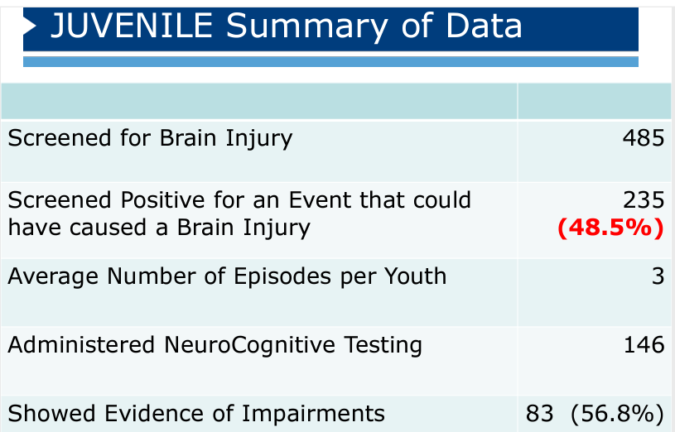

Slide 11


Downstream Consequences of TBI
Death & disability
Mental Health/PTSD
Incarceration
Substance use disorder
Domestic Violence
Financial
Homelessness
Pain
Notes:
10% to 20% of patients with TBI develop a new substance use disorder after injury.
It’s all connected and tangled together. Even though everyone doesn’t experience each of these problems – they’re all precursors or results of brain injury.
https://www.practiceupdate.com/content/opioid-use-among-individuals-with-traumatic-brain-injury/88168
A survey of health plan participants found that people with TBI who had no evidence of SUD a year prior to injury had a 4 times the odds of substance abuse within a year post-injury. And 2-3 years after a little under 2% https://www.liebertpub.com/doi/10.1089/neu.2019.6451

Slide 12
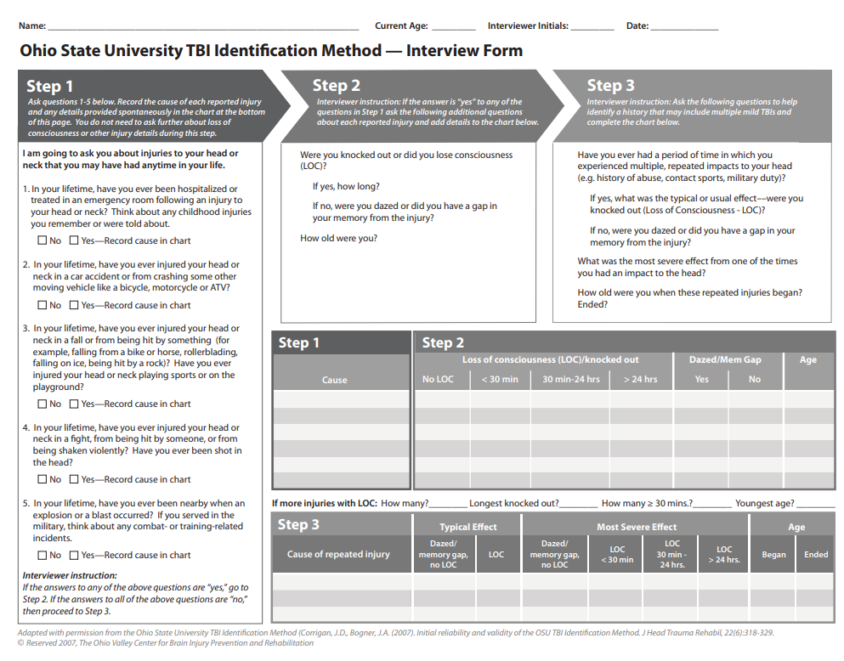
Screening for Prior History of Brain Injury
Ohio State University
TBI Identification Method
Can be administered with minimal training
Takes about 5 minutes
Used in a variety of settings

Slide 13

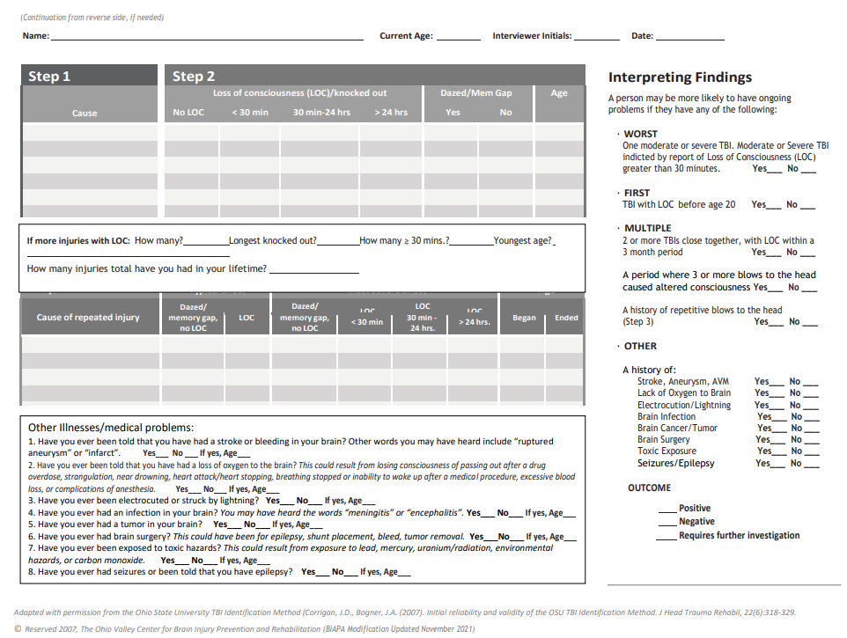
Ohio State University
TBI Identification Method –
MODIFIED to include ABI:
Stroke
Loss of Oxygen
Infection
Tumor
Brain Surgery, etc.

Slide 14
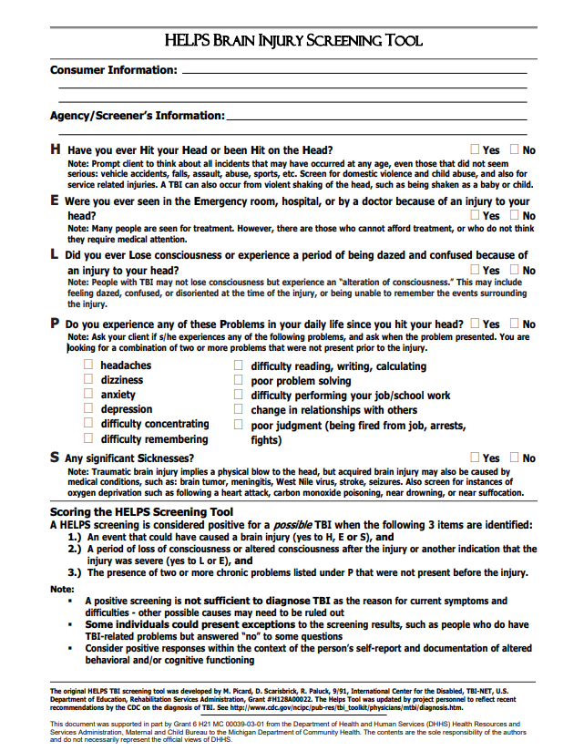

Another Screening Option:
HELPS
An easier option to send home
Quick
Simple Questions
Includes ABI

Slide 15
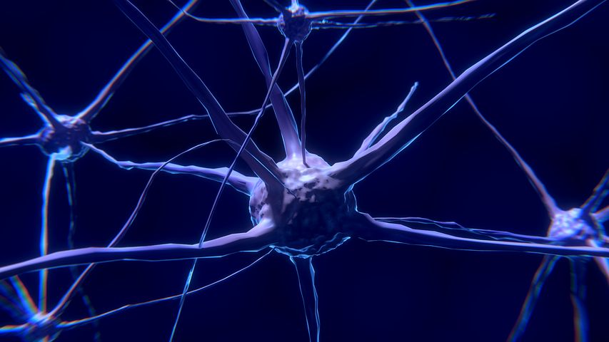
Questions to Add to Health History
Ask: Has your child had a head injury? Yes No
Cause of injury: Fall Car/motor vehicle accident Sports-related other
If Yes: Did your child lose consciousness or become dazed? Yes No Not sure
Please explain: __________________________________________________

Slide 16
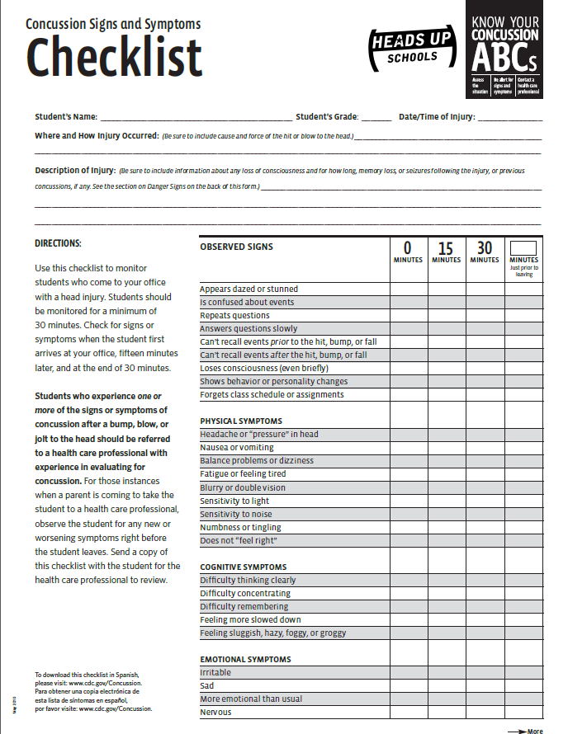
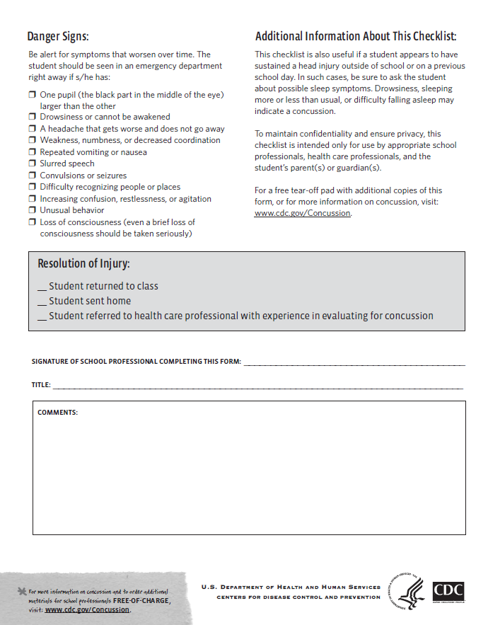
Concussion Signs & Symptoms Checklist

Slide 17
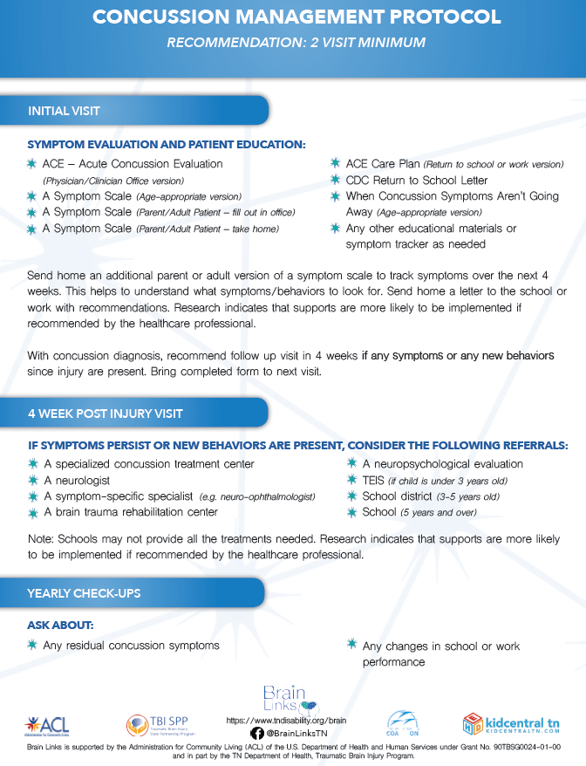
Concussion Protocol
Asking Healthcare Providers to
Think of Concussion as a 2-visit diagnosis
  1st visit: Symptoms Evaluation and Patient Education. Give parent/patient a symptom list to take home and observe.
  If symptoms exist/persist
    Return in 4 weeks
    Referral for treatment
Check in at yearly check-ups specifically
about the concussion
Notes:
This treatment model fits well with the Concussion Protocol. It is in our toolkit for healthcare providers. We are no longer waiting for symptoms to go away on their own. We are being more proactive because active treatment works and we know if we do nothing, some will go on to have significant issues.
The protocol is simple. All patients with concussion get two doctor visits.
After the first visit, the patient/family gets a symptom list to take home and observe. You make the 2nd appt. before you leave the doctor’s office.
4 weeks later, if symptoms have continued, you go back and may need a referral to a specialist. If no symptoms, cancel the appointment.
Check in every year about the concussion as it could cause changes that show up with new learning.

Slide 18
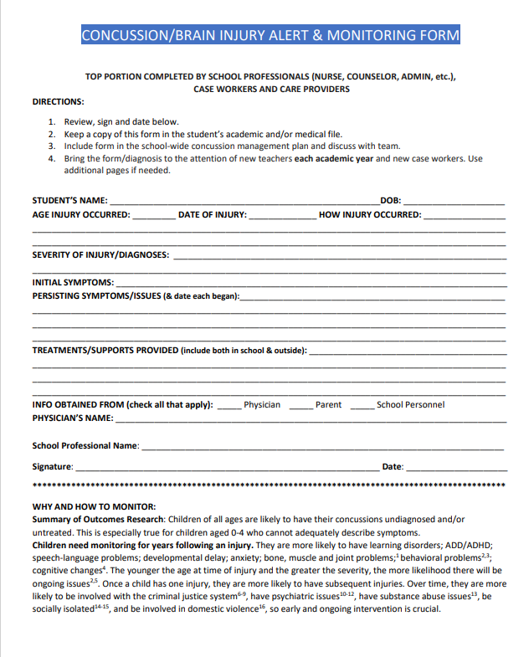
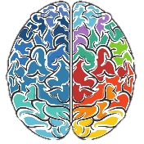
Concussion Alert Form
Used once a concussion/TBI is identified
To monitor from year to year/teacher to teacher
So injuries are not forgotten
To help document the injury for future services
Brief

Slide 19

Baseline Testing
The ImPACT Test
“ImPACT, an FDA cleared medical device, is used by healthcare, educational, and sports organizations to help assess and manage concussions.”
Pre-injury/pre-season testing to compare with post-injury performance
$$$$$

Slide 20

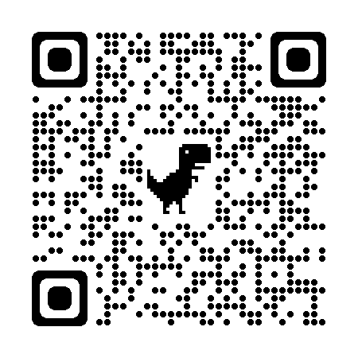
How to get the best new supports in place for every student?
Teacher Acute Concussion Tool (TACT)
Designed to help the teacher and the student through the acute phase of recovery – those first 4 weeks.
Password: TACTtennessee2020

Slide 21


Fast
In TN, it has no cost.
Free
Use it now, get help to teachers now.
Password: TACTtennessee2020
Easy
You need no training. There is no contract or extra work to use this tool.
Notes:
Did that seem too fast? It might also help to say what the Teacher Acute Concussion Tool (TACT) is NOT.
It’s FAST, FREE, and EASY.

Slide 22

How TACT works
I learned that a student has a concussion.
Go to the website, answer 6 quick questions
You’ll get 5 emails over next month
Use the customized tools as needed
TACTtennessee2020
Notes:
First – a teacher learns of the concussion (not a diagnosis, a meeting, a SPED plan, can be as simple as the student tells the teacher they had a fall or fender bender over the weekend.) The teacher goes to the website, spends 2 minutes and instantly receives tools that will help. You’ll enter your contact information, answer the multiple choice questions about your teaching style, what time of day you have the student. There are no questions about the student’s injury or symptoms.

Slide 23
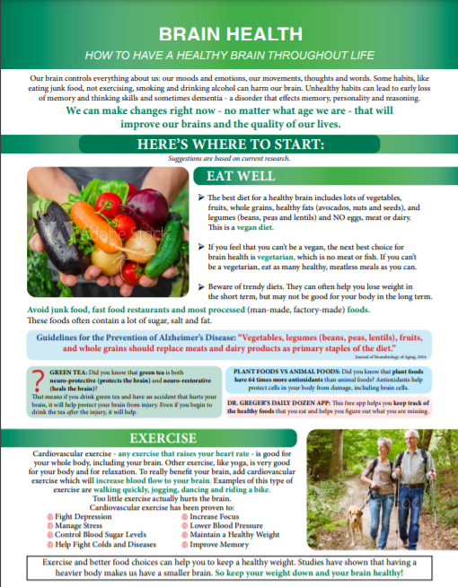
Brain Health
How to Have a Healthy Brain Throughout Life
Evidence-based information on
Eating Well
Exercise
Being Social
Learning
Mental Health
Gratitude
How to Make Change
Free Resources
Resilience
Purpose and Joy
Brain Injury Prevention
Avoiding Toxicity
Sleep
Notes:
Everyone can benefit from learning more about how to take better care of their brain – after brain injury especially, but we this is a highly requested training once people understand that it help them, too.

Slide 24
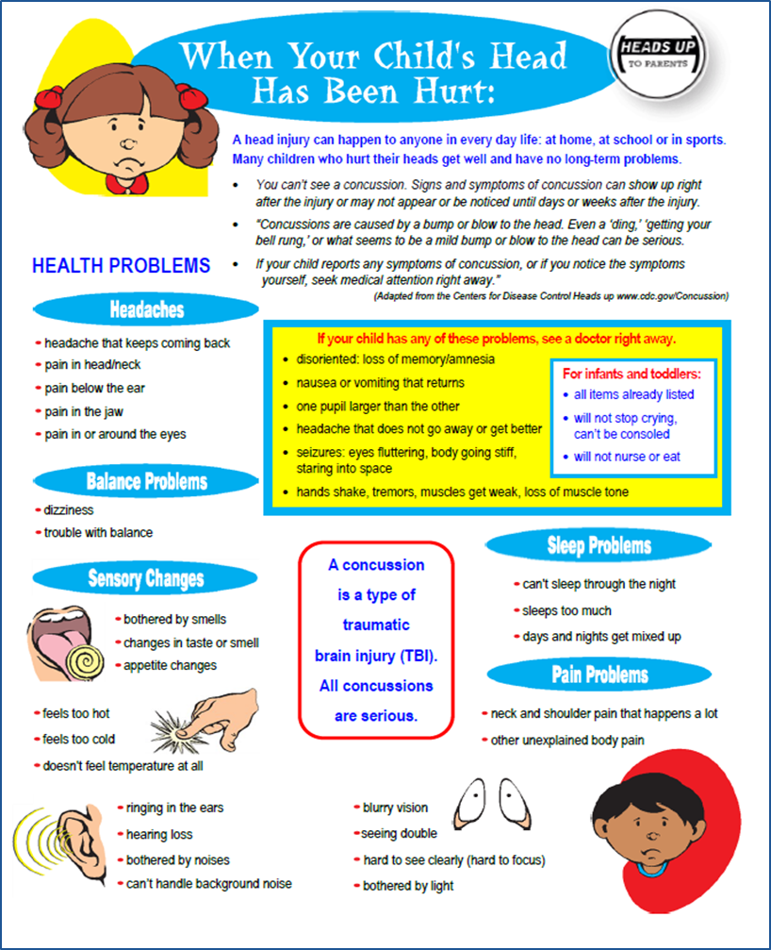
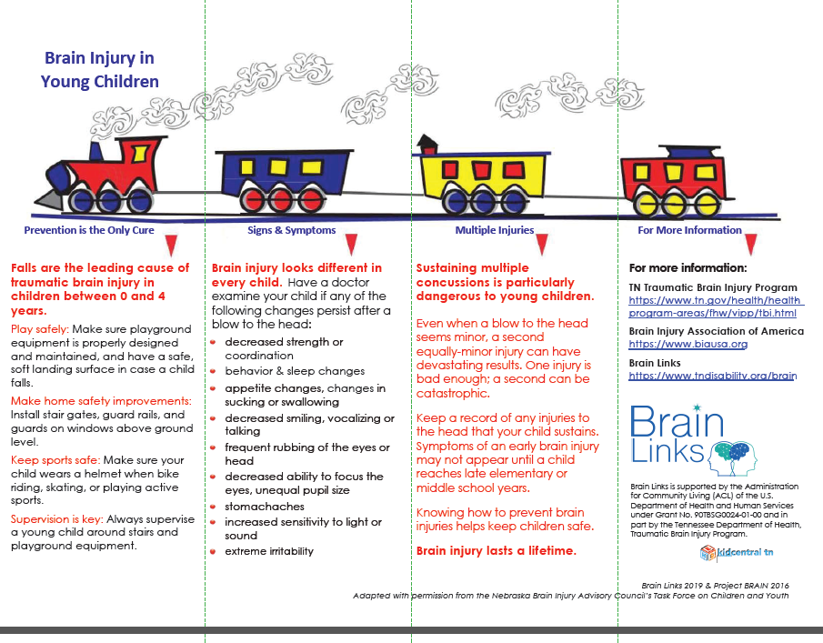
Signs & Symptoms Tools
Spanish Available
!
!
School-Aged
Young Children
tndisability.org/brain
Notes:
These are for children – these you might share this with the family and school or preschool and family to help them identify symptoms. It’s also perfect for taking to the doctor to begin talking about symptoms. Just circle those you notice and bring it to the doctor. Continue to notice changes after seeing the doctor and share any concerns.

Slide 25
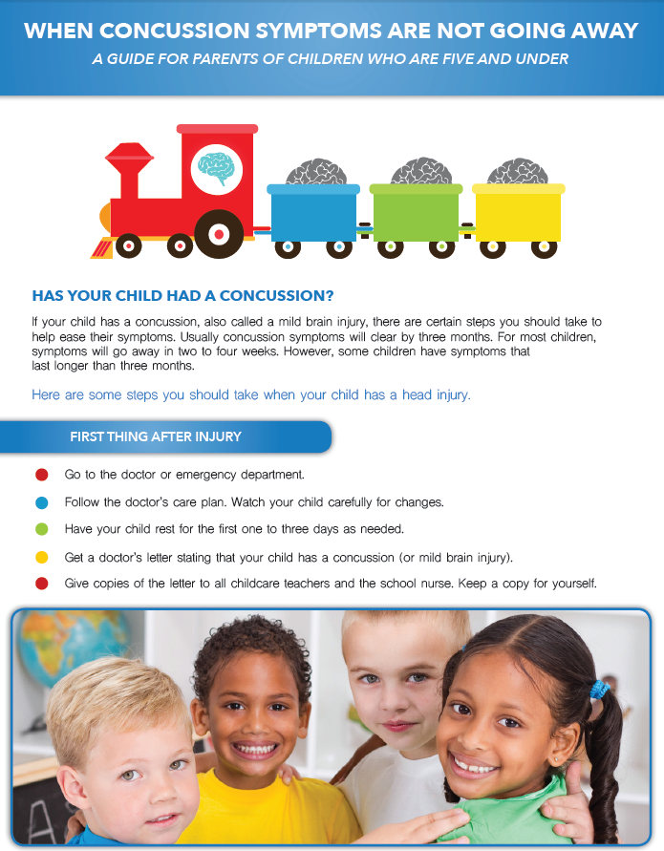
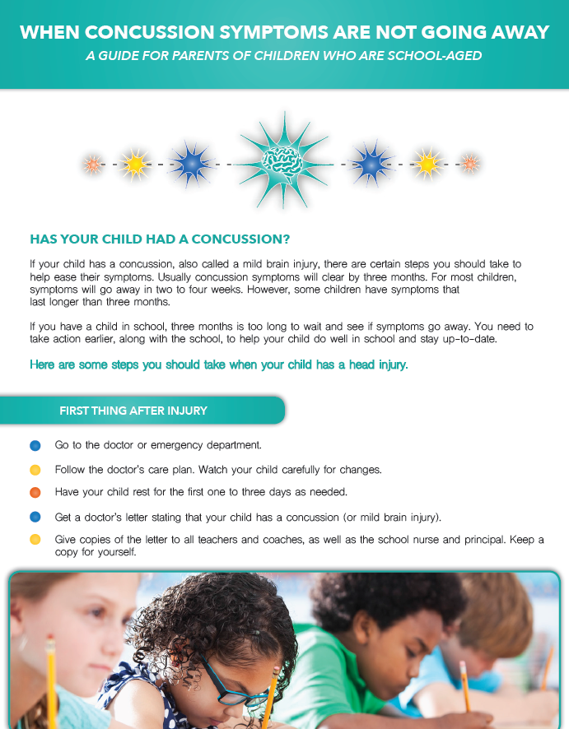
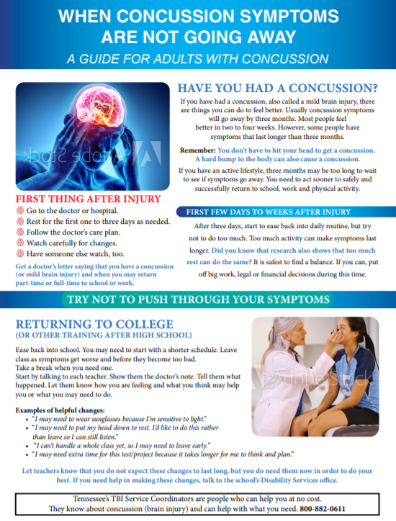
When Concussion Symptoms Aren’t Going Away
5 and Under
School-Aged
Adults
Spanish Available
Notes:
When Concussion Symptoms Are Not Going Away are are for families. It helps them to understand what to do immediately after an injury but also weeks and months downstream.
It tells them changes to watch for and resources to access. They are all different and the one for school-aged kids includes how to interact with the school for things like a 504 Plan and an IEP.

Slide 26
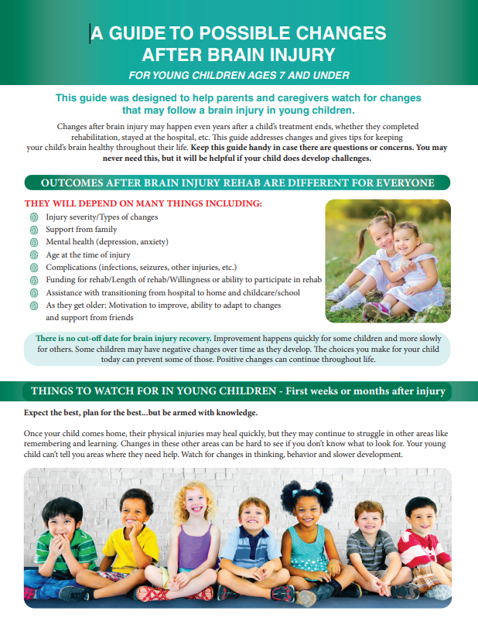
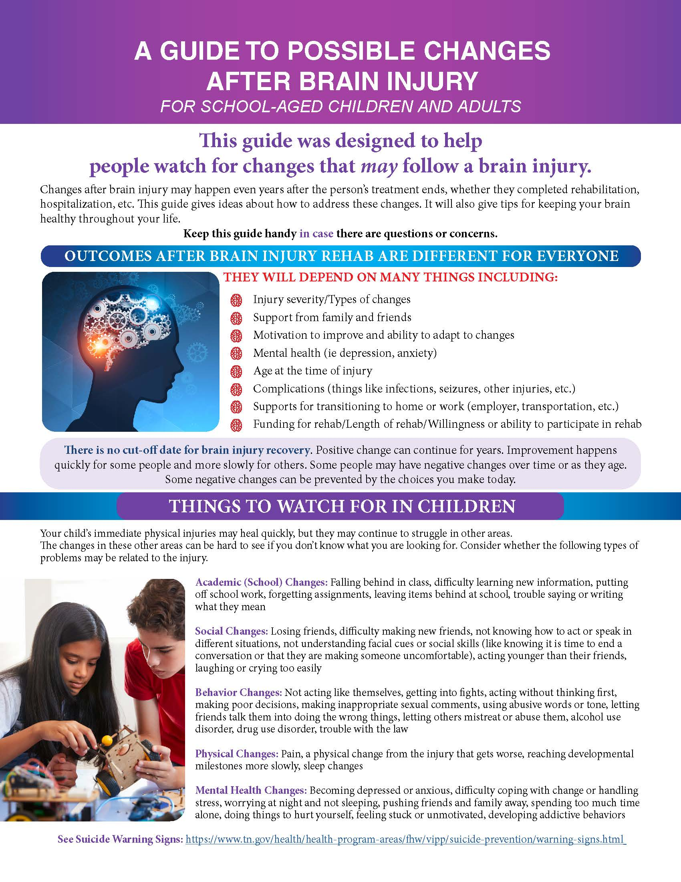
Problems Can Arise Even After Brain Injury Treatment
Spanish Available
tndisability.org/brain
Notes:
This is our newest resource and it’s a single handout with a four pages that covers changes that may happen after a more significant injury.
The Guide is designed to be distributed by rehabilitation personnel in inpatient and outpatient therapy programs and by medical personnel in trauma units, pediatrician’s offices, family practices, neurology offices, surgical offices, and other specialty offices. It is meant to be given to anyone who has sustained a diagnosed brain injury, as well as anyone who sustained a significant trauma where they may experience brain injury symptoms and downstream consequences; even if they don’t show early symptoms or early symptoms seem to have cleared.

Slide 27
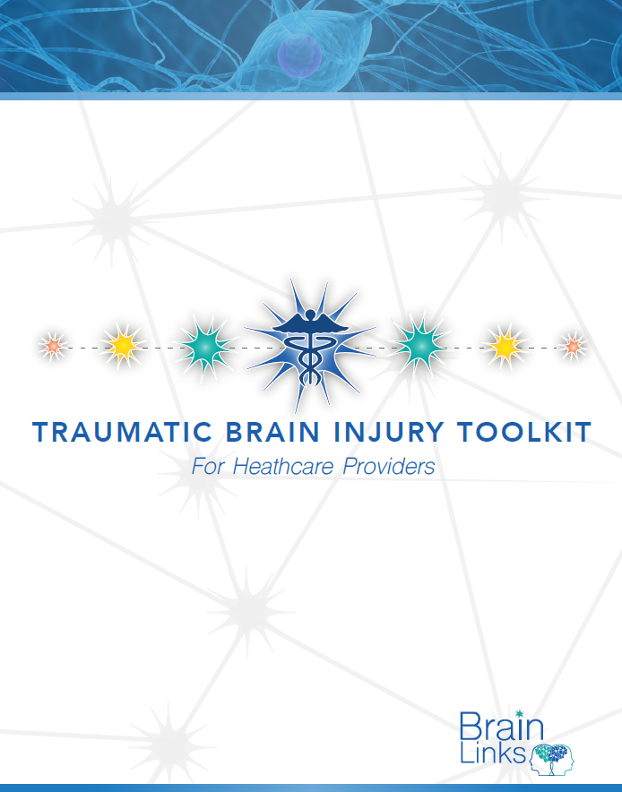
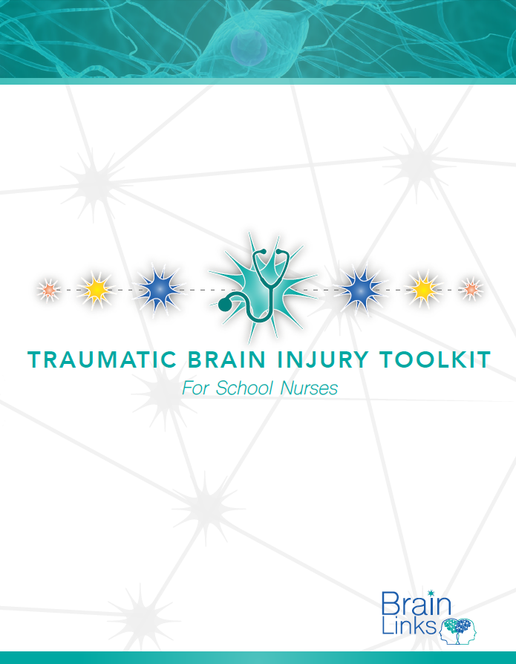
Helpful Toolkits for Healthcare
Notes:
We have offered toolkits for schools nurses and healthcare providers since 2019. We’ve added to those and updated materials for this free downloadable

Slide 28
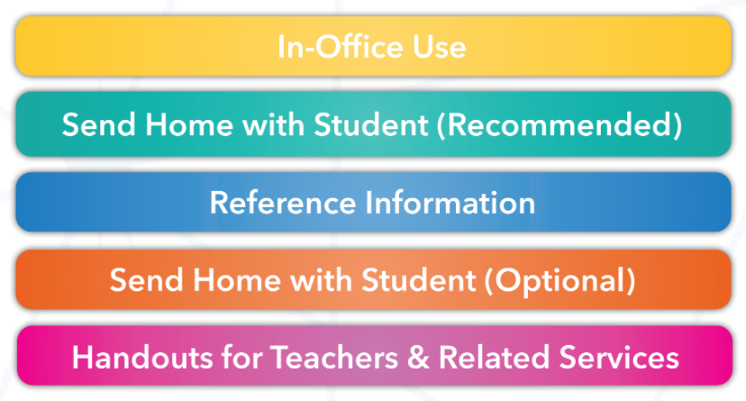
Download the School Nurses’ Toolkit!
!
!
https://www.tndisability.org/school-nurses
Notes:
Since we last talked with you about the School Nurse toolkits, we’ve updated it and we’ve added a new sections for teachers and related services.
We’ve kept the color coding for the different sections and you’ll see that as we look at some of the items in those sections now.
Updated TN Return to Learn & Play Concussion Guidelines
When Concussion Symptoms Are Not Going Away for ALL ages
Brain Health: How to Have a Healthy Brain Throughout Life
Recognizing Concussion in People Who Communicate Without Words
Concussion/Mental Health Infographics
A Guide to Possible Changes After Brain Injury
Driving After TBI
School Nurses Toolkit: NEW section for Teachers & Related Services

Slide 29
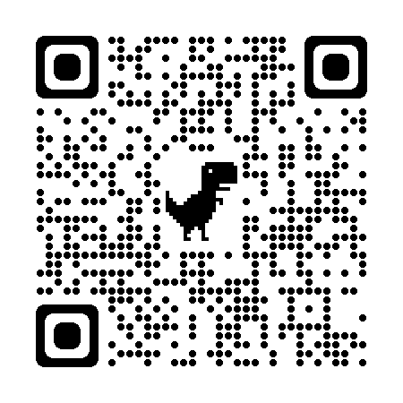




Thank you and survey
Take the 1 minute survey!
Get a certificate of attendance
Notes:
Please take one minute to complete our quick survey – you can use the link in the chat or you can take a picture of this QR code with your phone.
We appreciate getting the feedback and need it for our grant records. There’s also a link in the chat.

