Slide 1
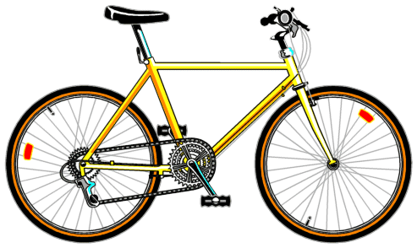
No Math= No Bicycling (How Math is Applied to Bicycling)
By Daniel Ferioli

Slide 2
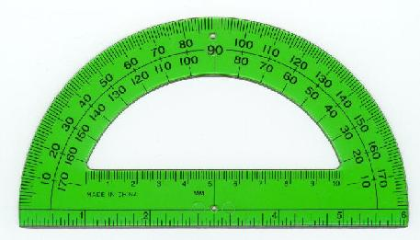
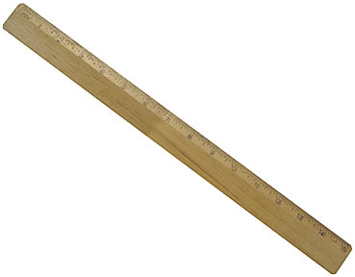
Introduction
We may not realize how many activities need math. Cooking and building models are obvious areas where math is used. However, one activity where we may not realize math is applied is bicycling. Without math, bicycling cannot exist.

Slide 3
Ways Math is Used for Cycling
Using math I can compare the circumferences of the wheels on two different bicycles. How does knowing this help, and why do we even use wheels?
Math is used to figure out which frame to use for different types of bicycles. What is the difference between a racing bike frame and a BMX bike frame?
A cyclist uses different gear combinations for different terrains. How is the right gear combination calculated?
How can I figure out the speed I traveled on each trip?

Slide 4
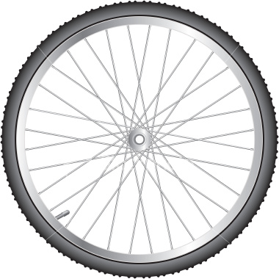
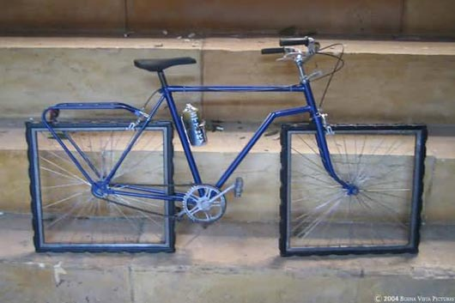
Why Wheels are Circles
The wheel is very important to the bicycle. It allows it to move over the ground.
No other shape would work. Could you imagine a bike with square or even octagon wheels?
A shape other than a circle has edges and would create bumps and friction.

Slide 5
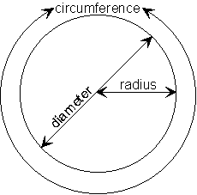
Wheel Circumference
The circumference of a circle is the distance around the circle.
The equation is: 2πr=c where r is the circle’s radius and c is the circumference.
The circumference of a bicycle’s wheel is equal to the distance the bike will go for each wheel rotation. If a bike’s wheel has a circumference of 6 feet then it will travel 6 feet for each wheel rotation.
The larger the size of the wheel the more distance is covered for each wheel rotation.

Slide 6
Wheel- Example
My black bicycle has a wheel radius of 13 inches, and my blue bicycle has a wheel radius of 10 inches. To find the bike that is better for longer distances:
c=2πr c=2πr
c=2π13 c=2π10
c=81.64in. c=62.8in. c=6.80ft. c=5.23ft.
The black bicycle has a larger size wheel and therefore will go 1.57ft. farther for each rotation of the pedals. The black bike is better for going longer distances than the blue bike.

Slide 7
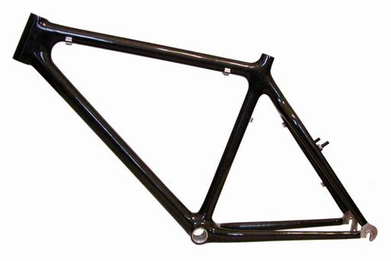
Frames- The Shapes That are Used
Most modern bicycles are made using a diamond frame.
A diamond frame is made of two triangles, the front triangle
and the back triangle.
The triangle is one of the strongest shapes.
Back triangle
Front Triangle

Slide 8
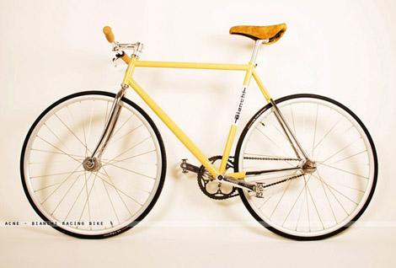
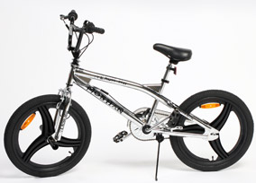
Frame Differences- BMX Vs. Racing
Math is used in deciding the type of frame to use for a bicycle.
A frame from a BMX bike is elongated, thus making its seat angle
more obtuse than a racing bike’s seat angle. This allows the BMX bike rider to do tricks because there is a lower center of gravity.
(An obtuse angle is >90°)
Racing Bike
BMX Bike
Seat Angle

Slide 9
Frame Differences- Racing Bikes
A racing bike frame is taller than a BMX bike frame. It allows for bigger wheels, which are needed for greater distances.

Slide 10
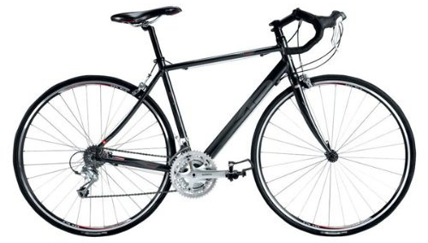
Gears- What They are for
A single gear combination is good on downhill or flat surfaces.
But happens when the rider goes uphill or into the wind?
A bicycle with several gear combinations allows the rider to adapt to different conditions. The rider can make different gear combinations (gear ratios) depending on the type of surface.
One Gear Combination
Several Gear Combinations

Slide 11
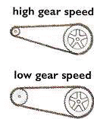
How to Calculate the Gear Ratio
The Gear ratio is the number of teeth on the front gear divided by the number of teeth on the rear gear.
Lower gear ratios are better for up hills and higher gear ratios are better for down hills. Lower gear ratios let you pedal more times for each rotation of the wheel.
The equation to figure out the gear ratio is g=f/r, where g is the gear ratio, f is the number of teeth on the front gear, and r is the number of teeth on the rear gear.

Slide 12
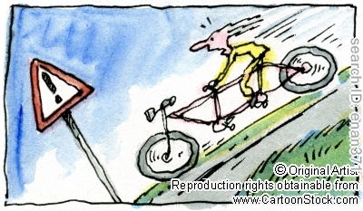
Gear Ratio Example
My bike has a rear gear with 32 teeth and another rear gear with 11 teeth. It also has a front gear with 48 teeth and another front gear with 44 teeth.
To calculate some possible gear ratios:
g=f/r g=f/r
g=48/32 g=44/11
g=3/2 or 3:2 g=4/1 or 4:1
Because 3:2 is a lower gear ratio than 4:1, it is better for up hills while 4:1 is better for down hills.

Slide 13
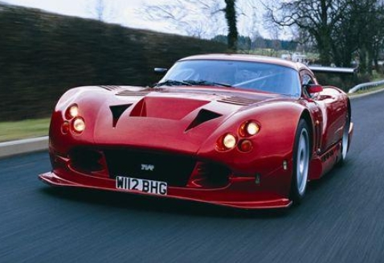
How Fast Can You Go?
The average rate of speed is determined the same way when on a car,
bike,
or just running.
The average rate of speed is determined using the equation r=d/t
r is the average rate of speed.
d is the distance traveled.
t is the time it took to travel.

Slide 14
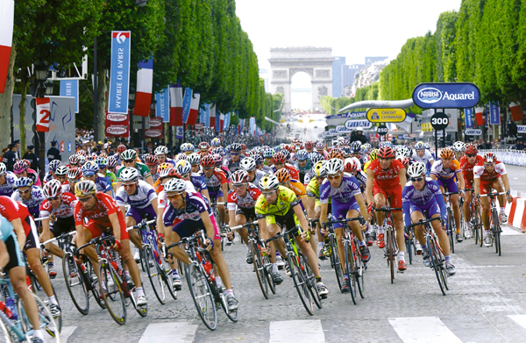
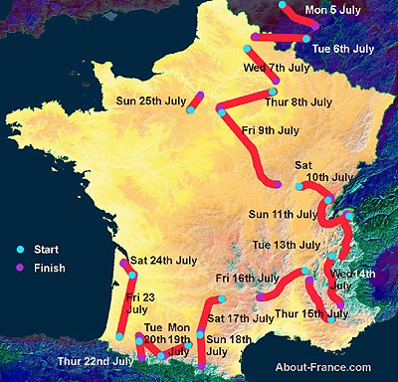
Speed Calculation Example
The 20th stage in the 2010 Tour de France was 63.7 miles long and went from Longjumeau to the Champs-Elysees in Paris. First place Mark Cavendish of Britain completed it in 2 hours and 42 minutes.
To find out the average rate of speed he traveled:
r=d/t
r= _ 63.7_ _
2 42/60
r= 23.6 miles per hour

Slide 15
Conclusion
Without math the bike cannot be built.
Geometric figures are used in the construction of a bicycle.
Wheel circumferences and frame angles are calculated using math, so the rider could select the right bicycle.
Ratios are used to figure out what gear combination to use on different surfaces.
Algebraic equations are used to figure out the average speed of a trip.
Math puts the action in my passion because…
No Math= No Bicycling!

Slide 16
Works Cited
“Building Better Wheels.” BMW Plus Oct. 2009: 42-45. EBSCOhost. Hillsdale Public Library, Hillsdale, NJ. 2 Jan. 2010. <http://www.bccls.org/databases/log-in.shtml>.
Crossingham, John. Cycling in Action. New York: Crabtree Publishing Company, 2002.
The Exploratorium’s Science of Cycling. The Exploratorium. 27 Dec. 2010 <http://www.exploratorium.edu/cycling/ >.
The Math Forum @ Drexel. Drexel University. 27 Dec. 2010 <http://mathforum.org/dr.math/faq/faq.distance.html >.

